Slide 1
Lectures 2&3: Introduction to SQL

Slide 2
Announcements!
Lecture 2
If you still have Jupyter trouble, let us know!
Problem Set #1 is released!

Slide 3
Lecture 2: SQL Part I
Lecture 2

Slide 4
Today’s Lecture
Lecture 2
SQL introduction & schema definitions
ACTIVITY: Table creation
Basic single-table queries
ACTIVITY: Single-table queries!
Multi-table queries
ACTIVITY: Multi-table queries!

Slide 5
1. SQL Introduction & Definitions
Lecture 2 > Section 1

Slide 6
What you will learn about in this section
Lecture 2 > Section 1
What is SQL?
Basic schema definitions
Keys & constraints intro
ACTIVITY: CREATE TABLE statements

Slide 7




SQL Motivation
Lecture 2 > Section 1 > SQL
Dark times 5 years ago.
Are databases dead?
Now, as before: everyone sells SQL
Pig, Hive, Impala
“Not-Yet-SQL?”

Slide 8
Basic SQL
Lecture 2 > Section 1 > SQL

Slide 9
SQL Introduction
Lecture 2 > Section 1 > SQL
SQL is a standard language for querying and manipulating data
SQL is a very high-level programming language
This works because it is optimized well!
Many standards out there:
ANSI SQL, SQL92 (a.k.a. SQL2), SQL99 (a.k.a. SQL3), ….
Vendors support various subsets
SQL stands for
Structured Query Language
NB: Probably the world’s most successful parallel programming language (multicore?)

Slide 10
SQL is a…
Lecture 2 > Section 1 > SQL
Data Definition Language (DDL)
Define relational schemata
Create/alter/delete tables and their attributes
Data Manipulation Language (DML)
Insert/delete/modify tuples in tables
Query one or more tables – discussed next!

Slide 11
Tables in SQL
Lecture 2 > Section 1 > Definitions
A relation or table is a multiset of tuples having the attributes specified by the schema
Product
PName | Price | Manufacturer
Gizmo | $19.99 | GizmoWorks
Powergizmo | $29.99 | GizmoWorks
SingleTouch | $149.99 | Canon
MultiTouch | $203.99 | Hitachi
Let’s break this definition down

Slide 12
Tables in SQL
Lecture 2 > Section 1 > Definitions
A multiset is an unordered list (or: a set with multiple duplicate instances allowed)
Product
PName | Price | Manufacturer
Gizmo | $19.99 | GizmoWorks
Powergizmo | $29.99 | GizmoWorks
SingleTouch | $149.99 | Canon
MultiTouch | $203.99 | Hitachi
List: [1, 1, 2, 3]
Set: {1, 2, 3}
Multiset: {1, 1, 2, 3}
i.e. no next(), etc. methods!

Slide 13
Tables in SQL
Lecture 2 > Section 1 > Definitions
Product
An attribute (or column) is a typed data entry present in each tuple in the relation
PName | Price | Manufacturer
Gizmo | $19.99 | GizmoWorks
Powergizmo | $29.99 | GizmoWorks
SingleTouch | $149.99 | Canon
MultiTouch | $203.99 | Hitachi
NB: Attributes must have an atomic type in standard SQL, i.e. not a list, set, etc.

Slide 14
Tables in SQL
Lecture 2 > Section 1 > Definitions
Product
PName | Price | Manufacturer
Gizmo | $19.99 | GizmoWorks
Powergizmo | $29.99 | GizmoWorks
SingleTouch | $149.99 | Canon
MultiTouch | $203.99 | Hitachi
A tuple or row is a single entry in the table having the attributes specified by the schema
Also referred to sometimes as a record

Slide 15
Tables in SQL
Lecture 2 > Section 1 > Definitions
Product
PName | Price | Manufacturer
Gizmo | $19.99 | GizmoWorks
Powergizmo | $29.99 | GizmoWorks
SingleTouch | $149.99 | Canon
MultiTouch | $203.99 | Hitachi
The number of tuples is the cardinality of the relation
The number of attributes is the arity of the relation

Slide 16
Data Types in SQL
Lecture 2 > Section 1 > Definitions
Atomic types:
Characters: CHAR(20), VARCHAR(50)
Numbers: INT, BIGINT, SMALLINT, FLOAT
Others: MONEY, DATETIME, …
Every attribute must have an atomic type
Hence tables are flat

Slide 17
Table Schemas
Lecture 2 > Section 1 > Definitions
The schema of a table is the table name, its attributes, and their types:
A key is an attribute whose values are unique; we underline a key
Product(Pname: string, Price: float, Category: string, Manufacturer: string)
Product(Pname: string, Price: float, Category: string, Manufacturer: string)

Slide 18
Key constraints
Lecture 2 > Section 1 > Keys & constraints
A key is a minimal subset of attributes that acts as a unique identifier for tuples in a relation
A key is an implicit constraint on which tuples can be in the relation
i.e. if two tuples agree on the values of the key, then they must be the same tuple!
Students(sid:string, name:string, gpa: float)
1. Which would you select as a key?
2. Is a key always guaranteed to exist?
3. Can we have more than one key?

Slide 19
NULL and NOT NULL
Lecture 2 > Section 1 > Keys & constraints
To say “don’t know the value” we use NULL
NULL has (sometimes painful) semantics, more detail later
Students(sid:string, name:string, gpa: float)
sid | name | gpa
123 | Bob | 3.9
143 | Jim | NULL
Say, Jim just enrolled in his first class.
In SQL, we may constrain a column to be NOT NULL, e.g., “name” in this table

Slide 20
General Constraints
Lecture 2 > Section 1 > Keys & constraints
We can actually specify arbitrary assertions
E.g. “There cannot be 25 people in the DB class”
In practice, we don’t specify many such constraints. Why?
Performance!
Whenever we do something ugly (or avoid doing something convenient) it’s for the sake of performance

Slide 21
Summary of Schema Information
Lecture 2 > Section 1 > Summary
Schema and Constraints are how databases understand the semantics (meaning) of data
They are also useful for optimization
SQL supports general constraints:
Keys and foreign keys are most important
We’ll give you a chance to write the others

Slide 22
ACTIVITY: Activity-2-1.ipynb
Lecture 2 > Section 1 > ACTIVITY

Slide 23
2. Single-table queries
Lecture 2 > Section 2

Slide 24
What you will learn about in this section
Lecture 2 > Section 2
The SFW query
Other useful operators: LIKE, DISTINCT, ORDER BY
ACTIVITY: Single-table queries

Slide 25
SQL Query
Lecture 2 > Section 2 > SFW
Basic form (there are many many more bells and whistles)
SELECT <attributes> FROM <one or more relations> WHERE <conditions>
Call this a SFW query.

Slide 26
Simple SQL Query: Selection
Lecture 2 > Section 2 > SFW
PName | Price | Category | Manufacturer
Gizmo | $19.99 | Gadgets | GizmoWorks
Powergizmo | $29.99 | Gadgets | GizmoWorks
SingleTouch | $149.99 | Photography | Canon
MultiTouch | $203.99 | Household | Hitachi
Selection is the operation of filtering a relation’s tuples on some condition
SELECT * FROM Product WHERE Category = ‘Gadgets’
PName | Price | Category | Manufacturer
Gizmo | $19.99 | Gadgets | GizmoWorks
Powergizmo | $29.99 | Gadgets | GizmoWorks

Slide 27
Simple SQL Query: Projection
Lecture 2 > Section 2 > SFW
PName | Price | Category | Manufacturer
Gizmo | $19.99 | Gadgets | GizmoWorks
Powergizmo | $29.99 | Gadgets | GizmoWorks
SingleTouch | $149.99 | Photography | Canon
MultiTouch | $203.99 | Household | Hitachi
Projection is the operation of producing an output table with tuples that have a subset of their prior attributes
SELECT Pname, Price, Manufacturer FROM Product WHERE Category = ‘Gadgets’
PName | Price | Manufacturer
Gizmo | $19.99 | GizmoWorks
Powergizmo | $29.99 | GizmoWorks

Slide 28
Notation
Lecture 2 > Section 2 > SFW
Input schema
Product(PName, Price, Category, Manfacturer)
SELECT Pname, Price, Manufacturer FROM Product WHERE Category = ‘Gadgets’
Output schema
Answer(PName, Price, Manfacturer)

Slide 29
A Few Details
Lecture 2 > Section 2 > SFW
SQL commands are case insensitive:
Same: SELECT, Select, select
Same: Product, product
Values are not:
Different: ‘Seattle’, ‘seattle’
Use single quotes for constants:
‘abc’ - yes
“abc” - no

Slide 30
LIKE: Simple String Pattern Matching
Lecture 2 > Section 2 > Other operators
SELECT * FROM Products WHERE PName LIKE ‘%gizmo%’
s LIKE p: pattern matching on strings
p may contain two special symbols:
% = any sequence of characters
_ = any single character

Slide 31
DISTINCT: Eliminating Duplicates
Lecture 2 > Section 2 > Other operators
Category
Gadgets
Photography
Household
SELECT DISTINCT Category
FROM Product
Versus
Category
Gadgets
Gadgets
Photography
Household
SELECT Category
FROM Product

Slide 32
ORDER BY: Sorting the Results
Lecture 2 > Section 2 > Other operators
SELECT PName, Price, Manufacturer
FROM Product
WHERE Category=‘gizmo’ AND Price > 50
ORDER BY Price, PName
Ties are broken by the second attribute on the ORDER BY list, etc.
Ordering is ascending, unless you specify the DESC keyword.

Slide 33
ACTIVITY: Activity-2-2.ipynb
Lecture 2 > Section 2 > ACTIVITY

Slide 34
3. Multi-table queries
Lecture 2 > Section 3

Slide 35
What you will learn about in this section
Lecture 2 > Section 3
Foreign key constraints
Joins: basics
Joins: SQL semantics
ACTIVITY: Multi-table queries

Slide 36
Foreign Key constraints
Lecture 2 > Section 3 > Foreign Keys
Suppose we have the following schema:
And we want to impose the following constraint:
‘Only bona fide students may enroll in courses’ i.e. a student must appear in the Students table to enroll in a class
Students(sid: string, name: string, gpa: float)
Enrolled(student_id: string, cid: string, grade: string)
Students
Enrolled
student_id alone is not a key- what is?
sid | name | gpa
101 | Bob | 3.2
123 | Mary | 3.8
student_id | cid | grade
123 | 564 | A
123 | 537 | A+
We say that student_id is a foreign key that refers to Students

Slide 37
Declaring Foreign Keys
Lecture 2 > Section 3 > Foreign Keys
Students(sid: string, name: string, gpa: float)
Enrolled(student_id: string, cid: string, grade: string)
CREATE TABLE Enrolled(
student_id CHAR(20),
cid CHAR(20),
grade CHAR(10),
PRIMARY KEY (student_id, cid),
FOREIGN KEY (student_id) REFERENCES Students(sid)
)

Slide 38
Foreign Keys and update operations
Lecture 2 > Section 3 > Foreign Keys
Students(sid: string, name: string, gpa: float)
Enrolled(student_id: string, cid: string, grade: string)
What if we insert a tuple into Enrolled, but no corresponding student?
INSERT is rejected (foreign keys are constraints)!
What if we delete a student?
Disallow the delete
Remove all of the courses for that student
SQL allows a third via NULL (not yet covered)
DBA chooses (syntax in the book)

Slide 39
Keys and Foreign Keys
Lecture 2 > Section 3 > Foreign Keys
Company
What is a foreign key vs. a key here?
CName | StockPrice | Country
GizmoWorks | 25 | USA
Canon | 65 | Japan
Hitachi | 15 | Japan
Product
PName | Price | Category | Manufacturer
Gizmo | $19.99 | Gadgets | GizmoWorks
Powergizmo | $29.99 | Gadgets | GizmoWorks
SingleTouch | $149.99 | Photography | Canon
MultiTouch | $203.99 | Household | Hitachi

Slide 40
Joins
Lecture 2 > Section 3 > Joins: Basics
Product(PName, Price, Category, Manufacturer)
Company(CName, StockPrice, Country)
Note: we will often omit attribute types in schema definitions for brevity, but assume attributes are always atomic types
Ex: Find all products under $200 manufactured in Japan; return their names and prices.
SELECT PName, Price FROM Product, Company WHERE Manufacturer = CName
AND Country=‘Japan’ AND Price <= 200

Slide 41
Joins
Lecture 2 > Section 3 > Joins: Basics
Product(PName, Price, Category, Manufacturer)
Company(CName, StockPrice, Country)
Ex: Find all products under $200 manufactured in Japan; return their names and prices.
SELECT PName, Price FROM Product, Company WHERE Manufacturer = CName
AND Country=‘Japan’ AND Price <= 200
A join between tables returns all unique combinations of their tuples which meet some specified join condition

Slide 42
Joins
Lecture 2 > Section 3 > Joins: Basics
Product(PName, Price, Category, Manufacturer)
Company(CName, StockPrice, Country)
Several equivalent ways to write a basic join in SQL:
SELECT PName, Price FROM Product, Company WHERE Manufacturer = CName
AND Country=‘Japan’ AND Price <= 200
SELECT PName, Price FROM Product
JOIN Company ON Manufacturer = Cname
AND Country=‘Japan’ WHERE Price <= 200
A few more later on…

Slide 43
Joins
Lecture 2 > Section 3 > Joins: Basics
Product
Company
PName | Price | Category | Manuf
Gizmo | $19 | Gadgets | GWorks
Powergizmo | $29 | Gadgets | GWorks
SingleTouch | $149 | Photography | Canon
MultiTouch | $203 | Household | Hitachi
Cname | Stock | Country
GWorks | 25 | USA
Canon | 65 | Japan
Hitachi | 15 | Japan
SELECT PName, Price FROM Product, Company WHERE Manufacturer = CName
AND Country=‘Japan’ AND Price <= 200
PName | Price
SingleTouch | $149.99

Slide 44
Tuple Variable Ambiguity in Multi-Table
Lecture 2 > Section 3 > Joins: Semantics
Person(name, address, worksfor) Company(name, address)
Which “address” does this refer to?
Which “name”s??
SELECT DISTINCT name, address FROM Person, Company WHERE worksfor = name

Slide 45
Tuple Variable Ambiguity in Multi-Table
Lecture 2 > Section 3 > Joins: Semantics
Person(name, address, worksfor) Company(name, address)
SELECT DISTINCT Person.name, Person.address FROM Person, Company WHERE Person.worksfor = Company.name
Both equivalent ways to resolve variable ambiguity
SELECT DISTINCT p.name, p.address FROM Person p, Company c WHERE p.worksfor = c.name

Slide 46
Meaning (Semantics) of SQL Queries
Lecture 2 > Section 3 > Joins: semantics
SELECT x₁.a₁, x₁.a₂, …, x_{n}.a_{k}
FROM R₁ AS x₁, R₂ AS x₂, …, R_{n} AS x_{n}
WHERE Conditions(x₁,…, x_{n})
Almost never the fastest way to compute it!
Answer = {}
for x₁ in R₁ do
for x₂ in R₂ do
…..
for x_{n} in R_{n} do
if Conditions(x₁,…, x_{n})
then Answer = Answer ∪ {(x₁.a₁, x₁.a₂, …, x_{n}.a_{k})}
return Answer
Note: this is a multiset union

Slide 47
An example of SQL semantics
Lecture 2 > Section 3 > Joins: semantics
SELECT R.A
FROM R, S
WHERE R.A = S.B
Output
A
3
3
A
1
3
A | B | C
1 | 2 | 3
1 | 3 | 4
1 | 3 | 5
3 | 2 | 3
3 | 3 | 4
3 | 3 | 5
Cross Product
Apply Projection
Apply Selections / Conditions
B | C
2 | 3
3 | 4
3 | 5
A | B | C
3 | 3 | 4
3 | 3 | 5

Slide 48
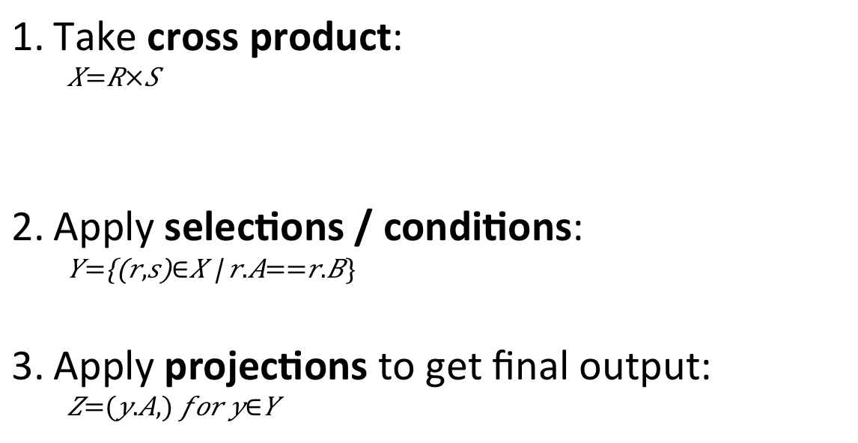
Note the semantics of a join
Lecture 2 > Section 3 > Joins: semantics
SELECT R.A
FROM R, S
WHERE R.A = S.B
Take cross product:
$$X=R×S$$
Apply selections / conditions:
$$Y=\left\{\left(r,s\right)∈X \right| r.A==r.B\}$$
Apply projections to get final output:
$$Z=(y.A,) for y∈Y$$
Recall: Cross product (A X B) is the set of all unique tuples in A,B
Ex: {a,b,c} X {1,2}
= {(a,1), (a,2), (b,1), (b,2), (c,1), (c,2)}
= Filtering!
= Returning only some attributes
Remembering this order is critical to understanding the output of certain queries (see later on…)

Slide 49
Note: we say “semantics” not “execution order”
Lecture 2 > Section 3 > Joins: semantics
The preceding slides show what a join means
Not actually how the DBMS executes it under the covers

Slide 50
A Subtlety about Joins
Lecture 2 > Section 3 > ACTIVITY
Lecture 2 > Section 3 > Joins: semantics
Product(PName, Price, Category, Manufacturer)
Company(CName, StockPrice, Country)
Find all countries that manufacture some product in the ‘Gadgets’ category.
SELECT Country FROM Product, Company WHERE Manufacturer=CName AND Category=‘Gadgets’

Slide 51
A subtlety about Joins
Lecture 2 > Section 3 > Joins: semantics
Lecture 2 > Section 3 > ACTIVITY
Product
Company
PName | Price | Category | Manuf
Gizmo | $19 | Gadgets | GWorks
Powergizmo | $29 | Gadgets | GWorks
SingleTouch | $149 | Photography | Canon
MultiTouch | $203 | Household | Hitachi
Cname | Stock | Country
GWorks | 25 | USA
Canon | 65 | Japan
Hitachi | 15 | Japan
SELECT Country FROM Product, Company WHERE Manufacturer=Cname
AND Category=‘Gadgets’
Country
?
?
What is the problem ?
What’s the solution ?

Slide 52
ACTIVITY: Lecture-2-3.ipynb
Lecture 2 > Section 3 > ACTIVITY

Slide 53
An Unintuitive Query
Lecture 2 > Section 3 > ACTIVITY
SELECT DISTINCT R.A
FROM R, S, T
WHERE R.A=S.A OR R.A=T.A
What does it compute?

Slide 54
An Unintuitive Query
Lecture 2 > Section 3 > ACTIVITY
SELECT DISTINCT R.A
FROM R, S, T
WHERE R.A=S.A OR R.A=T.A
S
T
R
But what if S = φ?
Computes R ∩ (S ∪ T)
Go back to the semantics!

Slide 55
An Unintuitive Query
Lecture 2 > Section 3 > ACTIVITY
SELECT DISTINCT R.A
FROM R, S, T
WHERE R.A=S.A OR R.A=T.A
Recall the semantics!
Take cross-product
Apply selections / conditions
Apply projection
If S = {}, then the cross product of R, S, T = {}, and the query result = {}!
Must consider semantics here.
Are there more explicit way to do set operations like this?

Slide 56
Lecture 3: SQL Part II
Lecture 3

Slide 57
Announcements
Lecture 3
Please let us know if you’re stuck on Jupyter!
Lectures:
I’m working to talk slower ☺ (PB note: poll here!)
I will repeat questions (please hold me accountable!)
Office hours: SCPD is on Google Hangouts (see Piazza)
Submission info: probably still in .txt format
Project 1 will be released on Thursday

Slide 58

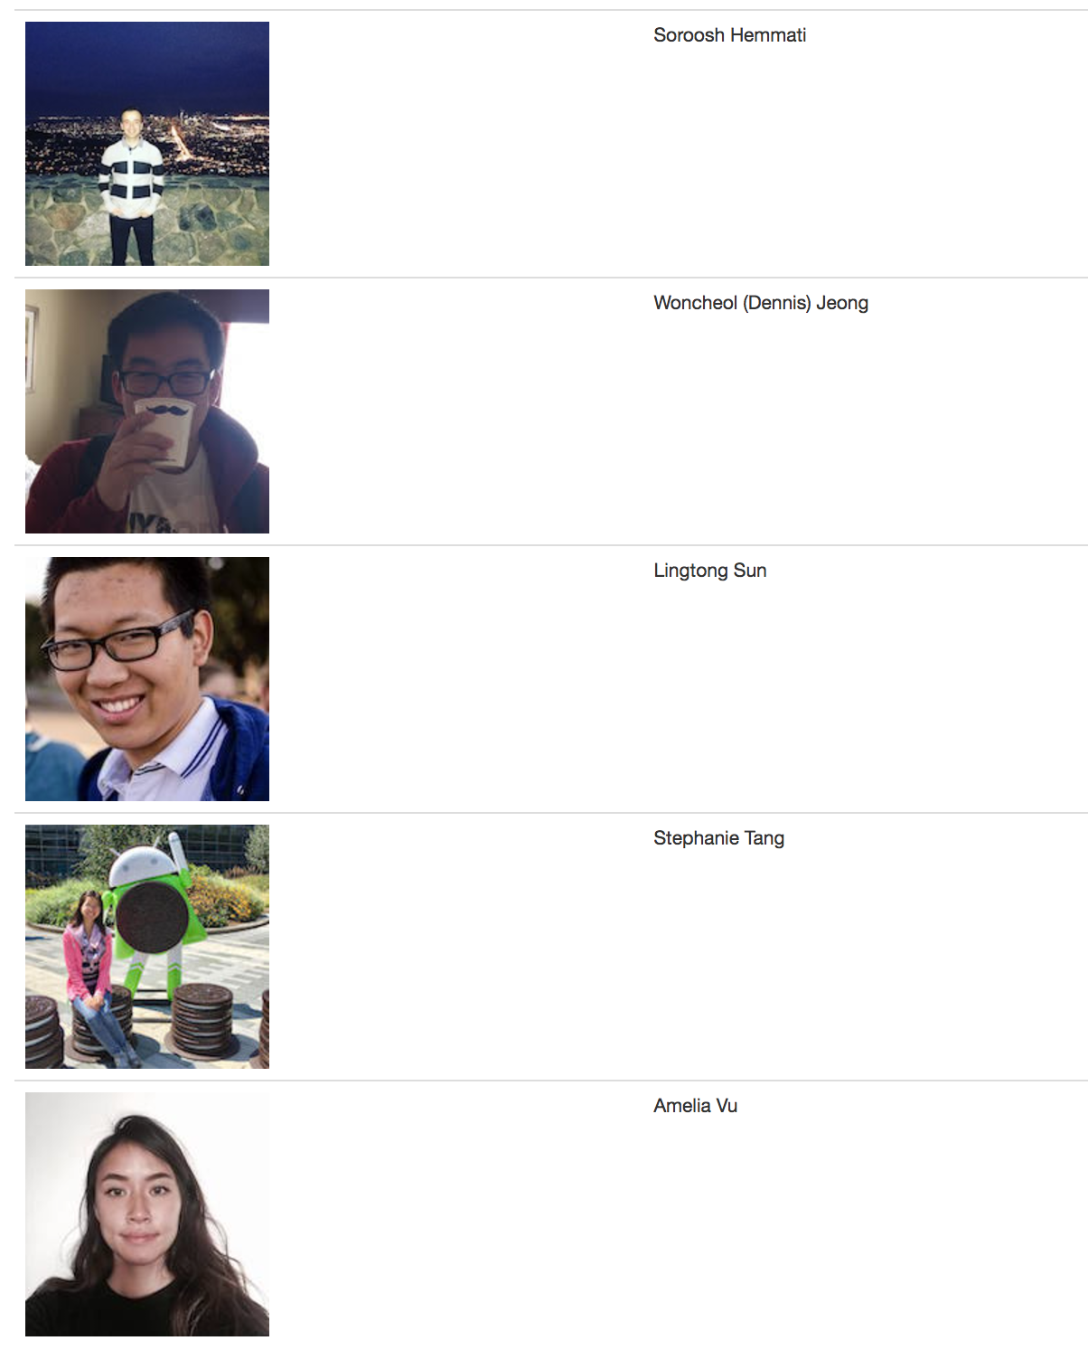

Slide 59
A note on quality, not quantity: We are following Chris Ré’s course material and format (he revised this course in depth several years ago… …I learned I’m now teaching this course as of three weeks ago) We will follow Chris’s material but I want to make sure you understand the big ideas in this course So, from now on: -- Please come with questions and/or post on Piazza before class to begin lecture! -- We may not cover everything that Chris did in one lecture; if we fall behind, I will cut less essential material from the course (still in slides, can come to OH, but not responsible for on exams, etc.)

Slide 60
Today’s Lecture
Lecture 3
Set operators & nested queries
ACTIVITY: Set operator subtleties
Aggregation & GROUP BY
ACTIVITY: Fancy SQL Part I
Advanced SQL-izing
ACTIVITY: Fancy SQL Part II

Slide 61
1. Set Operators & Nested Queries
Lecture 3 > Section 1

Slide 62
What you will learn about in this section
Lecture 3 > Section 1
Multiset operators in SQL
Nested queries
ACTIVITY: Set operator subtleties

Slide 63
An Unintuitive Query
Lecture 3 > Section 1 > Set Operators
SELECT DISTINCT R.A
FROM R, S, T
WHERE R.A=S.A OR R.A=T.A
What does it compute?

Slide 64
An Unintuitive Query
Lecture 3 > Section 1 > Set Operators
SELECT DISTINCT R.A
FROM R, S, T
WHERE R.A=S.A OR R.A=T.A
S
T
R
But what if S = φ?
Computes R ∩ (S ∪ T)
Go back to the semantics!

Slide 65
An Unintuitive Query
Lecture 3 > Section 1 > Set Operators
SELECT DISTINCT R.A
FROM R, S, T
WHERE R.A=S.A OR R.A=T.A
Recall the semantics!
Take cross-product
Apply selections / conditions
Apply projection
If S = {}, then the cross product of R, S, T = {}, and the query result = {}!
Must consider semantics here.
Are there more explicit way to do set operations like this?

Slide 66
What does this look like in Python?
Lecture 3 > Section 1 > Set Operators
S
T
SELECT DISTINCT R.A
FROM R, S, T
WHERE R.A=S.A OR R.A=T.A
R
R ∩ (S ∪ T)
Semantics:
Take cross-product
Apply selections / conditions
Apply projection
Joins / cross-products are just nested for loops (in simplest implementation)!
If-then statements!

Slide 67
What does this look like in Python?
Lecture 3 > Section 1 > Set Operators
S
T
SELECT DISTINCT R.A
FROM R, S, T
WHERE R.A=S.A OR R.A=T.A
R
R ∩ (S ∪ T)
output = {}
for r in R:
for s in S:
for t in T:
if r[‘A’] == s[‘A’] or r[‘A’] == t[‘A’]:
output.add(r[‘A’])
return list(output)
Can you see now what happens if S = []?
See bonus activity on website!

Slide 68
Multiset Operations
Lecture 3 > Section 1 > Set Operators

Slide 69
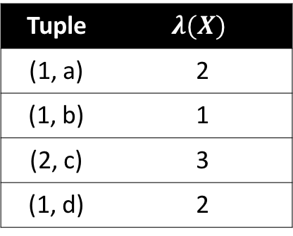
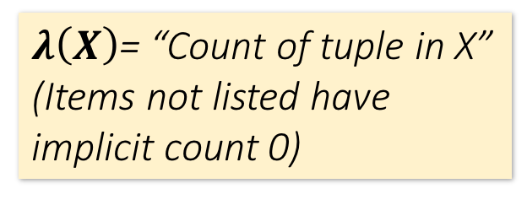
Recall Multisets
Lecture 3 > Section 1 > Set Operators
$λ\left(X\right)$= “Count of tuple in X”
(Items not listed have implicit count 0)
Multiset X
Tuple
(1, a)
(1, a)
(1, b)
(2, c)
(2, c)
(2, c)
(1, d)
(1, d)
Multiset X
Tuple | $$λ(X)$$
(1, a) | 2
(1, b) | 1
(2, c) | 3
(1, d) | 2
Equivalent Representations of a Multiset
Note: In a set all counts are {0,1}.

Slide 70
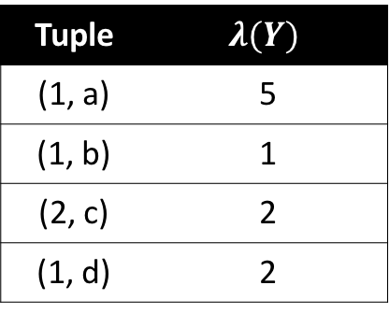


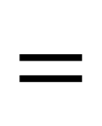


Generalizing Set Operations to Multiset Operations
Lecture 3 > Section 1 > Set Operators
Multiset X
Multiset Y
Multiset Z
Tuple | $$λ(X)$$
(1, a) | 2
(1, b) | 0
(2, c) | 3
(1, d) | 0
Tuple | $$λ(Y)$$
(1, a) | 5
(1, b) | 1
(2, c) | 2
(1, d) | 2
Tuple | $$λ(Z)$$
(1, a) | 2
(1, b) | 0
(2, c) | 2
(1, d) | 0
$$∩$$
$$=$$
For sets, this is intersection
$$λ\left(Z\right)=min(λ\left(X\right),λ\left(Y\right))$$

Slide 71



Generalizing Set Operations to Multiset Operations
Lecture 3 > Section 1 > Set Operators
Multiset X
Multiset Y
Multiset Z
Tuple | $$λ(X)$$
(1, a) | 2
(1, b) | 0
(2, c) | 3
(1, d) | 0
Tuple | $$λ(Y)$$
(1, a) | 5
(1, b) | 1
(2, c) | 2
(1, d) | 2
Tuple | $$λ(Z)$$
(1, a) | 7
(1, b) | 1
(2, c) | 5
(1, d) | 2
$$∪$$
$$=$$
For sets,
this is union
$$λ\left(Z\right)=λ\left(X\right)+ λ\left(Y\right)$$

Slide 72
Multiset Operations in SQL
Lecture 3 > Section 1 > Set Operators

Slide 73
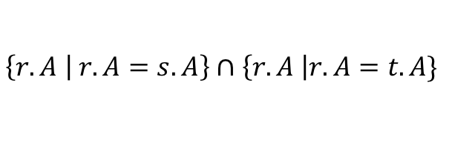
Explicit Set Operators: INTERSECT
Lecture 3 > Section 1 > Set Operators
SELECT R.A
FROM R, S
WHERE R.A=S.A
INTERSECT
SELECT R.A
FROM R, T
WHERE R.A=T.A
$$\left\{r.A | r.A=s.A\right\}∩\left\{r.A \right|r.A=t.A\}$$
Q₁
Q₂

Slide 74
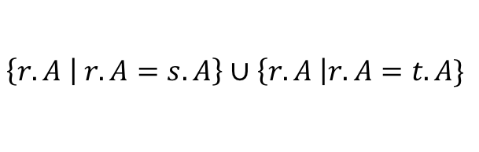
UNION
Lecture 3 > Section 1 > Set Operators
$$\left\{r.A | r.A=s.A\right\}∪\left\{r.A \right|r.A=t.A\}$$
Q₁
Q₂
Why aren’t there duplicates?
SELECT R.A
FROM R, S
WHERE R.A=S.A
UNION
SELECT R.A
FROM R, T
WHERE R.A=T.A
By default:
SQL uses set semantics!
What if we want duplicates?

Slide 75
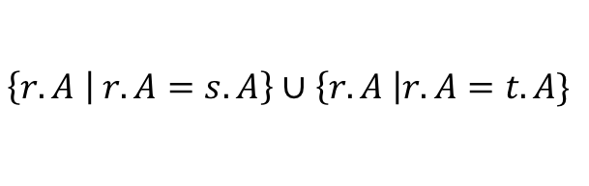
UNION ALL
Lecture 3 > Section 1 > Set Operators
SELECT R.A
FROM R, S
WHERE R.A=S.A
UNION ALL
SELECT R.A
FROM R, T
WHERE R.A=T.A
$$\left\{r.A | r.A=s.A\right\}∪\left\{r.A \right|r.A=t.A\}$$
Q₁
Q₂
ALL indicates Multiset operations

Slide 76
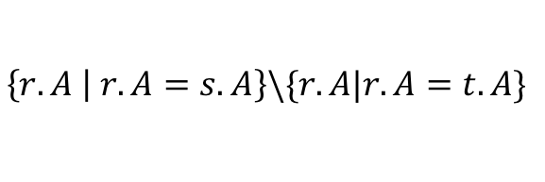
EXCEPT
Lecture 3 > Section 1 > Set Operators
SELECT R.A
FROM R, S
WHERE R.A=S.A
EXCEPT
SELECT R.A
FROM R, T
WHERE R.A=T.A
$$\left\{r.A | r.A=s.A\right\}\backslash \{r.A|r.A=t.A\}$$
Q₁
Q₂
What is the multiset version?
Notes:
A: max(lambda(x) – lambda(y), 0)

Slide 77
INTERSECT: Still some subtle problems…
Lecture 3 > Section 1 > Set Operators
Company(name, hq_city)
Product(pname, maker, factory_loc)
SELECT hq_city
FROM Company, Product
WHERE maker = name
AND factory_loc = ‘US’
INTERSECT
SELECT hq_city
FROM Company, Product
WHERE maker = name
AND factory_loc = ‘China’
“Headquarters of companies which make gizmos in US AND China”
What if two companies have HQ in US: BUT one has factory in China (but not US) and vice versa? What goes wrong?

Slide 78
INTERSECT: Remember the semantics!
Lecture 3 > Section 1 > Set Operators
Example: C JOIN P on maker = name
Company(name, hq_city) AS C
Product(pname, maker, factory_loc) AS P
C.name | C.hq_city | P.pname | P.maker | P.factory_loc
X Co. | Seattle | X | X Co. | U.S.
Y Inc. | Seattle | X | Y Inc. | China
SELECT hq_city
FROM Company, Product
WHERE maker = name
AND factory_loc=‘US’
INTERSECT
SELECT hq_city
FROM Company, Product
WHERE maker = name
AND factory_loc=‘China’

Slide 79
INTERSECT: Remember the semantics!
Lecture 3 > Section 1 > Set Operators
Example: C JOIN P on maker = name
Company(name, hq_city) AS C
Product(pname, maker, factory_loc) AS P
C.name | C.hq_city | P.pname | P.maker | P.factory_loc
X Co. | Seattle | X | X Co. | U.S.
Y Inc. | Seattle | X | Y Inc. | China
SELECT hq_city
FROM Company, Product
WHERE maker = name
AND factory_loc=‘US’
INTERSECT
SELECT hq_city
FROM Company, Product
WHERE maker = name
AND factory_loc=‘China’
X Co has a factory in the US (but not China)
Y Inc. has a factory in China (but not US)
But Seattle is returned by the query!
We did the INTERSECT on the wrong attributes!

Slide 80
One Solution: Nested Queries
Lecture 3 > Section 1 > Nested Queries
Company(name, hq_city)
Product(pname, maker, factory_loc)
“Headquarters of companies which make gizmos in US AND China”
SELECT DISTINCT hq_city
FROM Company, Product
WHERE maker = name
AND name IN (
SELECT maker
FROM Product
WHERE factory_loc = ‘US’)
AND name IN (
SELECT maker
FROM Product
WHERE factory_loc = ‘China’)
Note: If we hadn’t used DISTINCT here, how many copies of each hq_city would have been returned?

Slide 81
High-level note on nested queries
Lecture 3 > Section 1 > Nested Queries
We can do nested queries because SQL is compositional:
Everything (inputs / outputs) is represented as multisets- the output of one query can thus be used as the input to another (nesting)!
This is extremely powerful!

Slide 82
Nested queries: Sub-queries Return Relations
Lecture 3 > Section 1 > Nested Queries
Another example:
Company(name, city) Product(name, maker) Purchase(id, product, buyer)
SELECT c.city
FROM Company c
WHERE c.name IN (
SELECT pr.maker
FROM Purchase p, Product pr
WHERE p.product = pr.name
AND p.buyer = ‘Joe Blow‘)
“Cities where one can find companies that manufacture products bought by Joe Blow”

Slide 83
Nested Queries
Lecture 3 > Section 1 > Nested Queries
Are these queries equivalent?
SELECT c.city
FROM Company c
WHERE c.name IN (
SELECT pr.maker
FROM Purchase p, Product pr
WHERE p.name = pr.product
AND p.buyer = ‘Joe Blow‘)
SELECT c.city
FROM Company c,
Product pr,
Purchase p
WHERE c.name = pr.maker
AND pr.name = p.product
AND p.buyer = ‘Joe Blow’
Beware of duplicates!

Slide 84
Nested Queries
Lecture 3 > Section 1 > Nested Queries
SELECT DISTINCT c.city
FROM Company c,
Product pr,
Purchase p
WHERE c.name = pr.maker
AND pr.name = p.product
AND p.buyer = ‘Joe Blow’
SELECT DISTINCT c.city
FROM Company c
WHERE c.name IN (
SELECT pr.maker
FROM Purchase p, Product pr
WHERE p.product = pr.name
AND p.buyer = ‘Joe Blow‘)
Now they are equivalent (both use set semantics)

Slide 85
Subqueries Return Relations
Lecture 3 > Section 1 > Nested Queries
You can also use operations of the form:
s > ALL R
s < ANY R
EXISTS R
ANY and ALL not supported by SQLite.
Ex:
Product(name, price, category, maker)
SELECT name
FROM Product
WHERE price > ALL(
SELECT price
FROM Product
WHERE maker = ‘Gizmo-Works’)
Find products that are more expensive than all those produced by “Gizmo-Works”

Slide 86
Subqueries Returning Relations
Lecture 3 > Section 1 > Nested Queries
You can also use operations of the form:
s > ALL R
s < ANY R
EXISTS R
Ex:
Product(name, price, category, maker)
Find ‘copycat’ products, i.e. products made by competitors with the same names as products made by “Gizmo-Works”
SELECT p1.name
FROM Product p1
WHERE p1.maker = ‘Gizmo-Works’
AND EXISTS(
SELECT p2.name
FROM Product p2
WHERE p2.maker <> ‘Gizmo-Works’
AND p1.name = p2.name)
<> means !=

Slide 87
Nested queries as alternatives to INTERSECT and EXCEPT
Lecture 3 > Section 1 > Nested Queries
INTERSECT and EXCEPT not in some DBMSs!
(SELECT R.A, R.B
FROM R) INTERSECT
(SELECT S.A, S.B
FROM S)
SELECT R.A, R.B
FROM R WHERE EXISTS(
SELECT * FROM S WHERE R.A=S.A AND R.B=S.B)
If R, S have no duplicates, then can write without sub-queries (HOW?)
(SELECT R.A, R.B
FROM R) EXCEPT
(SELECT S.A, S.B
FROM S)
SELECT R.A, R.B
FROM R WHERE NOT EXISTS(
SELECT * FROM S WHERE R.A=S.A AND R.B=S.B)

Slide 88
Correlated Queries Using External Vars in Internal Subquery
Lecture 3 > Section 1 > Nested Queries
Movie(title, year, director, length)
Find movies whose title appears more than once.
SELECT DISTINCT title
FROM Movie AS m
WHERE year <> ANY(
SELECT year
FROM Movie
WHERE title = m.title)
Note the scoping of the variables!
Note also: this can still be expressed as single SFW query…

Slide 89
Complex Correlated Query
Lecture 3 > Section 1 > Nested Queries
Product(name, price, category, maker, year)
SELECT DISTINCT x.name, x.maker
FROM Product AS x
WHERE x.price > ALL(
SELECT y.price
FROM Product AS y
WHERE x.maker = y.maker
AND y.year < 1972)
Find products (and their manufacturers) that are more expensive than all products made by the same manufacturer before 1972
Can be very powerful (also much harder to optimize)

Slide 90
Basic SQL Summary
Lecture 3 > Section 1 > Summary
SQL provides a high-level declarative language for manipulating data (DML)
The workhorse is the SFW block
Set operators are powerful but have some subtleties
Powerful, nested queries also allowed.

Slide 91
Activity-3-1.ipynb
Lecture 3 > Section 1 > ACTIVITY

Slide 92
2. Aggregation & GROUP BY
Lecture 3 > Section 2

Slide 93
What you will learn about in this section
Lecture 3 > Section 2
Aggregation operators
GROUP BY
GROUP BY: with HAVING, semantics
ACTIVITY: Fancy SQL Pt. I

Slide 94
Aggregation
Lecture 3 > Section 2 > Aggregation
SELECT AVG(price)
FROM Product
WHERE maker = “Toyota”
SELECT COUNT(*)
FROM Product
WHERE year > 1995
SQL supports several aggregation operations:
SUM, COUNT, MIN, MAX, AVG
Except COUNT, all aggregations apply to a single attribute

Slide 95
Aggregation: COUNT
Lecture 3 > Section 2 > Aggregation
COUNT applies to duplicates, unless otherwise stated
SELECT COUNT(category)
FROM Product
WHERE year > 1995
Note: Same as COUNT(*). Why?
We probably want:
SELECT COUNT(DISTINCT category)
FROM Product
WHERE year > 1995

Slide 96
More Examples
Lecture 3 > Section 2 > Aggregation
Purchase(product, date, price, quantity)
SELECT SUM(price * quantity)
FROM Purchase
What do these mean?
SELECT SUM(price * quantity)
FROM Purchase
WHERE product = ‘bagel’

Slide 97
Simple Aggregations
Lecture 3 > Section 2 > Aggregation
Purchase
Product | Date | Price | Quantity
bagel | 10/21 | 1 | 20
banana | 10/3 | 0.5 | 10
banana | 10/10 | 1 | 10
bagel | 10/25 | 1.50 | 20
SELECT SUM(price * quantity)
FROM Purchase
WHERE product = ‘bagel’
50 (= 1*20 + 1.50*20)

Slide 98
Grouping and Aggregation
Lecture 3 > Section 2 > GROUP BY
Purchase(product, date, price, quantity)
SELECT product,
SUM(price * quantity) AS TotalSales
FROM Purchase
WHERE date > ‘10/1/2005’
GROUP BY product
Find total sales after 10/1/2005 per product.
Let’s see what this means…

Slide 99
Grouping and Aggregation
Lecture 3 > Section 2 > GROUP BY
Semantics of the query:
1. Compute the FROM and WHERE clauses
2. Group by the attributes in the GROUP BY
3. Compute the SELECT clause: grouped attributes and aggregates

Slide 100
1. Compute the FROM and WHERE clauses
Lecture 3 > Section 2 > GROUP BY
SELECT product, SUM(price*quantity) AS TotalSales
FROM Purchase
WHERE date > ‘10/1/2005’
GROUP BY product
Product | Date | Price | Quantity
Bagel | 10/21 | 1 | 20
Bagel | 10/25 | 1.50 | 20
Banana | 10/3 | 0.5 | 10
Banana | 10/10 | 1 | 10
FROM

Slide 101
2. Group by the attributes in the GROUP BY
Lecture 3 > Section 2 > GROUP BY
SELECT product, SUM(price*quantity) AS TotalSales
FROM Purchase
WHERE date > ‘10/1/2005’
GROUP BY product
Product | Date | Price | Quantity
Bagel | 10/21 | 1 | 20
Bagel | 10/25 | 1.50 | 20
Banana | 10/3 | 0.5 | 10
Banana | 10/10 | 1 | 10
GROUP BY
Product | Date | Price | Quantity
Bagel | 10/21 | 1 | 20
 | 10/25 | 1.50 | 20
Banana | 10/3 | 0.5 | 10
 | 10/10 | 1 | 10

Slide 102
3. Compute the SELECT clause: grouped attributes and aggregates
Lecture 3 > Section 2 > GROUP BY
SELECT product, SUM(price*quantity) AS TotalSales
FROM Purchase
WHERE date > ‘10/1/2005’
GROUP BY product
Product | Date | Price | Quantity
Bagel | 10/21 | 1 | 20
 | 10/25 | 1.50 | 20
Banana | 10/3 | 0.5 | 10
 | 10/10 | 1 | 10
Product | TotalSales
Bagel | 50
Banana | 15
SELECT

Slide 103
GROUP BY v.s. Nested Quereis
Lecture 3 > Section 2 > GROUP BY
SELECT product, Sum(price*quantity) AS TotalSales
FROM Purchase
WHERE date > ‘10/1/2005’
GROUP BY product
SELECT DISTINCT x.product,
(SELECT Sum(y.price*y.quantity) FROM Purchase y WHERE x.product = y.product AND y.date > ‘10/1/2005’) AS TotalSales
FROM Purchase x
WHERE x.date > ‘10/1/2005’

Slide 104
HAVING Clause
Lecture 3 > Section 2 > GROUP BY
SELECT product, SUM(price*quantity)
FROM Purchase
WHERE date > ‘10/1/2005’
GROUP BY product
HAVING SUM(quantity) > 100
Same query as before, except that we consider only products that have more than
100 buyers
HAVING clauses contains conditions on aggregates
Whereas WHERE clauses condition on individual tuples…

Slide 105
General form of Grouping and Aggregation
Lecture 3 > Section 2 > GROUP BY
SELECT S
FROM R₁,…,R_{n}
WHERE C₁
GROUP BY a₁,…,a_{k}
HAVING C₂
Why?
S = Can ONLY contain attributes a₁,…,a_{k} and/or aggregates over other attributes
C₁ = is any condition on the attributes in R₁,…,R_{n}
C₂ = is any condition on the aggregate expressions

Slide 106
General form of Grouping and Aggregation
Lecture 3 > Section 2 > GROUP BY
SELECT S
FROM R₁,…,R_{n}
WHERE C₁
GROUP BY a₁,…,a_{k}
HAVING C₂
Evaluation steps:
Evaluate FROM-WHERE: apply condition C₁ on the attributes in R₁,…,R_{n}
GROUP BY the attributes a₁,…,a_{k}
Apply condition C₂ to each group (may have aggregates)
Compute aggregates in S and return the result

Slide 107
Group-by v.s. Nested Query
Lecture 3 > Section 2 > GROUP BY
Author(login, name)
Wrote(login, url)
Find authors who wrote ≥ 10 documents:
Attempt 1: with nested queries
SELECT DISTINCT Author.name
FROM Author
WHERE COUNT(
SELECT Wrote.url FROM Wrote WHERE Author.login = Wrote.login) > 10
This is SQL by a novice

Slide 108
Group-by v.s. Nested Query
Lecture 3 > Section 2 > GROUP BY
Find all authors who wrote at least 10 documents:
Attempt 2: SQL style (with GROUP BY)
SELECT Author.name
FROM Author, Wrote
WHERE Author.login = Wrote.login
GROUP BY Author.name
HAVING COUNT(Wrote.url) > 10
This is SQL by an expert
No need for DISTINCT: automatically from GROUP BY

Slide 109
Group-by vs. Nested Query
Lecture 3 > Section 2 > GROUP BY
Which way is more efficient?
Attempt #1- With nested: How many times do we do a SFW query over all of the Wrote relations?
Attempt #2- With group-by: How about when written this way?
With GROUP BY can be much more efficient!

Slide 110
Activity-3-2.ipynb
Lecture 3 > Section 2 > ACTIVITY

Slide 111
3. Advanced SQL-izing
Lecture 3 > Section 3

Slide 112
What you will learn about in this section
Lecture 3 > Section 3
Quantifiers
NULLs
Outer Joins
ACTIVITY: Fancy SQL Pt. II

Slide 113
Quantifiers
Lecture 3 > Section 3 > Quantifiers
Product(name, price, company)
Company(name, city)
SELECT DISTINCT Company.cname
FROM Company, Product
WHERE Company.name = Product.company
AND Product.price < 100
Find all companies that make some products with price < 100
An existential quantifier is a logical quantifier (roughly) of the form “there exists”
Existential: easy ! ☺

Slide 114
Quantifiers
Lecture 3 > Section 3 > Quantifiers
Find all companies with products all having price < 100
Product(name, price, company)
Company(name, city)
SELECT DISTINCT Company.cname
FROM Company
WHERE Company.name NOT IN(
SELECT Product.company
FROM Product.price >= 100)
Equivalent
Find all companies that make only products with price < 100
A universal quantifier is of the form “for all”
Universal: hard ! ☹

Slide 115
NULLS in SQL
Lecture 3 > Section 3 > NULLs
Whenever we don’t have a value, we can put a NULL
Can mean many things:
Value does not exists
Value exists but is unknown
Value not applicable
Etc.
The schema specifies for each attribute if can be null (nullable attribute) or not
How does SQL cope with tables that have NULLs?

Slide 116
Null Values
Lecture 3 > Section 3 > NULLs
For numerical operations, NULL -> NULL:
If x = NULL then 4*(3-x)/7 is still NULL
For boolean operations, in SQL there are three values:
FALSE = 0
UNKNOWN = 0.5
TRUE = 1
If x= NULL then x=“Joe” is UNKNOWN

Slide 117
Null Values
Lecture 3 > Section 3 > NULLs
C1 AND C2 = min(C1, C2)
C1 OR C2 = max(C1, C2)
NOT C1 = 1 – C1
SELECT *
FROM Person
WHERE (age < 25)
AND (height > 6 AND weight > 190)
Won’t return e.g. (age=20 height=NULL weight=200)!
Rule in SQL: include only tuples that yield TRUE (1.0)

Slide 118
Null Values
Lecture 3 > Section 3 > NULLs
Unexpected behavior:
SELECT *
FROM Person
WHERE age < 25 OR age >= 25
Some Persons are not included !

Slide 119
Null Values
Lecture 3 > Section 3 > NULLs
Can test for NULL explicitly:
x IS NULL
x IS NOT NULL
SELECT *
FROM Person
WHERE age < 25 OR age >= 25
OR age IS NULL
Now it includes all Persons!

Slide 120
RECAP: Inner Joins
Lecture 3 > Section 3 > Outer Joins
By default, joins in SQL are “inner joins”:
Product(name, category)
Purchase(prodName, store)
SELECT Product.name, Purchase.store
FROM Product
JOIN Purchase ON Product.name = Purchase.prodName
Both equivalent:
Both INNER JOINS!
SELECT Product.name, Purchase.store
FROM Product, Purchase
WHERE Product.name = Purchase.prodName

Slide 121
Inner Joins + NULLS = Lost data?
Lecture 3 > Section 3 > Outer Joins
By default, joins in SQL are “inner joins”:
Product(name, category)
Purchase(prodName, store)
SELECT Product.name, Purchase.store
FROM Product
JOIN Purchase ON Product.name = Purchase.prodName
SELECT Product.name, Purchase.store
FROM Product, Purchase
WHERE Product.name = Purchase.prodName
However: Products that never sold (with no Purchase tuple) will be lost!

Slide 122
Outer Joins
Lecture 3 > Section 3 > Outer Joins
An outer join returns tuples from the joined relations that don’t have a corresponding tuple in the other relations
I.e. If we join relations A and B on a.X = b.X, and there is an entry in A with X=5, but none in B with X=5…
A LEFT OUTER JOIN will return a tuple (a, NULL)!
Left outer joins in SQL:
SELECT Product.name, Purchase.store
FROM Product
LEFT OUTER JOIN Purchase ON
Product.name = Purchase.prodName
Now we’ll get products even if they didn’t sell

Slide 123
INNER JOIN:
Lecture 3 > Section 3 > Outer Joins
Product
Purchase
name | category
Gizmo | gadget
Camera | Photo
OneClick | Photo
prodName | store
Gizmo | Wiz
Camera | Ritz
Camera | Wiz
name | store
Gizmo | Wiz
Camera | Ritz
Camera | Wiz
SELECT Product.name, Purchase.store
FROM Product
INNER JOIN Purchase
ON Product.name = Purchase.prodName
Note: another equivalent way to write an INNER JOIN!

Slide 124
LEFT OUTER JOIN:
Lecture 3 > Section 3 > Outer Joins
Product
Purchase
name | category
Gizmo | gadget
Camera | Photo
OneClick | Photo
prodName | store
Gizmo | Wiz
Camera | Ritz
Camera | Wiz
name | store
Gizmo | Wiz
Camera | Ritz
Camera | Wiz
OneClick | NULL
SELECT Product.name, Purchase.store
FROM Product
LEFT OUTER JOIN Purchase
ON Product.name = Purchase.prodName

Slide 125
Other Outer Joins
Lecture 3 > Section 3 > Outer Joins
Left outer join:
Include the left tuple even if there’s no match
Right outer join:
Include the right tuple even if there’s no match
Full outer join:
Include the both left and right tuples even if there’s no match

Slide 126
Activity-3-3.ipynb
Lecture 3 > Section 3 > ACTIVITY

Slide 127
Summary
Lecture 2 & 3 > SUMMARY
SQL is a rich programming language that handles the way data is processed declaratively

