Slide 1
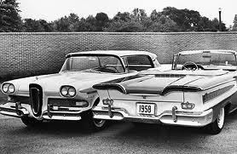
From Mass Incarceration to Mass Supervision? Punishment in Society
Presentation at the ASC Chicago, 17th Nov 2012 (based on the P&S Handbook Chapter by Gwen Robinson, Fergus McNeill and Shadd Maruna)

Slide 2
From… to…
The title is not a reference to the complex and contingent relationships between these two penal phenomena (on which, see Phelps…)
It is a call for a diversification of our objects of study in respect of Punishment and Society

Slide 3
The way of the Edsel?
Rethinking Probation (1998)
  A crisis of public legitimacy
  Problems of performance
  Failure to appeal to ‘widely held values’
The End of Probation (2001)
  Time to retire ‘probation’; a brand based on the ‘rather bizarre assumption that surveillance and some guidance can steer the offender straight’ (Maloney, Bazemore and Hudson, 2001)

Slide 4
So what happened?
‘... Community corrections experienced some of its most vicious public criticism, but it was also during this time that it experienced unprecedented growth and diversification’ (Wodahl, et al., 2011)
Similar patterns elsewhere

Slide 5
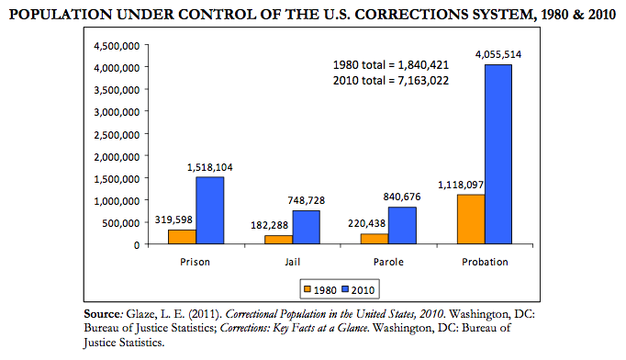
USA, 1980 & 2010
1:3.6
1:4.8
1:4.1
1:3.8

Slide 6
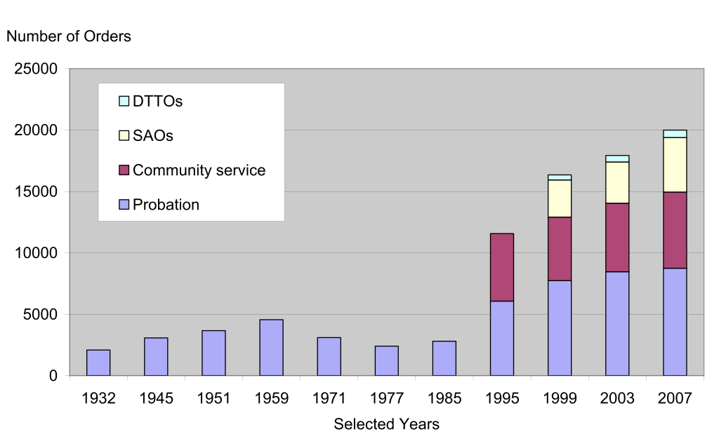
Scotland, 1932… 2007
Adding post-release supervision (from the late 60s) eventually leads to another 1,000 supervisees per annum

Slide 7
Punishment in Society
In most jurisdictions, CSM are or were deeply associated with and embedded in penal welfarism
According to some accounts, penal welfarism, at least in some places, has been eclipsed
So how and why are CSM apparently thriving? How have they adapted to survive a potentially hostile social and penal climate? [And what are the implications of our answers for P&S more generally?]

Slide 8
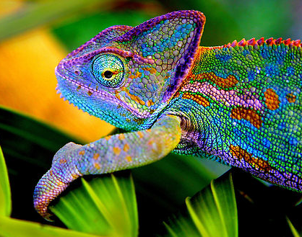
Adaptation and legitimation
Four key strategies (sometimes pursued simultaneously)
  Managerial CSM
  Punitive CSM
  Rehabilitative CSM
  Reparative CSM

Slide 9
Chameleon sanctions?
Color change in chameleons has functions in social signaling and in reactions to temperature and other conditions as well as camouflage. The relative importance of the classes of function vary with the circumstances as well as the species. Color change signals a chameleon's physiological condition and intentions to other chameleons.[18][19] Chameleons tend to show darker colors when angered, or attempting to scare or intimidate others, while males show lighter, multi-colored patterns when courting females… Some species, such as Smith's dwarf chameleon, adjust their colors for camouflage in accordance with the vision of the specific predator species (bird or snake) that they are being threatened by.[20]
http://en.wikipedia.org/wiki/Chameleon
]

Slide 10
Managerial CSM
Systemisation of the CJS, linked to acceptance of crime as a ‘normal social fact’, a risk to be managed
Working for (and on) the system, not ‘the client’
  E.g. Alternatives to custody
Working in partnership towards a common goal (usually ‘public protection’)
Judged on scaled down ‘outputs’ not aspirational ‘outcomes’
  But still struggling to displace custody by front or back door means
  What counts is not what matters (to many practitioners and probationers), and what matters is not what counts

Slide 11
Punitive (Retributive?) CSM
Traditionally, alternatives to punishment
  Though always disciplinary in nature
Developing punitive credentials
  Penal reduction requires ‘credible’ alternatives
  Deserts-based sentencing requires clarity in relation to ‘punitive weight’: length, intrusiveness, intensity
  Politicisation of crime and justice; populist punitiveness
New conditions, new combinations
Lower tolerance of non-compliance

Slide 12
Rehabilitative (Protective?) CSM
CSM as social work, as welfarism
The revival of rehabilitation
  The ‘What Works’ story
  California DCR
  UK Rehabilitation Revolution
Adaptations of rehabilitation
  Re-entry and resettlement
  Managerialised rehabilitation
  Rehabilitation as public protection
Rehabilitation as reform/treatment versus restoration of citizenship

Slide 13
Reparative CSM
By 1980, an emerging alternative to rehabilitation
  (cf. Bottoms, Christie, Hulsman)
Yet, CS/unpaid work was often marketed in other ways too:
  Punishment, rehabilitation, reintegration
Lack of clarity in the post-rehabilitation narrative for CSM
  Perennially underdeveloped links with restorative justice
Reparation offers constructive redress (justice), with rehabilitation and reintegration as (potential) secondary outcomes
  Or even casts rehabilitation as a form of reparation
Reparation, CSM and public attitudes

Slide 14
Other adaptations and strategies?
Technology, ‘Community Custody’ and the ‘Virtual Prison’
  A fifth adaptation strategy: incapacitative CSM?
The depth, weight and tightness (Crewe, 2012) of supervision…
And its changing legal forms
  Civil legal supervision (ASBOs)
  Administrative supervision (MAPPA, Integrated Offender Management)

Slide 15
Legitimacy and capital
The legitimacy struggles of the welfarist sanction, out in the open
A struggle for capital in a reconfiguring field (Page, 2012)
Pragmatic, moral and cognitive legitimacy (Wodahl et al. 2011; Suchman, 1995)

Slide 16
Adaptation and legitimacy
 | Prudential | Moral | Cognitive
Managerial | ✔ | X | X
Punitive | ? | ✔ | X
Rehabilitative | ✔ | ? | X
Reparative | ✔ | ✔ | ?

Slide 17
Where next?
Supervision and (inter-group, organic) social solidarity
A political economy of supervision (but within a broadened materialist framework)
Supervision and (old and new) technologies of power
Supervision and (de)civilizing processes
The cultural meanings of supervision
Supervision and risk
Supervision in the penal field; supervision as a penal field

Slide 18
But before we theorize it, what is supervision?
Supervision as a lived experience
Supervision as an instantiated practice
Supervision as a decision-making logic
Supervision as a (multi-level) governed penal institution
It is one thing to ask what kinds of penality supervision reflects, another to ask what kind of ‘punishment in society’ it constitutes

Slide 19
