Slide 1
Devolving the carceral state:
Race, reentry, and the responsibilization of the “new” urban poor
Reuben Jonathan Miller, PhD
Assistant Professor of Social Work
University of Michigan
*The author is grateful for research support from a HUD Doctoral Dissertation Grant, and fellowships from the American Society of Criminology, the Robert McCormick Tribune Foundation, and the Center for Urban Research and Learning at Loyola University Chicago
Notes:
Note here…

Slide 2
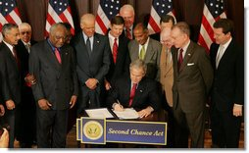

Slide 3
The Second Chance Act of 2007 (SCA)
Reinvigorated the place of rehabilitation in criminal justice
Legitimized risk reduction through personal transformation as appropriate social policy intervention for the underclass
Renewed commitment to the redemptive capacities of self reliance and personal accountability

Slide 4
Second Chance Act Appropriations
$165 million for
  Vocational training and Workforce Development
  Commitment to reduce recidivism by 50%
The “text” of SCA speaks to risk reduction
  But… the devil is in the empirical details
Funding appropriated for:
  Surveillance
    Court Monitoring and Parole enforcement
  Mentorship programs
  WORKFORCE PREPERATION SERVICES

Slide 5
Prisoner Reentry and U.S. Poverty Policy
Exhibits Enduring Collusion between welfare state and criminal justice actors to manage marginality (Garland 1985; Beckett and Western 2001)
Demonstrates the reconfiguration and considerable expansion of the state (Wacquant, 2012)
Not at all about risk reduction, but the transformation of the ex-offender into a “productive citizen” (Foucault, 1977; Hasenfeld, 1972)

Slide 6
CARCERAL DEVOLUTION
A Double Movement Occurring across Geographic and Conceptual Domains
  Geographically
    From Prisons (central/public sector) to Communities (local authority/government and third sector)
    Why this is not simply “Privitization”
  Shifting Ideological/Conceptual Terrain
    From ex-convict social ecology (community risk) to interiority of the ex-offender (Psychologies, spiritualties, rationalities, and mentalities of ex-offenders)
Notes:
Available only through street level analysis… coupled with critical interrogation of macro level processes. Heavy emphasis on one or the other obscures the role of agency (predetermined social outcomes… or worse… romantic conceptualizations of street life… This is about the quotidian…

Slide 7
Brief Literature Review
1870 Declaration of Principles
Rehabilitation built around moral suasion through personal transformation via religion and work (Foucault 1977; Simon 1993)
“Penal Welfarism” modus operandi of Corrections for nearly a century (Garland 2001)

Slide 8
Ending Welfare (and rehabilitation) as we knew it
The assault on prisoner rehabilitation occurred alongside an assault on public welfare
  What works (Martinson 1974)
  Broken Windows (Wilson and Kelley 1982),
  Losing Ground (Murray 1985)
  Crime and Human Nature (Hernstein and Wilson 1985)
  The Bell Curve (Hernstein and Murray 1994)
Initiating a punitive turn in criminal justice and social welfare policy

Slide 9
Punitive processes variegated occurring differentially across time and region (Beckett and Western 2001; Schram et al. 2009)
Ascendance of reentry programming between 1991 and 2004 (Phelps 2011)
A tripling of community based prisoner reentry services between 1996 (welfare reform) and 2008 (second chance act)

Slide 10
That these changes occurred at the moment of welfare reform is far from inconsequential
Welfare reform “… [S]ignaled the victory of three great forces—the war on dependence, the devolution of public authority, and the application of market models to public policy—that redefined not only welfare but all of America's vast welfare state" (Kats, 2001)
Following Wacquant’s (2012) admonition, we must “relink social welfare and penal policies to grasp the ‘new politics’ of marginality”

Slide 11
Re-conceptualizing Prisoner Reentry
Reentry understood as “the process of prisoners returning home” (Travis et al. 2001)
Strategically theorized as an event almost all prisoners undergo, and therefore politically neutral

Slide 12
Reentry as Interactive Political Process
Far from apolitical
Occurs with various stakeholders
Actors involved have vested interests:
  In their positions within their given field of practice
  In how ex-offenders are understood
  In how programs are implemented
  In the outcomes of prisoners who participate in those programs

Slide 13
Research Questions
What Strategies do reentry organizations employ to rehabilitate former prisoners?
How do the practices of reentry articulate with larger social policy processes?
What lessons can be learned for theory, policy and practice?

Slide 14
Research Methods (Overview)
Mixed Ethnographic Approach
  Process here is just as important as outcome
  Sought to relay texture of social phenomenon
  Thinking carefully about the “field” of practice and reentering prisoners subjective experiences within it
  Sought to explore connections between prisoners experience with street level bureaucracy and larger social policy processes

Slide 15
Research Methods:
Qualitative Archival Analysis
Sought to “map” the programmatic/conceptual landscape of the Chicago reentry scene

Slide 16
Research Methods:
In Depth Interviews
45 In Depth Interviews
  I sought to better understand the process of reentry programming and the goals of reentry work
    Administrators and local political leaders (5)
    Front line staff (15)
    Former prisoners (25)
Numerous additional informal interviews

Slide 17
Research Methods:
Participant Observation
Three and a half years of participant observation
  Remembering that talk can be cheap!
  Took place at 3 sites, primarily within one organization, Emmaus Road
  For this presentation I present findings from treatment group observations

Slide 18
Entering the Scene: The Racial Geography of the Prisoner Reentry in Chicago
African Americans represent 80% of all felony convictions in cook county, 80% of these arrests for formal drug charges (Lurigio et al. 2010)
54% of ex-offenders return to just 7 of 77 Chicago Community Areas (LaVigne 2003)
2/3 all MCRSP organizations located in 4 zip codes across just 3 Chicago Community Areas
Notes:
Carceral Policy Narrative Notes Here:

Slide 19
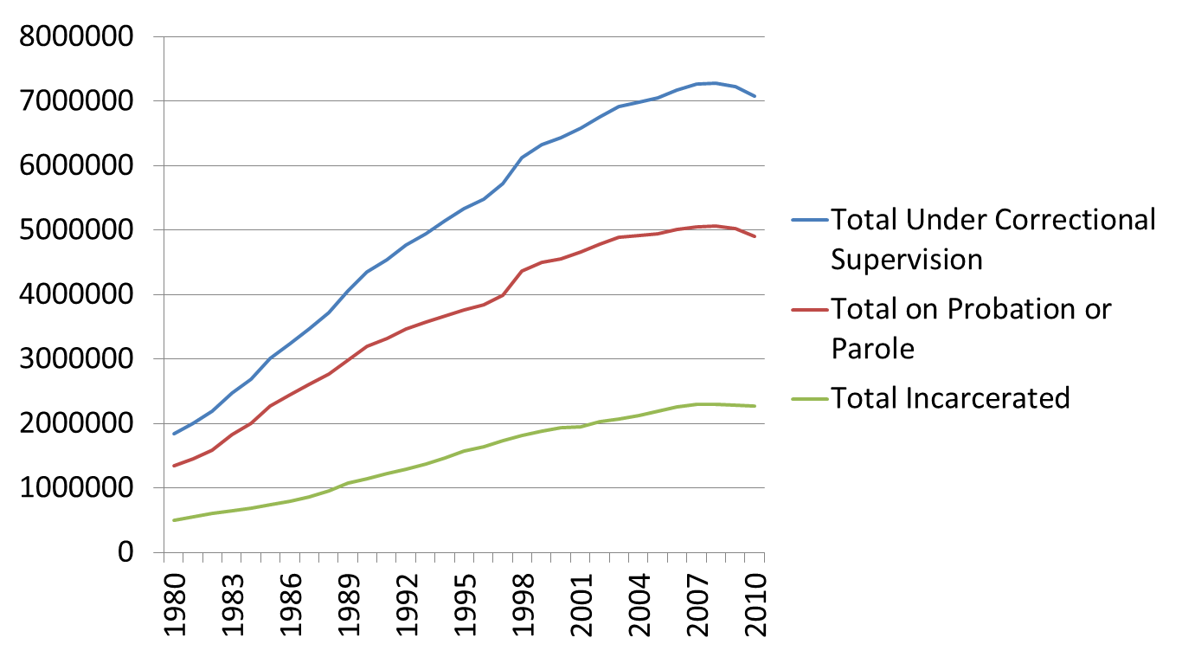
Trends in Adult Corrections, 1980-2010

Slide 20
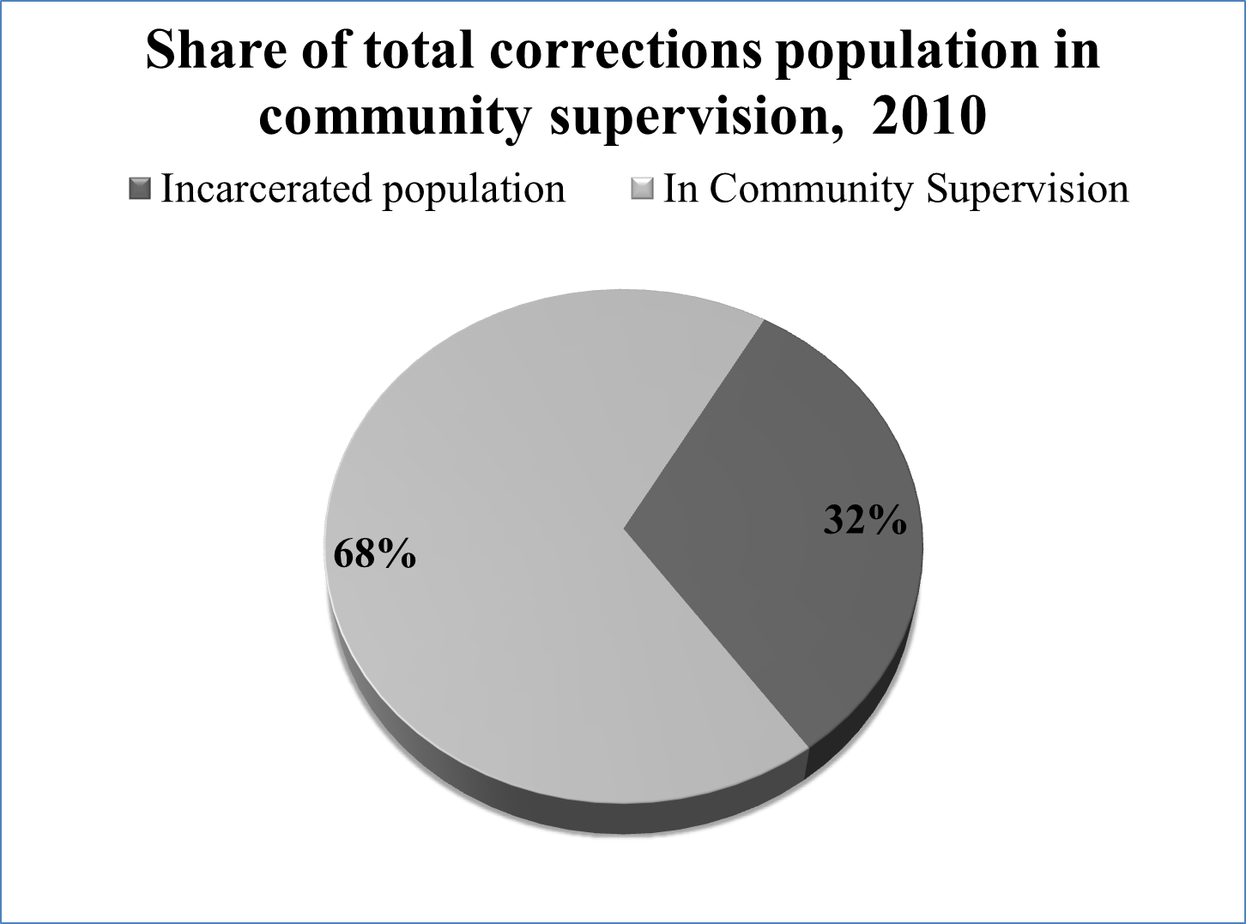

Slide 21
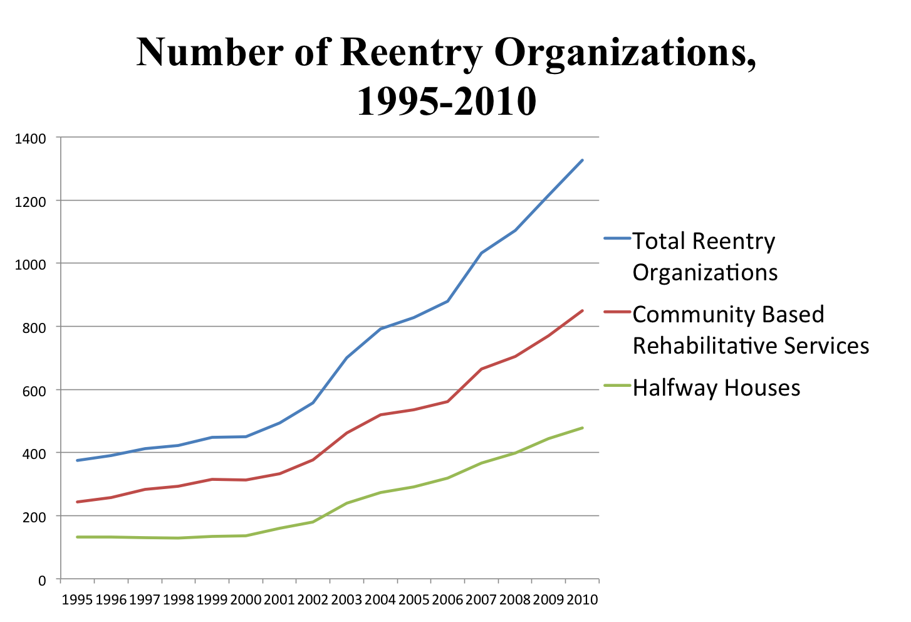

Slide 22


Slide 23
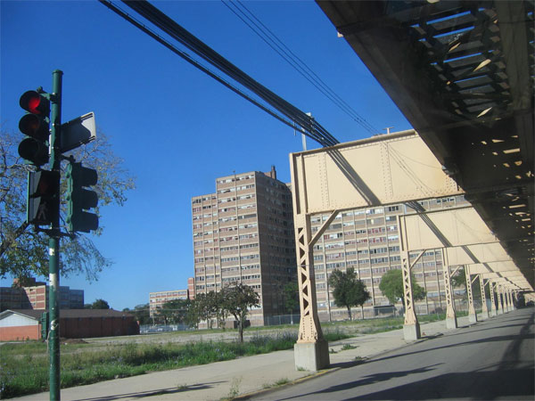

Slide 24
The “Work” of Work in the Reentry Scene
Reentry programming occurs across three strata
  1. Social Skills Groups
  2. Life Skills Groups
  3. Workforce Development Groups
Stakeholders make 3 claims about their work
  1. Rehabilitation is alive and well
  2. They do more than reduce risk
  3. They are foremost in the business of transforming lives

Slide 25
Inventory of Mission Statements
Just 1 of 30 reentry specific orgs. Mentions crime reduction in their mission statements
Recidivism, public safety, and substance use are respectively mentioned or alluded to once
Themes of personal transformation and Change in 21 of 30 organizations
Risk mitigation viewed as a by-product of a “transformed life”

Slide 26
Mission Statement:
  Hope’s Door: A third sector reentry organization
  “To operate a supportive housing program where the breath of a meaningful life is transferred from one person to another where, as we encourage recovery, embrace and teach healthy, positive values, family commitment, hard work, self-respect and responsible living, we are able to transform a once belittled life of addiction into an enlarged life filled with the promise of a more meaningful existence.” (Hope’s Door, A Third Sector Reentry Organization)

Slide 27
Mission Statement:
  Plowshares: IDOC Prisoner Reentry Program
  “The mission of Plowshares is to enhance the job skills of inmates by providing opportunities to address offending behavior and acquire qualifications and work experience in a real working environment and routine. We aim to transform patterns of destructive behavior into conscious life enhancing choices.”

Slide 28
Reentry Services
Employment is central to goals of reentry organizations
Despite this, just 4/30 organizations provide direct job placement
21/30 instead refer to workforce development programs

Slide 29
Workforce Development
Treatment Groups in Reentry sites as Human Capital Investment
Built around long standing economic argument suggesting unemployment due to “skills mismatch”
Work Release, vocational training and education vs. Work Force Development
The “Work” of work in Reentry Spaces
Notes:
Emergence of Work force development… Sustainable Employment is hard to come by… The “work” of workforce development

Slide 30
Workforce Development and the Project of Responsibilization
We’re not into entitlements.
…All we can do is get you dressed, teach you to tie a tie, write a resume, do an interview.
At the end of the day you’ve got to go out there. At the end of the day, it’s on you.
(Bryant, Director of Workforce Services)

Slide 31
Reentry as Cognitive Reframing
The main thing we try to get done with individuals is to get individuals to change the way they talk to themselves. That’s the main emphasis.
Because it’s not what you think it is. It’s only what you tell you.
Just starting the process of changing how you talk to yourself, that’s the most difficult challenge I encounter.”

Slide 32
Notes on the Aspirational Self
Personal Transformation is unattainable
Former prisoners submit to becoming a work in progress
A “transformed life” therefore is an aspirational category the ex-offender embodies rather than achieved status

Slide 33
Know your Role: Telling Ex-Convict Code
“I’m tired of people watching me, like I’m a animal or some shit, asking me fucking questions, bro… What do you want me to say. We got bed bugs and shit. You want me to say that shit?”
“I not fucked up. I don’t has that problem bro.” (Manny, former prisoners , three 1 year sentences)
“We all fucked up!” (Gary, 38, former prisoner, one 20 year sentence)

Slide 34
Implications for Theory, Policy and Practice
Social policy as stratifying (Esping-Anderson) and classifying (Bourdieu) machine (ala Wacquant 2012)
  Reentry as Human Capital Investment
    Addresses employment/employment skills mismatch hypothesis
  Reentry as Cognitive Reframing
  Reentry as Redemption Ritual
  Reentry as symbolic intervention

Slide 35
Implications for Theory, Policy and Practice
Social policy as stratifying (Esping-Anderson) and classifying (Bourdieu) machine (ala Wacquant 2012)
  Reentry as “People Changing” Institution (Hasenfeld, 1972)
  Reentry as “People making” process (Hacking, 1996)
  On race and dangerousness
    The Need for Transformation is both inscribed (via external identification, geography and demographic profile) and co-constituted through bureaucratic processes
    These processes affect how former prisoners are understood
    Indeed these processes affect how former prisoners understand themselves

Slide 36
Some Final Thoughts on Reentry
Reentry programs are not “bad” programs
  We need more reentry organizations
  We also need critical examination of all helping mechanisms…
Ex-offender as the New Urban Poor
Human Service Organizations as arms of the Penal State

Slide 37
Reentry as promise and problematic
Challenge dominant narratives to move beyond the “evidence base”
Reentry and Human Rights
Reentry and labor
Redemption and life transformation
  As promise, possibility, and problematic
“My point is not that everything is bad, but that everything is dangerous, which is not exactly the same as bad. If everything is dangerous, then we always have something to do. So my position leads not to apathy but to a hyper- and pessimistic activism.” (Foucault 1983)

Slide 38
Acquiescence
When I got here I was like, fuck this group shit. I’mma go over to the “Tech center” and get on the computer. Get my black ass up outta here.
I don’t know shit about no computer man. I’m computer illiterate.
So I had to sit down and do these groups. I need these groups man.
That’s all I’m going to say about that man. That’s all I got. (Dante, 4 month Emmaus Resident)_

Slide 39
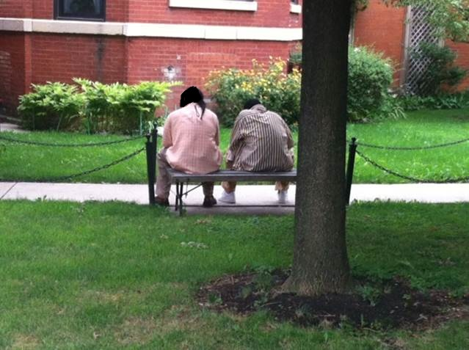
Q and A

Slide 40
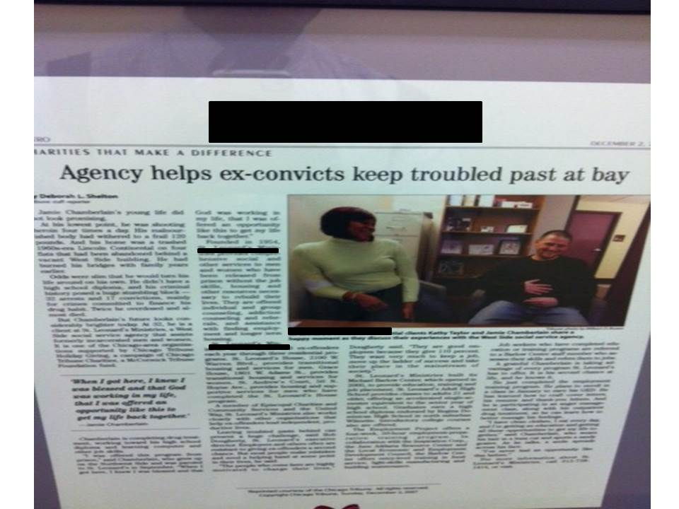

Slide 41
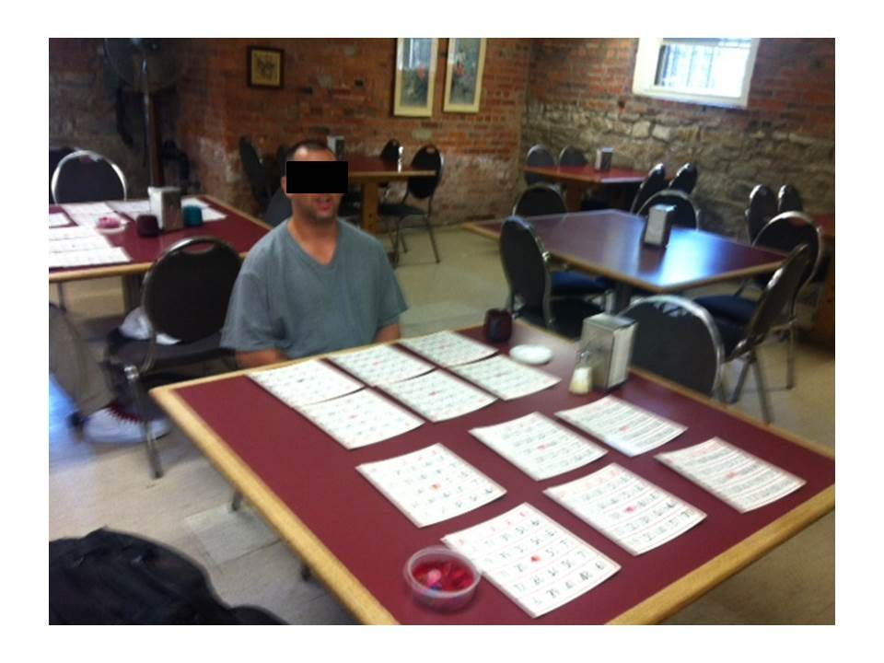

Slide 42
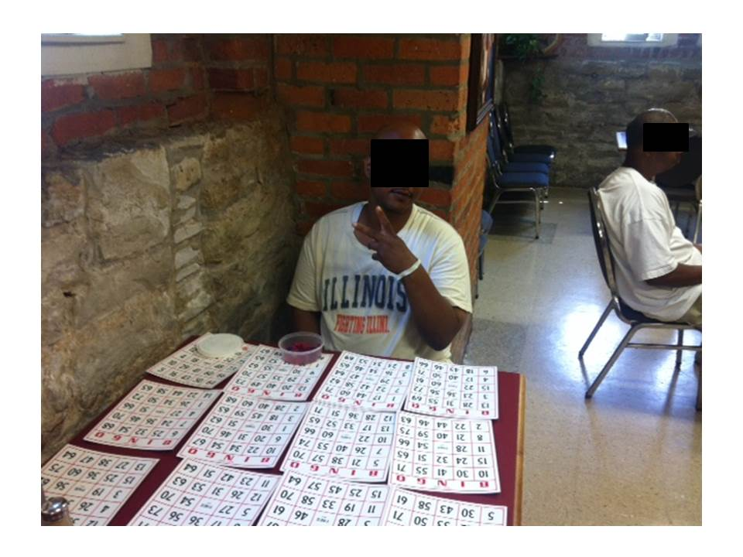

Slide 43
