Slide 1

Decision-making research:
Escaping the Top-Down Mentality?
Offender Supervision and Decision-Making in Europe, Bratislava 2013
Prof dr Cyrus Tata
Strathclyde Centre for Law, Crime and Justice, Scotland

Slide 2
What are we trying to compare?
Types of systems?
Prevalent principles/ideologies?
Co-relations in decision-making?
Decision-making process?

Slide 3
Where are the gaps?
Boone & Herzog-Evans & assoc authors 2013:
“The most striking finding from this literature review is that there is a paucity of research on the decision-making process itself, on the influence that different agencies have on each other, and whether different construction/ organisation of d-m processes could lead to different outcomes.” [original emphasis retained]

Slide 4
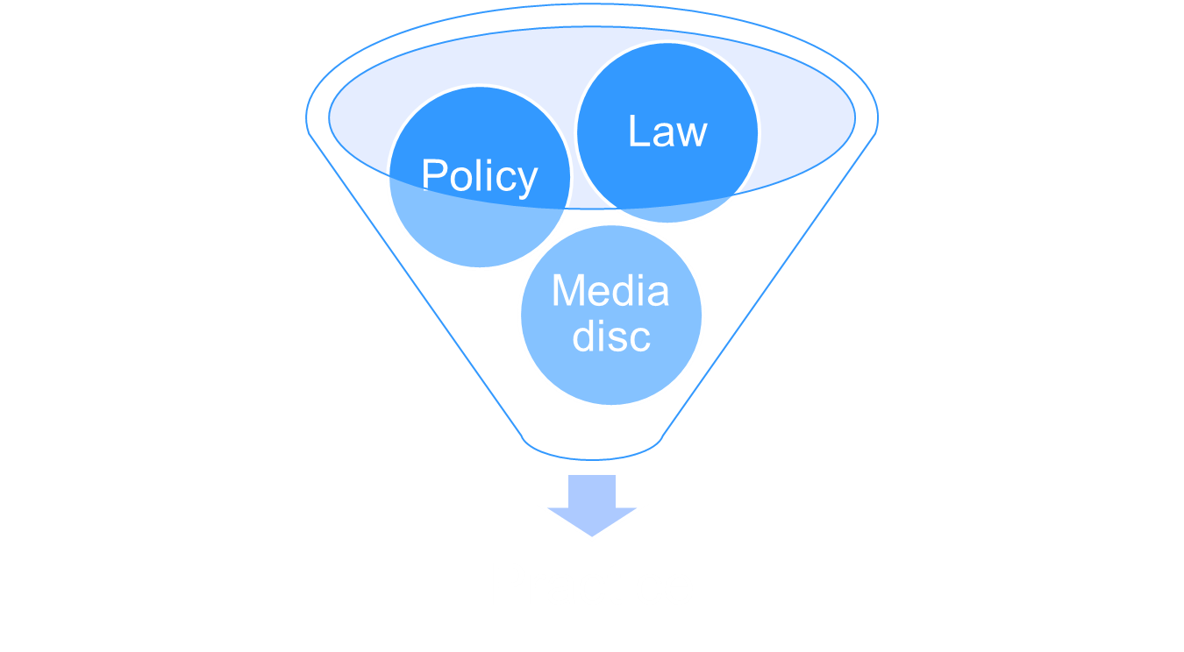
Practice as a by-product of bigger things?

Slide 5
Top-Down Change more or less Inevitable
A new configuration does not fully and finally emerge until it is formed in the minds and habits of those who work in the system. Until these personnel have a settled habitus appropriate to the field, enabling them to cope with its demands and reproduce it ‘as a matter of course’, the process of change remains partial and incomplete. (Garland 2001 p. 24, emphasis added except ‘habitus’)

Slide 6

Sketch to colour in?

Slide 7
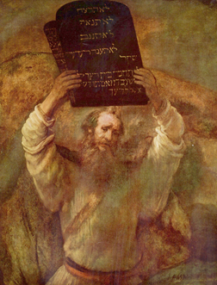
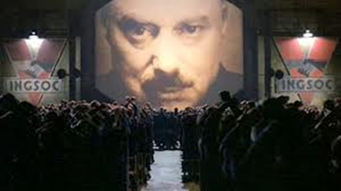
Top-Down Assumptions are hard to escape
Top-Down (Progressive/utopian)
Top-Down (Regressive/dystopian)

Slide 8
Top-Down Normative Binaries Street-level research should try to Avoid
Intellect vs Emotion
Explicability vs Intuition
Rules vs Discretion
Reason vs emotion
Principle vs caprice
Act (offence) vs Actor (offender)

Slide 9
Intellect vs Intuition
Hostility to intuition as mystification
But still explicable
Pre-dominance of ‘Analysis’ of ‘factors’

Slide 10
Factor analysis
Behaviorist S-R Model
Quasi-mechanistic
Variables with own discrete power (eg Hogarth 71 – sentencing as an individual intellectual exercise)
Pull apart then try then to reassemble the pieces
But how are ‘factors’ decided?
Weak on relational meaning

Slide 11
Eg SIS
How to record and represent cases meaningfully to judges?
Eg Multi-offence cases are not adequately recorded in official data
Principal Offence not enough – add in info as individual factors – additive, piecemeal model
‘Whole Offence Approach’ - holistic
Offender not meaningfully represented
Need to merge into recognisable ‘typified whole case stories’

Slide 12
Principle vs caprice?
The search for ‘coherent’ explanation
Why are Judges’ reasons so ‘incoherent’?
Coherent to whom and what?
But penal-philosophical ‘incoherence’ is subjectively coherent!
Can you directly observe pure thought?
Accounts - socially contingent (though not completely)

Slide 13

Rules vs discretion
Dworkin (1977) Taking Rights Seriously

Slide 14
Why is Rules vs Discretion empirically misleading?
Makes sense at level of public discourse but not at routine street level
At street level, Rules & Disc not opposites, but mutually constituitive.
Inter-play of ‘rules’ with ‘facts’ creates meaning
Which applies to which?
‘Discretion’ to expand or deny ‘discretion’!

Slide 15
Case construction
Starting pt for both inter- and intra-jurisdictional research?
Process makes cases
How are cases?
What are the ‘typified whole case stories’?
How are they understood by different penal actors?
Eg multi-perspectives on same info
Serial – pre and post cues

Slide 16
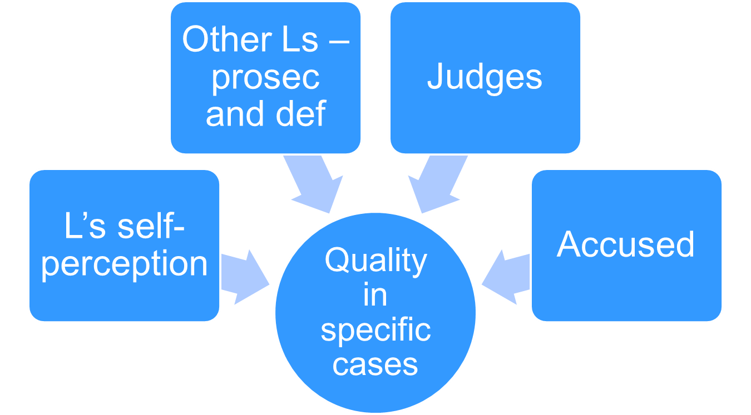
Study of quality of Defence work (Tata 2007)

Slide 17
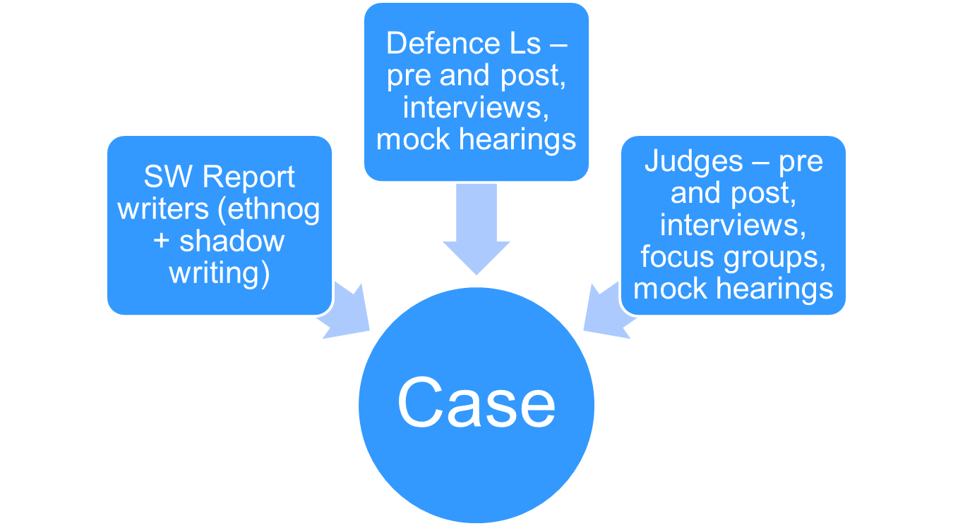
Multi-Perspective Research on same cases Eg Pre-Sentence Reports study

Slide 18
Mr Laverty
SER: Education/Employment. The accused began his education at [name] Primary School and transferred to [name] School at the age of 7 years because of learning difficulties. He reported he enjoyed school and found the smaller classes beneficial in comparison to mainstream education…. Conclusion. During the interview Mr [Laverty] was cooperative, although vague at times, although this may have been due to his perceived level of comprehension.
Shadow Report Writing Diary: Tricia mentioned his learning difficulties because she wanted to highlight to the [judge] that the level of understanding may be an issue [diary case 25 Mr Laverty]

Slide 19
Skipping a point
Intv: ‘Education and employment’: anything interesting or valuable?
J5: All I picked up from that was that he hadn't worked for some time and I mean, that's possibly a problem.
J14: Yeah, for me all of this biographical material is useful in this kind of case.
Intv: What about, it's mentioned here, “his school behaviour suffered because of learning difficulties”[…] so how does the mention of that…?
J5: I have to say I skipped over that. [Focus group 7]

Slide 20
Mr Laverty
Diary [Immediately after] Mr [Laverty] leaves, [Tricia] sighs: “I’ll need to do a home visit.” She’s not happy about the amount of information she received…..
[After the home visit to Mrs Laverty] On the way back in the car, [Tricia] tells me that she found the meeting very useful. Useful in that it confirmed much of what he had said about his own circumstances; about what happened during the offence; and about his reluctance to access services. [diary post home visit, case 25]

Slide 21
Corroborating accounts
“Basis of Report. This report is based on one interview with the accused in the Social Work Department and one interview with his wife at her home.
Both Mr and Mrs [Laverty] described a good marital relationship, and stated that difficulties seem to arise when they have both been drinking. [The report then alternates between information provided by Mrs then Mr Laverty. […]
Conclusion : During interview Mr [Laverty] was cooperative, although vague at times […] However, his wife confirmed some of his statements, which indicated he had been truthful […]” [SER southpark case 25]

Slide 22
Corroborating Accounts
J5: Well I was horrified that the wife was interviewed at the same time as the accused. I think that's very bad practice.[…] So I have to say I was seriously unimpressed with this report. [emphasis added]
J 14: I agree, uh-hu.
J 5: It's really astonishingly bad practice to interview him alongside the wife. And if she is the victim of serious domestic abuse then of course she's going to support him because she's caught in a trap with him. She's not going to have the confidence or the self-esteem to contradict him. So I think this one is very bad practice. […]
J 14: I agree that she should have been seen independently…. I think that these things ought to be done because the wife may have been intimidated by his presence, so agree with you, that is not appropriate and she should have been seen privately [emphasis added]

Slide 23
Corroborating Accounts
J5: He doesn’t realise how lucky he is to have such a supportive wife.
J 14: I think the jury's out with the social worker as to whether or not this is a serial abuser or whether or not there's potential for [change]. And the fact that the wife was there and he has made the right noises and he's never had probation before would tilt me in that direction to give it a chance. [Focus Group 7, emphasis added]

Slide 24
Conclusions
We won’t understand street level decision-making processes if we import top-down assumptions
Process Constructs Cases
Typified Whole Case Stories
Multi-perspectives
Multi-moment decision-making
Reasons will be ‘incoherent’

Slide 25
A few References
Beyens K and Scheirs (2010) ‘Encounters of a different kind’ Punishment and Society 309-328
Boone, M and Herzog-Evans, M. (2013) ‘Offender Supervision and Decision-Making in Europe in K.Beyens and F.McNeill (2013) Offender Supervision in Europe (Palgrave) In press.
Cheliotis, L. (2006) ‘How Iron is the Iron Cage of New Penology?’ Punishment and Society 8(3): 313-340
R. Dworkin (1977) Taking Rights Seriously (OUP)
Garland, D. (2001) ‘The Culture of Control’ (Oxford: Oxford University Press)
McNeill, F, Tata, C., Hutton, N. Halliday, S (2009) ‘Reconfiguration and Hysteresis’ Punishment & Society: The International Journal of Penology Vol. 11 No.4 pp 419-442
C. Tata (2007) ‘In the Interests of Commerce or Clients? Supply, Demand, and “Ethical Indeterminacy” in Criminal Defence Work’ The Journal of Law & Society Vol.38 No. 4 pp 489-519.
Tata, C. (2007) ‘Sentencing as Craftwork and the Binary Epistemologies of the decision process’ Social and Legal Studies 16: 425-447
Tata, C., Burns, N., Halliday, S., Hutton, N., McNeill, F. (2008) ‘Assisting and Advising the Sentencing Decision Process: the Pursuit of “Quality” in Pre-Sentence Reports’ British Journal of Criminology 48: 835-855

Slide 26

E: Cyrus.Tata@strath.ac.uk

