Slide 1



Doing probation work: identity in a criminal justice occupation
Rob Mawby, University of Leicester
Anne Worrall, Keele University

Slide 2
Context
Change and the Probation Service
  eg, structure, training, role and practices
Turbulent criminal justice context
  eg, budget cuts, penal populism, negative media discourses
Impact on probation workers?

Slide 3
Key questions
What are the characteristics of contemporary probation cultures as perceived by probation workers?
How do probation workers interact with other CJ agencies and how do they perceive this interaction?
How do they respond to the turbulent conditions in which they work?
What is the impact of this understanding on offender management?

Slide 4
The study
ESRC funded, 20 months, 2010-2011
Supported by Probation Chiefs Association
Small scale and reflective
60 interviews completed:
  26 current PSOs, POs, SPOs (PWs)
  10 Trainee Probation Officers (TPOs)
  16 Chief Officer Grades (COs)
  8 former & retired probation workers (FPWs)
  North and South-East England locations

Slide 5
Choice of methodology
Why no observation?
Construction of identity through telling stories
Building on researcher knowledge and experience
Cross between oral history and semi-structured interviews
Purposeful conversations

Slide 6
Access and other practicalities
Basic sampling – no claim to statistical representativeness
Range of experience and demographics
Building on personal contacts
Finding sympathetic gate-keepers
Randomised self-selection

Slide 7
Doing the interviews
Preparation on both sides – no ambushing
Over-estimating time to ensure a relaxed interview
Active interviewing – listening, feeding back, joint reflection, simultaneous analysis
Deliberate bumbling and rambling

Slide 8
Ethical issues
Consent for archiving
Anonymity for elites
Offering transcript checks
Keeping participants informed as project progressed
Interim report conference

Slide 9
Analysing the data, emerging themes
Transcribe recordings
Transcript summaries – joint reading
Agreed themes and re-reading for coding
Emerging themes included:
  Biographical and motivational groupings
  Computers and open plan offices
  Long hours, office-bound
  Police good, NOMS bad
  No-one understands us
  Loss of autonomy, desire to be creative
  Job crafting and coping with turbulence
  Feminisation?

Slide 10
Neglect -
lax behaviour
(Farrell 1983)
Exit -
actual or imagined
Voice -
speaking up
Loyalty -
belief in the organization
(Hirschman 1970)
Edgework –
voluntary risk-taking,
testing the boundaries
(Lyng 1990)
Probation worker responses
Organizational Expedience -
rule stretching to achieve goals
(McLean Parks et al. 2010)
Organizational Cynicism -
loss of faith in organization
(Naus et al. 2007)

Slide 11
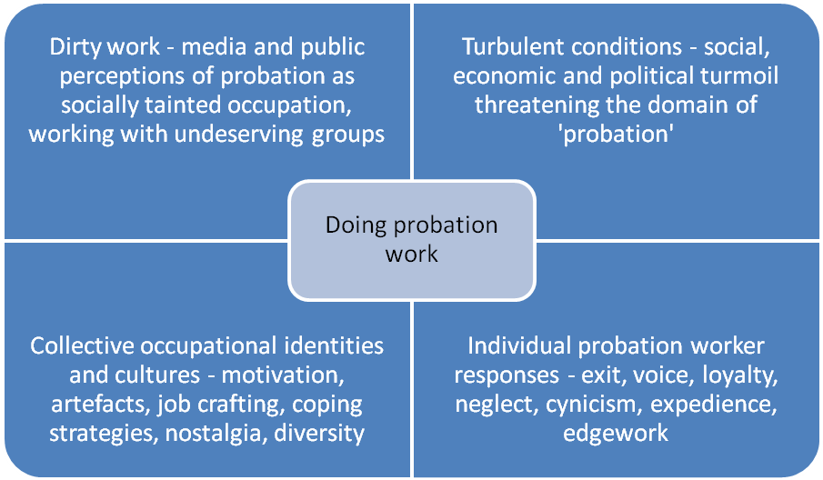
The square of probation work
Source: Mawby and Worrall (2013) Doing Probation Work, London: Routledge

Slide 12
Publications
Mawby, R.C. & Worrall, A. (2013) Doing probation work: identity in a criminal justice occupation, Routledge 182pp.
Mawby, R.C. & Worrall, A. (2013) ‘Probation worker responses to turbulent conditions: constructing identity in a tainted occupation’, Australia and New Zealand Journal of Criminology, 46, 1: 101-118.
Worrall, A. & Mawby, R.C. (2012) ‘Unlikely edgeworkers: probation workers and voluntary risk-taking’, ECAN Bulletin 13, Howard League, pp.6-9.
Mawby, R.C. &Worrall, A. (2011) ‘”They were very threatening about do-gooding bastards”: Probation’s changing relationships with the police and prison services in England and Wales’, European Journal of Probation, 3, 3: 78-94.
Worrall, A. & Mawby, R.C. (2011)’It is rocket science: the role of the probation worker in turbulent times’, Britain in 2012, ESRC annual magazine, p.25.
Worrall, A. & Mawby, R.C. (2011) ‘Probation workers – still the servants of the court?’ Magistrate, Winter, p.12.
Mawby, R.C. & Worrall, A. (2011) Probation workers and their occupational cultures, University of Leicester, www.le.ac.uk/criminology

