Slide 1
Crime & Punishment
P7, XXXX Primary School
21st January 2014

Slide 2
Punishment
Think of as many examples of different forms of punishment as you can… This could be:
  At home
  At school
  In court
Why do people get punished? What is punishment supposed to achieve?

Slide 3
Fair and unfair punishments
Think of an example of unfair punishment. It might be from home or school, or something you have seen on the TV or at the movies.
What made it unfair?
  Was it something to do with the way the punishment was decided?
  Was it something to do with the specific punishment that was chosen?

Slide 4
Ordering crimes
Stealing from a shop
Stabbing someone with a knife
Shouting and swearing at someone
Punching someone in the face
Telling lies in court
Murdering someone
Dangerous driving
Selling illegal drugs

Slide 5
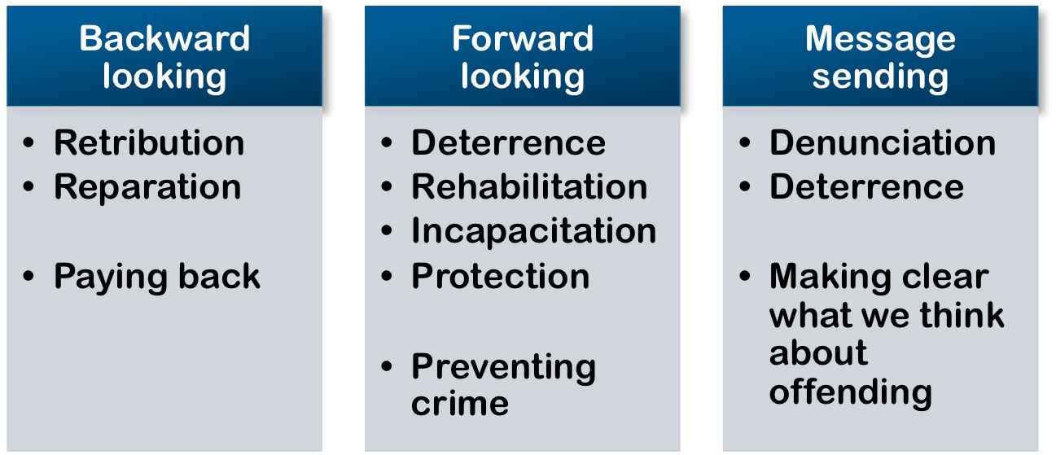
Purposes of punishment

Slide 6
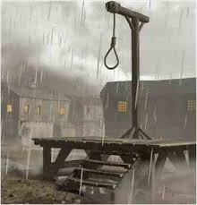
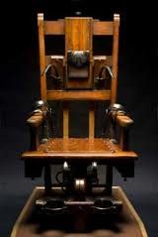
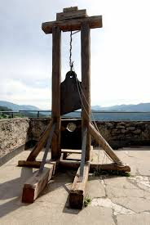
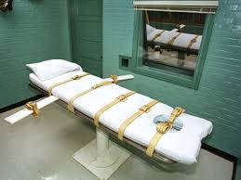

Slide 7
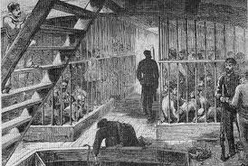
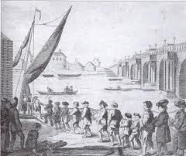

Slide 8
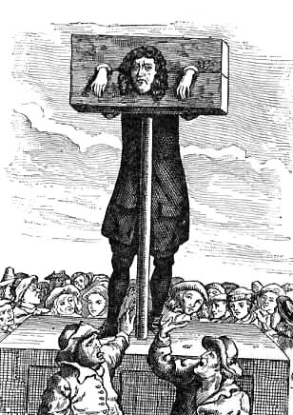
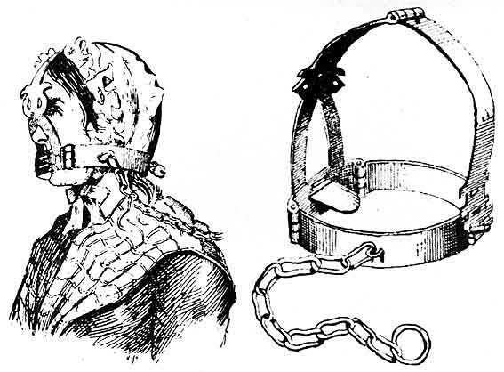

Slide 9
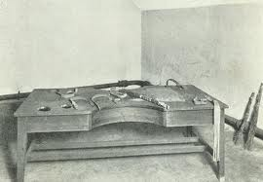

Slide 10
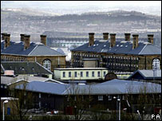
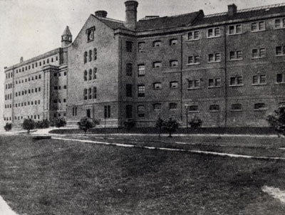
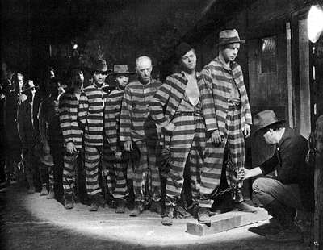
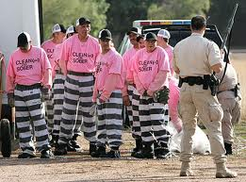

Slide 11
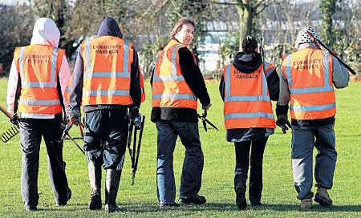
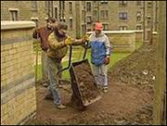
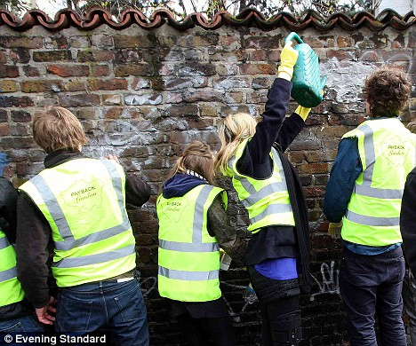

Slide 12
Ordering punishments
Fines
Flogging/Whipping
Unpaid work
Execution
Supervision
Imprisonment
Warnings

Slide 13
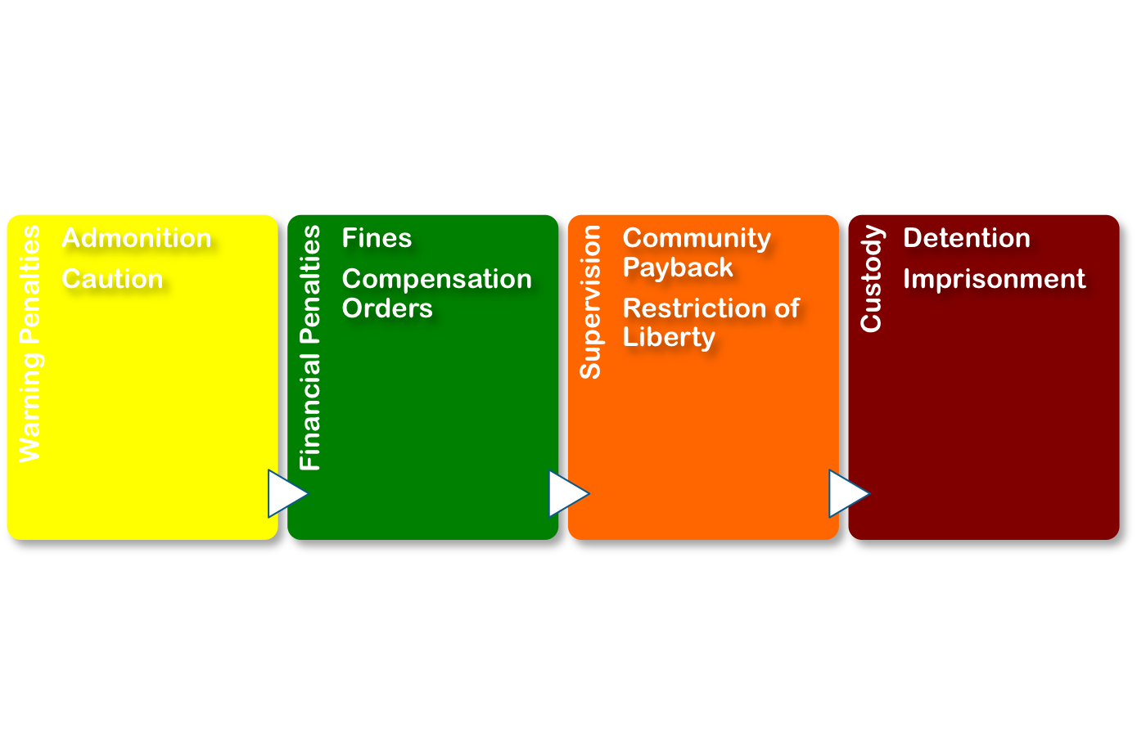
Kinds of sentences

Slide 14
You be the judge
Robert Johnson breaks into a house in the night. He breaks a window to get in. No one is at home. He steals a TV and an iPad; goods worth about £1,000. The cost of repairing the window is £250.
Robert has been in trouble before; he has two convictions for stealing from shops.
What sentence would you pass?

Slide 15
A little more information
The owner of the house is an old lady called Mrs Beech. She is a widow and lives alone. She has been in hospital at the time of the break-in. She doesn’t get out much anymore and relies on the TV for news and entertainment. Her iPad held all the photos of her grandchildren who live in Australia and she used it to Skype them regularly. She has house insurance and can get the TV and iPad replaced (and maybe the photos too), but she has been left scared about living on her own. She fears the thief might come back.
Does this information make you want to reconsider the sentence you gave Robert?

Slide 16
And some more information
Robert is 21. He is a drug addict and is homeless. He has been living on the streets since he was 15, when we ran away from a children’s home. He was in the home because his mum couldn’t look after him properly because of her drug problem. He doesn’t know his dad.
He says he broke into the house because he was desperate for money. He has a son (aged 3) who lives with his ex-girlfriend. He wanted to be able to buy his son something nice for Christmas. He didn’t have any money because (a) he can’t work because of his drug problem and (b) his benefits had been stopped when he missed appointments (also because of his drug problems).
Does any of this information change the way you would sentence Robert?

Slide 17
And some more…
You delayed sentence on Robert because he had made plans to go into drug rehab and sort himself out. You wanted to see if he was serious about that. He was. He completed the programme and has been drug free for 6 months; he’s back in regular contact with his ex-girlfriend and son and has just started a college course. He’s also now a volunteer helper in the drug rehab.

Slide 18
And finally…
During his time in the rehab, Robert wrote a letter to Mrs Beech and, after some careful planning, they met up. He apologised and explained why he had done what he had done. Mrs Beech was relieved to find that he hadn’t targeted her house for any particular reason. She was also very glad to know that he was sorting his life out. She and Robert agreed that he would spend the next 2 or 3 weekends tidying up her garden as a way of saying sorry.
The time has come to pass final sentence on Robert. What will you do?

Slide 19
Stopping Offending
What might help keep Robert out of trouble and off drugs in future?
  Getting older and becoming more mature; learning to think things through before acting
  Getting an education, a job and a house; being able to be a good dad
  Thinking differently about himself; realising he can be a good person and lead a good life.

Slide 20
Supervising Robert
If you were Robert’s social worker and had to supervise him for a year or two, what sorts of things might you do with him or for him to help him keep out of trouble?

Slide 21
Any questions?

