Slide 1
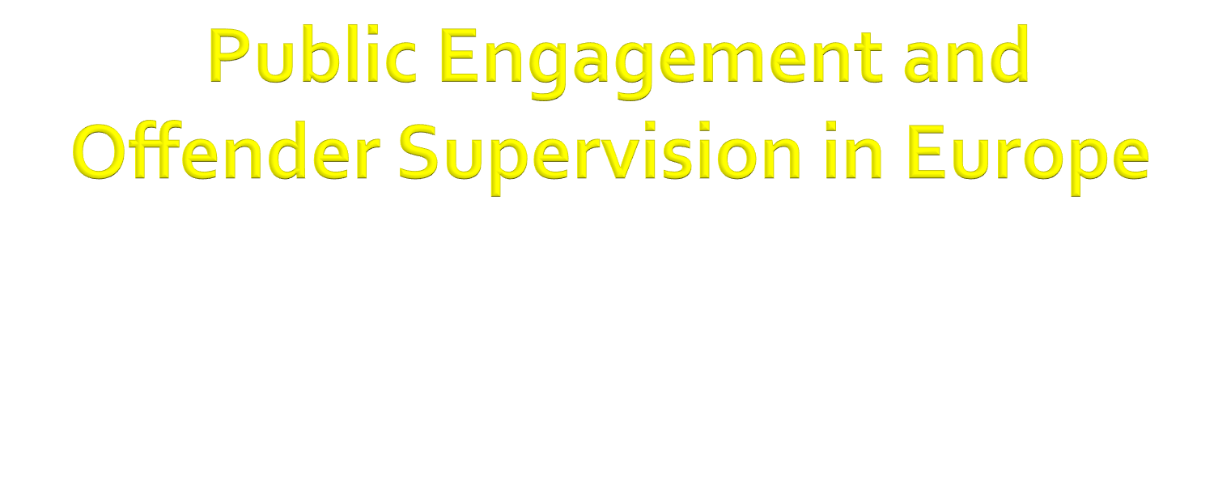
“We would esteem our research not worth the labour of a single hour if its interest were merely speculative. If we distinguish carefully between theoretical and practical problems it is not in order to neglect the latter category. On the contrary, it is in order to put ourselves in a position where we can better resolve them”. [Durkheim, 1984:xxvi]
Fergus McNeill
University of Glasgow
Fergus.McNeill@glasgow.ac.uk
Twitter: @fergus_mcneill

Slide 2

Training Schools within the framework of the Action topic are aimed at:
• Widening the knowledge of the Action activities.
• Providing intensive training on a new and emerging subject.
• Offering familiarisation with unique equipment or know how in one of the laboratories of the Action.
Training Schools are not intended to provide general training or education. Those attending a Training School are typically – but not exclusively – young researchers from across Europe. Furthermore, Training Schools may also cover appropriate re-training as part of life-long learning.
A Training School can also take the form of an Early Stage Researchers (less than PhD + 8 years) network created as a "think tank".
COST support covers organisation of the school and participation support to both trainers (including external experts) and trainees.
Duration of 3 days to 2 weeks

Slide 3

Policy and Practice Transfer
  One idea: a networked project of key informant interviews with (serving or retired) probation leaders, that seeks to (literally?) map the travel of ideas about, discourses of and techniques for supervision practice?
  Risk, programmes, accreditation, desistance?
  Is this a project for all/any of us or does it belong to WG3 Practising Supervsion?

Slide 4
We promised public engagement…
  European institutions
  National policymakers
  Managers, practitioners, inspectors, educators
  Non-state providers
  NGOs, think tanks, reform groups
  Media and general public

Slide 5

Professional sociology
  represented by the traditional academic generating new knowledge by defensible methods, accountable to his or her peers in an essentially self-referential system)
Policy sociology
  concerned with concrete knowledge for effective policy, serving policy clients and interests)
Critical sociology
  pursuing foundational knowledge, driven by moral vision, tending towards the dogmatic
Public sociology
  seeking communicative knowledge, drawing legitimacy from relevance, accountable to a series of constituencies… and tending towards the faddish

Slide 6

Criminology as a successful failure
  Academic growth; policy irrelevance
Passive toleration
  Divisions and divisiveness
Takeover
  Methodological fundamentalism
Divorce
  Categorically compromised
  Splitting the assets and going back to parents

Slide 7

How to address the heating up of the penal climate?
PC as climate change activists
  Lonely prophets and social movement theorists/activists
PC and cooling devices
  Scientific experts, policy advisors and observers turned players
    What works, new technologies and techniques, legal restraints, policy insulation

Slide 8

Loader and Sparks (2010)
  What is the role and value of criminology in a democratic society? How should we engage with politics and public policy [...and practice?]
Democratic under-labouring for ‘a better politics of crime and regulation’
  The moment of discovery
  The institutional critical moment
  The normative moment
Notes:
Democratic under-labouring involves three ‘moments’; the moment of discovery (of new knowledge about and constructions of ‘problems’ and ‘solutions’), the institutional-critical moment (which generates new knowledge that challenges existing systems, cultures and practices), and the normative moment (which engages with the moral dimensions of and value judgments at stake in criminal justice).

Slide 9
‘If one was to encapsulate all the above in a single phrase it would be this: intellectual ambition, political humility. Democratic under-labouring brings coherence to criminology’s public role by combining intellectual curiosity and generosity on the one hand, with political humility, the knowing of one’s limits and one’s place, on the other’ (Loader and Sparks, 2010: 132).

Slide 10

“I want to both congratulate and chastise Ian Loader and Richard Sparks for their oddly titled book, Public Criminology? (Loader and Sparks 2010, henceforth PC). I will make my remarks brief and pointed for the sake of provoking and then reorienting the discussion away from textualist disquisitions on the hoary label of ‘public’ (enter discipline) and towards the political economy of the production, circulation and consumption of criminological knowledge in the age of escalating inequality and pornographic penality” (Wacquant, 2011: 438).

Slide 11

Public sociology in the USA
  ‘…an occupational charade whose ironies are too many to recount here’ (p440)
What kind of reflexivity is required?
  Not personal or textual so much as epistemic reflexivity: the social conditions and techniques of production of [criminological] knowledge.
What kind of typology is required?
  Not one based on the subjectivities of the actors as one based on objectivist account of the production, distribution and consumption of their ‘knowledge’

Slide 12

Peers, participants, publics, communities
  With whom do we engage and refuse to engage, why and to what effect (e.g. Transforming Rehabilitation)?
Ethics, codes and rules
Rights and duties
…Or virtues
  What is it to be a ‘good’ or a ‘bad’ social scientist? Is that just a question of knowledge and skills?
  Are there any distinctively social scientific virtues (reflexivity; a particular kind of imagination; a special sensitivity to our own positionality and its ‘conditioning structures’)?
  Or are there just some general virtues that matter especially in the context of doing social science well?

Slide 13

Unless we cast ourselves as strict objectivists (and perhaps realists), to one degree or another we must admit and analyse our own positions and dispositions in the process of knowledge production and exchange (as well as the conditions that influence these positions and dispositions).
We always tell ‘partial stories’ but when exactly does partiality become partisanship?
  “Why, Mr McNeill, do you only ever criticise the methodology of studies you disagree with?”
Does an explicit moral or political stance augment or weaken our arguments and our credibility?
E.g. Changing Paradigms: Research publications and academic credentials as cultural resources in multiple fields (or sites of struggle)…

Slide 14
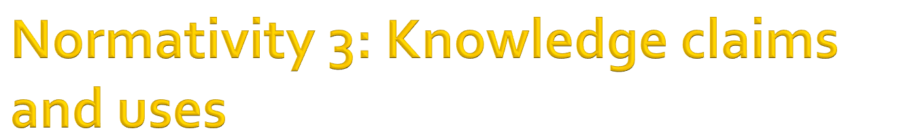
What exactly is special or distinctive about the knowledge claims we make…?
And how does that relate to the questions of how, for whom and to what effect our knowledge is used?
What do we do about ‘dangerous’ knowledge, or knowledge that is vulnerable to misappropriation?
  E.g. When anti-managerialist, anti-positivist messages become resources for de-professionalisation…
What are the challenges of co-producing knowledge with others with different positions and dispositions?
  E.g. The Desistance Knowledge Exchange Project

Slide 15

Loader and Sparks (2010)
The scientific expert
The policy advisor
The observer turned player
The social movement theorist/activist
The lonely prophet
And the consultant…

Slide 16

“We would esteem our research not worth the labour of a single hour if its interest were merely speculative. If we distinguish carefully between theoretical and practical problems it is not in order to neglect the latter category. On the contrary, it is in order to put ourselves in a position where we can better resolve them”. [Durkheim, 1984:xxvi]
If Durkheim is right, then we need a social science of and for critical and reflexive engagement, not just enlightenment.

Slide 17

‘Supervision 360’
  In the process of developing our funding proposals and pilot studies, we build in public engagement (or plans for it) from the outset.
  We aim for our final conference to be as much a public event as an academic one: a day on which we make OS visible and intelligible, through collaboration with others (people who have experienced supervision, practitioners, policymakers, artists?)
  Maybe we can seek funds for ‘artists in residence’?

Slide 18

Burawoy, M. (2004) ‘Public Sociologies. Dilemmas, Contradictions, Possibilities’ Social Forces 82, 1613-26.
Durkheim, E. (1984)[1893]. The Division of Labour in Society. New York: Free Press.
Loader, I. and Sparks, R. (2010) Public Criminology? London: Routledge.
Wacquant, L. (2011) ‘From ‘Public Criminology’ to the Reflexive Sociology of Criminological Production and Consumption. A Review of Public Criminology? by Ian Loader and Richard Sparks (London: Routledge, 2010)’, British Journal of Criminology 51: 438-448

