Slide 1
The Future of Probation in Europe: Practice, Research and Knowledge Exchange
Fergus McNeill
University of Glasgow
Fergus.McNeill@glasgow.ac.uk
@fergus_mcneill

Slide 2
This paper assesses probation’s current position in Europe and speculates about its prospects. More specifically, it draws on the 4 year programme of work of the COST Action IS1106 on Offender Supervision in Europe to examine the roles that research and knowledge exchange might play in shaping how probation *should* develop in future.

Slide 3
‘Mass supervision’
Aebi, Delgrande and Marguet (2015) have revealed that… the numbers of people subject to offender supervision have grown significantly (if unevenly) in almost all European jurisdictions in recent years. Seventeen of the 29 countries in their review now have more people under supervision than in prison. Perhaps more importantly, they show that this cannot be explained by crime rates and, crucially, that it has not led, as advocates of such sanctions often hope, to a reduction in the use of imprisonment. Indeed, seven of the countries with the highest probation rates are also among the top ten in their rates of imprisonment. Aebi et al.’s (2015) work therefore suggests that the expansion of these forms of sanction has led to widening of the net, sweeping more European citizens into diversifying forms of penal control.
See: http://pun.sagepub.com/content/17/5/575.refs, accessed 4th March 2016.

Slide 4
‘Mass supervision’
A question of scale?
A question of distribution?
A question of weightiness (intensity)?
A quality of mis/treatment?
Individualisation versus dividualisation

Slide 5
The Action (in numbers)
4 years (2012-16)
23 countries, 60+ active members
8 MC meetings, 26 WG meetings, 9 STSMs, 4 core group meetings, 2 workshops, 1 training school…
…events hosted in at least 13 countries

Slide 6

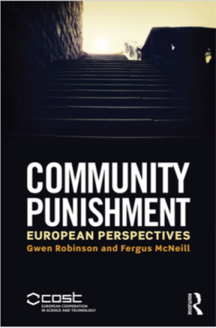
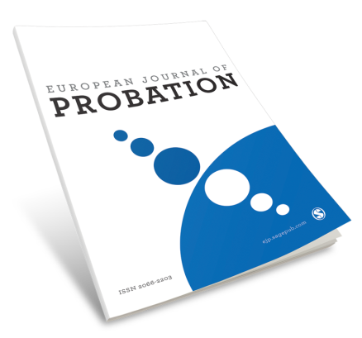
The Action (in numbers)
2 books (and one more to come)
2 special issues of EJP
63+ blog posts, 3 annual newsletters, 13 working group briefing papers, 9 reports from short-term scientific missions, 8 other reports, 12 audio recordings and one final report…
3 exhibitions, 1 song-writing workshop and 1 performance!
About €700,000 in new research funding, so far

Slide 7
The Action (in numbers)
Six research pilots
Comparative vignettes tested in 12 countries
Eurobarometer tested in 8 countries (2 planned)
Supervisible run in 3 countries (5 planned)
Visualising practice run in 5 countries
Observing practice run in 5 countries
Practice diaries run in 6 countries

Slide 8

Contextualising supervision
In ‘Community Punishment’, we compared the evolution of OS in 11 countries
Evolution of the field of supervision (within the penal state)
Four narratives, plus ‘state-building’
Evolution within the field
A clearer grasp of the past, the present and of possible futures

Slide 9
Experiencing supervision
Barometer
OS mostly a positive experience, but highly variable across and within countries, especially in the extent of practical help provided
Supervisible
OS has an immanent, pervasive quality in which people are made subject to life-altering and freedom-limiting conditions and live under the constant threat of further (worse) sanctions being imposed should they be judged as somehow ‘failing’. Their status as semi-free citizens feels precarious. Being supervised in a fair and helpful way may make these pains easier to bear, but it does not remove them

Slide 10
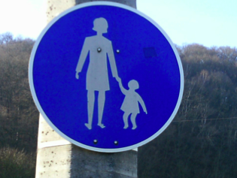
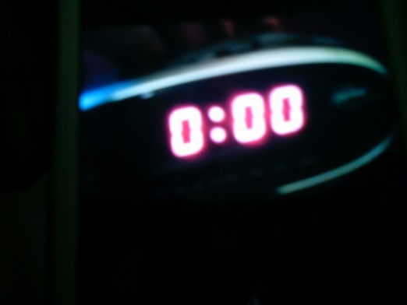
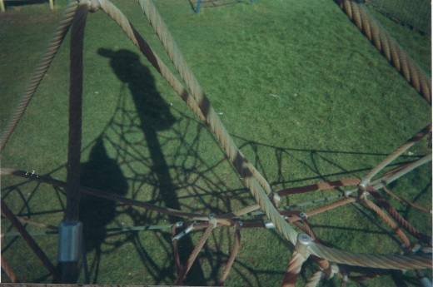
Representing probation
Tick by tick and line by line
You weave yours and I’ll weave mine
A web of shadows
A silk-spun tomb
A windowless room
Hold my hand and let me go
The things I know I can’t unknow
Let me go, please hold my hand
It’s time to fly, I know I can

Slide 11
Decision-making and supervision
Decision-making processes poorly understood (yet key to legitimacy).
Striking similarity in relation to the types of groups that are typically excluded at sentencing; e.g. foreigners, mentally ill people etc.
Considerable differences between jurisdictions in the dynamics of decision-making. In many countries decision-makers use much more discretion than is technically provided for by the law.

Slide 12
Practising supervision
Research relies too much on interviews
Great variation in practice, as much within a jurisdiction as between jurisdictions.
Yet, evidence of a common ‘habitus’ of offender supervision: an approach or disposition that is recognisable in offender supervision in different jurisdictions and settings

Slide 13
European norms, policy and practice
Policy transfer and penal politics
The limits of ‘What works?’: Rehabilitation as correction or as a right?
Appeal, fit and system effects (vs. ‘science’)
CSM Rules
A most valuable instrument: we deem it important that much of it will be kept or strengthened and protected against any watering down.
Must be adjusted to a comprehensive system of recommendations in the field, namely to the European Probation Rules, the Rec. on foreigners and the Rec. on Electronic Monitoring. It will hopefully keep its spirit, main aim and character as a Human Rights instrument.

Slide 14
Probation’s future?
First Principles
Since supervision hurts, decisions about imposing and revoking supervision are bound by considerations of proportionality. No one is subject to more demanding or intrusive supervision than their offending deserves.
Supervision is delivered in ways that actively minimize unintended and unnecessary pains both for those subject to supervision and for others affected by it (for example, family members).

Slide 15
Probation’s future
Availability
To avoid the unnecessary, inappropriate and disproportionate use of imprisonment, supervisory sanctions and measures are accessible to marginalized and vulnerable groups.
Discretion
In approaching compliance issues in supervision, careful attention to the spirit of the law and the intent of the sanction or measure is applied, as well as to its formal requirements.

Slide 16
Probation’s future
Legitimacy and help
Efforts to improve the practice of offender supervision attend carefully to its legitimacy and helpfulness since we now have strong evidence that these qualities support engagement, minimize pains and help to secure positive outcomes. In particular, practical help in addressing unmet needs is a central aspect of supervision. As well as helping citizens’ integration and inclusion, working fairly and helpfully also supports constructive relationships and thereby desistance.
[And effectiveness!]

Slide 17
The future of probation research
Closer examination and deeper understanding of
the contexts and uses of probation
the lived experience of probation
probation practice development
probation decision-making processes
the impact and effectiveness of supervision
probation policy and practice transfer

Slide 18
Knowledge Exchange
Lived experience
Practice development (and decision-making)
Impact and effect
Context and use
Policy
Supervisees
And researchers too!
Public
Practice

Slide 19
Final words
‘Mutual trust and understanding’
The benefits of facing the challenges of ‘translation’
Understanding and respecting difference
Seeking and finding common (normative) ground
Finding perspective… and taking a long hard look in the punishing mirror
All are key to developing probation legitimately… and to developing probation’s legitimacy
Pragmatic, moral and cognitive

