Slide 1
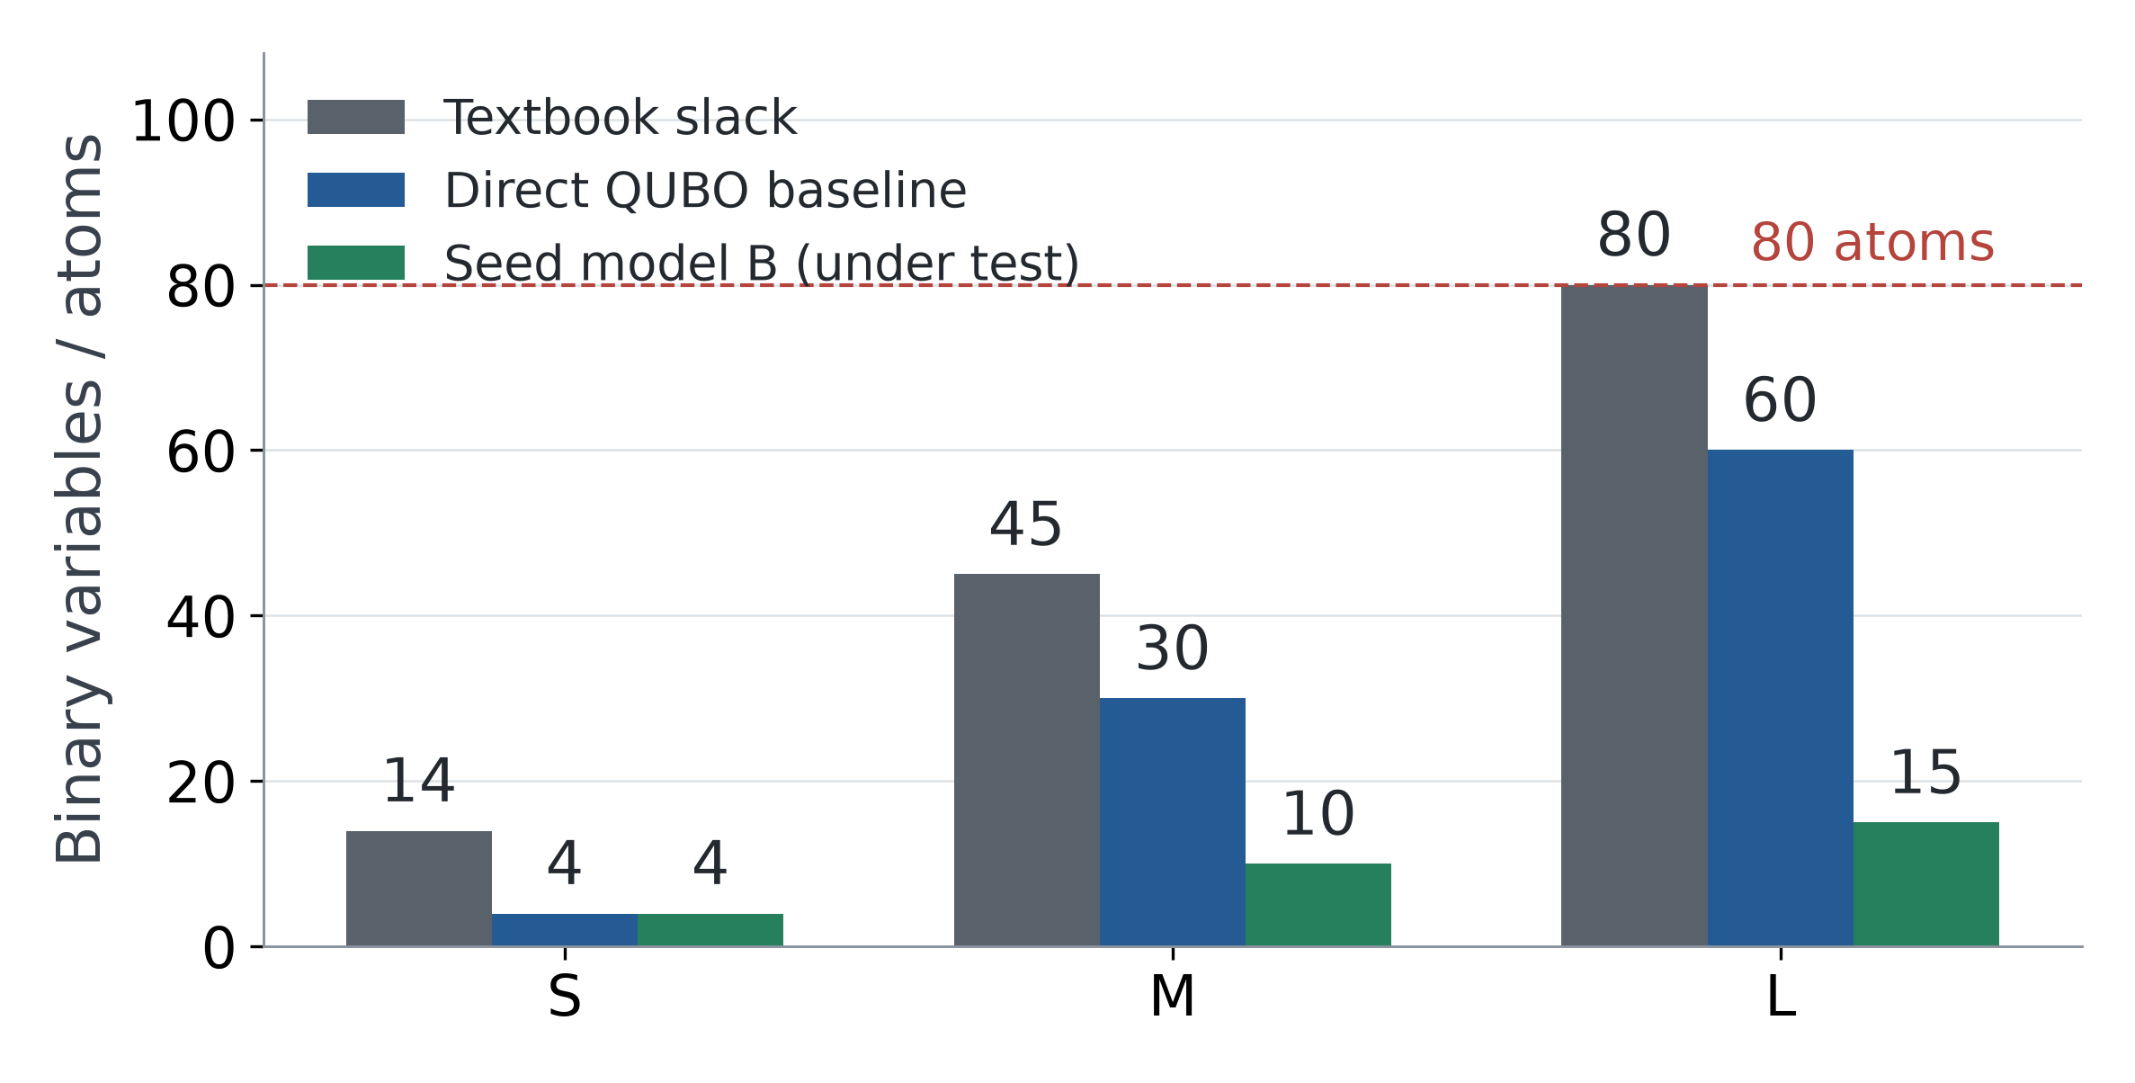
TRACK A | TWO QUESTIONS
What QUBO? Where do the atoms go?
One variable = one atom. A1 designs the loss; A3 makes Pasqal’s E equation approximate it.
A1 — design the QUBO
Cluster function: optimize.
Capacity: meet the passing line.
A3 — choose atom positions
Minimize disagreement between
our QUBO and the machine’s energy.
Workflow: A2 instances → A1 loss → A3 atom distances → A4 pulse. Model B counts are a direction under test.
DuQuantum × Pasqal | MODEL / CLASSICAL DATA
1 / 7
Notes:
[45 秒] 我们按自己的理解，把 challenge 拆成两个主要问题：A1 怎么设计 QUBO，以及 A3 怎么摆放 atoms，使 Pasqal 的 E equation 尽量接近我们的 loss。A2 是自动生成可行 instances 和 references；A4 是把模型接到 pulse 和 emulator。右边是真实变量数量：direct baseline 是 4/30/60，textbook slack 是 14/45/80。Model B 选择 seeds，用 4/10/15 atoms，但仍在测试，不能当作已验证的量子结果。

Slide 2
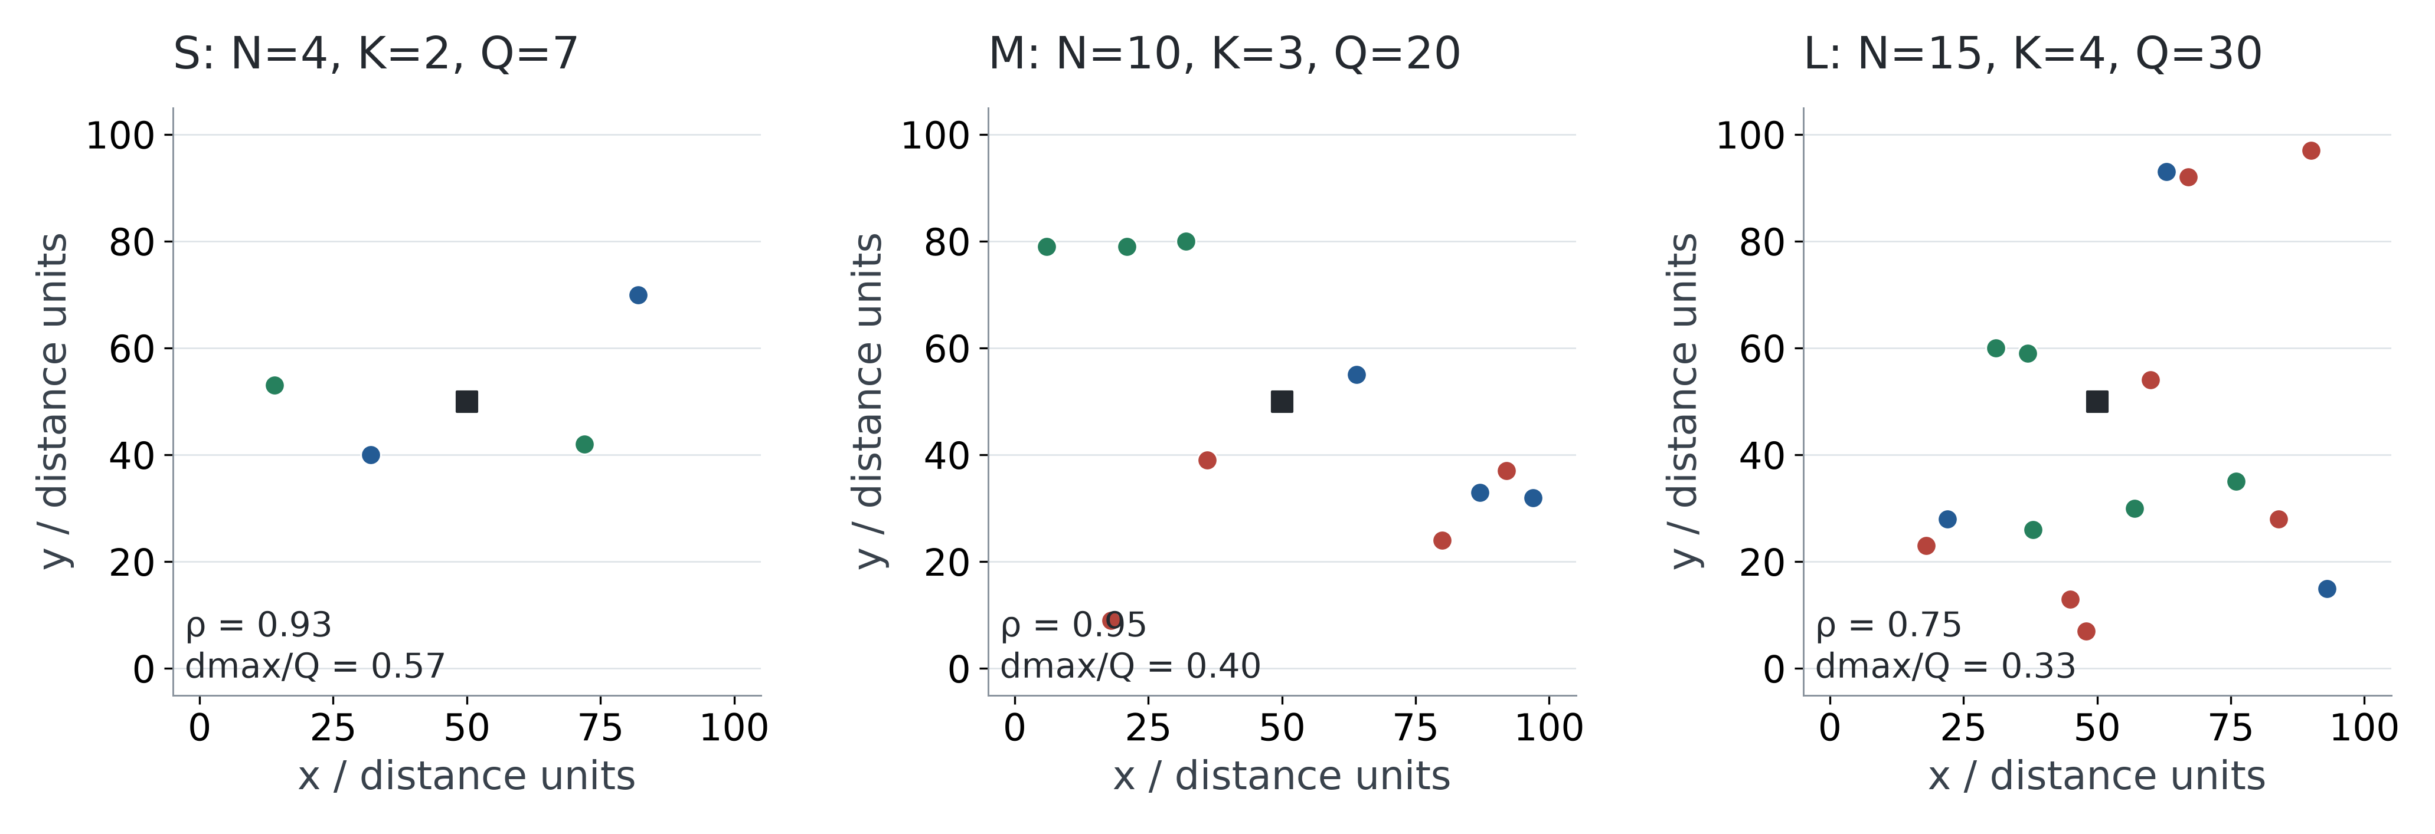
TRACK A | A2 — GROUND TRUTH
Instances come with a feasible answer and a reference.
A2 is automated: seeded generation → certificate → validator → exact classical reference.
S_seed0 | C* = 110.14
M_seed0 | C* = 353.04
L_seed0 | C* = 475.36
Proven constrained clustering optimum
Proven constrained clustering optimum
Proven constrained clustering optimum
3 seeds per tier (0, 1, 2); maps show certificates, not EMU outputs. Depot fixed at (50, 50).
DuQuantum × Pasqal | MODEL / CLASSICAL DATA
2 / 7
Notes:
[35 秒] A2 是支持步骤，快速讲完。S/M/L 的 N K Q 按比赛要求固定；locations 和 demands 从 seeds 生成。每个 instance 有 feasible certificate 和 validator，并报告 load ratio 和最大 demand ratio。图上是 seed0 certificates，下面是 repository 保存的 proven constrained model optima。三个 seeds 一共九个 instances，参考值通过 exact classical DP 得到，不能称为 quantum output。

Slide 3
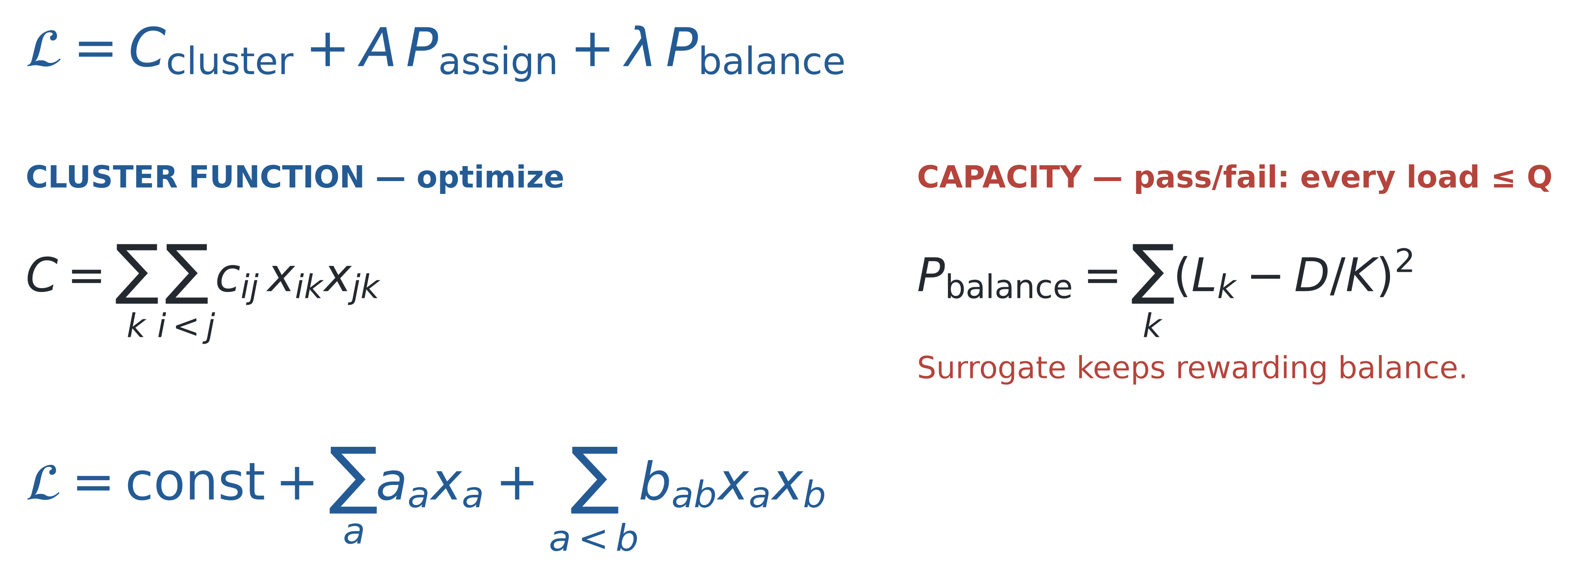
TRACK A | A1 — LOSS
Cluster: optimize. Capacity: pass the line.
The desired constraint is Lₖ ≤ Q. Our direct QUBO uses load balance as a slack-free surrogate.
aₐ = constant per atom | bₐᵦ = constant per atom pair | assignment: exactly one vehicle
M/L one-hot model shown; S uses one bit/customer. Balance still penalizes unequal feasible loads: it is not a flat pass/fail penalty.
DuQuantum × Pasqal | MODEL / CLASSICAL DATA
3 / 7
Notes:
[80 秒] 先定义我们真正想要的 loss：cluster function 越小越好；capacity 只要通过及格线，也就是每个 load 不超过 Q，就可以，不应继续追求更满或更平均。实际 direct baseline 使用 sum(L-D/K)^2 来省 slack，它会在 feasible 范围内继续奖励 balance，因此不完全符合我们想要的 pass/fail。这是明确的模型失真。M/L 还需要 assignment penalty，保证每个 customer exactly one vehicle。展开后每个 atom 前有一个 linear coefficient a，每对 atoms 有一个 coupling b，constant 不改变排序。下一页就将这两个 coefficient slots 和 Pasqal energy 对齐。S 使用二元 vehicle 标签，exactly-one assignment 自动满足。

Slide 4
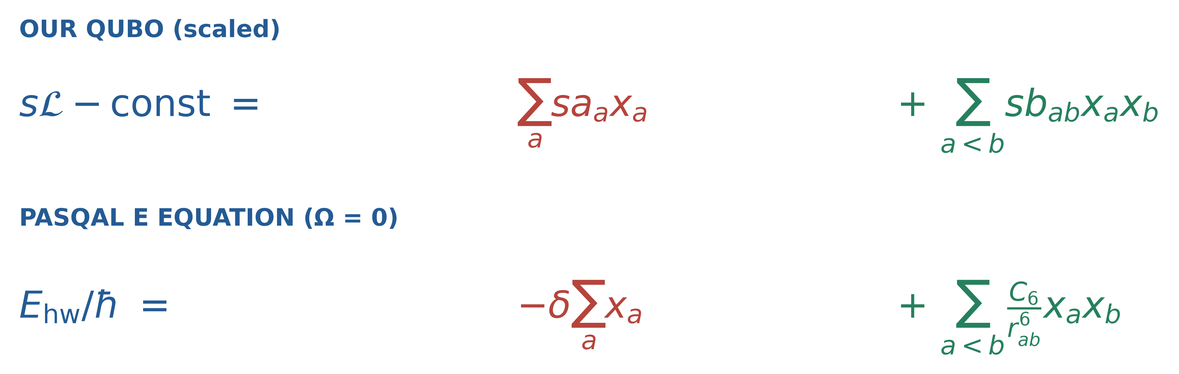
TRACK A | A1 → A3 — THE PIVOT
Which QUBO terms fit Pasqal’s E equation?
Same two slots: a constant per atom and an interaction per atom pair. Color identifies the inconsistency.
MATCH: positive pair sign.
Values still need a joint 2D fit.
MISMATCH: nonuniform aₐ
versus one global −δ.
MISMATCH: target-zero pairs
and many strong partners.
M/L: linear mismatch is constant on valid one-hot assignments, but changes invalid states. This does not hold for S.
DuQuantum × Pasqal | MODEL / CLASSICAL DATA
4 / 7
Notes:
[85 秒] 这页是主线的转折。上面是 scaled QUBO，下面是 Omega 回到零时 Pasqal 的 classical energy，每项按同样位置对齐。Green 表示 positive pair sign 与硬件一致，但不代表能精确 fit。Red 是 nonuniform linear coefficients 与 shared global detuning 的冲突。对 valid M/L one-hot assignments，这部分差异是常数，所以 valid states 的排序不会因这项而改变，但 invalid strings 的能量会变。另有 target-zero pairs，而 1/r6 永远 positive；以及每个 atom 想要太多相近强度的 partners，无法各自独立设置距离。我们不把 dense baseline 的问题归咎于 detuning，真正重要的是 jointly realizable geometry。

Slide 5
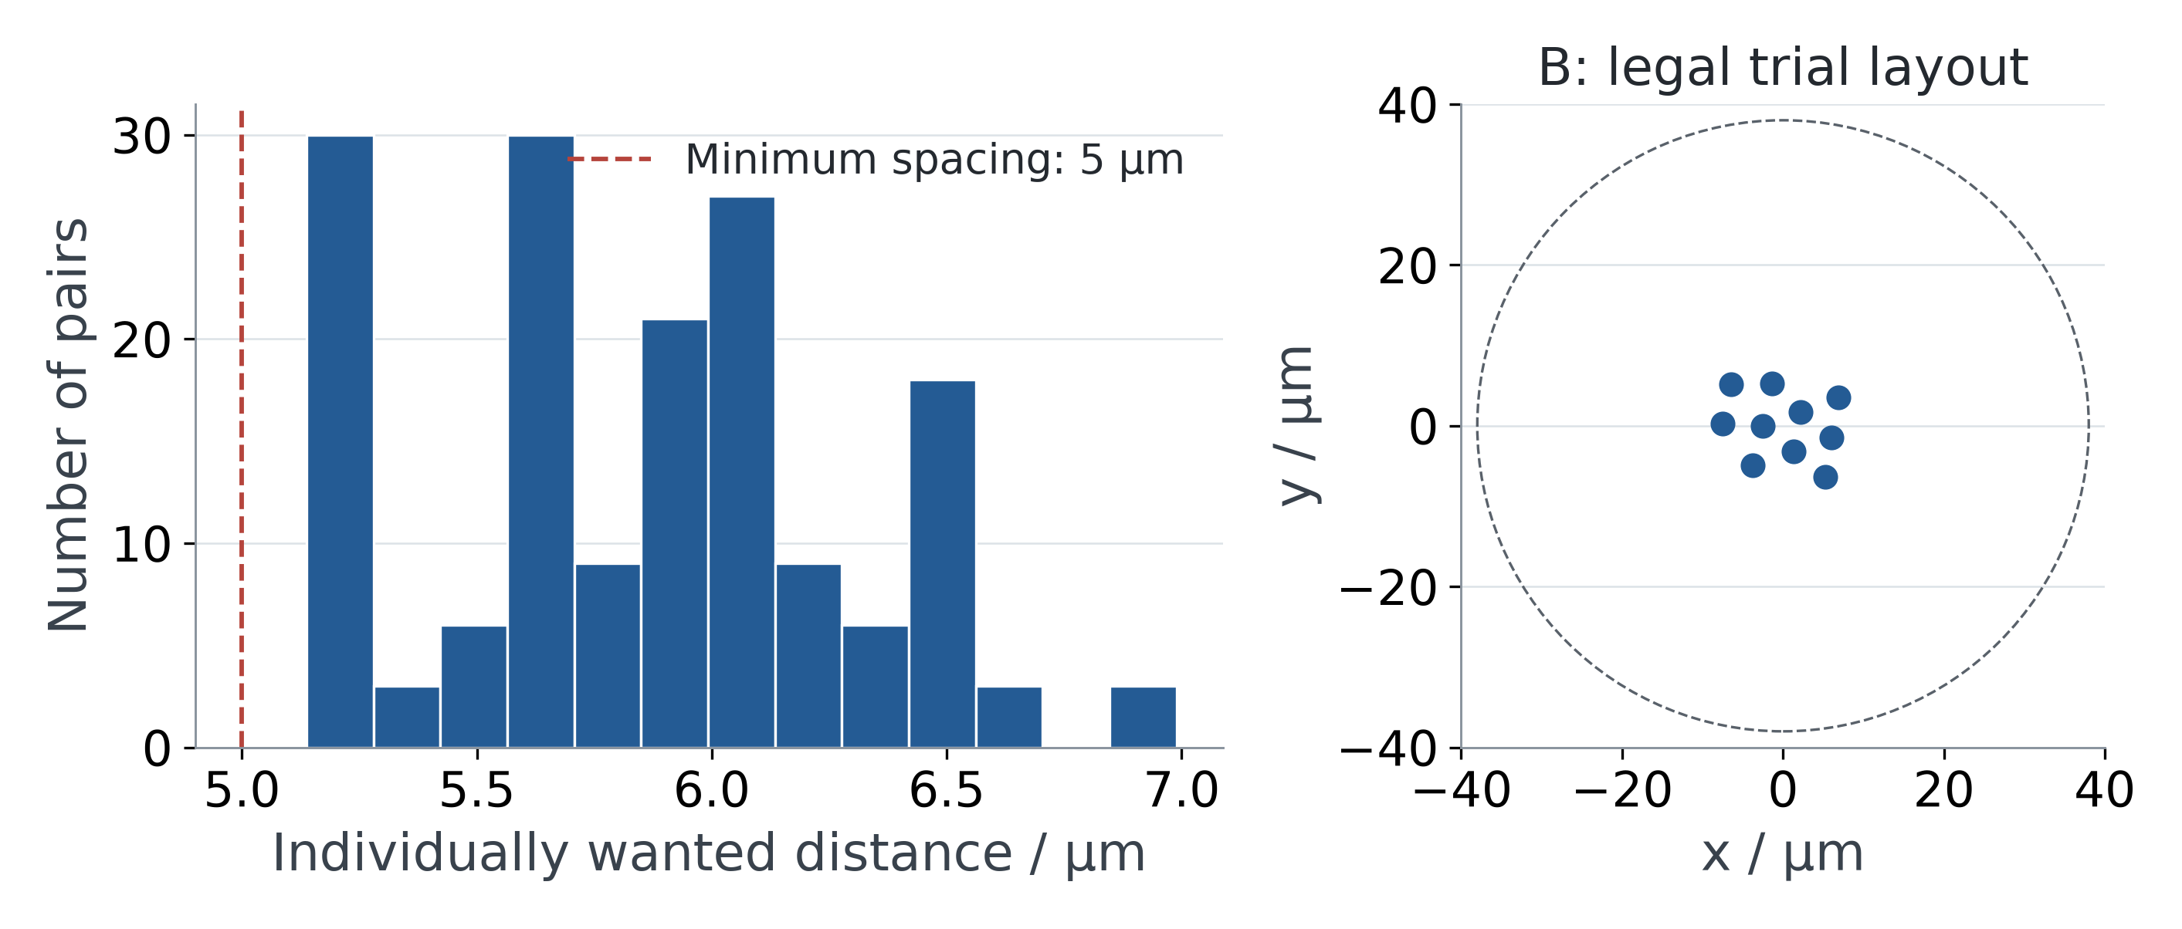

TRACK A | A3 — ATOM DISTANCE & EXPECTED LOSS
Fit the energy ranking, not just each distance.
rₐᵦ* = (C₆ / Uₐᵦ*)¹⁄⁶, with U* = s b. Minimum spacing 5 µm; register radius ≤ 38 µm.
Dense baseline: a measured limit
PLAN §6 reports M ranks ≈10⁴ / 59,049
assignment-valid states; coupling error η ≈ 1.
Approximate logged findings, not new runs.
Next: model B — N seed atoms.
Energy selects spread-out seeds.
Nearest-fit decode checks capacity.
Compare against random K-seed sets.
M_seed0: baseline target distances and Pulser-valid model B trial layout. No EMU result; report P(F) separately.
DuQuantum × Pasqal | MODEL / CLASSICAL DATA
5 / 7
Notes:
[95 秒] A3 控制 positions，A4 控制 Omega detuning duration。把一个 coupling 反推为一个 distance 很容易，但所有 distances 必须同时来自一张合法 2D layout。左图来自 M_seed0 真实 target coefficients：目标距离挤在窄范围。PLAN 第六节记录 dense baseline approximate results：M 的 model optimum 在 59049 个 assignment-valid states 中落到大约一万名，eta 大约一。59049 是 3 的十次方，包括 capacity-infeasible assignments；不要说成全都 capacity-feasible。这里是日志摘要，不是本轮重跑。PLAN 仍在写 sparsification，代码新加 seeds.py；所以 Model B 是 next direction under test。量子部分选 spread-out seeds，classical capacity-aware nearest-fit decoder 分配其他 customers，失败计入 feasibility。Expected feasible loss = sum over feasible x of p(x|positions,pulse)*cluster_cost(decode(x)) 除以 feasibility probability。不能把 embedding eta 当作 expected clustering loss。

Slide 6
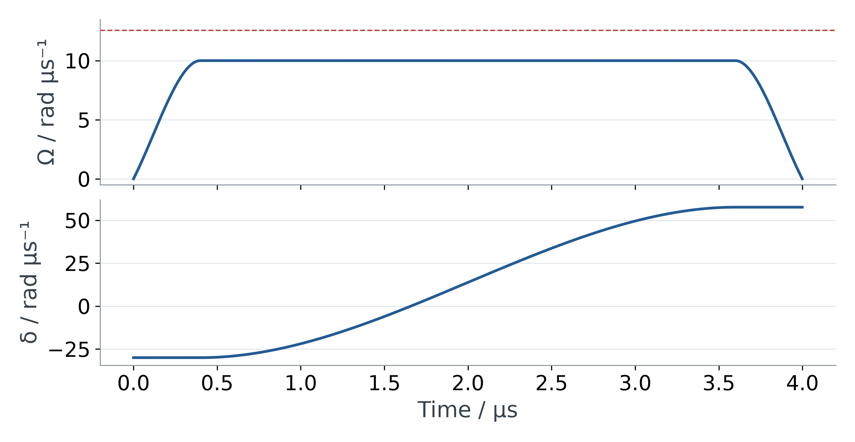
TRACK A | A4 — FIGURING OUT THE SYSTEM
Fix amplitude and duration; tune detuning per instance.
Proposed search policy, not completed optimization. All candidates must pass Pulser device validation.
Fixed within each tier — proposed
Ωpeak = 10 rad/µs; T = 4,000 ns
Starting policy shared across S/M/L.
Per-instance detuning grid
Direct: δf = {0.8, 1, 1.2} × δmap
Seeds: grid inside candidate K window
δ₀ = −{0.5, 1, 1.5} × Ωpeak
Check range and sequence legality first.
Shown: Pulser-constructed M_seed0 direct candidate, δf = −s mean(a). Seed-window cardinality needs a full-state check.
DuQuantum × Pasqal | PROPOSED PULSE / NO NEW EMU RESULTS
6 / 7
Notes:
[35 秒] A4 讲短一些。Amplitude 和 duration 先在 tier 内固定，proposed starting policy 都用 10 rad/us 和 4000 ns，不是假装已经找到 optimal settings。每个 instance final detuning 根据 mapping 来，direct model 以 minus s mean(a) 为中心，提出 0.8/1/1.2 grid。Seed model 以 candidate K-excitation window 为范围，但必须 full bitstring 检查 cardinality，不能仅看相邻 excitation numbers 就保证 ground state。Initial detuning 是负 0.5/1/1.5 倍 Omega。这是待跑的 search settings，不是实测最佳值。所有参数必须实际通过 Pulser validation。

Slide 7
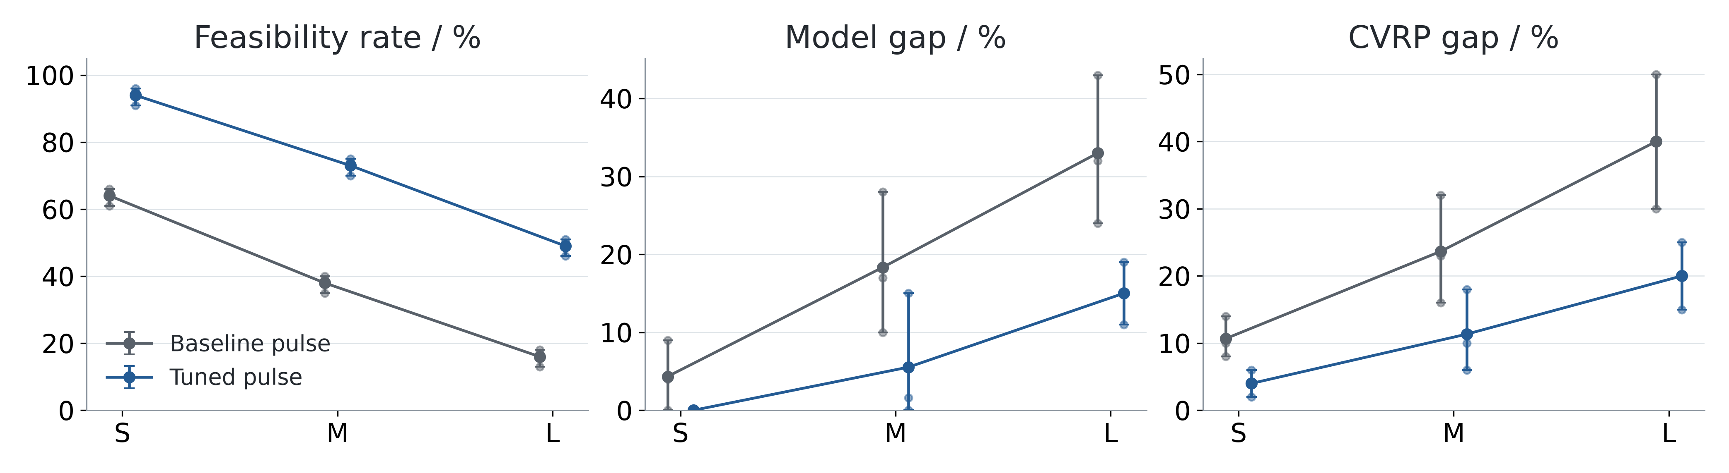
TRACK A | RESULTS / WHAT DID NOT WORK
Report feasibility, model gap, CVRP gap and atoms.
MOCK performance until real EMU output exists. Keep direct QUBO and seed model B results separate.
Known direct-model limit: M_seed2
329.21 → 374.60 clustering cost (+13.8%).
Atoms A: 4 / 30 / 60; B: 4 / 10 / 15.
B needs random-seed baseline + decode audit.
MOCK: means and min–max across 3 seeds. CVRP gap uses exact classical routing. AI assisted code, figures and drafting.
DuQuantum × Pasqal | MOCK PERFORMANCE — REPLACE BEFORE SUBMISSION
7 / 7
Notes:
[45 秒] 上面是明确标记的 mock performance：feasibility rate、model gap、CVRP gap，只是 placeholders，不是 EMU measurements，也不是 Model B 预测。正式结果按模型分别报告 atom count、reference-hit probability、embedding error、emulator settings。真实 failure example 是 M_seed2，balance surrogate 让 clustering objective 从 329.21 到 374.60，多 13.8%，发生在任何量子运行之前。Model B 要和 random K-seed sampler 用同一个 light decoder 对照，明确 classical work。AI 帮助 code、figures 和 draft，团队负责 review。

