Slide 1
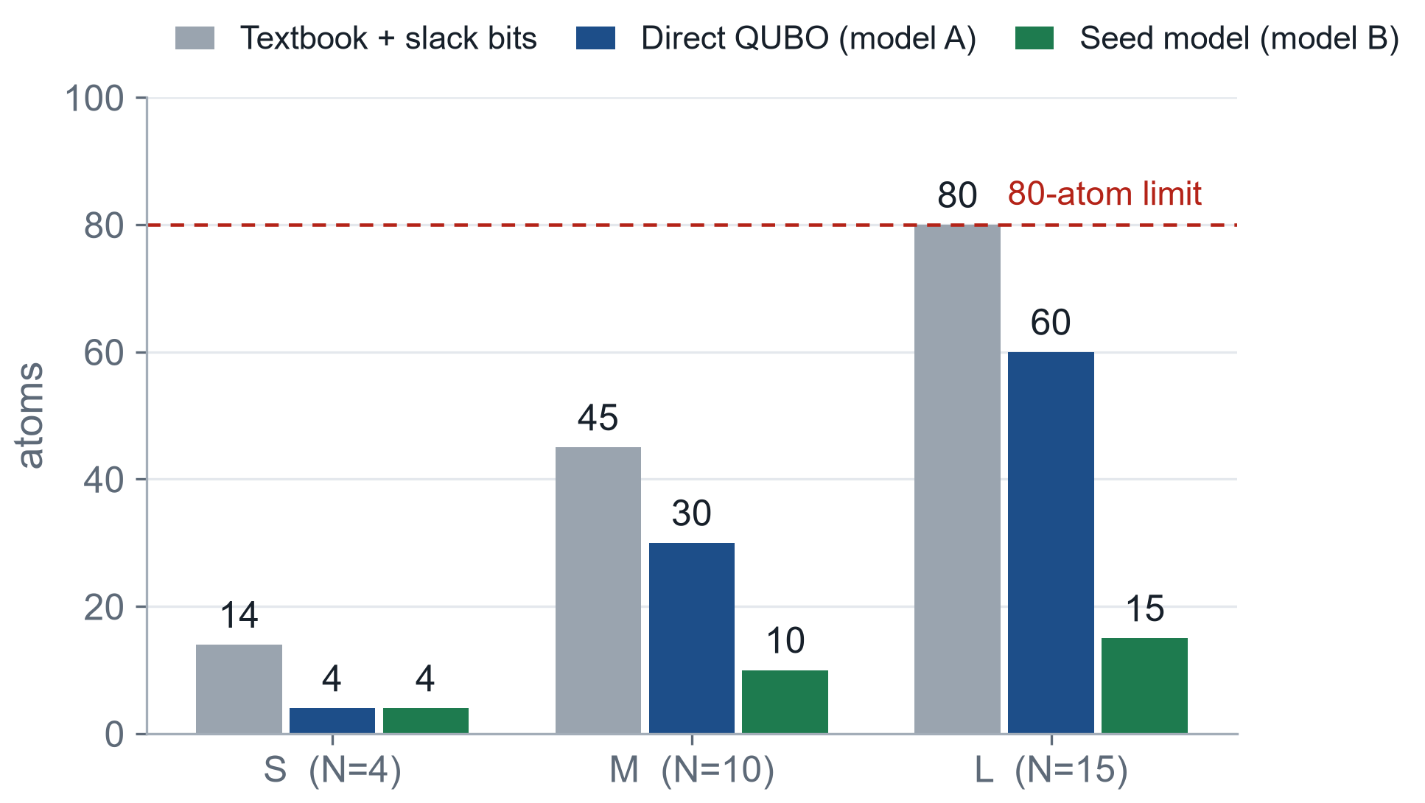
TRACK A · CAPACITY-FEASIBLE CLUSTERING
Two questions: what score, and where the atoms go
One binary variable = one atom. Fewer variables means a smaller, more faithful register.
A1 · design the QUBO
Write one score for every bitstring.
Lowest score = best valid grouping.
A3 · lay out the atoms
Place atoms so the machine’s energy gives
the same scores, and report how far off it is.
A2 instances and A4 pulse support these two.
Track A · DuQuantum × Pasqal
1 / 8
Notes:
[45 秒] 我们把 Track A 拆成两个问题。A1：给每个 bitstring 一个分数，分数最低的就是最好的合法分组。A3：把原子摆好，让机器的能量给出同样的分数，并且报告偏差有多大。A2 生成题目和标准答案，A4 调脉冲，这两个是支撑。右图是原子数：教科书做法加 slack 是 14/45/80；我们的直接 QUBO 是 4/30/60；最后的 seed model 只要 4/10/15。

Slide 2
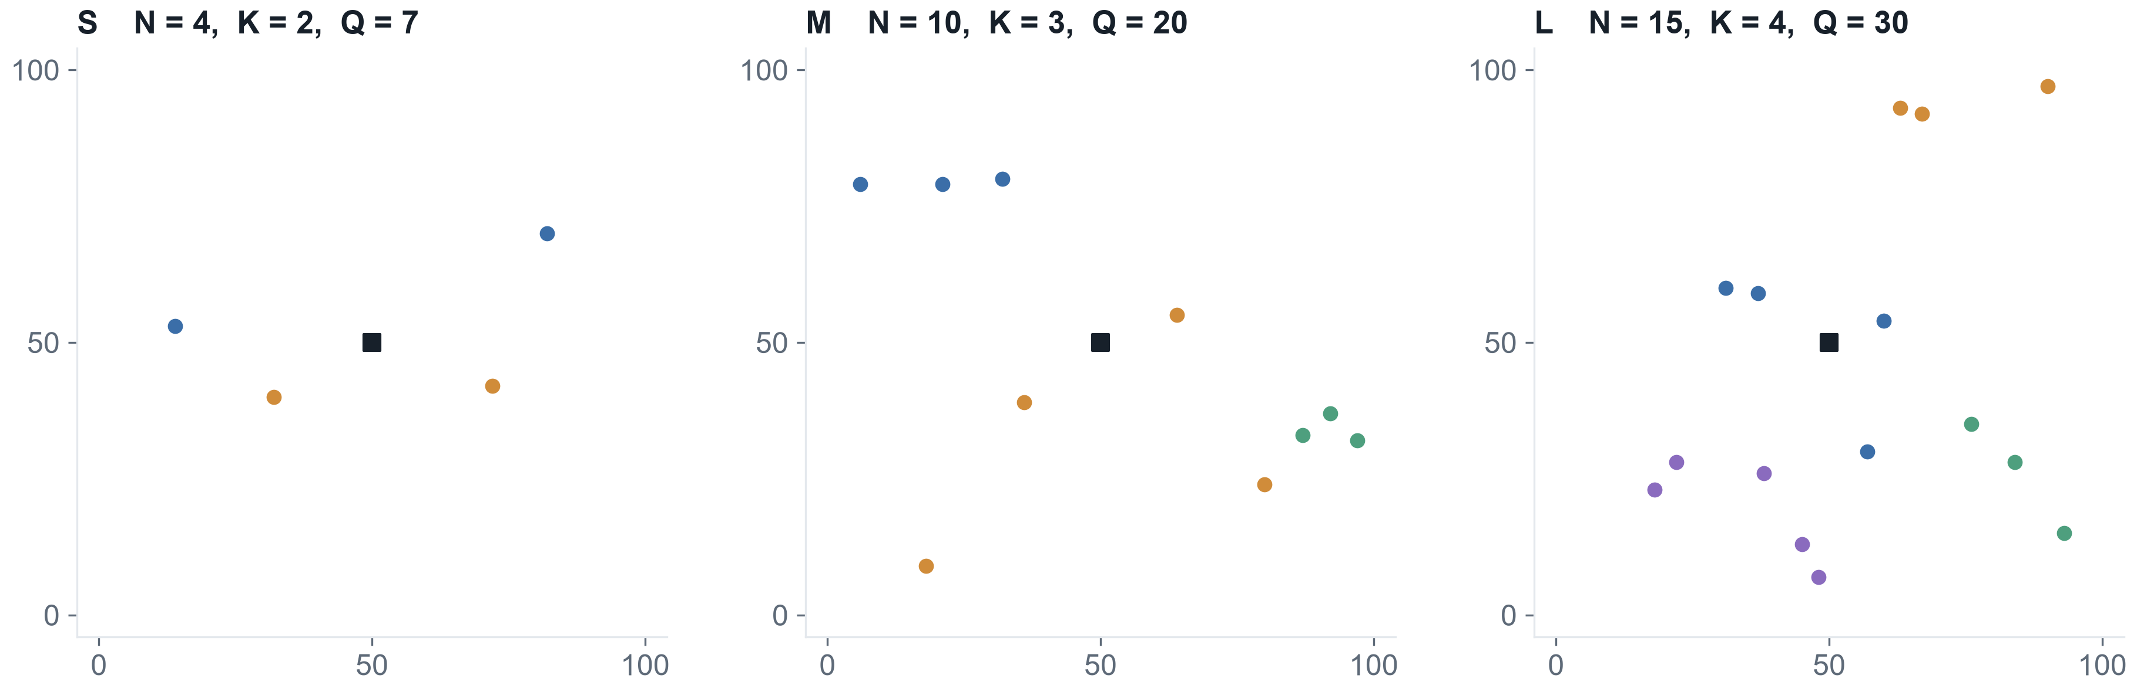
A2 · INSTANCES
Nine certified instances, each with a proven answer
3 seeds per tier. Every instance ships a feasible certificate and an exact optimum (DP, checked by CPLEX).
 | S | M | L
customers N / trucks K / capacity Q | 4 / 2 / 7 | 10 / 3 / 20 | 15 / 4 / 30
proven optimum C* (seed 0, cluster cost) | 110.1 | 353.0 | 475.4
Colour = truck in the proven optimum; black square = depot.
Track A · DuQuantum × Pasqal
2 / 8
Notes:
[35 秒] A2 是全自动的：每档三个 seed，生成器保证可行，附带一个可行分配作为证书，再用精确 DP 求出最优解，S 档还和 CPLEX、暴力枚举对过。图上颜色是最优分组，黑色方块是仓库。这些最优值就是后面所有 gap 的标准答案。

Slide 3
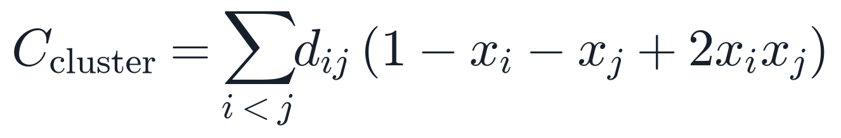
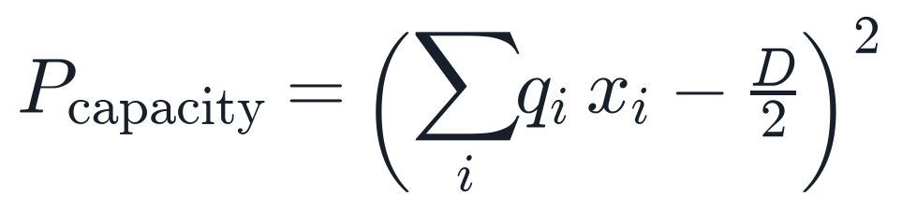
A1 · ① LOSS ② CLUSTER ③ CAPACITY
Cluster is optimised; capacity only has to pass the line
Example: customers A, B, C, D with demands 3, 4, 2, 3; 2 trucks of capacity 7. Bit 1 = truck 1, bit 0 = truck 2.
①
③ capacity on the example
bits ABCD | loads | P | valid?
1001 | 6 | 6 | 0 | yes
1100 | 7 | 5 | 1 | yes
1010 | 5 | 7 | 1 | yes
1110 | 9 | 3 | 9 | no
1111 | 12 | 0 | 36 | no
②
Pays dᵢⱼ only when i and j share a truck: the bracket is 1 for 00 and 11, 0 for 01 and 10.
③
Honest cost: among valid splits it still prefers 6 | 6. When the best split is unbalanced this loses objective (M_seed2: 13.8 %, before any quantum step).
qᵢ = demand, D = total demand. No slack bits: valid splits score 0–1, an overloaded truck scores ≥ 4, and λ makes that too expensive.
Track A · DuQuantum × Pasqal
3 / 8
Notes:
[60 秒] 总 loss 是两部分：cluster 越小越好，需要优化；capacity 只要过及格线就行。cluster 那个括号只有两个客户同车时等于 1。capacity 用 (Σ demand·x − D/2)² 实现：不加 slack bit，合法分法分数是 0 到 1，超载至少 4，λ 让超载永远不划算。代价是：在合法分法里它仍然偏爱最平均的那个，M_seed2 因此在量子之前就损失 13.8%。M/L 档是三到四辆车，用一车一位的 one-hot，再加每个客户恰好一辆车的惩罚，形式一样。

Slide 4
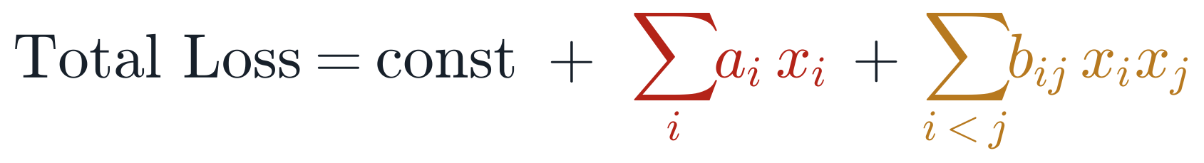
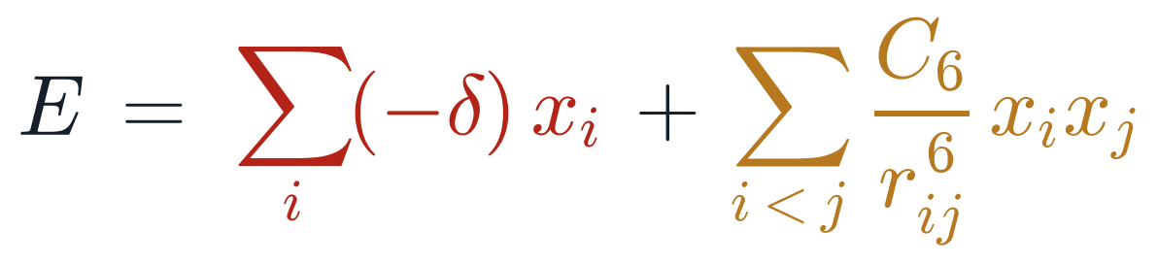
A1 → A3 · ④ EXPANDED ⑤ PASQAL ENERGY ⑥ MISMATCH
Same two slots, but not the same freedom
Expanded, our loss is one number per atom plus one per atom pair. Pasqal’s energy has exactly those two slots.
④
⑥ term | our QUBO | Pasqal | match?
per atom | aᵢ, different per customer | −δ, the same for all | no
per pair: value | bᵢⱼ, many different values | C₆ / r⁶, set by distance | approx.
per pair: sign | positive | positive | yes
Sᵢ = sum of customer i’s distances to everyone else.
⑤
On M and L the per-atom mismatch is harmless on valid answers (each customer has exactly one bit on, so Σ aᵢxᵢ is a constant).
The real problem is the pair slot: some pairs want 0, but 1/r⁶ is never 0.
δ = laser detuning (one value for all atoms); r = distance between atoms.
Track A · DuQuantum × Pasqal
4 / 8
Notes:
[70 秒] 这是整场的转折。上面是我们展开后的 QUBO：每个原子一个数 a，每对原子一个数 b。下面是 Pasqal 在激光关掉时的能量：每个原子前面是 −δ，每对原子前面是 C6/r⁶。槽位一样，但自由度不一样。红色：我们每个客户的 a 都不同，激光只给一个 δ。橙色：b 有很多不同的值，只能靠距离去近似。绿色：符号都为正，这一点吻合。M、L 档上，红色那一项在合法答案上是常数，不影响排序；真正的问题是原子对这一项，有些对需要 0，而 1/r⁶ 永远不是 0。

Slide 5
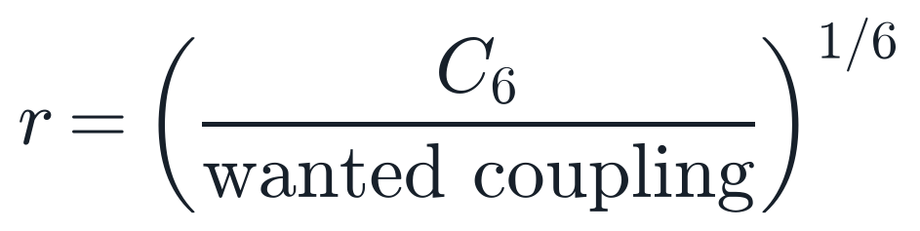
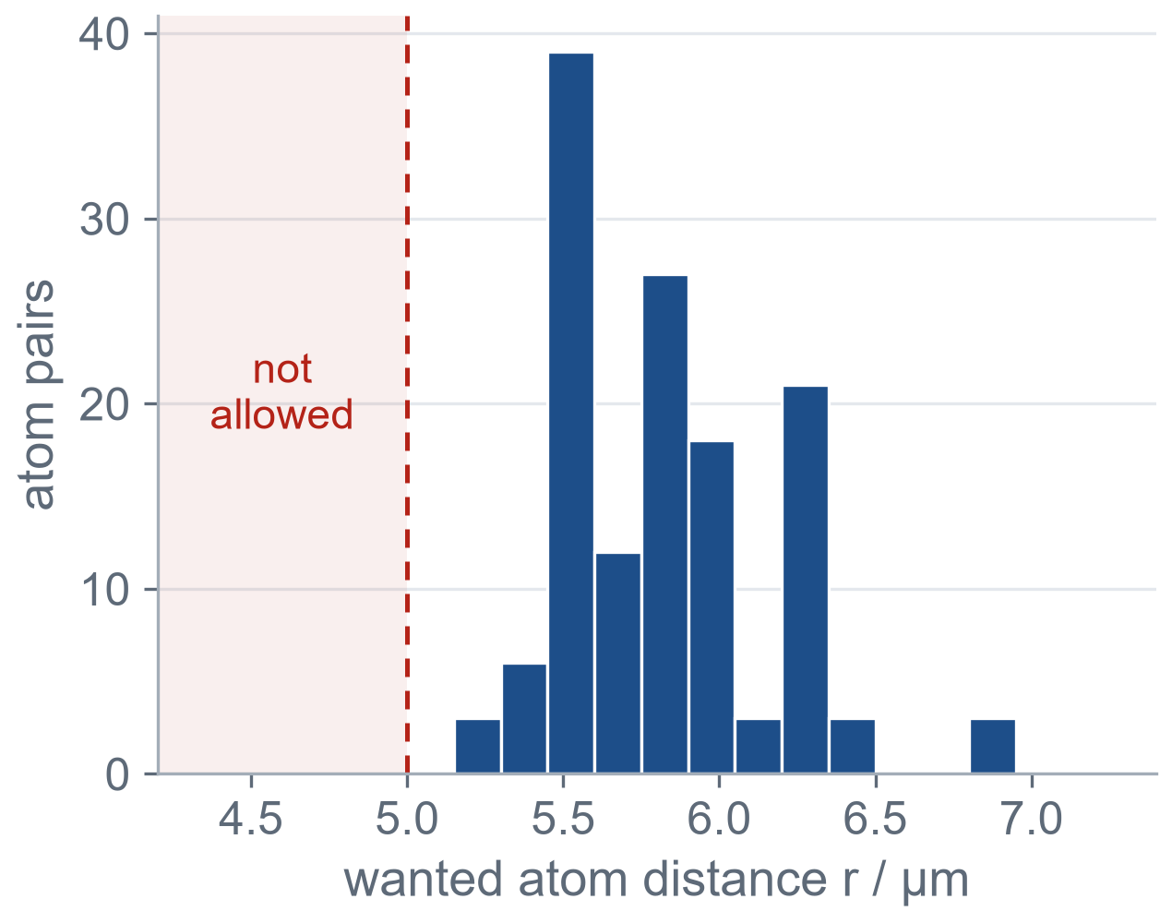
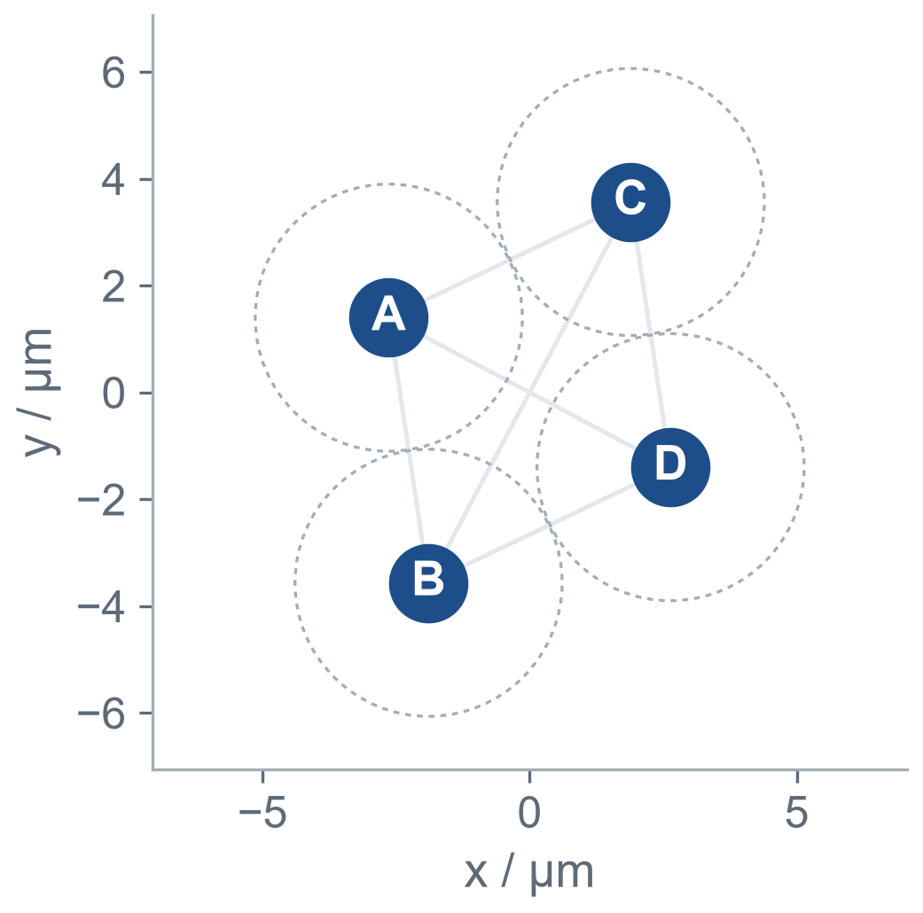
A3 · ⑦ ERROR ⑧ ATOM DISTANCE
Atom distance: S already distorts, M cannot be laid out
Each wanted coupling gives a wanted distance. The question is whether all of them fit in one 2D layout at once.
⑧
r ≥ 5 µm
radius ≤ 38 µm
M · 30 atoms
Every pair wants 5 to 7 µm. Each atom wants 11 partners that close.
⑦
S · 4 atoms
Legal layout found.
Coupling error η = 0.54
But the true optimum already ranks #8 of 16 under the realised energy.
A plane at 5 µm spacing fits about 6 neighbours that close.
Measured: the true optimum ranks ≈ 10⁴ of 59 049; η ≈ 1.
Track A · DuQuantum × Pasqal
5 / 8
Notes:
[60 秒] 第八点：想要的耦合除以 C6 开六次方就是想要的距离，必须 ≥ 5 µm、半径 ≤ 38 µm。第七点：误差 = Pasqal 实际给的值减去我们想要的值。S 档 4 个原子能摆出合法布局，最优解在实际能量下的排名见左边。M 档是 30 个原子：所有原子对都想要 5 到 7 µm，每个原子要 11 个这么近的邻居，但平面上 5 µm 间距最多放下大约 6 个。实测最优解排到大约一万名，η≈1，等于没有信息。所以直接 QUBO 在 M、L 上摆不出来。

Slide 6
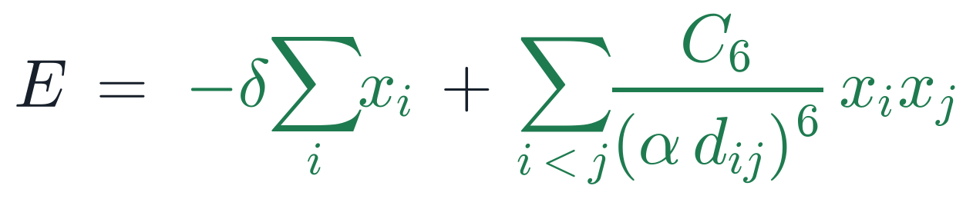
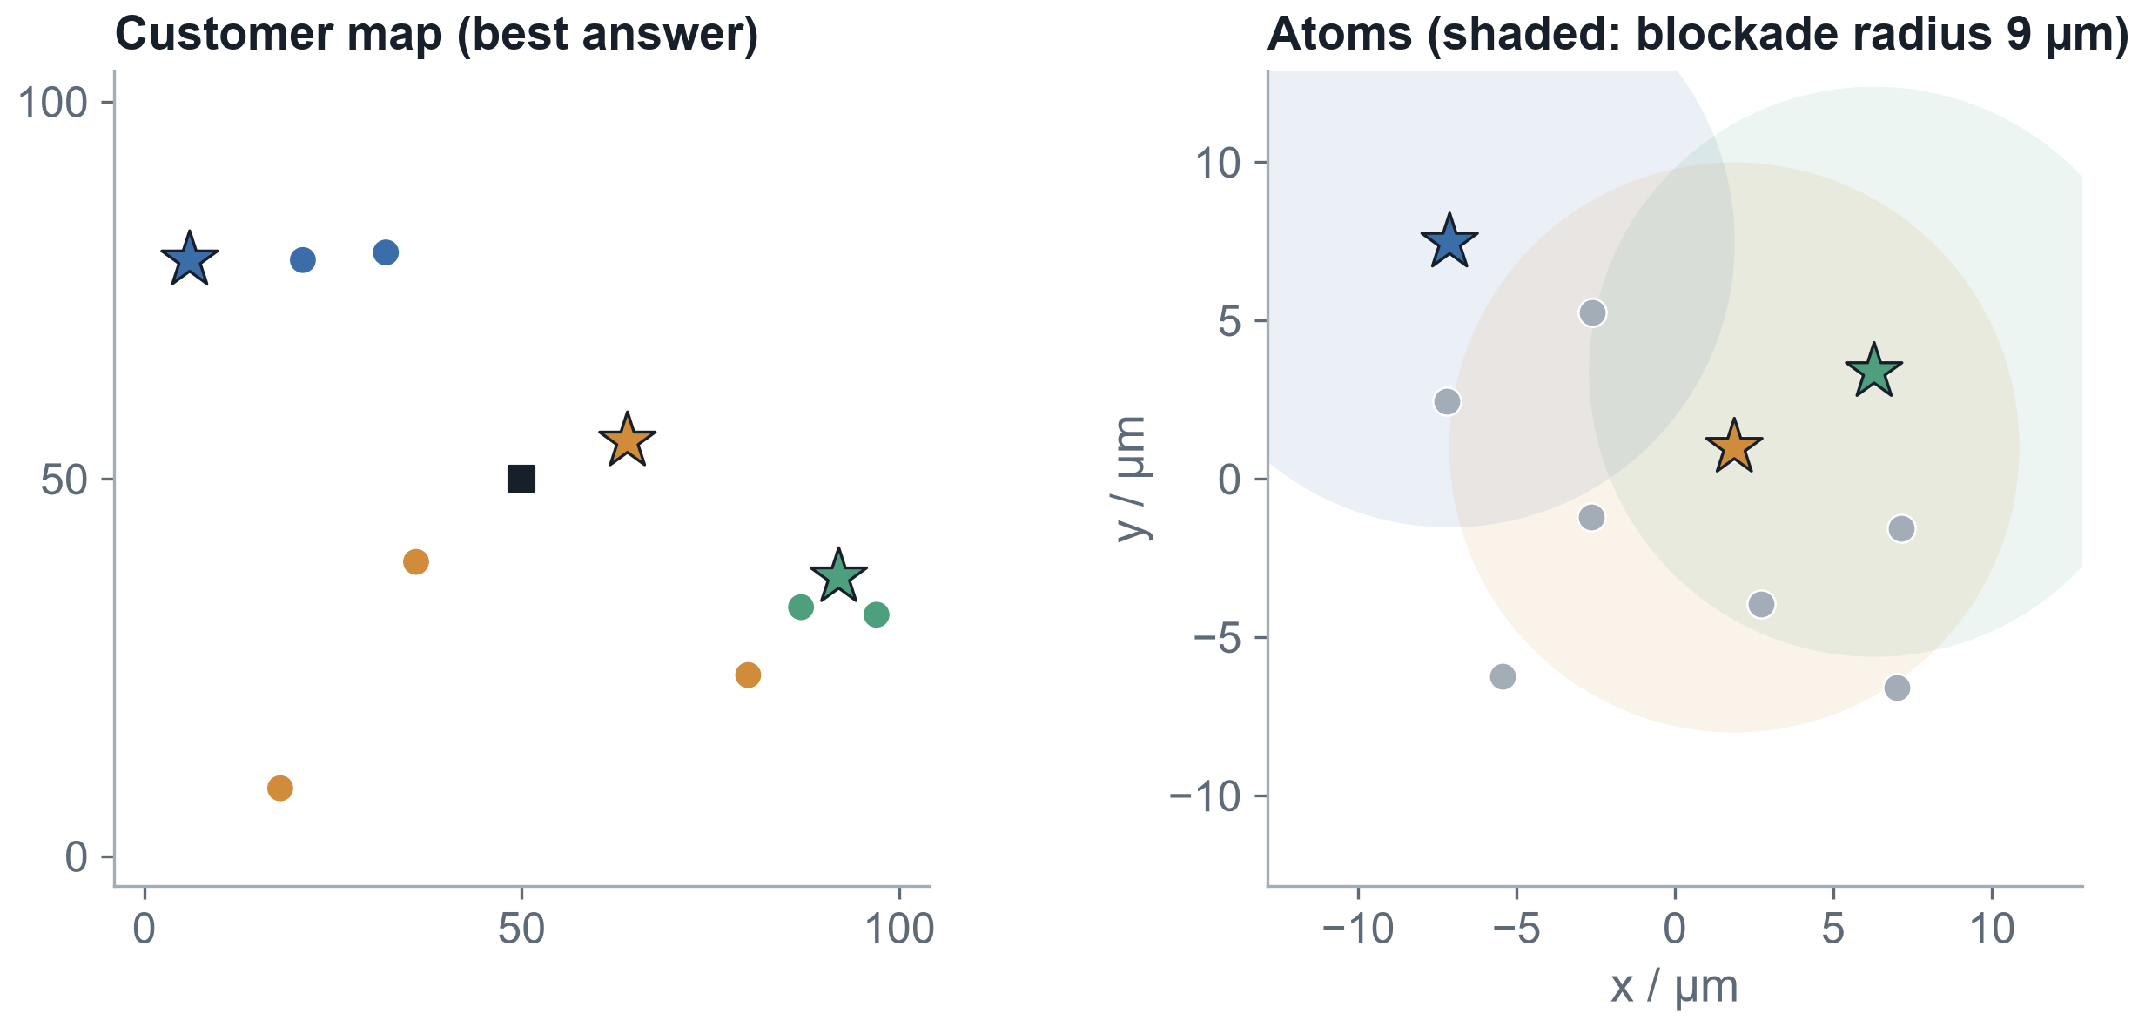
A1 + A3, REVISED · MODEL B
Change the question: the atom map is the customer map
Brief §4.1: “avoid the inequality altogether by changing what the model asks for.”
xᵢ = 1 ⇔ customer i anchors a truck. N atoms: 4 / 10 / 15.
term | model B wants | Pasqal gives | match?
per atom | the same −δ | −δ, the same for all | yes
per pair | C₆ / (α dᵢⱼ)⁶ | C₆ / r⁶ at r = α dᵢⱼ | yes
capacity | — | not in the energy | decode
Close customers block each other, so the lowest energy picks K spread-out seeds.
Then every other customer joins the nearest group with room (light decode, classical, O(N²K)).
M_seed0: η = 0.72; 12 of 120 seed sets decode to the optimum.
Track A · DuQuantum × Pasqal
6 / 8
Notes:
[60 秒] 既然直接 QUBO 摆不出来，我们换一个问法，这正是赛题 4.1 节说的。每个客户一个原子，位就是“这个客户是不是一辆车的中心”。原子直接按客户地图等比例摆，所以原子对的耦合天然就是客户距离的函数，不需要拟合，误差很小；每个原子要的线性项也都一样，正好是一个全局 δ。离得近的客户互相阻塞，能量最低的状态就是 K 个分得最开的中心。容量不在能量里，放在一个很轻的经典解码里：其他客户依次加入最近的、还有空位的组。右图是 M_seed0 的最优答案和对应的原子布局。

Slide 7
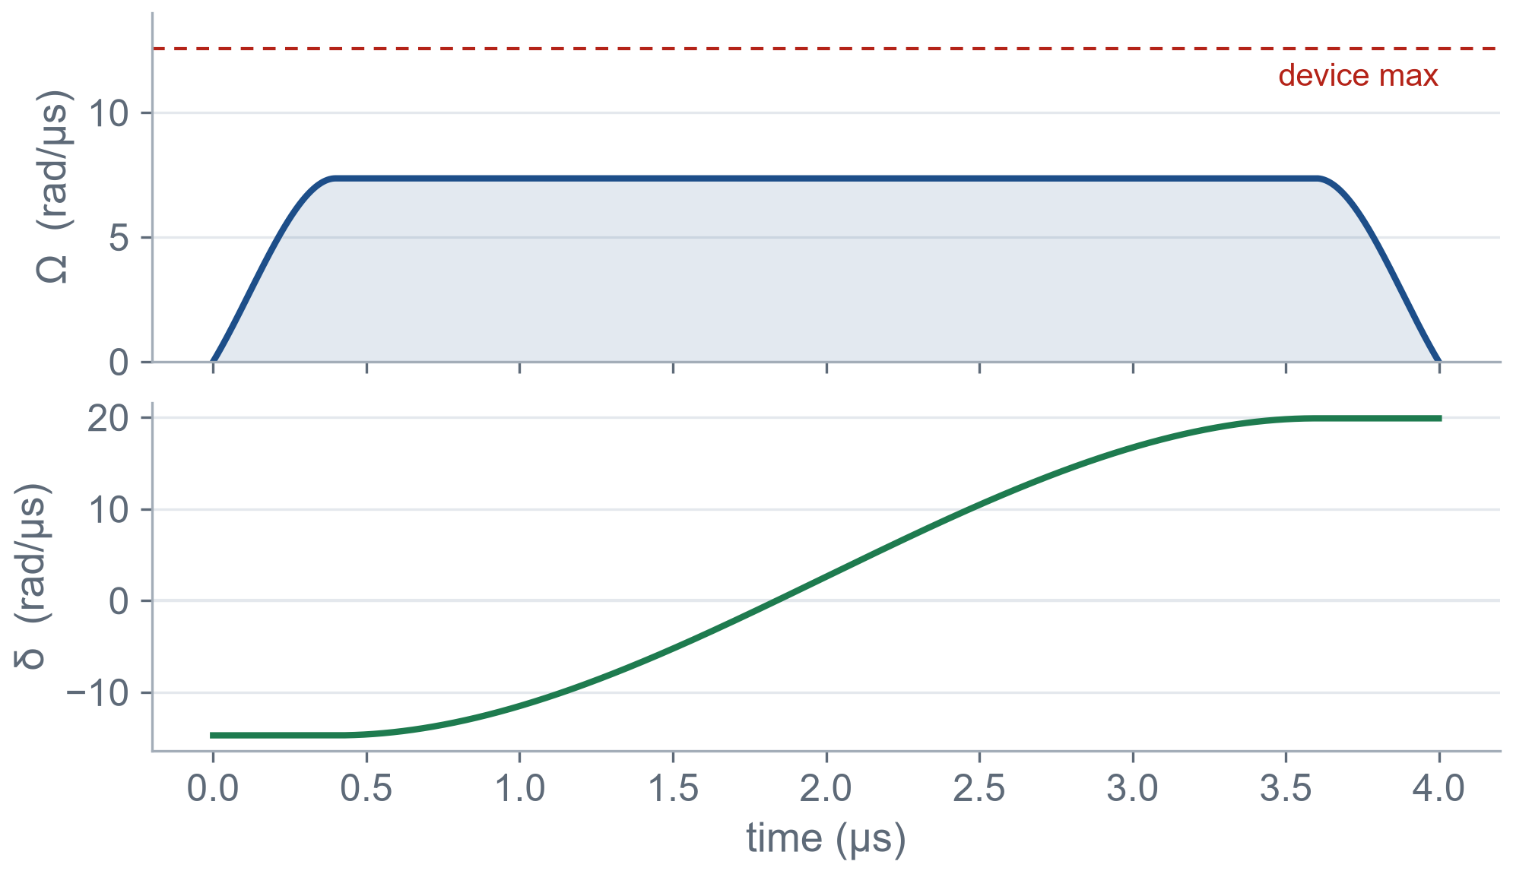
A4 · PULSE
Pulse: Ω and duration per tier, final δ per instance
Standard adiabatic sweep. Every sequence is built and checked by Pulser against AnalogDevice.
parameter | what it does | how we set it
final δ | the per-atom term | midpoint of the window where exactly K seeds is lowest
Ω (strength) | lets atoms flip; sets the blockade radius | grid per tier: radius ∈ {7, 9, 12} µm
duration T | longer = closer to the best answer | grid per tier: {2000, 4000, 6000} ns
δ scale c | fine-tunes the final δ | grid per instance: c ∈ {0.7, 1.0, 1.3}
shots | more = more reliable rates | 1000
Selection score: share of shots that hit the optimum, then best gap, then feasibility (brief §8.2: reward good shots, not the mean).
S_seed0 as run: Ωmax = 7.36 rad/µs, T = 4000 ns, δ: -14.7 → 19.9 rad/µs.
Track A · DuQuantum × Pasqal
7 / 8
Notes:
[40 秒] A4 就是把系统参数调好。标准的绝热扫描：Ω 先升后降，δ 从负扫到正。最终 δ 由几何直接算出，是“恰好 K 个中心最低”那个窗口的中点。Ω 决定阻塞半径，和时长一起每档做一次小网格；每个实例只再调一个 δ 的倍数。挑选标准按赛题 8.2：看命中最优的比例，而不是平均值。所有序列都通过 Pulser 的设备检查。

Slide 8
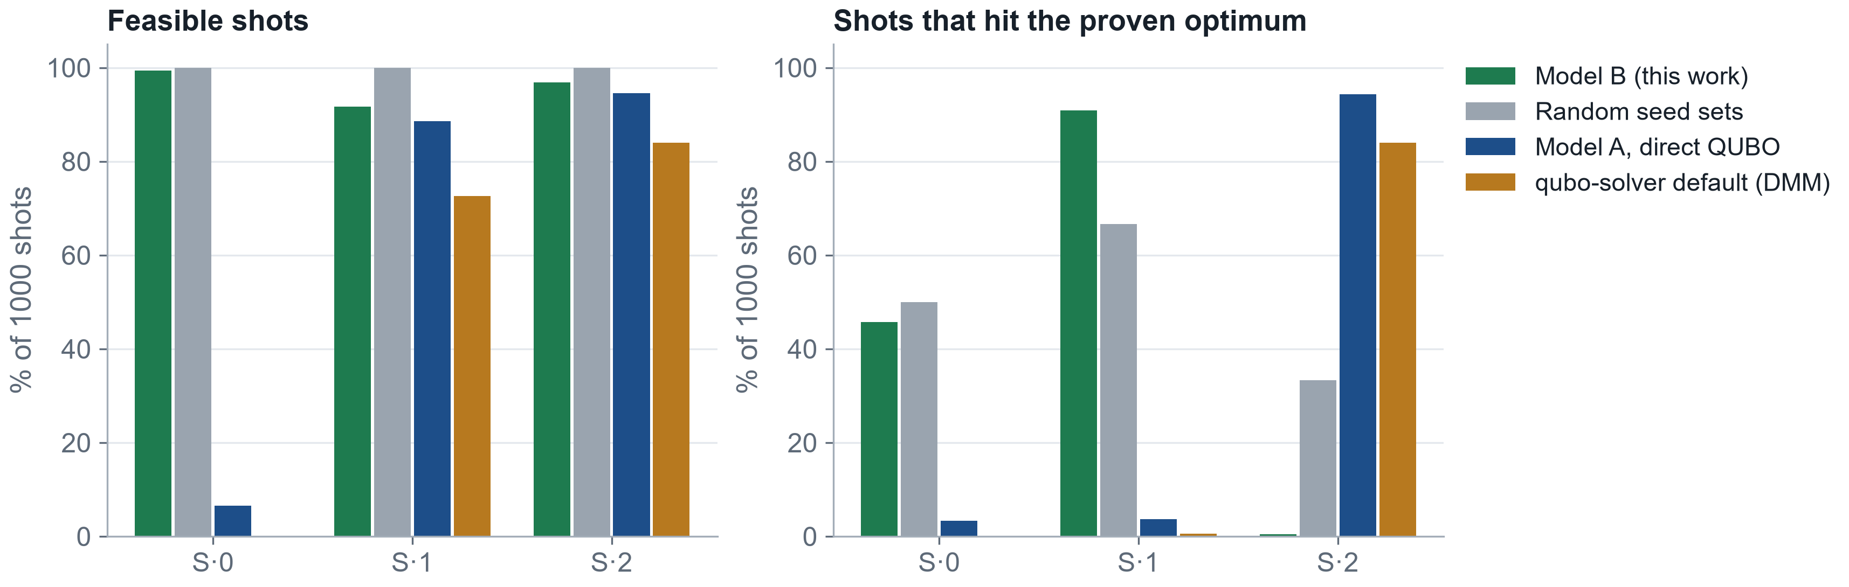
RESULTS · WHAT WORKED, WHAT DID NOT
Tier S is too small to beat chance; M and L decide
S has only 6 seed sets, so random picks already hit the optimum 33–67 % of the time. 1000 shots, global detuning unless marked.
Did not work
Direct QUBO on M/L: no 2D layout reproduces it (η ≈ 1). Load-balance penalty loses up to 13.8 % before any quantum step.
Caveats
Light decode is order-sensitive (S·2: 0.4 % vs 96 % with exact decode). AI assisted code, figures and drafting; every number is from results/.
Track A · DuQuantum × Pasqal · tiers M, L still running
8 / 8
Notes:
[50 秒] 结果：绿色是 model B 在模拟器上的表现，灰色是随机选 K 个中心再用同样的解码，这是公平的对照。我们看两件事：合法的 shot 比例，和命中已证明最优解的 shot 比例。蓝色是直接 QUBO，橙色是 Pasqal qubo-solver 的默认流程（用了 DMM）。失败的部分：直接 QUBO 在 M/L 摆不出来；均衡惩罚在量子之前就有损失。注意：light 解码对顺序敏感，S·2 上差别很大，我们如实报告。AI 帮助了代码、图和草稿，所有数字都来自 results 文件夹。

