Slide 1
GATK PIPELINE USING NEXTFLOW

Slide 2
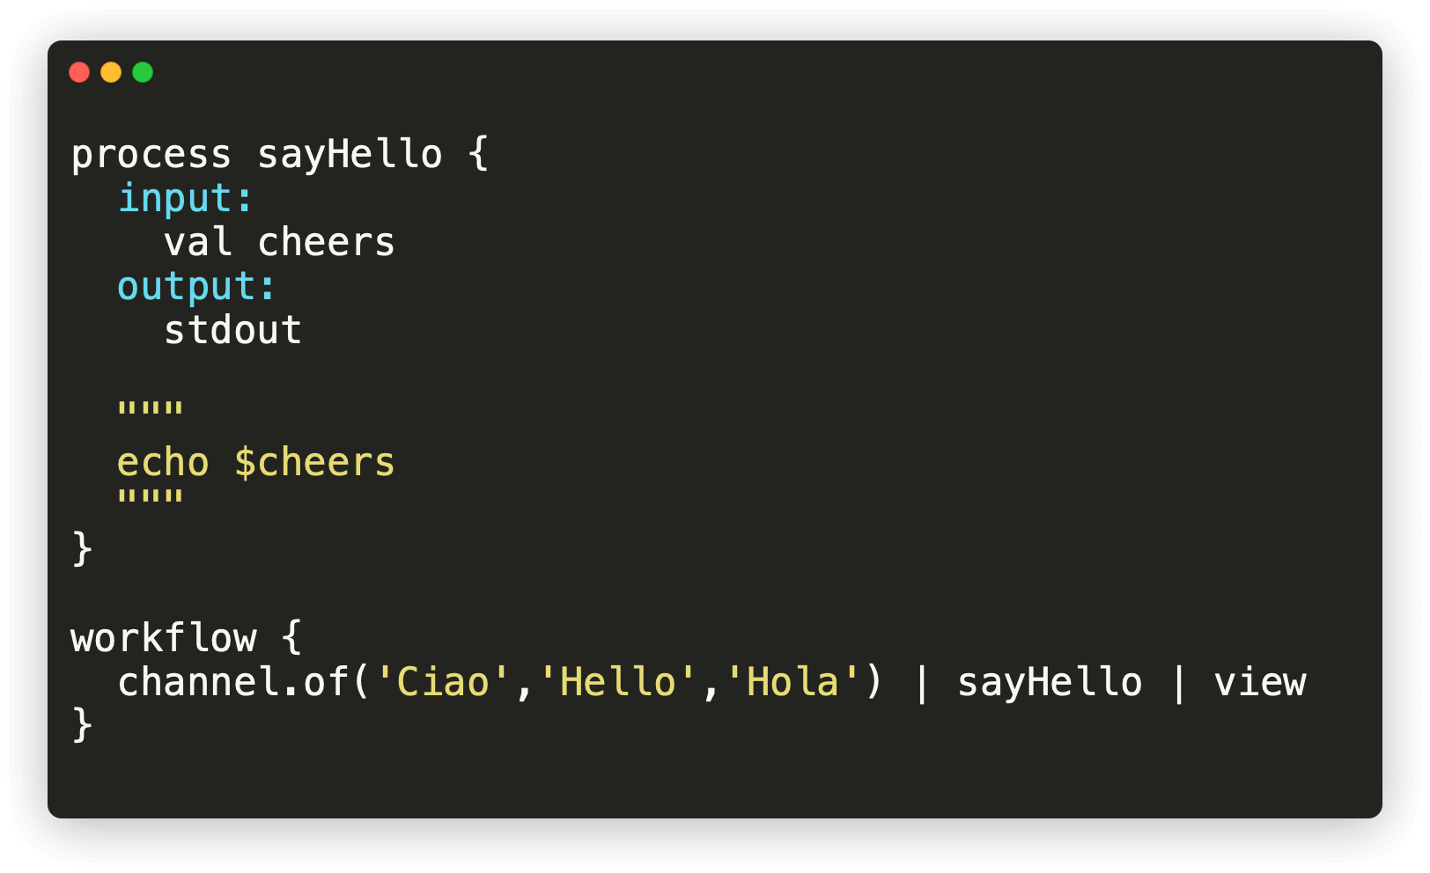
Introduction
GATK Pipeline: We have made a GATK pipeline for variant calling from samples using Nextflow. In this pipeline we have 10 different Nextflow processes for different works.
Process: In Nextflow, A process is the basic computing primitive to execute foreign functions.

Slide 3
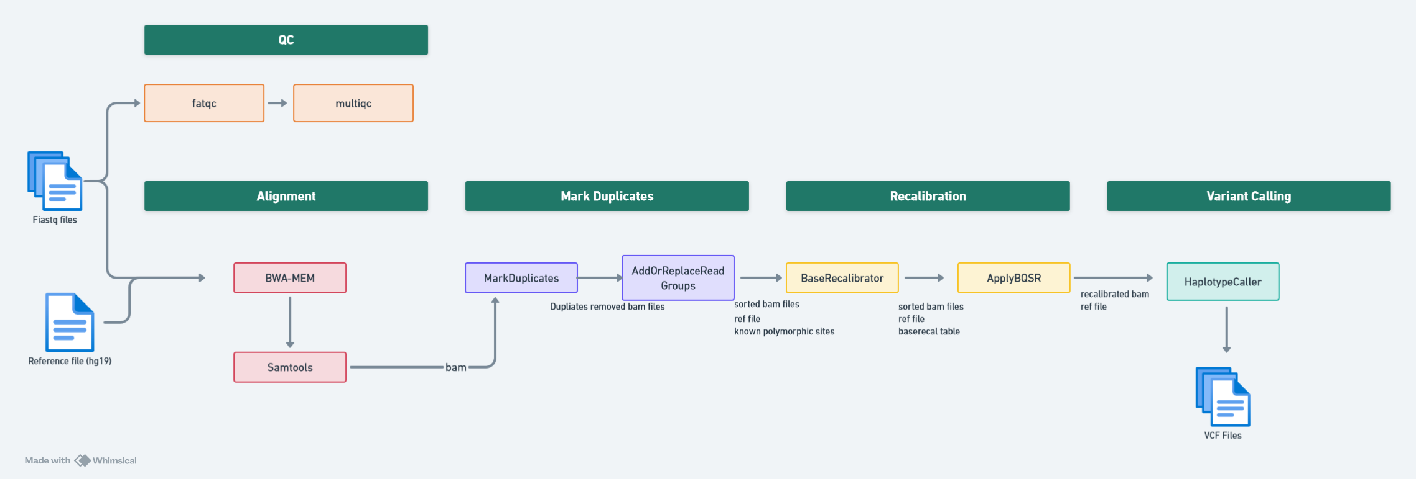
Nextflow processes of Gatk Pipeline and their inputs and outputs:
Fig: Gatk variant calling pipeline using Nextflow

Slide 4
Quality Control:
Fastqc :
Input :
fastq.gz files,
docker container: fastqc docker
fastqc command
Output:
qc of fastq files
Multiqc :
Input :
fastqc process output and
collect operator of nextflow
Output:
html file of multiqc

Slide 5
Alignment
BWA-MEM
Input:
Fastq files
Docker container : BWA
Reference file
Output:
Sam files
Samtools
Input:
Sam files
Docker container : Samtools
Output:
Bam files
Index files of bam

Slide 6
Mark Duplicates
MarkDuplicates
Input :
Bam files
Docker container :GATK
Output
Duplicates removed bam files
AddOrReplaceReadGroups
Input :
Duplicates removed bam files
Docker container : GATK
Output :
Sorted bam files

Slide 7
Recalibration
BaseCalibrator :
Input
Sorted bam files
ref file
Known polymorphic site
Docker container : GATK
Output
Basecalibrator table
ApplyBQSR
Input
Basecalibrator table
ref file
Known polymorphic site
Docker container: GATK
Output
Recalibrated bam

Slide 8
Variant Calling
HaplotypeCaller :
Input :
Recalibrated bam file
Docker container: GATK
Output :
VCF file

Slide 9
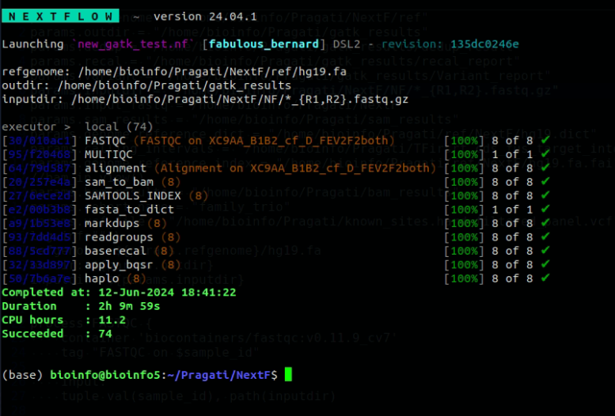
We have tested this pipeline on 8 samples of TARGET FIRST
It took 2 hours 9 minutes to process 8 samples of TARGET FIRST.
Total sample size : 6.6 gb

