Slide 1
NGS3Pipeline
A In-house built pipeline for variant analysis

Slide 2
Introduction
NGS3Pipeline:-
NGS3Pipeline is an in-house built pipeline of 4basecare for variant analysis using Basespace and different databases.
Input: fastq files
Output: Creates 7 different output folders
Annotation
CNV
Panel
Hotspot
Gene Covarage
QC
CNV Covarage

Slide 3
Basic steps for NGS data analysis:
Search fastq files on S3 bucket of AWS
Download fatsq files from S3 to local system
Rename the samples
Upload the samples on basespace and launch analysis using bs command
Downstream analysis of samples (annotation, CNV, CGI,Panel,QC,Gene_coverage,hotspot)
fastq
Download
Renaming
Upload and Launch
Downstream
Figure: workflow of NGS data analysis using basespace and their downstream analysis

Slide 4
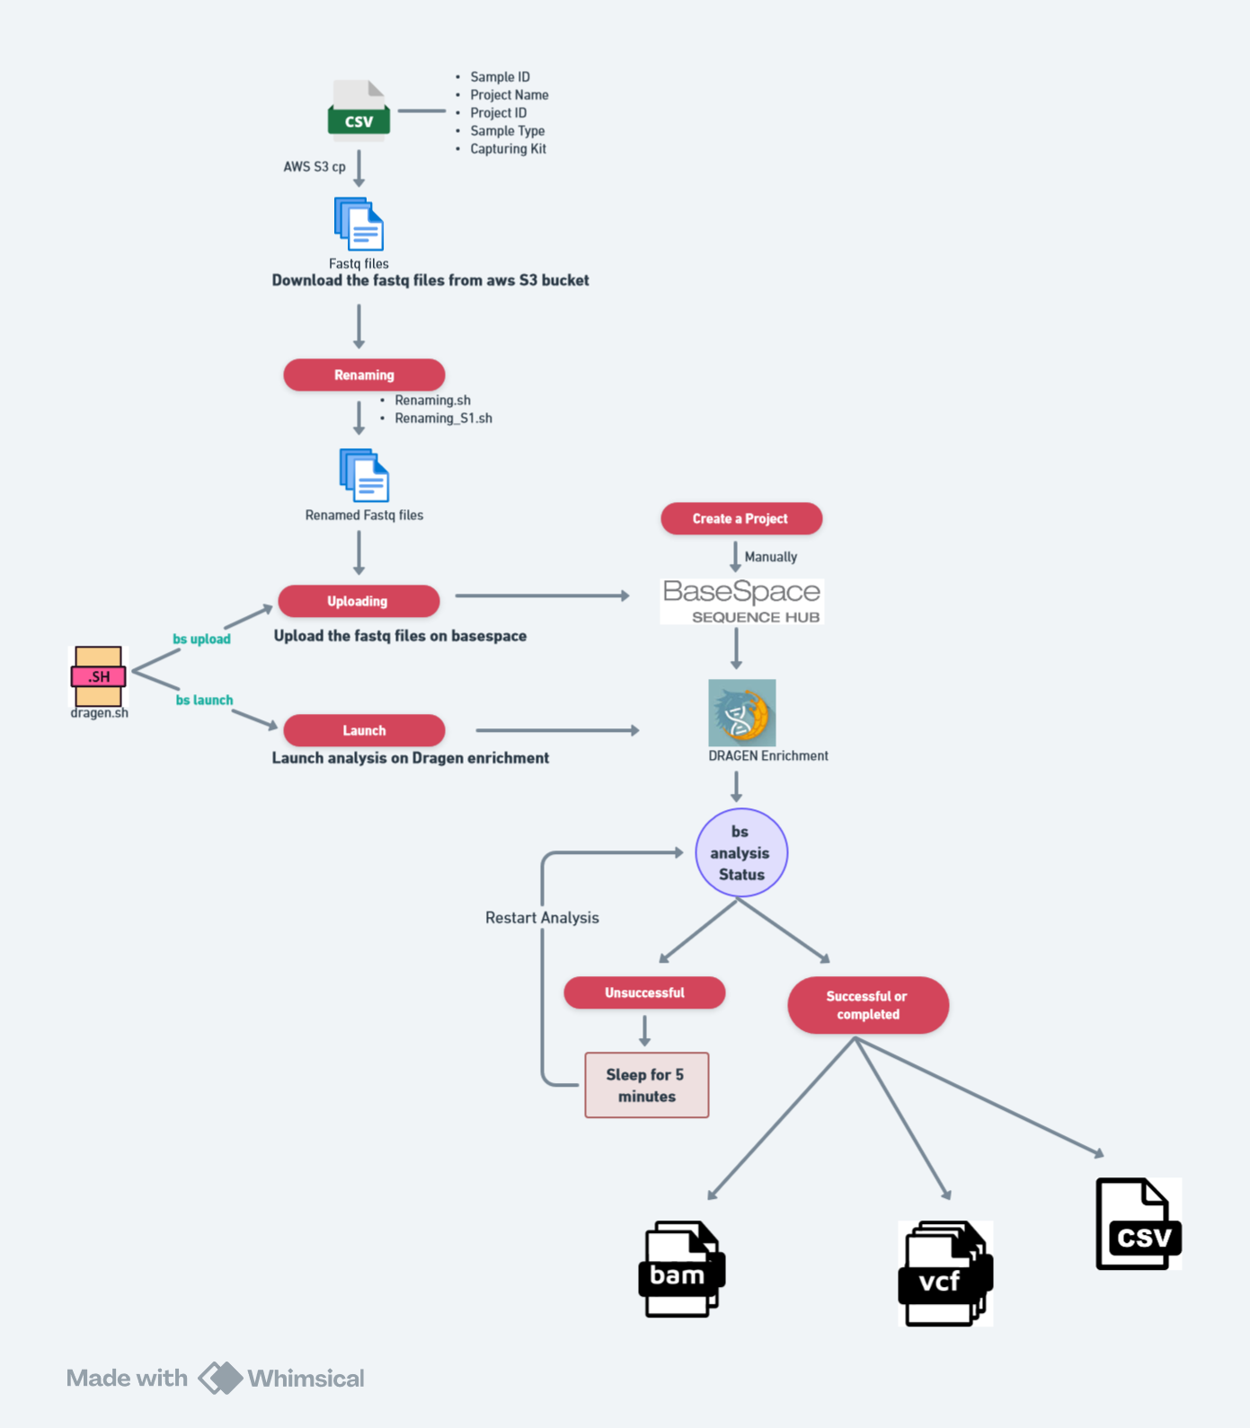
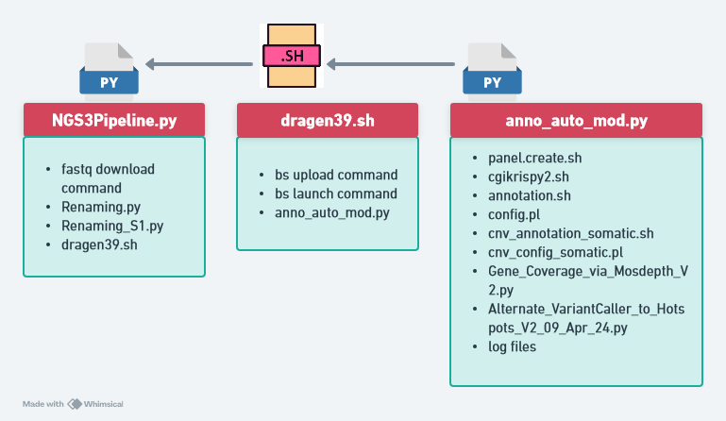
Pipeline:
Figure: Interconnection between important files to run whole pipeline
Figure: Workflow of NGS3Pipeline for variant analysis

Slide 5
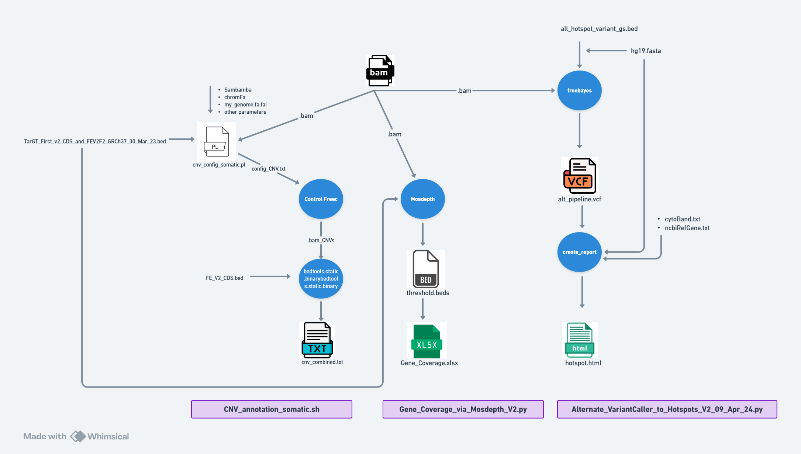
Downstream analysis of bam file:-
Figure: Downstream of bam file using NGS3pipeline and inputs and outputs of tools of each processes.

Slide 6
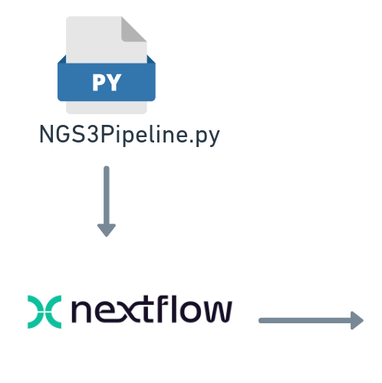
Implementation of pipeline in Nextflow:-
It will optimize changing many paths for databases using Docker.
It will process many samples at a time using implicit parallelism (example:-Annotation)
We can use channels to take input of a script from output of other script.
We can use its operators and modules to optimize codes (example:- avoiding loops )
Nextflow includes built-in error handling strategies that can automatically retry failed tasks and skip errors. If a process fails, Nextflow can resume from the last successful step, minimizing wasted computation and time.

Slide 7
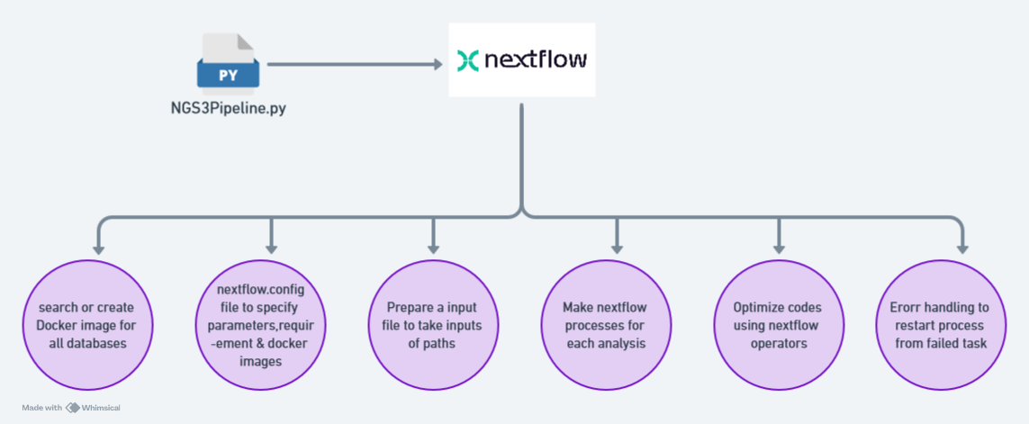
Workplan for Nextflow:-
Figure: Workplan for implementation of NGS3Pipeline in Nextflow for optimization of codes, computation, time and changing many paths

