Slide 1
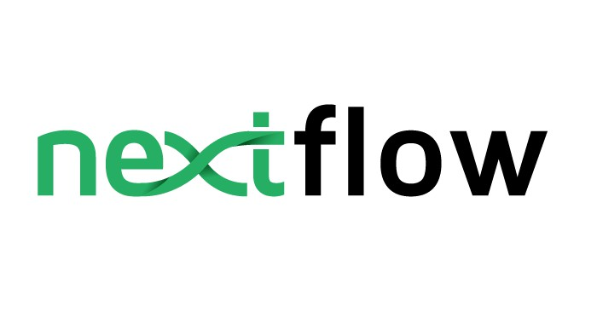

Slide 2
Introduction
Nextflow is a workflow system for creating scalable, portable, and reproducible workflows.
It is a domain specific language.
It uses implicit parallelism.
Implemented on top of the Groovy programming language.
Building Blocks of nextflow:
Processes
Channels
Workflow

Slide 3
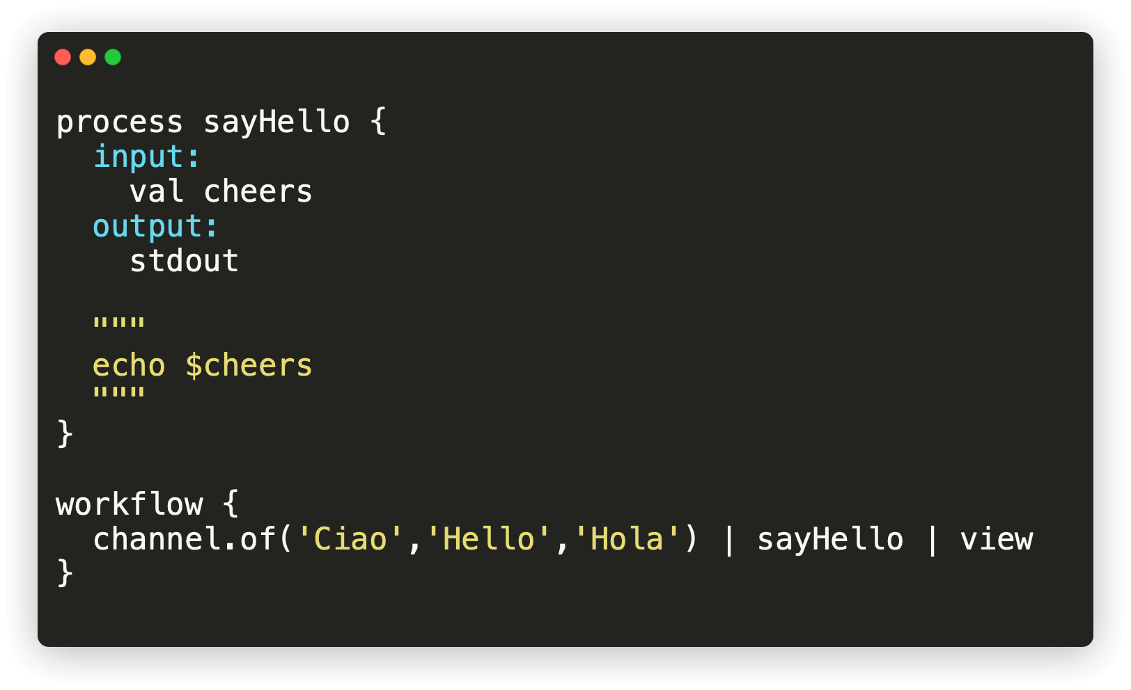
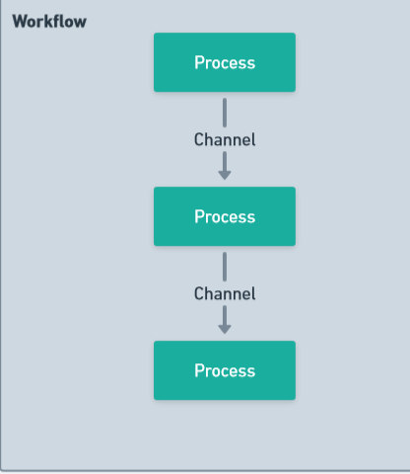
Overview of Nextflow workflow:
Fig: Nextflow workflow
Fig: Nextflow workflow code

Slide 4
Environment setup
Local
Requirements:
Bash
Java
Git
Docker
Gitpod
Requirements:
A GitHub account
Web browser (Google Chrome, Firefox)
Internet connection

Slide 5
Process
A process is the basic computing primitive to execute foreign functions.
Building blocks of Process:
Directives
Input
Output
When
Script
process < name > { [ directives ] input: < process inputs > output: < process outputs > when: < condition > [script|shell|exec]: """ < user script to be executed > """ }
Fig: Pseudo code of Nextflow proces

Slide 6
Channels
They are used to logically connect processes to each other.
Queue : It is an asynchronous unidirectional FIFO queue that connects two processes.
Value : It is bound to a single value and it can be read unlimited times without consuming its contents.
Channels Factories:
value()
of()
fromList()
fromPath()
fromFilePairs()

Slide 7
Operators
Nextflow operators are methods that allow you to manipulate channels.
Filtering: filter, randomSample, take, unique
Reduction: collect, groupTuple, reduce
Text processing: splitCsv, splitJson, splitText
Combining channels: combine, concat, join, mix
Forking channels: branch, multiMap
Maths: count, max, min, sum
Other: ifEmpty, map, set, view

Slide 8
Modularization
A module can be included in other modules or pipeline scripts and even shared across workflows.
Components defined in the module script can be imported into other Nextflow scripts using the “include” statement.
include { foo } from './some/module'

Slide 9
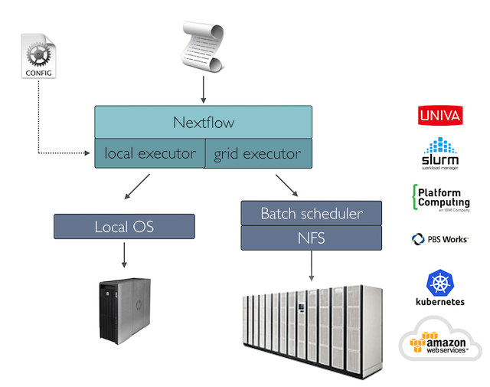
Deployment
Cloud deployment
Cluster deployment

Slide 10
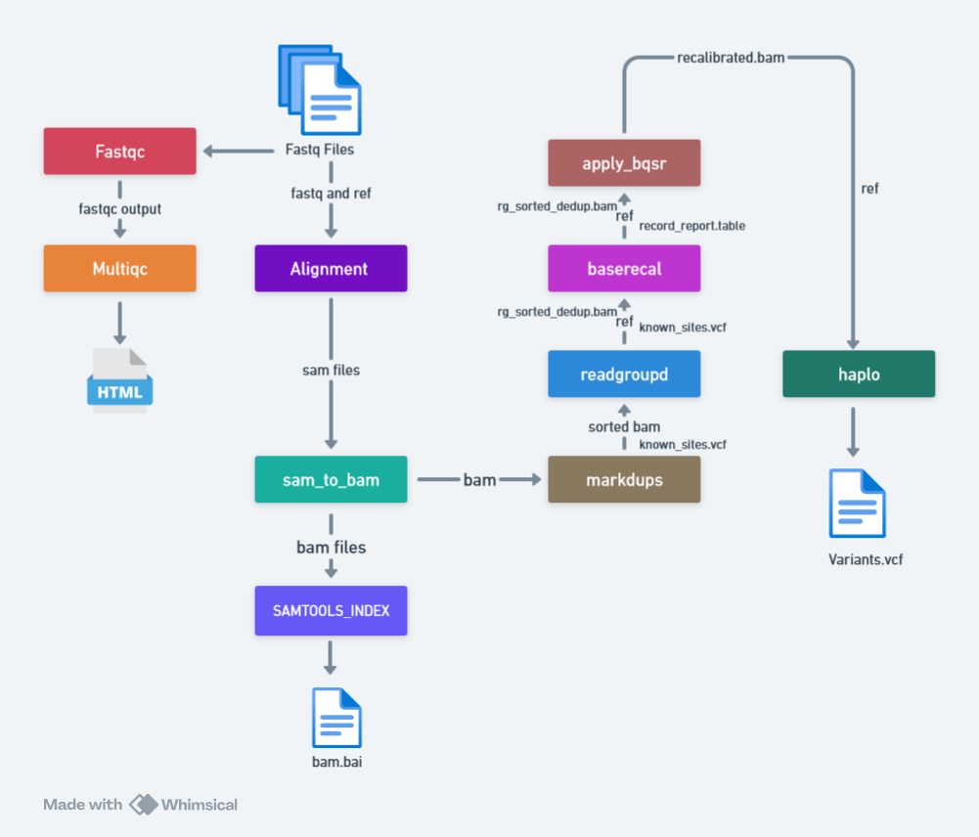
Gatk Pipeline
We have made 12 nextflow processes for GATK pipeline:

