Slide 1
Analysis of the Breweries and their Beers in the United States
Presenters:
Caroll Rodriguez
Aaron Tomkins

Slide 2
Dataset Preparation
The steps taken to produce initial master table of Breweries and their Craft Beers.

Slide 3


Datasets
Beers
Breweries
Brewery ID
Beers
Beer ID
ABV
IBU
Brewery ID
Style
Ounces
Brewery ID
Name
City
State
Beers
Beer ID
Beer ABV
Beer IBU
Brewery ID
Beer Style
Beer Ounces
Brewery Name
Brewery City
Brewery State

Slide 4
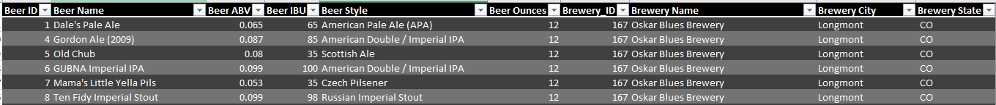
Sample of Merged Data

Slide 5
Missing Data
ABV
60
IBU
1005
Style
5
Does not include UT = Zero – need clarification on whether this is an NA
SD has NA in field for IBU – need clarification

Slide 6
Analysis and Reports
Reports produced from master dataset

Slide 7
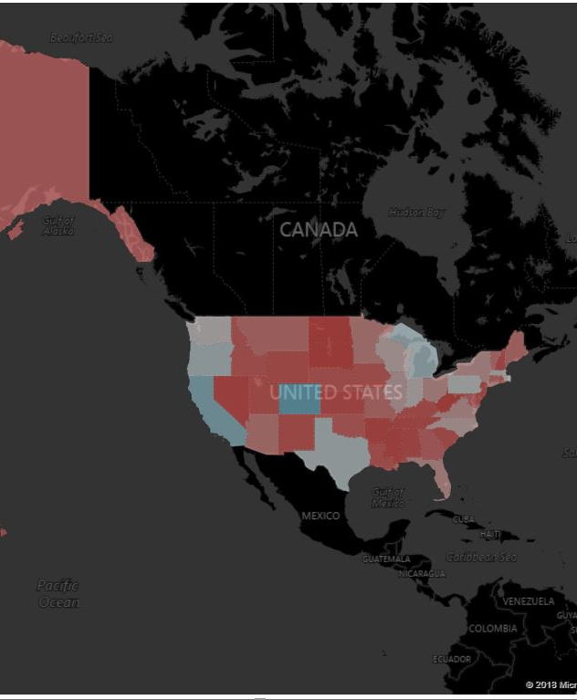
Number of Breweries 558

Slide 8
Number of Breweries

Slide 9
Median alcohol content for each state.

Slide 10
Median international bitterness unit for each state.

