Slide 1
Machine Learning: Predicting the Long Term Credit Ratings of S&P 500 Firms
Rayan Ayari, Nick Bischofberger, Dominik Bucher, Viviane Meyer

Slide 2
Abstract
Financial Data from 2007 to 2017 of the S&P500-firms plus additional Data
Aggregated and formatted Data
Imputation of missing values with MICE
Up-sampling with SMOTE
Applied three algorithms: XGBoost, Random Forrest, Support Vector Machines
XGBoost reached the best test score of 99.68%

Slide 3
Data Gathering and Handling
Warthon Research Data Services → Financial Ratios, Credit Ratings, Sectors, Returns
Federal Reserve Economic Data → Additional Data (Inflation, Interest rates)
Merging via Date, PERMNO and Ticker
Split Credit Ratings into 5 groups
Rating | AAA – AA- | A+ – A- | BBB+ – BBB- | BB+ – BB- | B+ – CCC+
Meaning | Prime & High Grade | Upper Medium Grade | Lower Medium Grade | Non-Investment Speculative Grade | Highly Speculative & Substantial Risk
Numerical Value | 4 | 3 | 2 | 1 | 0
No. of observations | 1421 | 7438 | 11445 | 3257 | 662

Slide 4
Missing Data
Dropped columns with more than 45% missing values
Dropped rows with more than 70% missing values
Imputed missing values with Multiple Imputation by Chained Equations [MICE]
Age | Income | Gender
33 | N.A. | F
18 | 12,000 | N.A.
N.A. | 13,542 | M
Age | Income | Gender
33 | 12,771 | F
18 | 12,000 | F
25.5 | 13,542 | M
Age | Income | Gender
33 | 12,771 | F
18 | 12,000 | F
N.A. | 13,542 | M
Mean imputation
Age back to N.A.
Repeat this process several times and average the datasets
Bootstrapped rows:
Linear Regression to predict age
Age | Income | Gender
33 | 13,542 | F
18 | 12,000 | F
33 | 13,542 | M
Age | Income | Gender
33 | 13,103 | F
18 | 12,000 | F
35.3 | 13,542 | M
Age | Income | Gender
33 | 12,771 | F
18 | 12,000 | F
35.3 | 13,542 | M
Find an observed value closest to your prediction (PMM)
Do this for all N.A. values
Source: https://www.youtube.com/watch?v=zX-pacwVyvU
Notes:
Numbers bc. There was a significant increase (or decrease) after that threshold
Also there were a lot of ‘D’ rating observations that hadn’t all the numbers
Also: fillna for Ratings

Slide 5
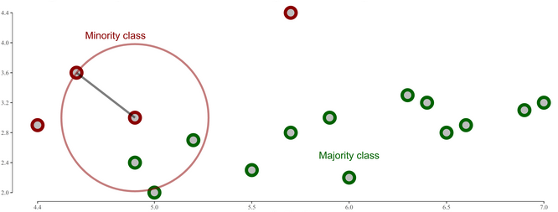
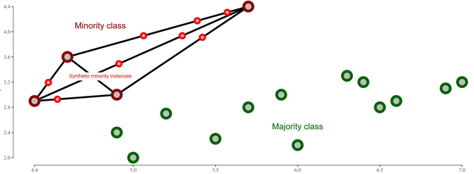
SMOTE
Rating | AAA – AA- | A+ – A- | BBB+ – BBB- | BB+ – BB- | B+ – CCC+
Numerical Value | 4 | 3 | 2 | 1 | 0
No. of observations | 10611 | 10611 | 10611 | 10611 | 10611
knn = 1
Handled class imbalance with Synthetic Minority Oversampling Technique
Up-sampled to number of observations of the largest Class
No replication
Less overfitting
knn = 3

Slide 6
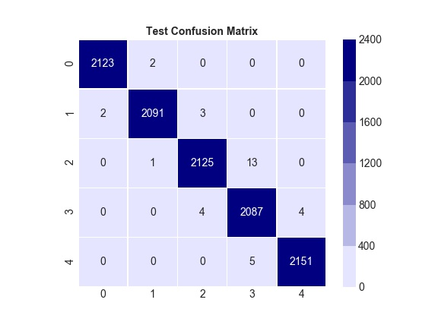
xGBoost (Extreme Gradient Boosting)
Runtime: 2000 seconds
Training Score: 99.3851%
Test Score: 99.6796%
F1 Score: 0 1.00 1 1.00 2 1.00 3 0.99 4 1.00
Notes:
Runtime only to compare between algo’s (not to be taken as absolute number)

Slide 7

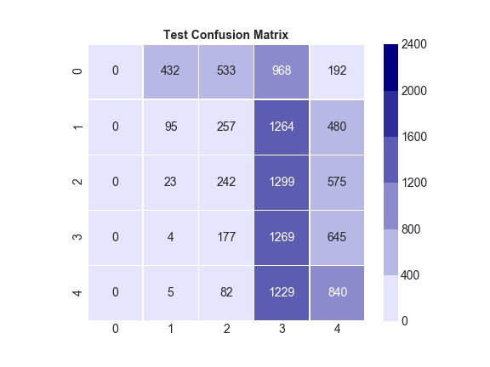
Random Forest
Runtime: 500 seconds
Training Score: 98.2188%
Test Score: 98.6146%
F1 Score: 0 1.00 1 0.98 2 0.97 3 0.98 4 1.00

Slide 8

Support Vector Machines
Runtime: 100 seconds
Training Score: 97.5968%
Test Score: 98.1340%
F1 Score: 0 1.00 1 0.99 2 0.96 3 0.97 4 1.00
Notes:
Draw a Hyperplan between the observations to best distinguish the classes.
Maximizing the margin between the nearest points

Slide 9
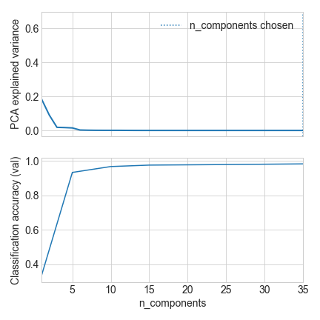



Principal Component Analysis
Lots of information in few components
Explained variance is nearly zero after five components

Slide 10
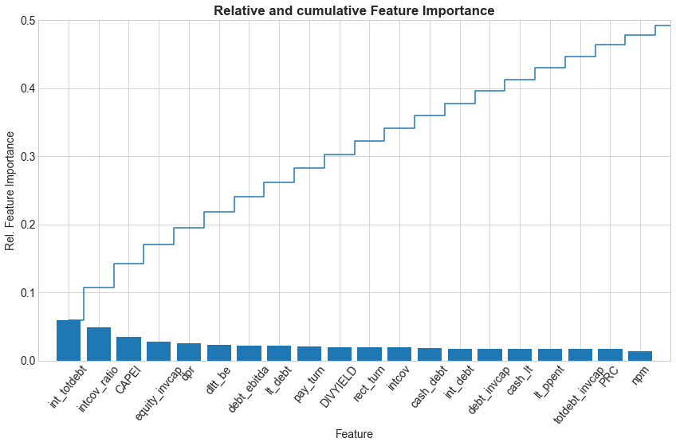
Feature Importance
As expected: no clear indicators
Ratios are important
Additional features (sector, interest rates, …) didn’t contribute much

Slide 11
Conclusion
Data preprocessing did, as expected, require the biggest part of the time (ca. 2/3)
Coordinating the tasks was very important to remain efficient
Reached a test score of 99.6796% which is better than expected
Tried out a lot of additional techniques (SMOTE, MICE, NeuralNetworks)
Lot of work but definitely worth it
Learned a lot about coding and statistics
Notes:
Didn’t manage to get AUC and Neural networks

