Slide 1


SMART INDIA HACKATHON 2026
TERRAFLY
PROBLEM STATEMENT • SIH26175
DepthWizard — Single-View Height Estimation and 3D Flythrough
ORGANIZATION • ISRO / Department of Space
CATEGORY • Software
TEAM • TerraFly
TEAM ID • Pending portal allotment
ONE IMAGE • TWO TRUTHFUL MODES • ONE EXPLORABLE 3D SCENE
Notes:
LEAD / CORE DEVELOPER — 35 to 45 seconds
Good morning. We are Team TerraFly, working on ISRO problem statement SIH26175.
The problem is simple to state: one optical image shows colour, but decision-makers need shape, height and an explorable 3D view.
Our promise is equally simple: TerraFly produces relative 3D from one image, and uses metre labels only after valid calibration. It runs locally and leaves an evidence trail.
HANDOFF: Saman will first show why this gap matters and what the user receives.
[Sources]
- C:/Users/USER/Downloads/SIH 2026 Official PS.xlsx — PS 26175
- https://github.com/IMG-PROCESS-SAC/SIH-DepthWizard-2026
[/Sources]

Slide 2
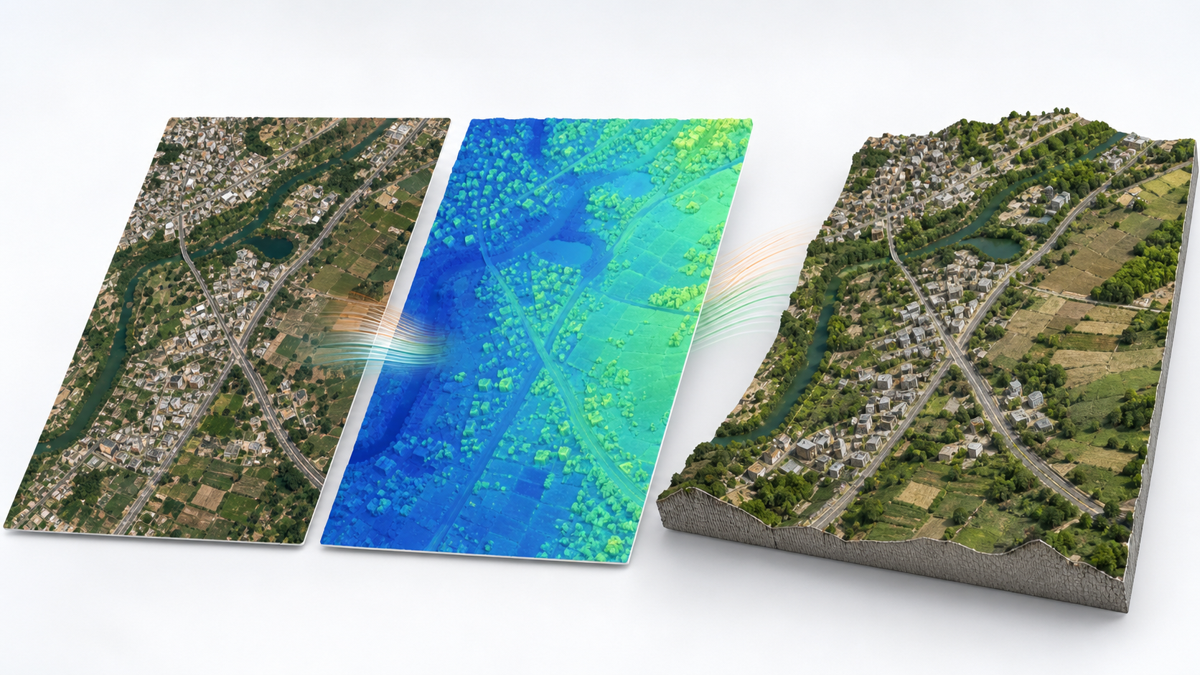
ONE IMAGE BECOMES A DECISION-READY 3D SCENE
TerraFly
TerraFly separates relative shape from metric elevation—then proves the difference.
RELATIVE BY DEFAULT
PNG / JPG → rDSM
shape and ordering, not fake metres
METRIC AFTER CALIBRATION
GeoTIFF + SRTM / GCP / reference DEM
→ DSM with units and residuals
LOCAL + EXPORTABLE
3D flythrough • height / slope
GeoTIFF • OBJ / glTF • manifest
RGB INPUT
RELATIVE SURFACE
TEXTURED 3D
Concept visualization — not model output
Notes:
SAMAN / RESEARCH & PRESENTATION — 55 to 65 seconds
A single optical RGB image contains appearance, not directly measured height. That is why TerraFly has two honest modes.
For an ordinary PNG or JPG, the output is a relative surface: which region is higher or lower. For a georeferenced image with a valid anchor such as SRTM, GCPs or a reference DEM, TerraFly fits scale and offset and can report a metric DSM.
The same run creates an interactive textured scene, analysis tools and reusable outputs. The visual on this slide is a concept illustration; our live application will supply the real evidence.
HANDOFF: Om will now explain exactly what happens after the user presses Generate.
[Sources]
- C:/Users/USER/Downloads/SIH 2026 Official PS.xlsx
- https://github.com/IMG-PROCESS-SAC/SIH-DepthWizard-2026
- Image generated with built-in ImageGen as a labelled concept visualization; it is not presented as model output.
[/Sources]

Slide 3
WHAT HAPPENS AFTER THE USER PRESSES GENERATE
TerraFly
A sensor-aware pipeline turns a model prediction into inspectable geospatial evidence.
01
02
03
04
05
VALIDATE
RGB bands • size • CRS
no-data • quality
INFER
Depth Anything V2 Small
tiled CUDA / CPU
CALIBRATE
z = a·r + b
SRTM • GCP • reference
BUILD
DSM GeoTIFF • mesh
texture • LOD
VERIFY / EXPORT
height • slope • residuals
OBJ / glTF • manifest
TRUTH LANE
Mode label → calibration residuals → input/model/output hashes → warnings and units
Python • PyTorch • Rasterio • FastAPI | React • Three.js | Windows • CUDA with CPU fallback
Notes:
OM / ML & BACKEND — 65 to 75 seconds
First we reject unsupported inputs and preserve geospatial metadata. Then a lightweight monocular depth model estimates a relative surface in tiles so an 8 GB GPU can handle larger images.
Calibration is a separate, visible step: we fit scale and offset against aligned reference elevations and report residual error. No successful calibration means no metre label.
Rasterio writes the geospatial output; Three.js builds the textured height-field and flythrough. Every job records units, model/checkpoint, calibration method, warnings and hashes.
CUDA simply means the NVIDIA GPU can accelerate model calculations. If it fails or runs out of memory, TerraFly reduces tile size or uses CPU fallback.
HANDOFF: Our validation member will show how we prove both accuracy and product quality.
[Sources]
- https://depth-anything-v2.github.io/
- https://github.com/DepthAnything/Depth-Anything-V2
- https://rasterio.readthedocs.io/
[/Sources]

Slide 4
WE BUILD TO THE JUDGING RUBRIC—NOT A GENERIC AI DEMO
TerraFly
The official problem balances height truth and an intuitive, stable 3D experience.
50% HEIGHT TRUTH
50% PRODUCT EXPERIENCE
MEASURE
JUDGES SEE
RMSE • MAE • correlation
calibration residuals • reference alignment
Textured 3D • orbit / first-person camera
height and slope inspection • clean export
STRESS TEST
ROBUSTNESS
Urban • sparse settlement • hilly • forest
plus one controlled poor-input case
8 GB target • tiled inference • OOM recovery
CPU fallback • offline restart
RESPONSIBLE BOUNDARY Rapid decision-support surface—not a replacement for survey-grade LiDAR.
Notes:
MEMBER 5 / QA & VALIDATION — 55 to 65 seconds
The official evaluation is not only whether a 3D scene looks impressive. Half is numerical surface accuracy; half is visualization quality and usability.
We therefore test aligned reference data with RMSE, MAE and correlation across four landscape types. We also show calibration residuals and one bad-input case, because a system that knows when not to claim certainty is more trustworthy.
For product quality we demonstrate camera controls, inspection, exports, offline restart and recovery on our actual 8 GB machine.
Do not place a number in the presentation until the saved evaluation report proves it.
HANDOFF: Our deployment member will connect this proof to the India and public-sector use case.
[Sources]
- C:/Users/USER/Downloads/SIH 2026 Official PS.xlsx — evaluation criteria
[/Sources]

Slide 5
THE GAP IS NOT ‘NO IMAGERY’—IT IS UNEVEN, HARD-TO-USE 3D
TerraFly
TerraFly turns authorized imagery into local, auditable decision support.
THE GAP
TERRAFLY
DECISION VALUE
Public 3D coverage is uneven
Detailed 3D needs special collection
Stereo / LiDAR may be unavailable or costly
Relative and metric modes
On-premise / offline-first
Auditable GeoTIFF + 3D assets
No invented input detail
Disaster first-look
Urban / infrastructure screening
Terrain assessment
Reusable analysis assets
USERS ISRO / NRSC analysts (potential integration) • disaster teams • planners • researchers
Accuracy depends on input resolution, scene conditions and calibration quality. India does not simply ‘ban good imagery’; collection, licensing, permissions and provider coverage all matter.
Notes:
MEMBER 6 / GEOSPATIAL & DEPLOYMENT — 55 to 65 seconds
We should not tell judges that India bans high-quality Google Earth imagery. That is too broad and may be wrong. Detailed 3D depends on satellite and aerial collection, local rules and permissions, licensing, processing priorities and provider coverage.
India's geospatial reforms encourage innovation while maintaining rules for sensitive attributes and high-accuracy data. TerraFly's contribution is not bypassing those rules; it is processing authorized imagery locally and recording how outputs were produced.
The outcome is fast first-look terrain understanding for disaster, planning and infrastructure workflows. We position this as potential integration for authorized ISRO/NRSC workflows—not as an adopted ISRO product.
HANDOFF: Parth will close with the exact proof package and then we will run the demo.
[Sources]
- https://support.google.com/earth/answer/6327779
- https://dst.gov.in/sites/default/files/Final%20Approved%20Guidelines%20on%20Geospatial%20Data.pdf
- https://dst.gov.in/sites/default/files/National%20Geospatial%20Policy.pdf
- https://www.isro.gov.in/DisasterManagementSupport.html
[/Sources]

Slide 6
A CLAIM ENTERS THE PPT ONLY AFTER IT HAS EVIDENCE
TerraFly
Our last slide is the proof plan; the next screen is the working product.
LIVE DEMO
EVIDENCE PACK
RESEARCH BASE
• Wi-Fi off
• Upload and Generate
• Relative / metric label
• 2D + textured 3D
• Inspect and export
• Controlled failure
• RMSE / MAE / correlation
• Calibration residuals
• Urban / forest / hill tests
• Runtime + VRAM log
• Input and artifact hashes
• Reproducible test report
• Official PS + SAC repo
• Depth Anything V2
• SRTM / NASADEM
• India geospatial rules
• Google imagery explanation
• ISRO DMS use cases
SHOW THE WORKING SYSTEM • MEASURE IT • ADMIT ITS BOUNDARY
Notes:
PARTH / FEASIBILITY, CLOSE & Q&A COORDINATION — 40 to 50 seconds
Winning teams repeatedly describe the same pattern: understand the problem, show a real MVP, speak visually, validate with users or data and make every member answer for their work.
Our evidence pack therefore contains numerical accuracy, calibration residuals, landscape tests, runtime/VRAM logs and reproducible job manifests.
CLOSE: We are not asking you to trust a promise. We will now run TerraFly locally with the network disconnected and show both a successful result and how it handles an invalid case.
DEMO HANDOFF: The team lead narrates while Om operates the application. One speaker, one operator; no laptop handoff.
[Sources]
- https://medium.com/@harshitamaheshwari321/i-won-smart-india-hackathon-2025-heres-what-actually-happens-behind-the-scenes-96198ae391b1
- https://www.reddit.com/r/Indian_Academia/comments/1uz483r/how_we_got_shortlisted_for_the_smart_india/
- https://lbrce.ac.in/committees/ciie_committee/ciie_achievements/2024-25/SIH%20FINAL%20REPORT.pdf
- https://sittechno.org/userfiles/file/events/Internal%20Hackathon%20Report%20SIH%202024%20SIT%20Siliguri.pdf
[/Sources]

