Slide 1
Operating systems FDY class week 2

Slide 2
Today
Questions and discussion arising from video
Worksheet
Research task
Closing discussion
Notes:
1

Slide 3
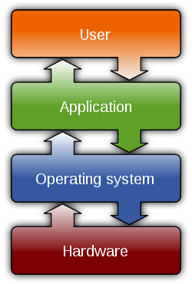
Recap/discuss
What is an operating system?
Notes:
Thats why OS’s may be specific for architectures and have components that are specific for certain hardware. A good example is a wifi device. Your OS will need to have the correct software to manage your wifi device, which is specific to that device. Once its installed and working, none of your applications need to worry how it is connected to the internet, thats managed at a lower level by the OS. Similarly, your word process or text editor does not have to worry about how it will write to a file on disk, or have to have any different implementations for different makes or types of hard disk.

Slide 4
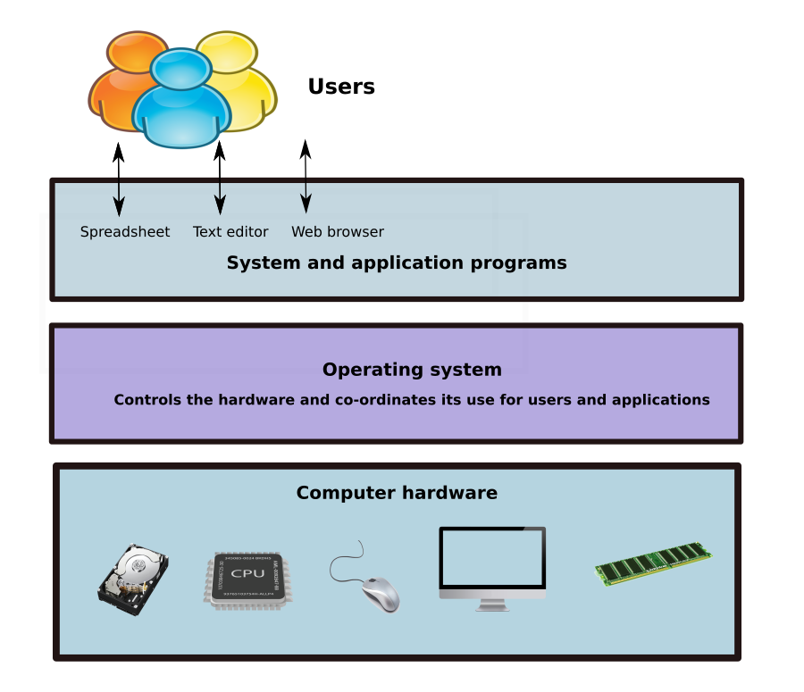
Give an example of how an operating system helps users perform a task, eg. sending an email
How to you understand ‘abstraction’ in the context of this layered model?

Slide 5

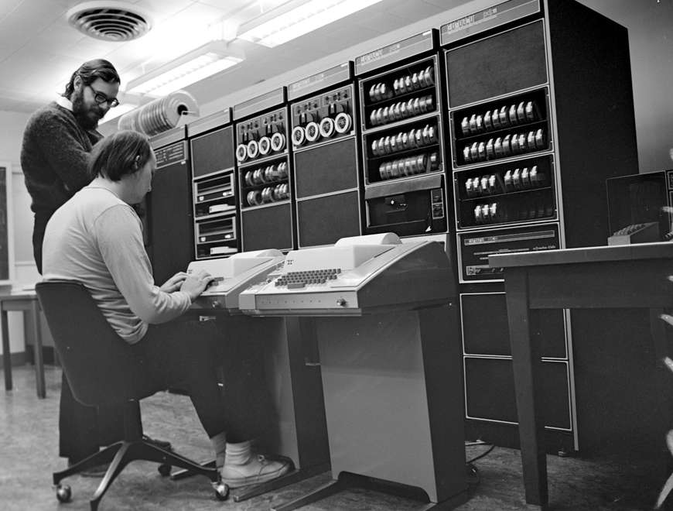

Do you think open source is important in computer science?
Why?
Ritchie and Thomson at Bell labs
https://www.bell-labs.com/var/articles/invention-unix
Notes:
Open source is fundamental to the operating system ‘eco-system’.

Slide 6


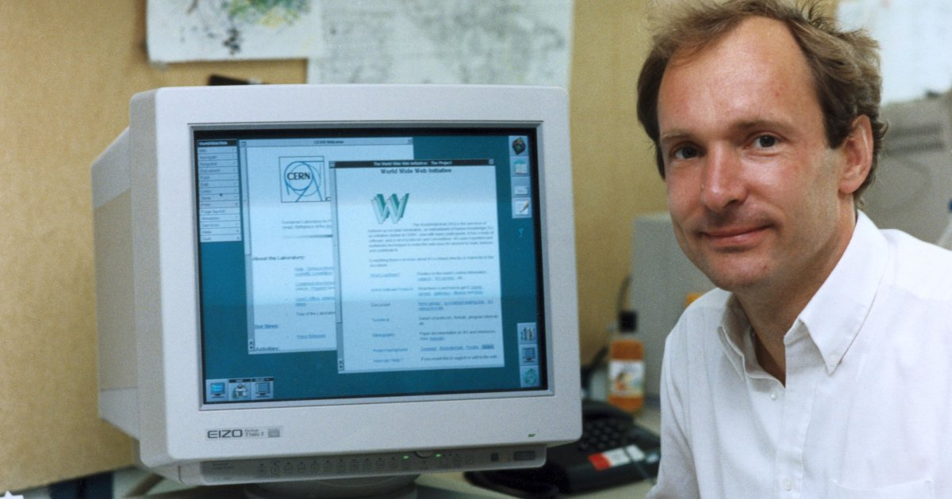
Give an example of a usage for which and OS would have to be specialised

Slide 7
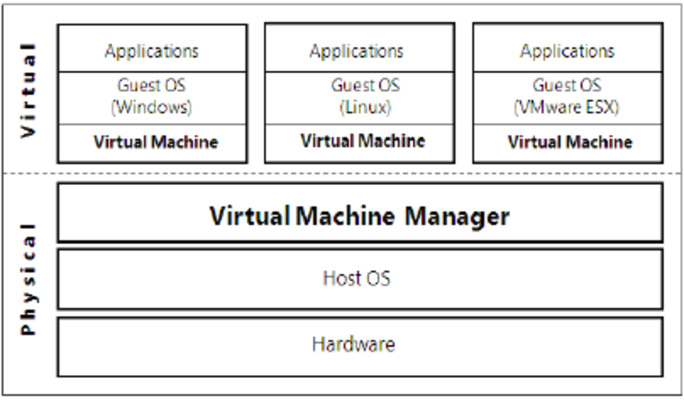
Virtualisation and cloud computing
Tell me how cloud computing does and does not conform to the ‘layered’ model of an OS that we looked at earlier?

Slide 8
The command line
What are some things that are difference between using a GUI and using the command line?
Why is the command line important?
Notes:
<number>

