Slide 1
ContentDistributionApp

Slide 2
Agenda
Architecture Diagram
Code Walkthrough
Challenges
Design Decisions
Limitations
Collaboration

Slide 3
Architecture Diagram

Slide 4
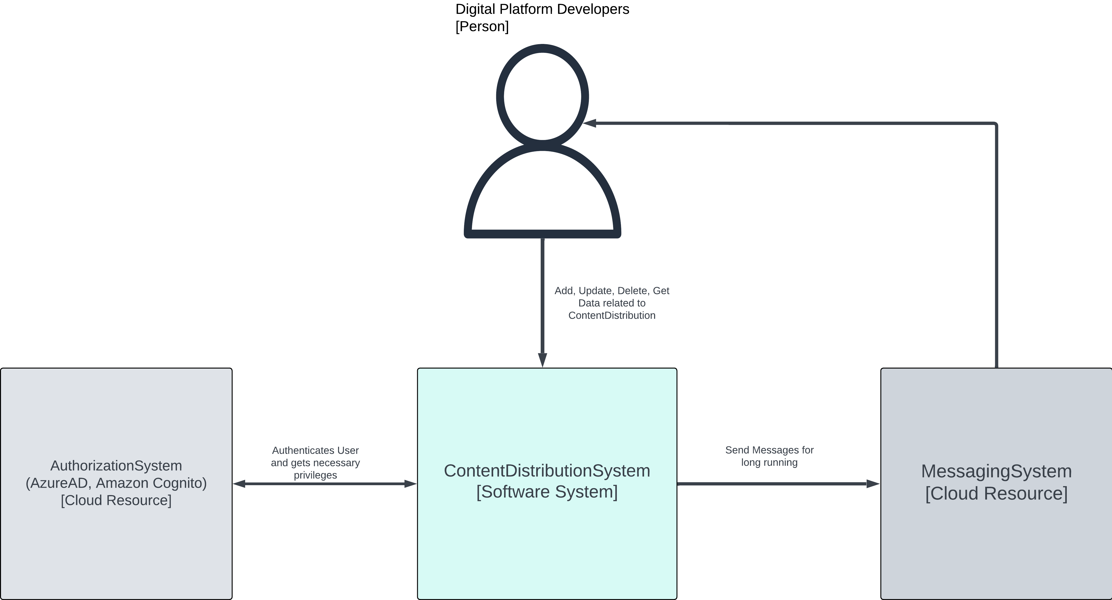
1. System Context Diagram

Slide 5
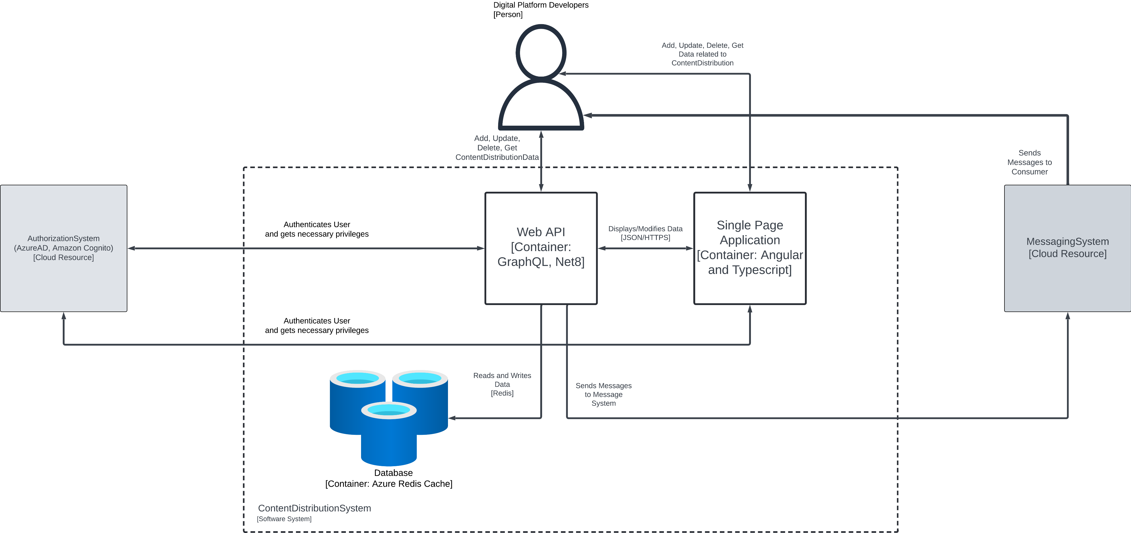
2. Container Diagram

Slide 6
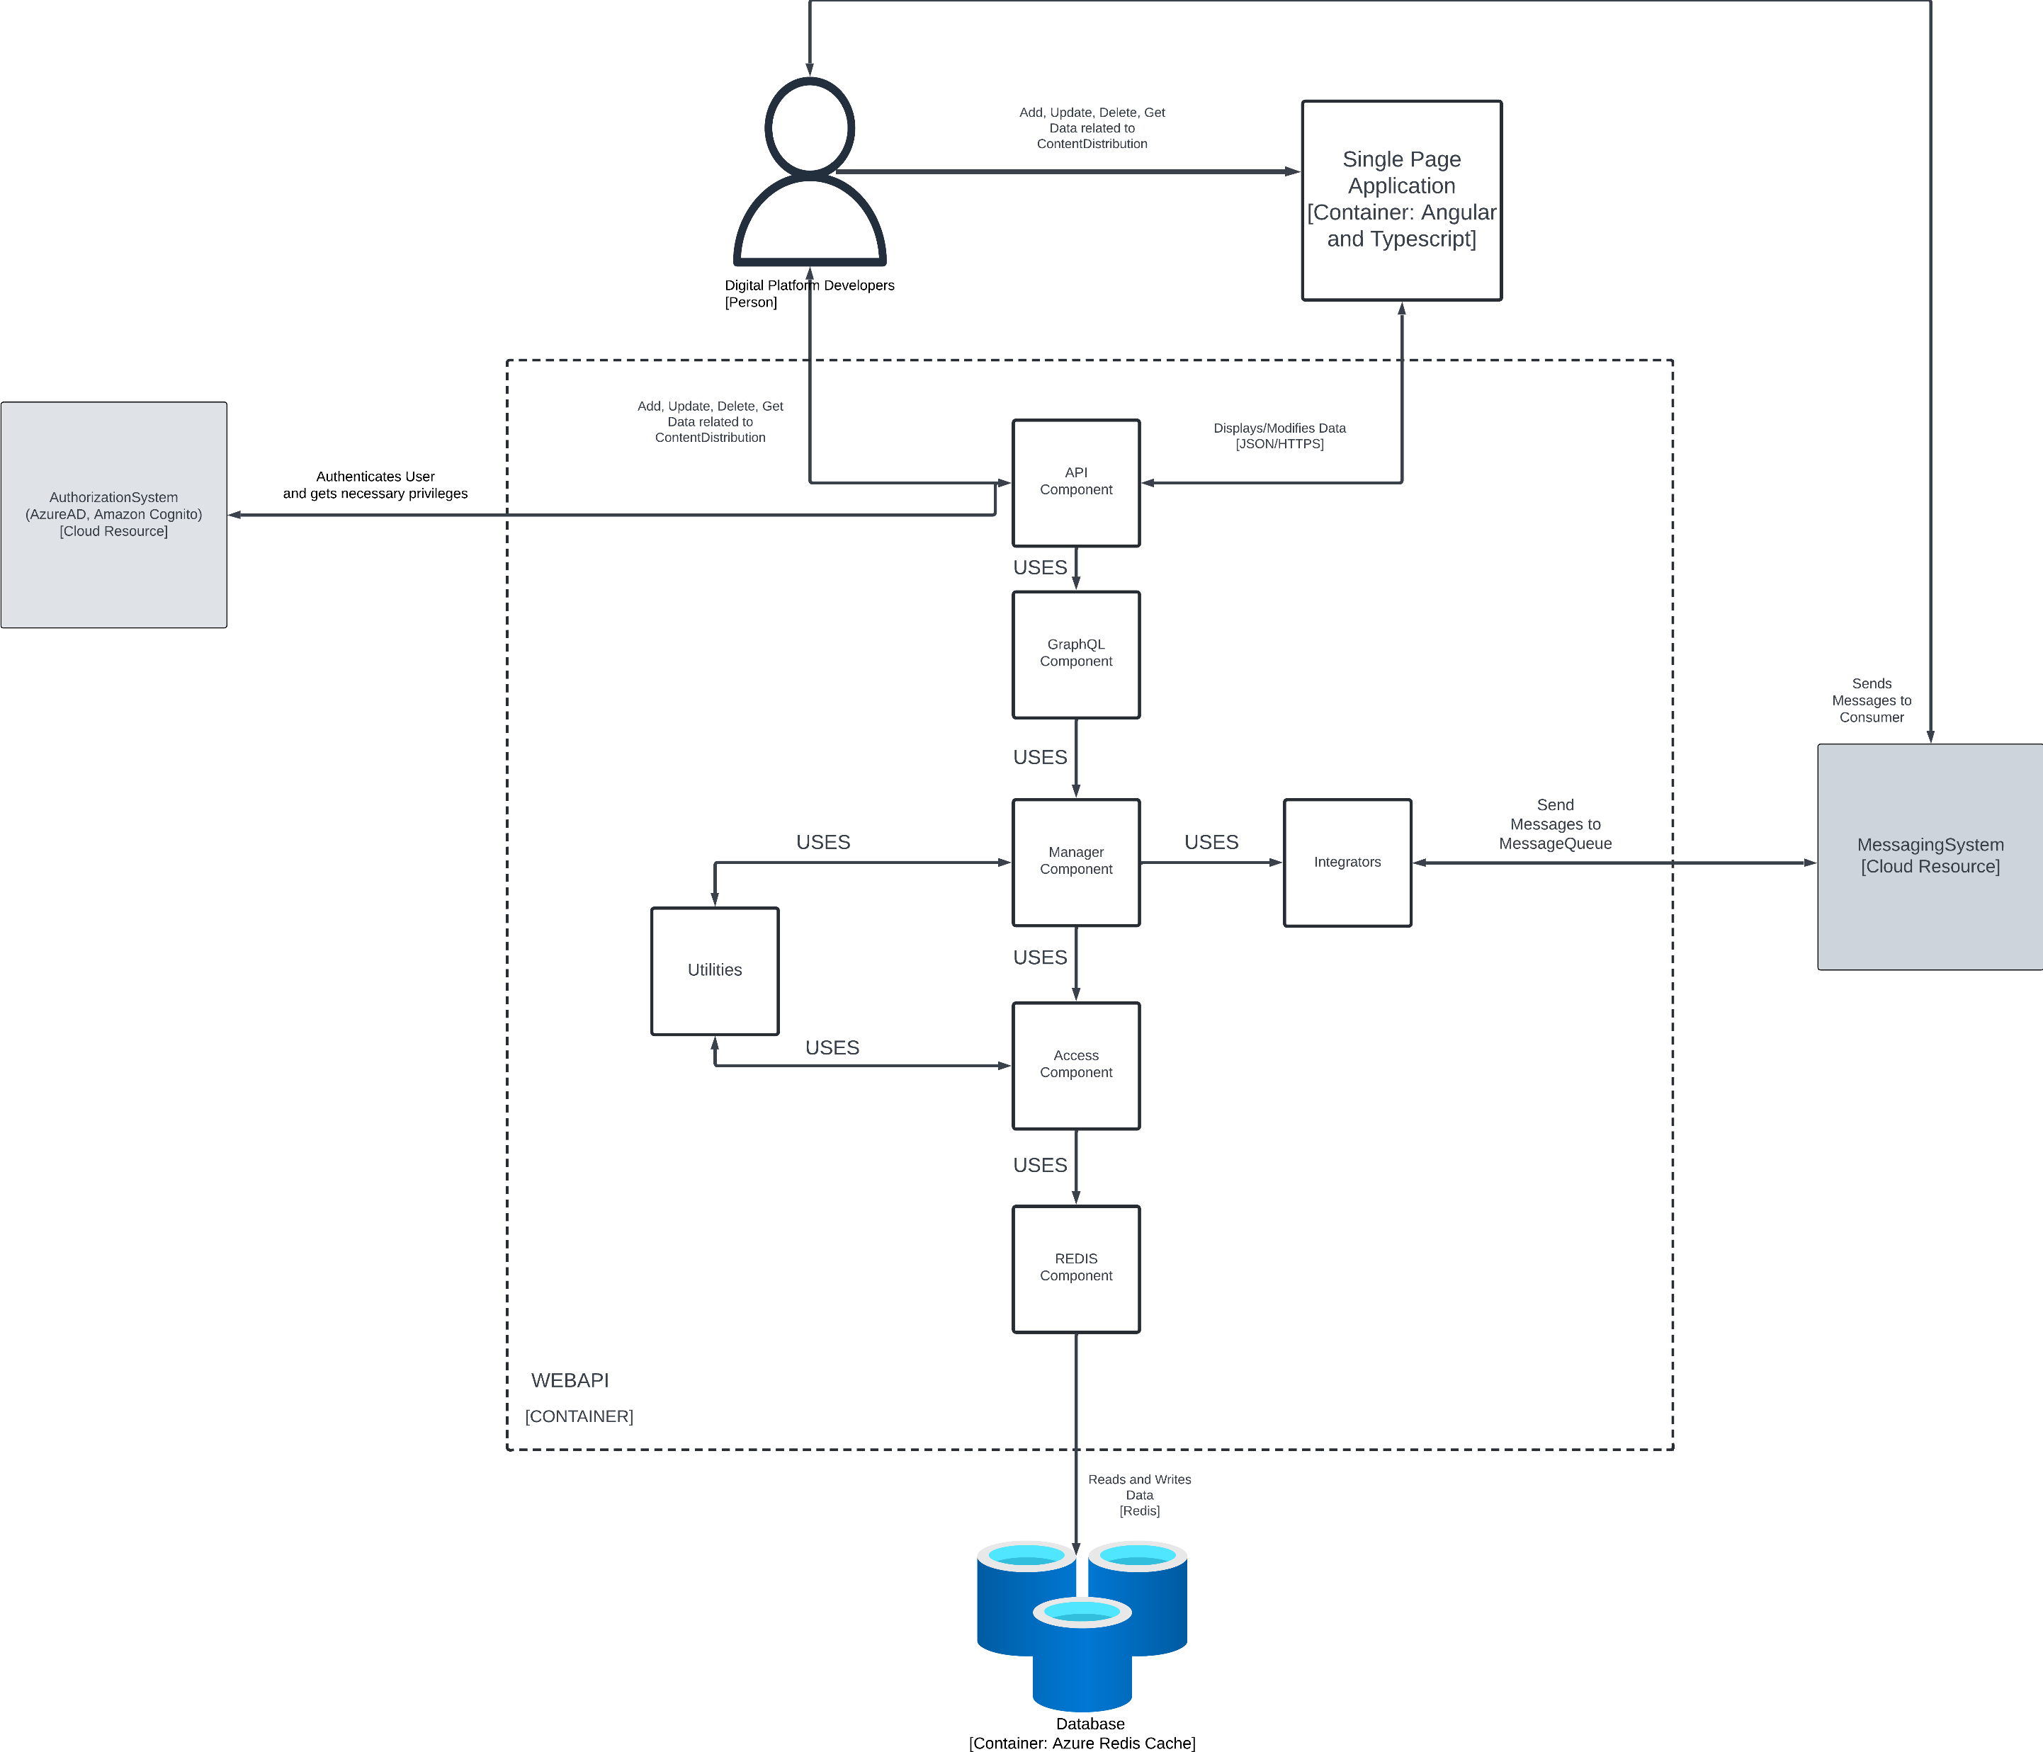
3. Component Diagram

Slide 7
Challenges

Slide 8
Challenges
Time Factor
Loosely Coupled Relationships
A Data Presentation Layer that can be easily configured without compromising the underlying data.
Scalability of Solution
A Cache Strategy
Maybe a UI Interface?

Slide 9
Design Decisions

Slide 10
Design Strategy
Time Factor
Easy to Code/Understand
Loosely Coupled Relationships
A Data Presentation Layer that can be easily configured without compromising the underlying data.
A technology where you can modify the presentation layer without compromising the underlying data
Scalability of Solution
Make the solution scalable in a sense that if you remove one part of the code, you can easily replace it with something more performant. Like LEGOs
An Interface (Maybe UI)

Slide 11
Solution

Slide 12
Solution
GraphQL
Redis as a backing store
GraphQL playground as UI Interface for developers

Slide 13
Code Walkthrough

Slide 14
Limitations

Slide 15
Limitations
Not much validation for duplicates, or uniqueness of data.
Not much validation for inputs.
Not so much thorough testing via Unit Tests/IntegrationTests
No UI Component due to time limitation
No Authentication/Authorization.
Mocked ClaimsPrincipal Information to mock a logged on user.

Slide 16
Questions?

Slide 17
Thank you! ☺

