Slide 1
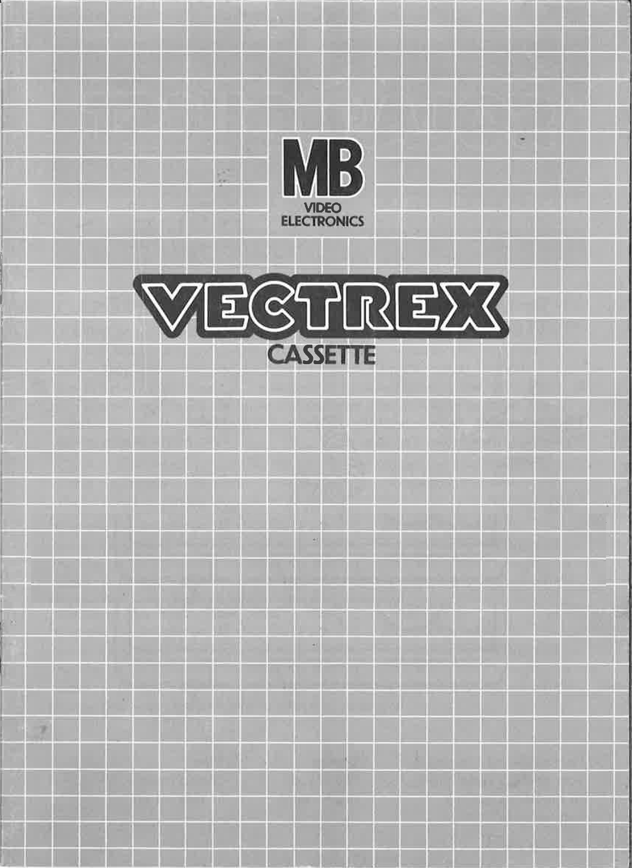
BATTLE DRONES

Slide 2
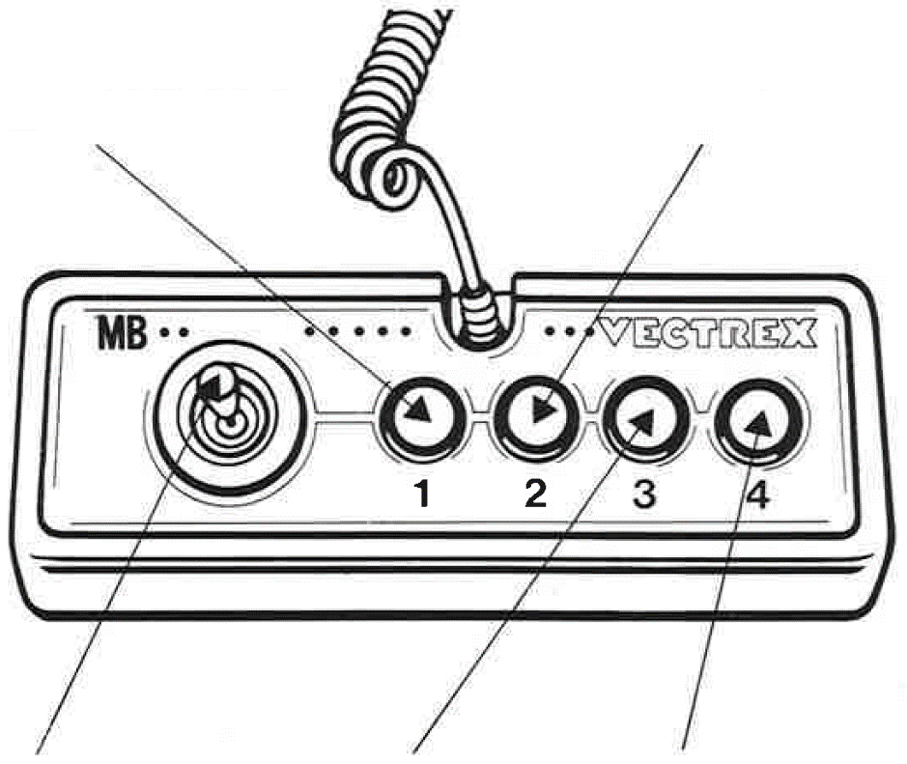
BATTLE DRONES
GAME CONTROLS
Battle Drones is designed to be played with the built-in control panel only. The functions of the controls are:
Button 1
Pauses and resumes the game
Button 2
No function
Joystick
Controls the movement of the drone in 8 directions
Button 3
No function
Button 4
Fires a bullet

Slide 3
HOW TO PLAY
PLAYER SELECTION
Battle Drones offers three different game modes for up to two players:
Singleplayer Mode: Are you better than the computer? One player competes against three computer controlled drones.
Multiplayer Mode: Invite a friend and let him join. Two human players and two computer controlled drones fight individually.
Duel Mode: Challenge a friend in direct combat! Only two human players compete against each other.
Remember: drones have no feelings and can’t team up. All drones fight against each other. Only one drone can win!
OPTION SELECTION
The game boots directly into the game mode selection, which is already the only option to configure. Search with Button 2 or 3 a game mode and start it with Button 4.
GAMEPLAY
Objective
Control your drone to shoot down the other drones while also avoiding their attacks.
Respawning
If your drone is shot down, don’t worry. You will receive a new drone after a 4 s cooldown period. There are also unlimited respawns.
Winning Condition
The first player to achieve ten kills wins the game.
SCORING RULES
Only the final hit counts! The last drone that strikes the killing blow receives credit for the elimination.
Assist do not exist. If you can’t finish, you loose!
“It's not about who shoots the most ... it's about who shoots last!”

Slide 4
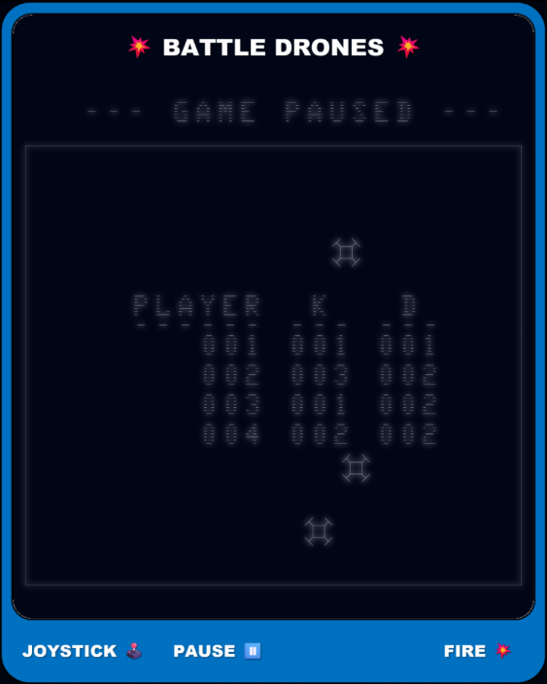
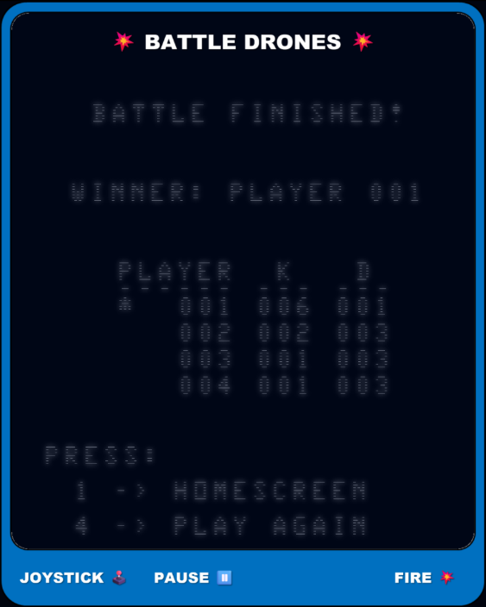
SCOREBOARD
During an active battle, you can view the current score board within the pause menu (see Figure 1).
As soon as the battle finishes, you will be presented a summary of the game (see Figure 2). You can view the scoreboard as long as you do not restart or return to the home screen. There is no battle history.
Fig. 1: Pause Menu Fig. 2: Battle Summary
AFTER THE BATTLE
The moment a player wins the battle a summary of the game will be shown. You can see the player who won, player stats and possible further actions.
PLAYER STATS
A table with kills and deaths of each player will be shown, to compare different players. An asterisk indicates the winning player.
FURTHER ACTIONS
If you want to select a different game mode, press button 1. If want to play the same game mode again, press the button 4.

Slide 5
PAUSE
If a player pauses the battle with button 1, only he can resume it with the same button again. During the break, the players can have a look at the current scoreboard (see Figure 2).
Additional Info:
Each drone starts with a default health of 50. Health decreases when hit by a bullet by 10.
…

Slide 6
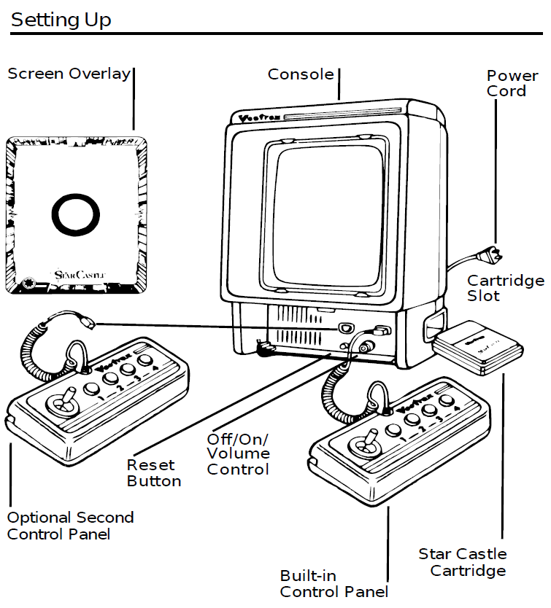
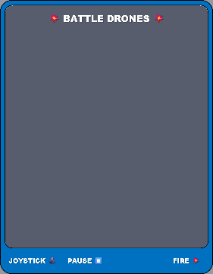
SETTING UP
CREDITS
This game was developed by Anthony Tonella and programmed in C and MC6809 assembly language. It is the outcome of a student project which was part of the elective course “Advanced hardware-oriented C and Assembly Language Programming” at Pforzheim University, Germany, in spring term 2025, supervised and tutored by Prof. Dr. rer. nat. Peer Johannsen.

Slide 7


