Slide 1
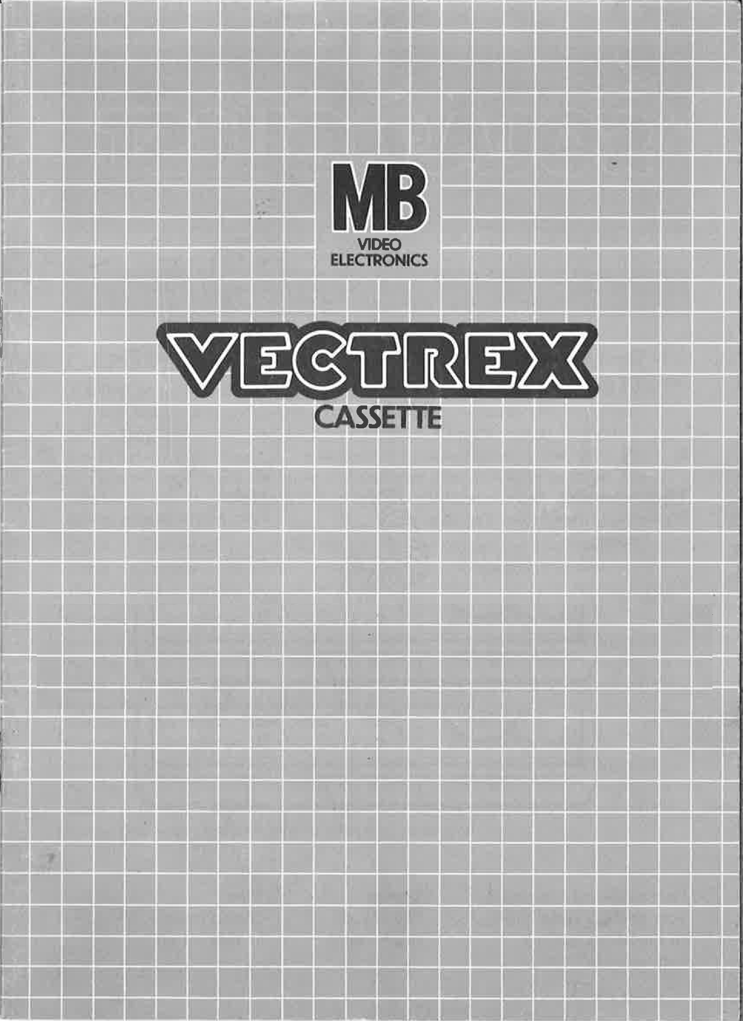
Vectrocopters

Slide 2
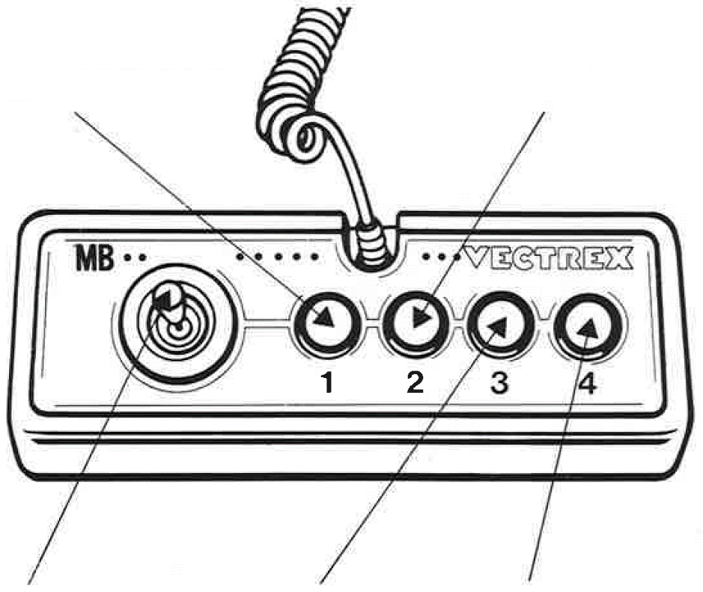
Vectrocopters
GAME CONTROLS
Vectrocopters is designed to be played with the built-in control panel only. The functions of the controls are:
Button 1
Pause / Resume
Button 2
No function
Joystick
Controls the movement of the vectrocopters in 8 directions
Button 3
No function
Button 4
Fires a bullet

Slide 3
HOW TO PLAY
PLAYER SELECTION
Vectrocopters offers three different game modes for up to two players:
Singleplayer Mode: Are you better than the computer? One player fights with three computer-controlled vectrocopters in the arena.
Multiplayer Mode: Invite a friend and let him join. Two human players and two computer-controlled vectrocopters fight individually.
Duel Mode: Challenge a friend in direct combat! Only two human players compete against each other.
Remember: Vectrocopters have no feelings and can’t team up. All vectrocopters fight against each other. Only one vectrocopter can win!
OPTION SELECTION
The game boots directly into the game mode selection, which is already the only option to configure. Scroll with Button 2 or 3 through the game modes and start it with Button 4. The numbers correspond to the numbering above.
GAMEPLAY
Objective
Control your vectrocopter to shoot down the other vectrocopters while also avoiding their attacks.
Respawning
If your vectrocopter is shot down, don’t worry. You will receive a new vectrocopter after a 4-second cooldown period. You have unlimited respawns.
Winning Condition
The first player to achieve ten kills wins the game.
SCORING RULES
Only the final hit counts. The last vectrocopter that strikes the killing blow receives credit for the elimination.
Assists do not exist. If you can’t finish, you loose!
“It’s not about who shoots the most ... It’s about who shoots last!”

Slide 4
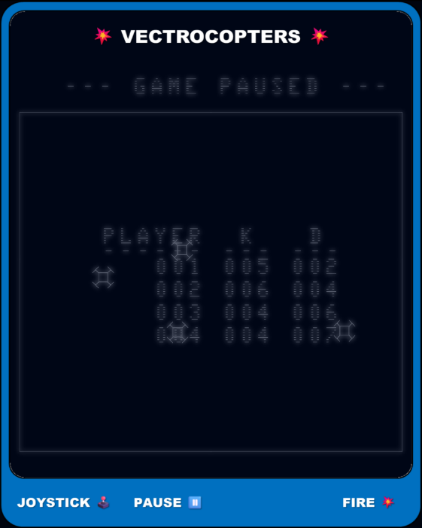
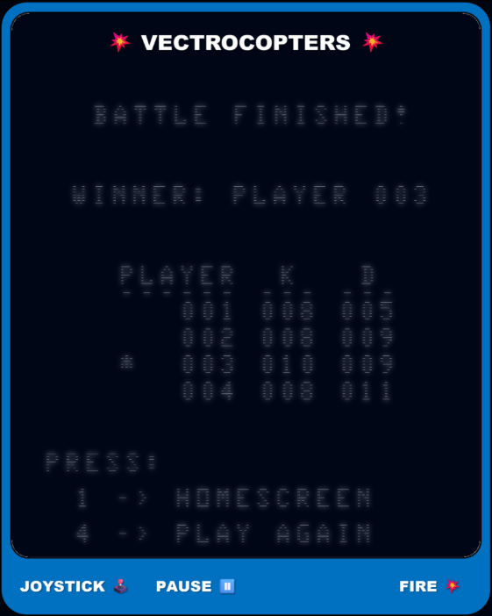
SCOREBOARD
During an active battle, you can view the current scoreboard within the pause menu (see Figure 1).
As soon as the battle finishes, you will be presented a summary of the game (see Figure 2). You can view the scoreboard as long you do not restart or return to the home screen. There is no battle history.
Fig. 1: Pause Menu Fig. 2: Winner Screen with Stats
PAUSE
If a player pauses the battle with button 1, only he can resume it with the same button again. During pause mode:
All in-game action is paused, but the rendering continues.
The current scoreboard is shown (see Figure 1) and shows the current stats for each player.
Press Button 1 again to resume the battle.

Slide 5
HEALTH & DAMAGE
Each vectrocopter starts with 50 health points:
Being hit by a bullet subtracts 10 points from the vectrocopter’s health.
When the health reaches 0, the vectrocopter is destroyed and removed from the arena.
It will respawn at a random position after a 4-second cooldown.
Vectrocopters have unlimited respawns.
AFTER THE BATTLE
The moment a player wins the battle a summary of the game will be shown. You can see the player who won, player stats and possible further actions.
PLAYER STATS
A table with kills and deaths of each player will be shown, to compare yourself with your opponents. An asterisk indicates the player who won.
FURTHER ACTIONS
If you want to select a different game mode, press button 1. In case you enjoyed the game mode, please press the button 4 to play again.

Slide 6
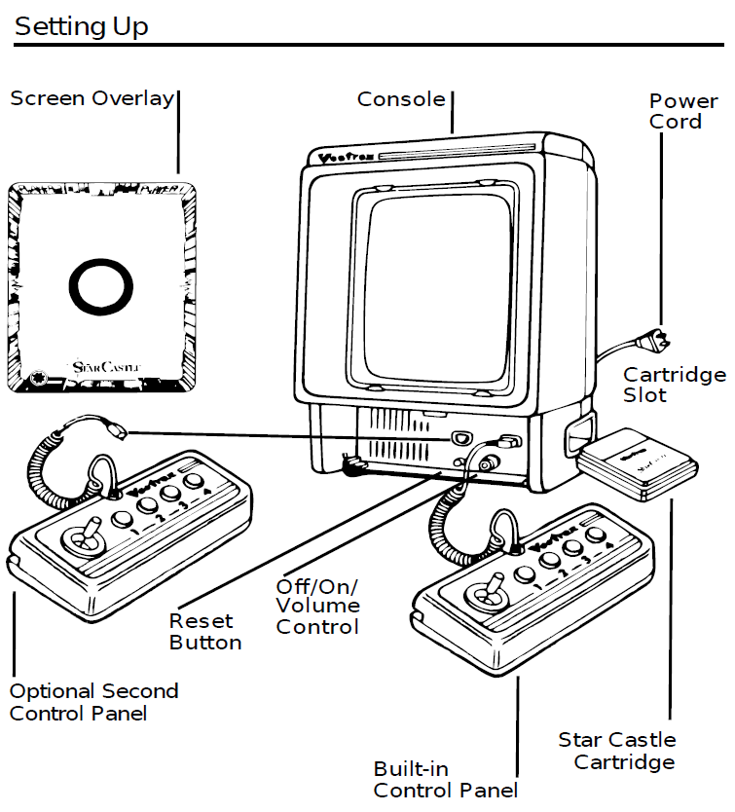
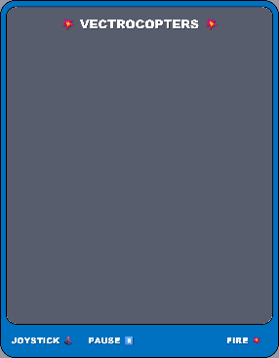
SETTING UP
CREDITS
This game was developed by Anthony Tonella and programmed in C and MC6809 assembly language. It is the outcome of a student project which was part of the elective course “Advanced hardware-oriented C and Assembly Language Programming” at Pforzheim University, Germany, in spring term 2025, supervised and tutored by Prof. Dr. rer. nat. Peer Johannsen.

Slide 7


