Slide 1
Machine Learning in Untargeted Metabolomics
Alexander Tong, Nicholas Alden,
Vlad Porokhin, Neda Hassanpour,
Kyongbum Lee, Soha Hassoun

Slide 2
Untargeted Metabolomics
Targeted Metabolomics
Measures the end products
Snapshot of biological status
Measure small target set of molecules
Untargeted Metabolomics
Simultaneous measurement of thousands of metabolites
Uses mass spectrometry techniques
Computationally harder

Slide 3
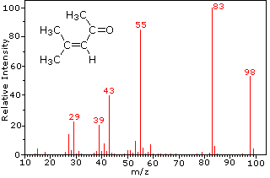
Mass Spec
Identify Compound by Molecular weight
m/z ratio

Slide 4
Problem
Interesting Questions
What metabolic pathways are active?
What undetected metabolites are we likely/unlikely to find?
Idea
Use Biological Context

Slide 5
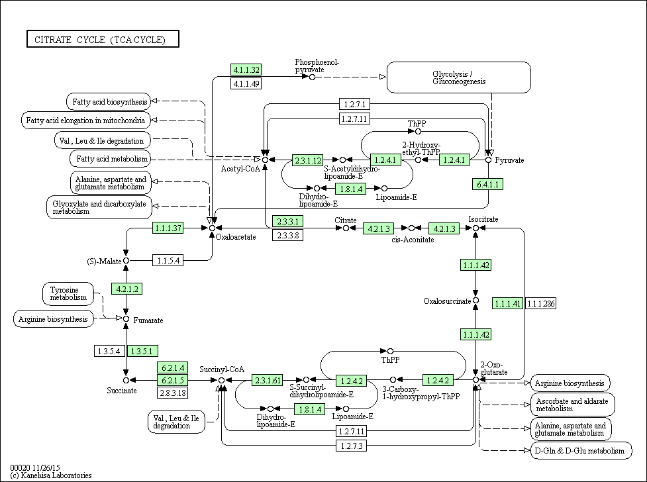

Slide 6
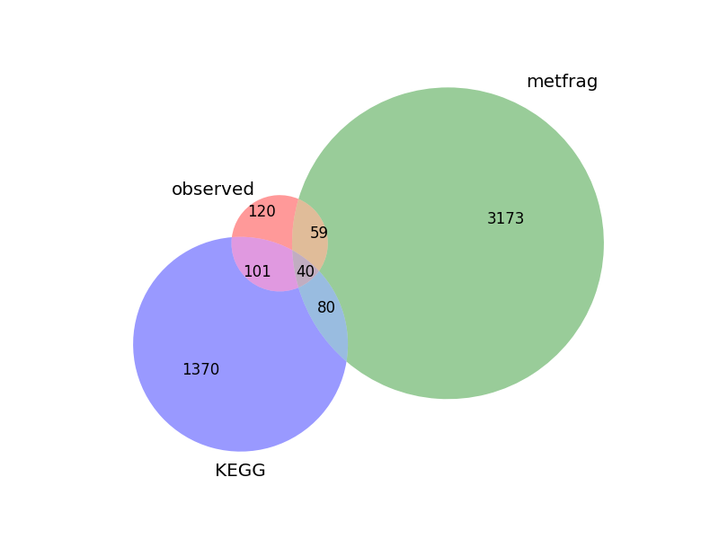
Databases/Tools
Spectral Databases
Metlin
HMDB
Compound Library
KEGG
In Silico Fragmentation
Metfrag

Slide 7
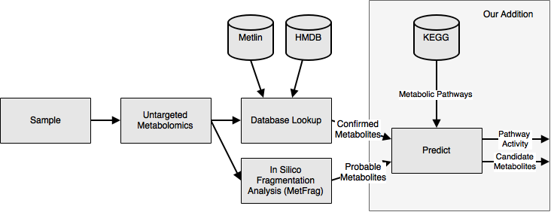
Data Flow

Slide 8
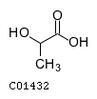



MetFrag Example
MW=89.0247 g/mol
D-Glyceraldehyde
Lactate
3-Hydroxypropanoate
Glycerone

Slide 9
Setup
Bayesian Network
PyMC
MCMC sampling

Slide 10
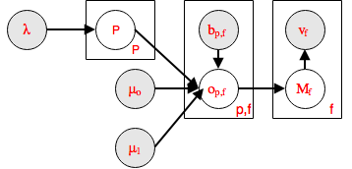
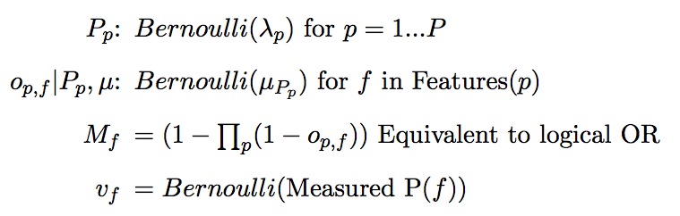
Network

Slide 11
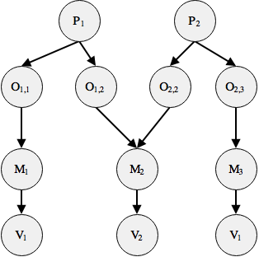
Example Network
#P = 86
#O = 2700
#M = 1600
#V = 200

Slide 12
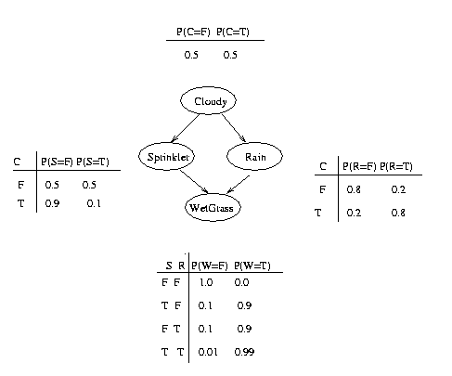
Classic Example

Slide 13
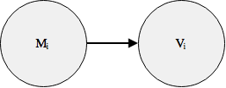
Virtual Evidence
How to model MetFrag Output?
Observations of probability distribution on M_{i}
Ex. Prob(M_{i}) = 0.75
Set V_{i} = 1, Incorporate evidence into CPT of V
M | V | P(V | M)
0 | 1 | 0.25
1 | 1 | 0.75

Slide 14
Preliminary Results
Hard Evidence Only
Marginal Posterior (cge00020) = 0.0
Include MetFrag (Virtual Evidence)
Marginal Posterior(cge00020) = 1.0
Why?
C05381 only in cge00020
MetFrag score 0.75

Slide 15
Conclusion
Summary
Continued Work
Centrality
Convergence of MCMC

