Slide 1

github.com/atoosa-r
github.com/atoosa-r
RECOMMENDATION SYSTEMS
ATOOSA RASHID

Slide 2
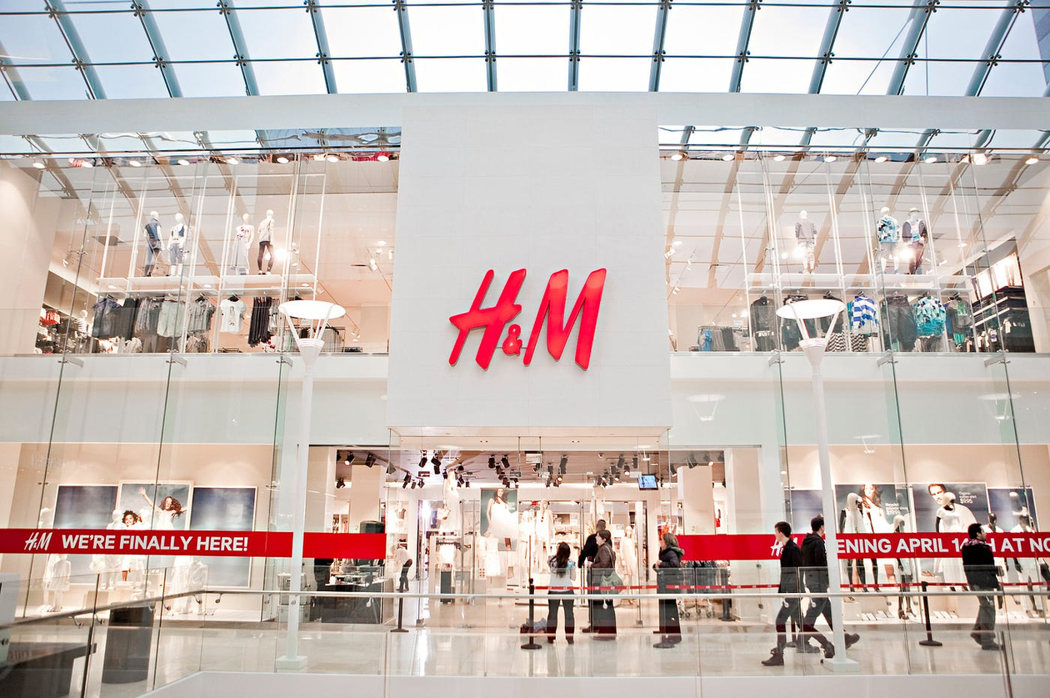
OVERVIEW
Problem: Difficulty finding suitable fashion items.
Solution: Personalized recommendation system.
Impact: Enhanced shopping experience, increased satisfaction, reduced returns.

Slide 3
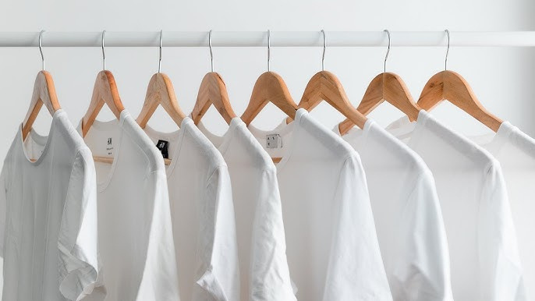
Datasets: Transactions, Articles, Customers.
Preprocessing: Cleaning, Feature Engineering, Text Processing.
Data Source: The dataset is sourced from H&M's transactional and product databases.
DATASET & PREPROCESSING

Slide 4
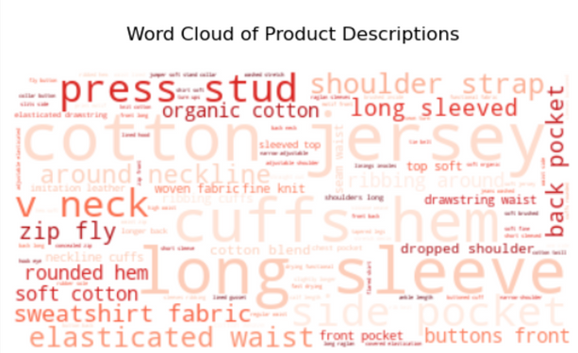
EXPLORATORY DATA ANALYSIS
PREPROCESSING
MODELING
Building on initial EDA
Reviewing top words within product descriptions
Analyzing top words by department
Data Cleaning: Removed duplicates and handled missing values to ensure data quality.
Feature Engineering: Aggregated transaction data to derive insights on customer spending habits and article popularity.
Text Processing: Tokenized product descriptions, removed stopwords. Preparing for word embedding.
Collaborative Filtering with Cosine Similarity
User-Item Matrix creation
Sample Recommendations

Slide 5
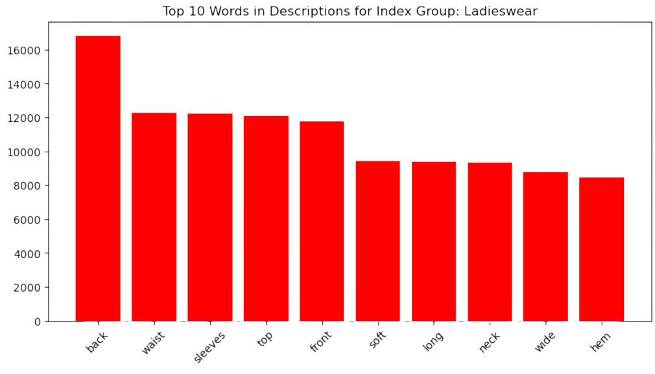
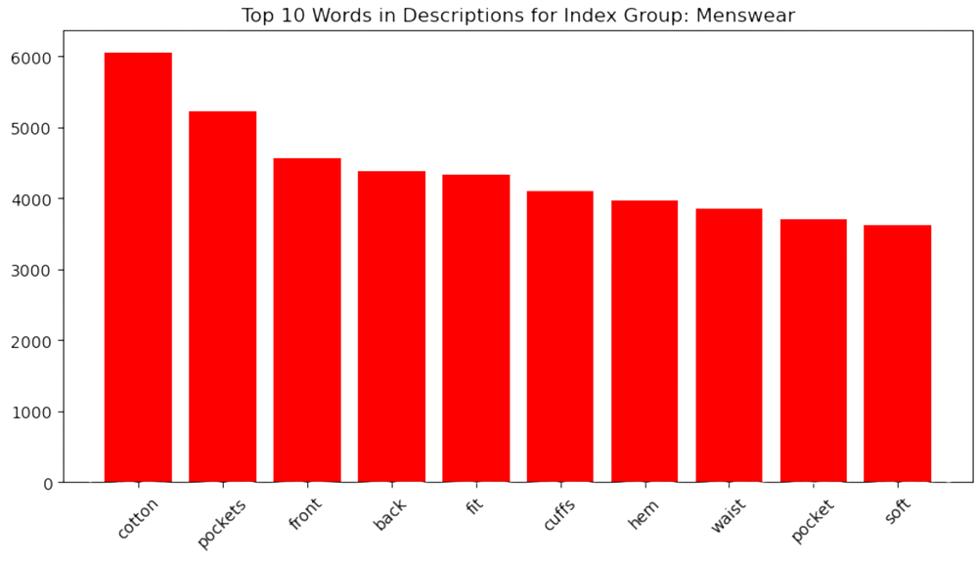
EXPLORATORY DATA ANALYSIS (EDA)

Slide 6
BASELINE MODEL AND EVALUATION
Collaborative Filtering:
Measuring cosine similarity between customers based on purchase history.
Identifying customers with similar tastes.
User-Item Matrix:
Created a user-item matrix where each row represents a customer and each column represents an article.
Evaluation:
Evaluated the recommendations by checking the similarity scores and the relevance of suggested items.

Slide 7
INPUT CUSTOMER ID
COLLABORATIVE FILTERING
RECOMMENDATION
GET CUSTOMER SIMILARITY SCORES
IDENTIFY TOP SIMILAR CUSTOMERS
RECOMMEND ARTICLES
PRINT OUT TOP 5 ARTICLE IDS, ARTICLE NAMES, AND IMAGES

Slide 8
EXAMPLE :
000493DD9FC463DF1ACC2081450C9E75EF8E87D5DD17ED6396773839F6BF71A9
COLLABORATIVE FILTERING
RECOMMENDATION
GET CUSTOMER SIMILARITY SCORES
IDENTIFY TOP SIMILAR CUSTOMERS
RECOMMEND ARTICLES
RECOMMENDED ARTICLES:
ARTICLE ID: 556539030, PRODUCT NAME: VELVET SCRUNCHIE
ARTICLE ID: 685604061, PRODUCT NAME: TOM FANCY
ARTICLE ID: 757964001, PRODUCT NAME: AMARYLLIS BLANKET
ARTICLE ID: 758027001, PRODUCT NAME: MARIELLE TOP
ARTICLE ID: 783359014, PRODUCT NAME: CAP EAZY SUEDE MIX

Slide 9
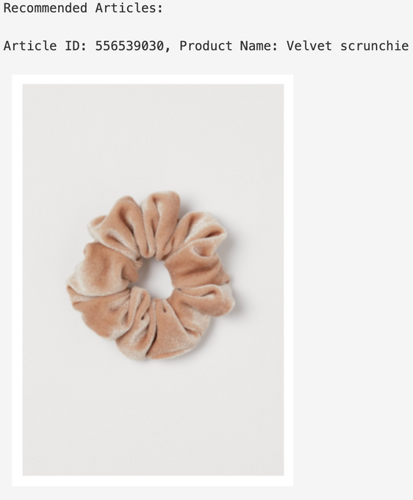
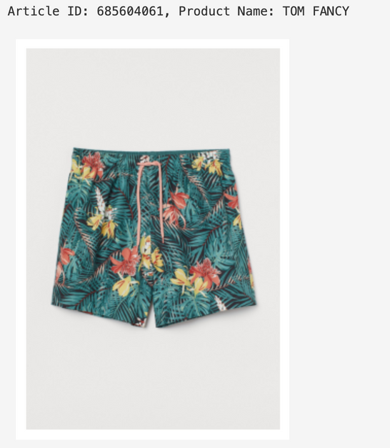
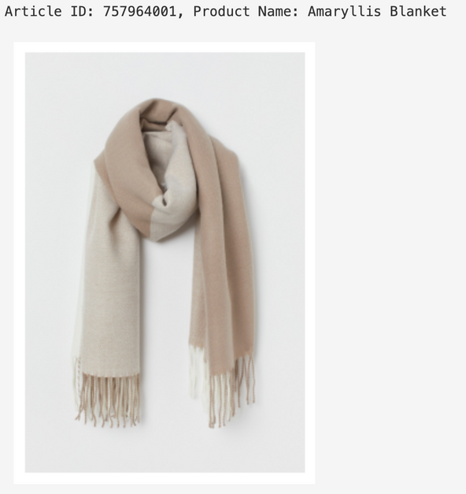
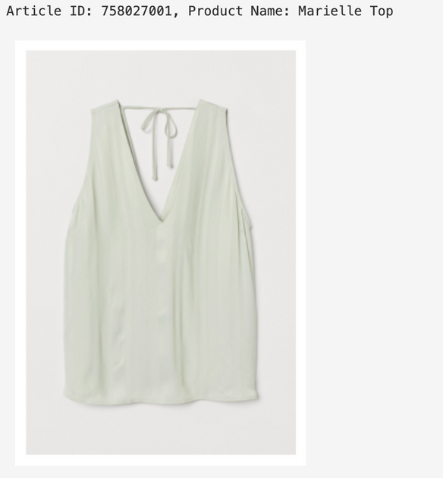
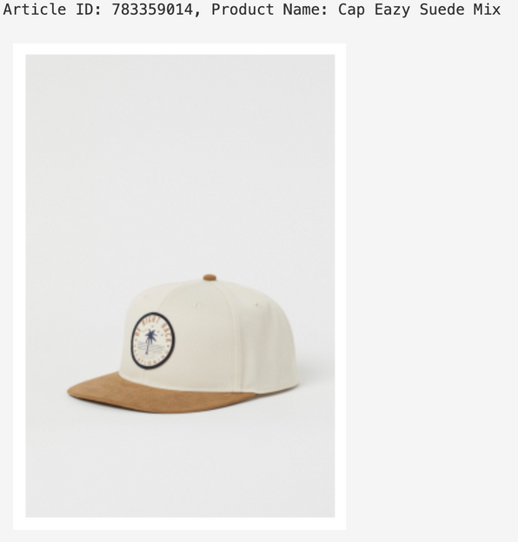

Slide 10
Advanced Preprocessing
Word Embedding
Additional Customer Data
Enhanced Modelling
Using advanced Natural Language Processing (NLP) on product descriptions
Hybrid Models - combining content-based and collaborative filtering
Computational Efficiency
Model Testing
Additional Sampling Data
NEXT STEPS & ADVANCED MODELLING

Slide 11
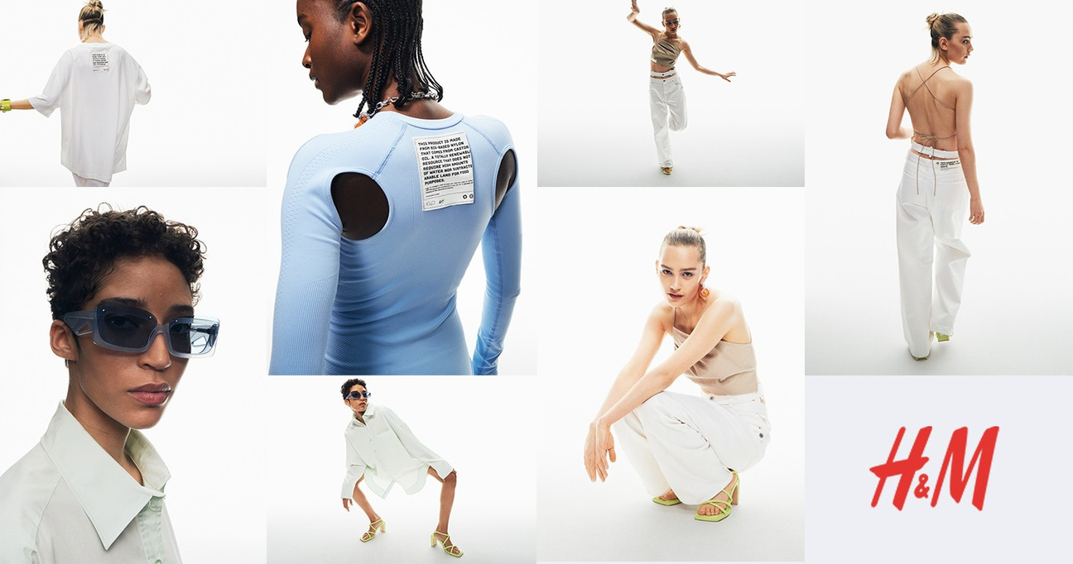
THANK YOU
QUESTIONS?

