Slide 1
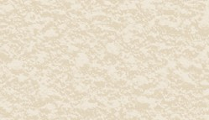
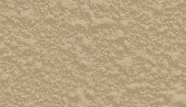
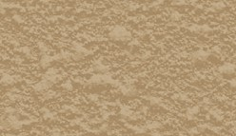
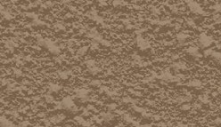
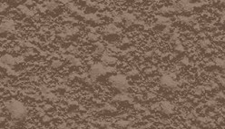
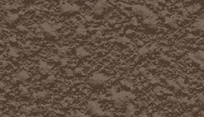
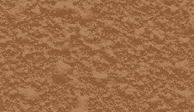
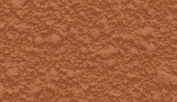
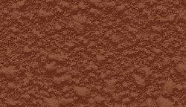
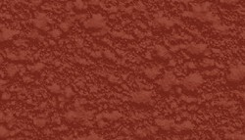
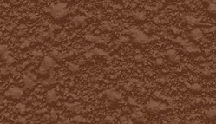
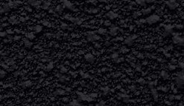
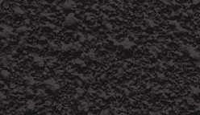
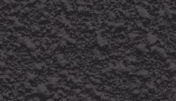
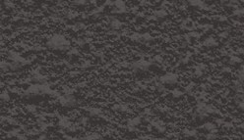
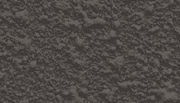
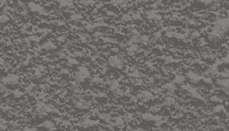
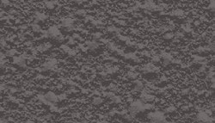
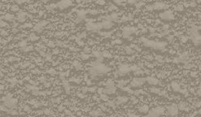
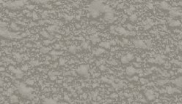
RESURFACING COLOURS
WHITE
FD500782-1KG
CREAM
FD500786-1KG
SANDY BEIGE
FD500780-1KG
MERINO
FD500777-1KG
LITE MOCHA
FD500775-1KG
CHESTNUT
FD500769-1KG
SANDSTONE
FD500779-1KG
LIGHT TERRACOTTA
FD500776-1KG
DARK TERRACOTTA
FD500770-1KG
BRICK RED
FD500763-1KG
CHOCOLATE
FD500767-1KG
JET BLACK
FD500760-1KG
CHARCOAL
FD500766-1KG
GUNMETAL
FD500773-1KG
BLUESTONE
FD500761-1KG
GRANITE
FD500892-1KG
FRENCH GREY
FD500772-1KG
SLATE GREY
FD500785-1KG
SILVER SANDS
FD500781-1KG
BLUEGUM
FD500784-1KG
Colours shown are intended as a guide only. Colours may vary from batch to batch. Variations in colour and shading may also occur depending on the job conditions, chosen texture and finishing practices employed by your concrete contractor.
Customer Service 1800 801 108
duluxavista.com.au
®Avista is a registered trade mark. ®Dulux is a registered trade mark of DuluxGroup (Australia) Pty Ltd.
SEP 2021

