Slide 1

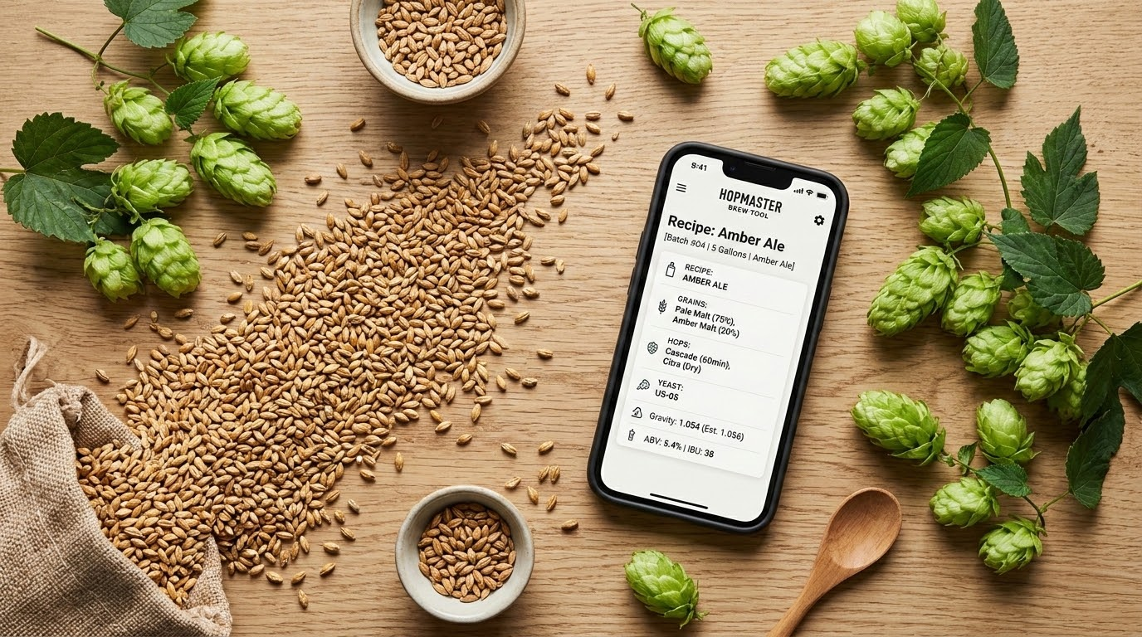
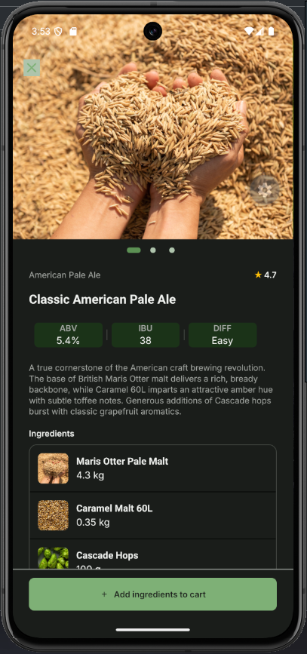
MOBILE APP ECOSYSTEM
Hop & Barley
The Complete Ecosystem for Craft Homebrewers
An all-in-one mobile ecosystem connecting craft beer recipes directly with fresh brewing ingredient shopping.
PRESENTER
Andrii Toptun
React Native / Mobile Developer

Slide 2
Bridging the Gap Between Recipe Discovery & Ingredient Procurement
THE PROBLEM
Fragmented Discovery & Calculations
The homebrewing market suffers from a strict disconnect between finding recipes on forums or calculators and purchasing ingredients across separate web shops.
Beginners struggle to configure precise brewing parameters—such as attenuation, IBU units, and yeast pitching rates—without unified guidance.
THE SOLUTION
Unified Mobile Exploration & Checkout
Hop & Barley delivers a cohesive mobile platform that seamlessly bridges recipe exploration with instant ingredient checkout.
By automating complex calculations and streamlining procurement into a single tap, it simplifies the entire brewing process for users of all skill levels.
Hop & Barley • React Native

Slide 3
Delivering a Comprehensive E-Commerce and Recipe Platform
SECURITY & ACCESS
Auth & Security
Full registration flow featuring 4-digit OTP verification with a timer, password reset, and guest browsing capabilities.
INVENTORY & SEARCH
Store Catalog
Live search with multi-category filters for Yeast, Hops, Malts, and Adjuncts, alongside 5 distinct sorting modes.
BREWING GUIDES
Recipe Library
Categorized by Easy, Medium, and Hard difficulty levels with ABV/IBU badges and step-by-step mashing, boiling, and fermentation guides.
PURCHASING FLOW
Cart & Checkout
Dynamic item counter, instant toast feedback, and comprehensive checkout order summaries.
Hop & Barley • React Native

Slide 4
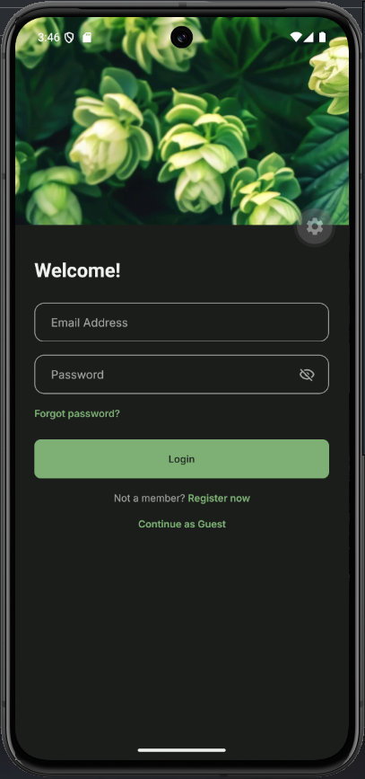
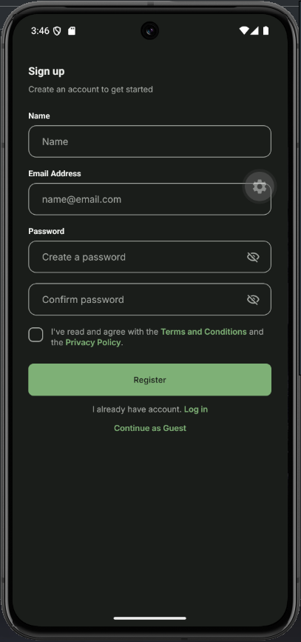
SECURITY & ACCESS
SECURITY & ACCESS
Auth & Security
Full registration flow featuring 4-digit OTP verification with a timer, password reset, and guest browsing capabilities.
OTP Verification: 4-digit code with live countdown timer
Password Recovery: Automated reset via secure email flow
Guest Mode: Browse store catalog without forced signup
Session State: Encrypted token storage via AsyncStorage
Hop & Barley • React Native

Slide 5
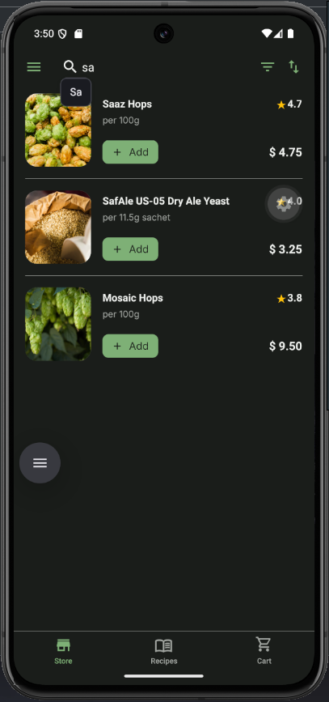
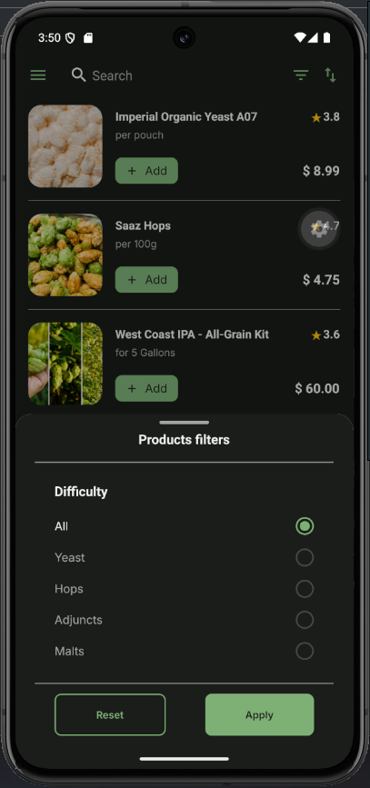
INVENTORY & SEARCH
INVENTORY & SEARCH
Store Catalog
Live search with multi-category filters for Yeast, Hops, Malts, and Adjuncts, alongside 5 distinct sorting modes.
Multi-Category Filters: Quick filtering for Yeast, Hops, Malts, and Adjuncts
5 Sorting Modes: Sort by Name (A-Z / Z-A), Price, or Rating
Live Search: Instant query matching across entire store catalog
Quick Add: One-tap add to cart directly from item list
Hop & Barley • React Native

Slide 6
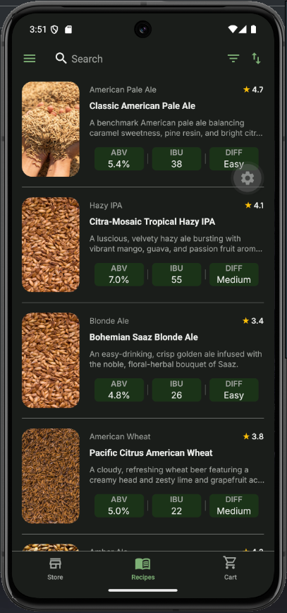
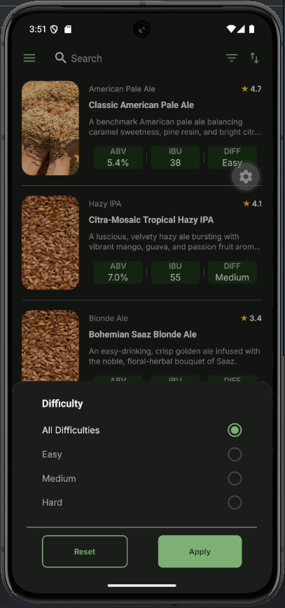
BREWING GUIDES
BREWING GUIDES
Recipe Library
Categorized by Easy, Medium, and Hard difficulty levels with ABV/IBU badges and step-by-step mashing, boiling, and fermentation guides.
Difficulty Levels: Categorized into Easy, Medium, and Hard
Vital Stats Badges: Instant visibility for ABV, IBU, and style tags
Step-by-Step Guides: Detailed mashing, boiling, and fermentation instructions
Sorting & Search: Quick filtering by rating, A-Z, or complexity
Hop & Barley • React Native

Slide 7
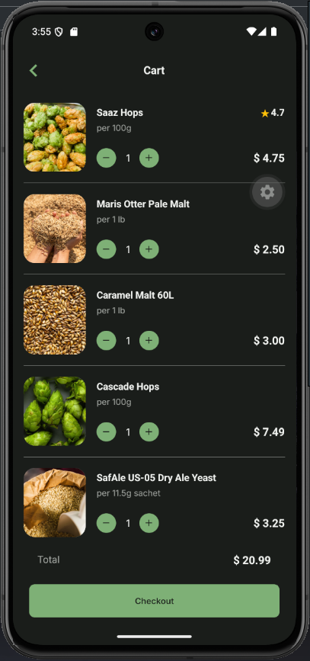
PURCHASING FLOW
PURCHASING FLOW
Cart & Checkout
Dynamic item counter, instant toast feedback, and comprehensive checkout order summaries.
Dynamic Item Counter: Real-time price recalculation and quantity controls
Instant Toast Feedback: Immediate status updates on cart changes
Order Summaries: Detailed itemized list with subtotal and total breakdown
Seamless Checkout: One-tap transition to final order placement
Hop & Barley • React Native

Slide 8

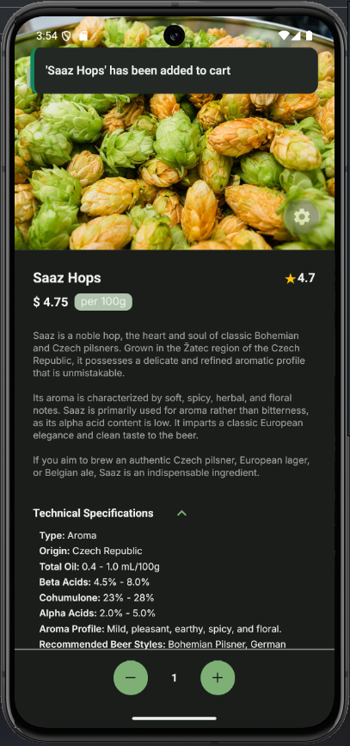
READY-TO-BREW KITS
1-CLICK CONVERSION
Recipe Kits & Technical Specs
Seamlessly converting custom and catalog recipes directly into ready-to-brew ingredient kits with deep technical specs.
1-Click Recipe Kits: Pushes all ingredients (malts, hops, yeast) directly into the cart with a single tap.
Deep Technical Specs: Detailed sheets detailing flocculation, attenuation, temp ranges, and alpha acids.
Automated Quantities: Exact weight scaling per batch size requirements.
Instant Checkout Sync: Directly connected to inventory and cart workflows.
Hop & Barley • React Native

Slide 9
Built with Modern React Native and Expo Technologies
React Native
Expo
React Navigation
AsyncStorage
Core Framework
React Native framework robustly powered by Expo for unified cross-platform development and rapid deployments.
Navigation Architecture
React Navigation utilizing Bottom Tabs for main screens, a Drawer for settings & profiles, and a Stack for modals and auth flows.
State & Persistence
Centralized store combined with AsyncStorage for dependable local data persistence, session management, and theme preferences.
UI / UX Experience
Supports Dark, Light, and System themes with instant switching, responsive adaptive layouts, and integrated toast alerts for user feedback.
Hop & Barley • React Native

Slide 10
Overcoming Complex State & Performance Hurdles
State Management
Cart State Synchronization
Ensuring atomic updates across the catalog, detailed product views, and the cart list to maintain accurate inventory and pricing.
Performance
Filter & Sort Pipeline
Implementing low-latency, client-side query filtering that prevents unnecessary component re-renders during catalog browsing.
UX & Auth
OTP Flow
Designing an accessible pin-code input system with smooth auto-focus transitions and robust resend timer logic.
Hop & Barley • React Native

Slide 11
Expanding the Hop & Barley Ecosystem
Phase 01
In-App Brewing Calculator
Upcoming features for OG/FG, ABV, and IBU calculations directly within the application.
Phase 02
Community & Custom Recipes
Enabling user-created recipe saving and sharing to foster a community of brewers.
Phase 03
Payment Gateway
Planned integration with Stripe, Apple Pay, and Google Pay for seamless transactions.
Thank you for your time.
Hop & Barley • React Native

