Slide 1
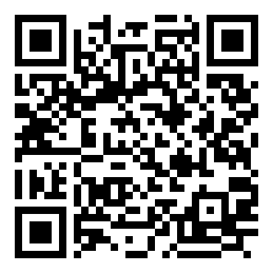
Suicide Mortality Trends in the U.S.
Interactive Shiny dashboard | 1999–2020 | CDC WONDER mortality data
App link:
https://atorbati.shinyapps.io/Suicide_Research_Spring_2026/
Presenter: Abigail Torbatian | Spring 2026
Scan to open
Source: CDC WONDER (NVSS mortality data). Rates shown are crude deaths per 100,000.
Notes:
Timing: ~45 seconds - This project is a short, interactive exploration of suicide mortality using CDC WONDER mortality data. - The Shiny app lets you change state, years, sex, and race to see how patterns shift. - I’ll focus on the key visuals, the statistical tests, and what they imply for public health planning.

Slide 2
Before I Begin…
If you are struggling or have a hard time with this topic, you are welcome to step out.
Please do not feel pressured to listen to my presentation.
If you need help, reach out to CaPS:
Call (412-268-2922) or visit:
Highmark Center for Health, Wellness, & Athletics
100 Tech St., 4th Floor
Across from Margaret Morrison Carnegie Hall and Posner Hall
U.S. Suicide & Crisis Lifeline: call or text 988

Slide 3
Objective & research questions
Objective
Describe how suicide mortality rates changed over time and how they differ by state, sex, and race.
Research questions
• RQ1: How do rates change over time?
• RQ2: Which states are highest and which are increasing fastest?
• RQ3: How do rates differ by sex and race?
Why it matters
• Identify hotspots
• Track growth over time
• Support prevention planning
Source: CDC WONDER mortality data export (ICD-10 intentional self-harm codes).
Notes:
Timing: ~50 seconds - The goal is descriptive: quantify patterns and compare across place and demographics. - The app is designed so a user can answer these three questions interactively in a few clicks. - Next I’ll briefly describe what’s behind the app: the data, the interactive EDA, and the three statistical tests.

Slide 4
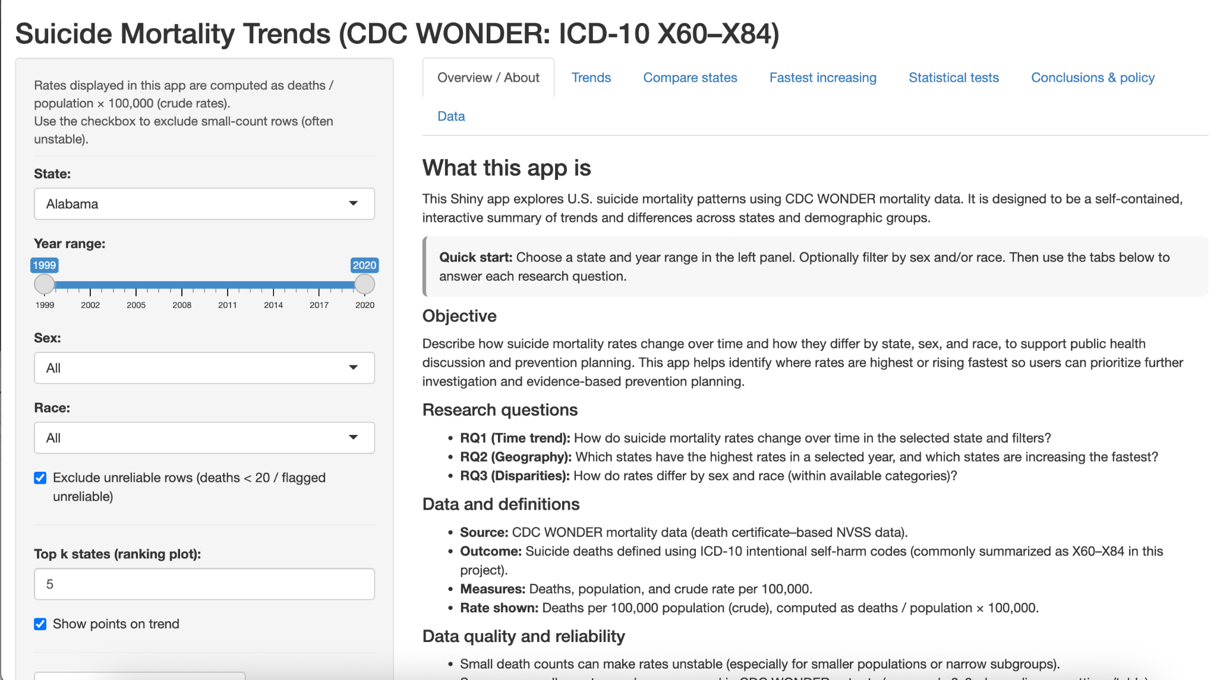
Methodology (EDA + statistical analysis)
Data
• CDC WONDER mortality data (NVSS)
• Years: 1999–2020
• Export: state × year × sex × race × cause code
EDA (in the app)
• Filter by state / years / sex / race
• Trend plot (time series)
• State ranking (single year)
• Fastest-increasing states (slope over time)
Statistical analysis
• Poisson regression trend (offset = log(population))
• Spearman correlation (year vs rate)
• Rate ratio test (first year vs last year)
Reliability rule
• Option to exclude estimates with deaths < 20 (unstable rates)
Note: Cause-code rows are collapsed before computing totals; population counted once per group.
Notes:
Timing: ~60 seconds - The export is detailed, including cause codes, so I collapse cause-code rows before computing totals. - Exploratory analysis happens through interactive tabs: trends, rankings, and slopes. - For statistics, I use Poisson regression with a population offset, a nonparametric correlation, and a first-vs-last year comparison. - The app includes a small-count filter (deaths < 20) to reduce unstable estimates.

Slide 5
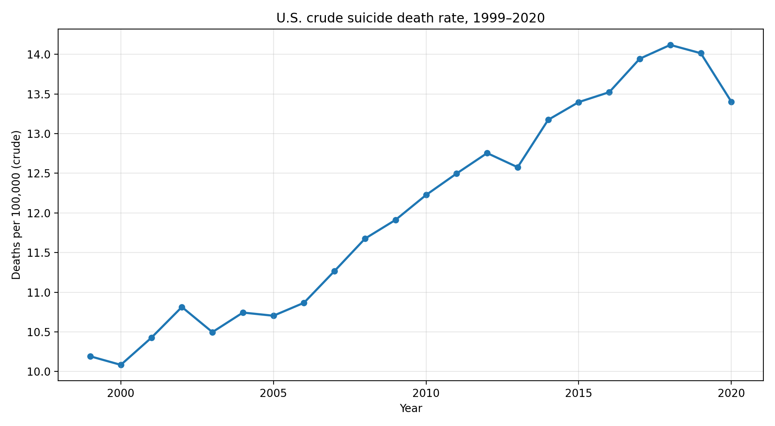
Key visualization 1: Trend explorer
U.S. crude rate rose overall
• 1999: 10.19 per 100k
• 2020: 13.40 per 100k
Peak in 2018: 14.12 per 100k
In the app, you can:
• Switch states
• Narrow the year window
• Filter by sex and race
Trend shown is national aggregate of state-year totals (crude rate).
Notes:
Timing: ~60 seconds - National context: crude rate increases from ~10.2 per 100k in 1999 to ~13.4 per 100k in 2020, peaking around 2018. - The app turns this into an interactive drill-down: select any state and demographic slice to see how patterns differ.

Slide 6
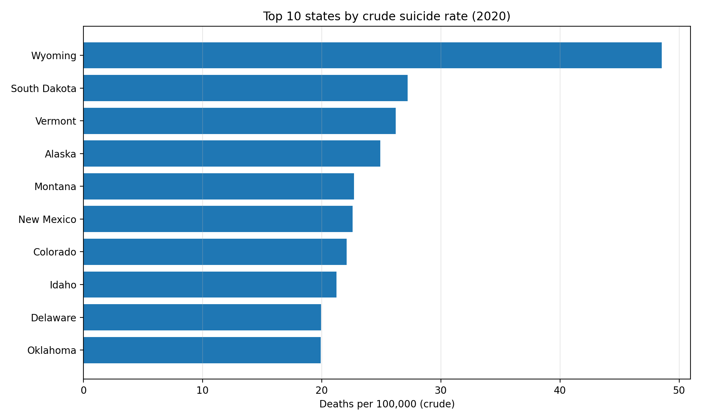
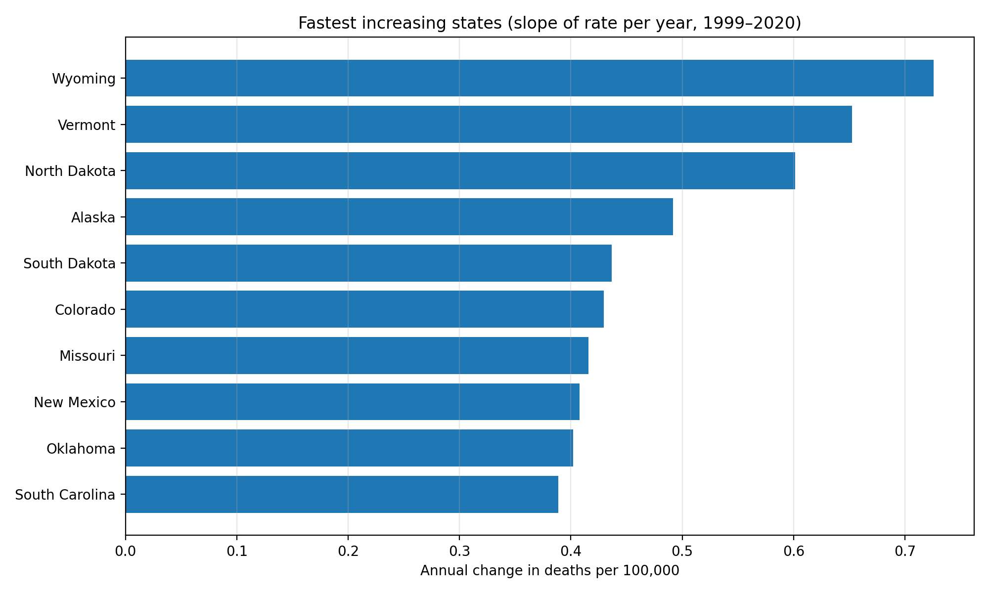
Key visualization 2: Compare states
Highest rates (2020): Wyoming (48.5), South Dakota (27.2), Vermont (26.2), Alaska (24.9), Montana (22.7)
Fastest increases: Wyoming (+0.73/yr), Vermont (+0.65/yr), North Dakota (+0.60/yr), Alaska (+0.49/yr), South Dakota (+0.44/yr)
Left: top states by crude rate in 2020. Right: slope of crude rate vs year (1999–2020).
Notes:
Timing: ~70 seconds - The ranking view answers: where are rates highest in a given year? - The slope view answers: where are rates increasing fastest over the period? - Small-population states can look extreme; treat these as flags for deeper investigation, not the whole story.

Slide 7
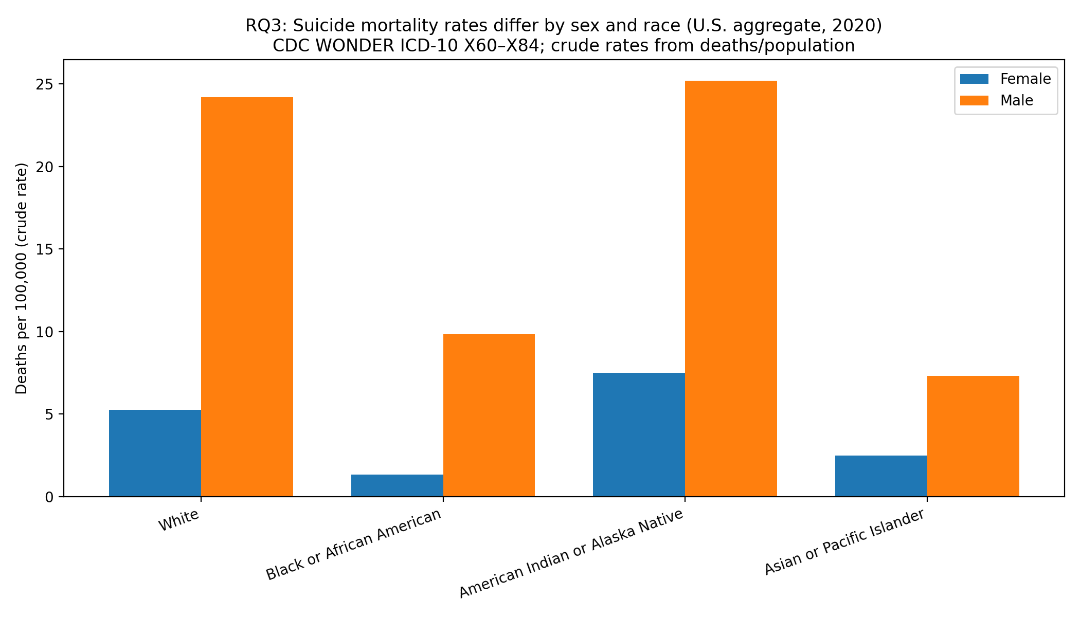
Key visualization 3: Differences by sex and race
2020 national crude rates by sex & race
Male rates are higher than female rates across every race category.
Highest observed rates: American Indian/Alaska Native male (25.2/100k) and White male (24.2/100k).
Lowest observed rate: Black female (1.33/100k).
Interpret cautiously: crude rates are not age-adjusted; smaller groups can be more variable.
U.S. aggregate from state-year totals (CDC WONDER ICD-10 X60–X84). Values are crude rates (deaths/population × 100,000).

Slide 8
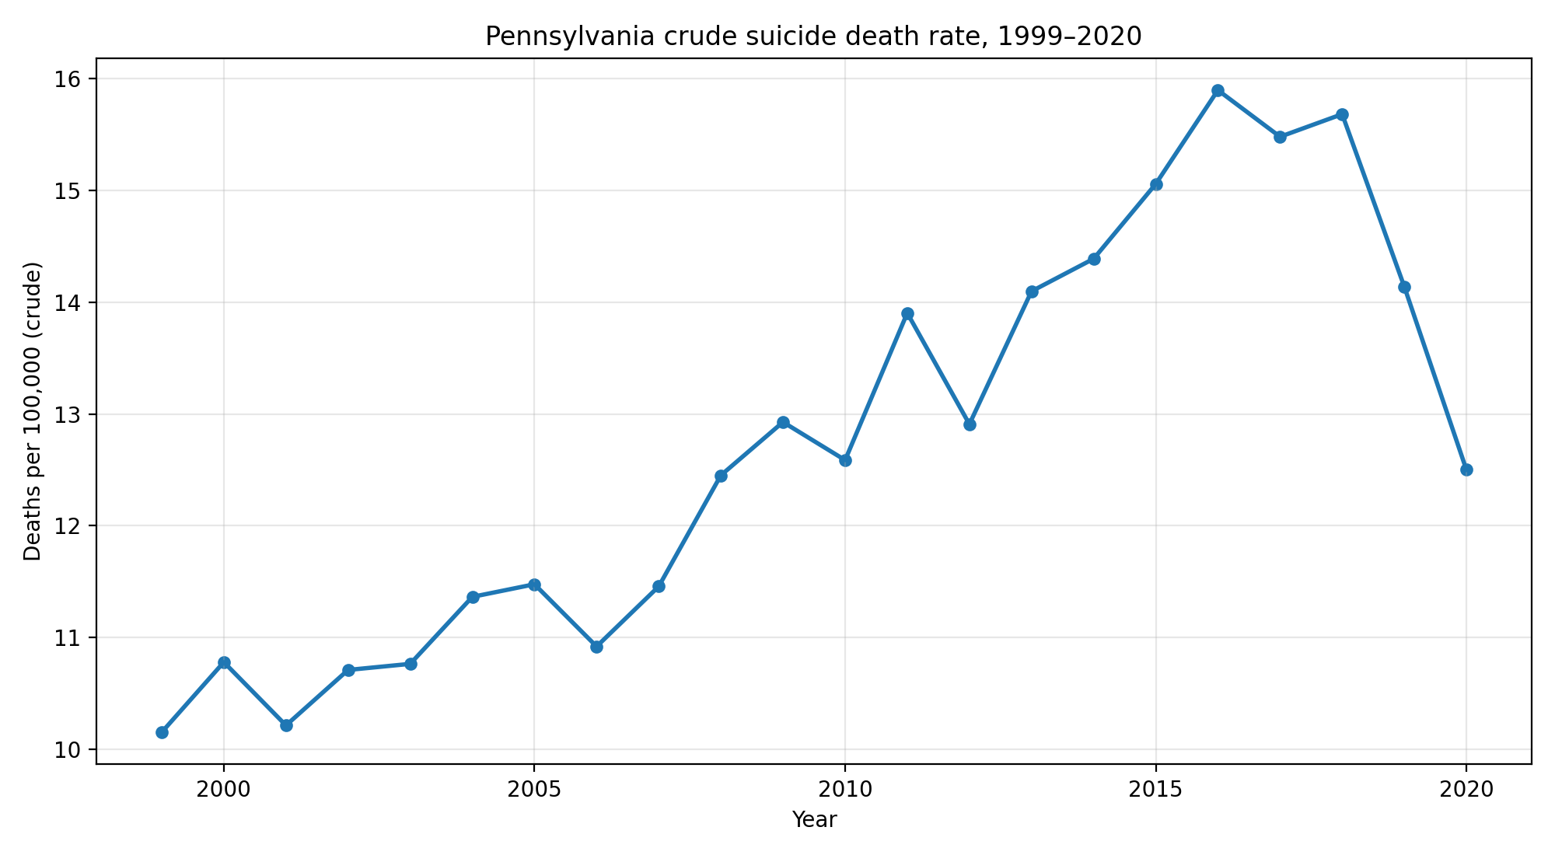
Statistical analysis (example: Pennsylvania)
Trend summary
• 1999: 10.15 per 100k
• 2020: 12.50 per 100k
• Peak: 2016 (15.90)
Test 1 — Poisson trend
• IRR/year = 1.0197
• 95% CI: [1.0180, 1.0215]
• p < 0.001
Test 2 — Spearman
• rho = 0.887 (p < 0.001)
Test 3 — Rate ratio
• 2020/1999 RR = 1.231
• 95% CI: [1.141, 1.329]
• p < 0.001
Example state is Pennsylvania; the app recomputes these tests for any state/filters.
Notes:
Timing: ~70 seconds - Pennsylvania is a concrete example of what the test tab provides. - Over the full period the model estimates ~2% growth per year (IRR ~1.02), but the visual shows a peak around 2016 and a decline afterward. - Takeaway: pair tests with visuals, and interpret trends in context rather than assuming constant growth.

Slide 9
Summary
Key findings
National crude rate increased (10.2 → 13.4 per 100k).
2020 highest-rate states include Wyoming, South Dakota, Vermont.
Fastest increases include Wyoming, Vermont, North Dakota.
Disparities: male rates exceed female across races; 2020 AIAN male 25.2/100k vs Black female 1.33/100k.
Limitations
• Crude rates (not age-adjusted).
• Ecological; not causal.
• Small counts can be unstable.
Next steps
• Add age-adjusted rates / age groups.
• Add method of suicide and covariates.
• Explore changepoints / non-linear trends.
Policy relevance
• Prioritize monitoring and prevention where rates are highest or rising fastest.
If you or someone you know is struggling, call or text 988 (U.S. Suicide & Crisis Lifeline).
Notes:
Timing: ~45–60 seconds - Summarize the takeaways: national increase, geographic variation, and fastest-increasing states. - Emphasize the deliverable: an interactive dashboard that makes comparisons transparent and reproducible. - Close with limitations + future work, and a policy framing: where to prioritize monitoring and prevention planning.

