Slide 1


ECEN 404
Team #44
Biweekly Update 2
Cubesat EM Material Discharge Eval:
Ian Poynter
Joshua Feldman
Michael Kim
Alejandro Torres
Sponsor: Orbital Arc & SATOP
TA: Souryendu Das

Slide 2
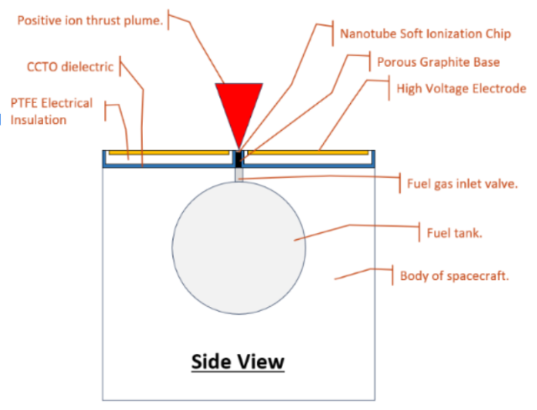
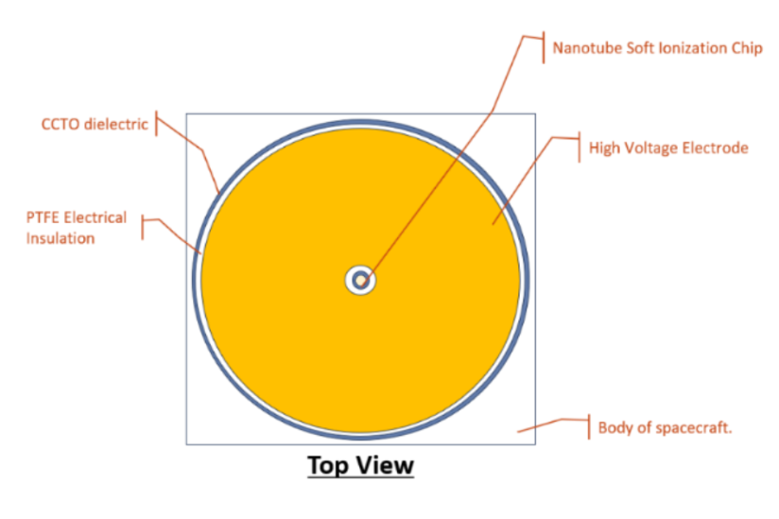
Project Summary
Develop the first prototype for the RIOT Drive
Interior Electronics
Gas Feed Control
Component Selection for Accelerator Plate

Slide 3
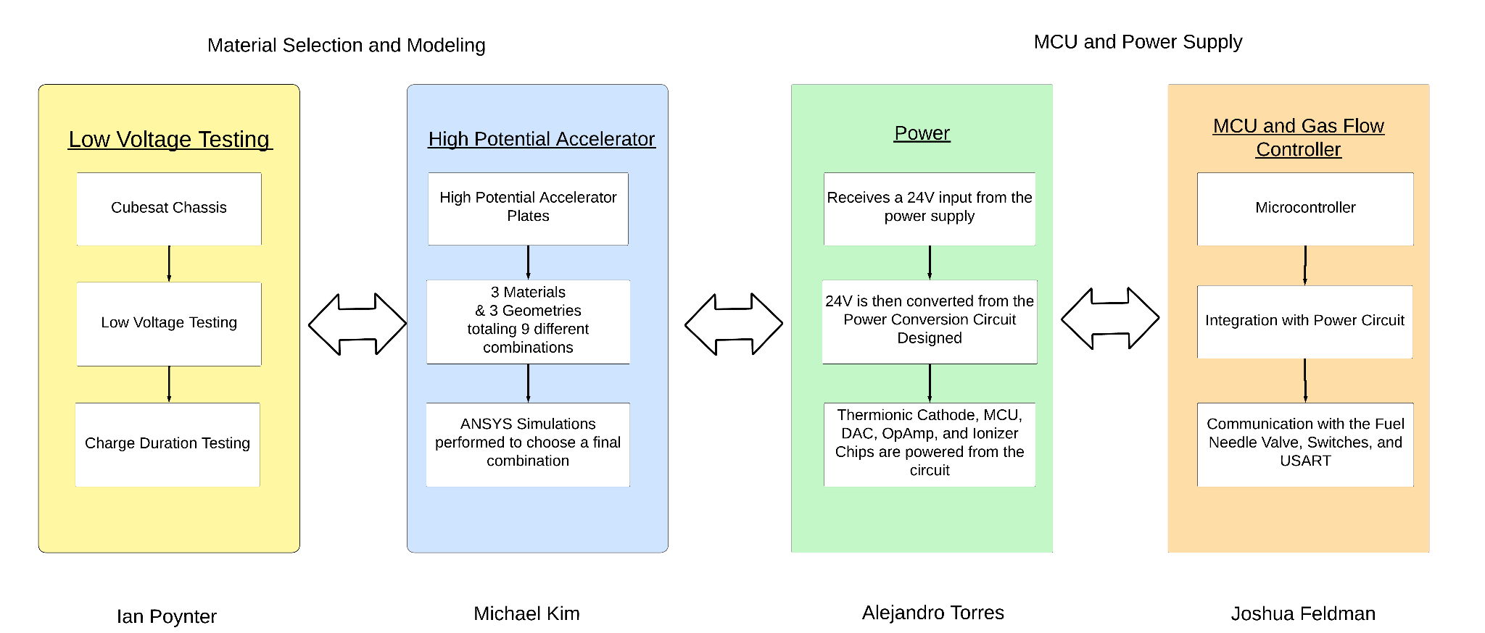
Diagram of Subsystems

Slide 4
Project Timeline
Mechanical Subsystems Design and Testing (completed 12/3) | Hardware Subsystems Redesign and Testing (to complete by 2/22) | Integration of Microcontroller and Power Subsystems (to complete by 3/18) | Validation of Integrated Hardware (to complete by 3/28) | Component Selection for Accelerator Plate (to complete by 3/28) | Final Integration (to complete by 4/12) | Final Demo (to complete by 4/19)

Slide 5
Power Subsystem
Alejandro Torres
Accomplishments since Presentation 1 18 hrs of effort | Ongoing progress/problems and plans until the next presentation
Completed Altium Schematic and PCB Layout configured and routed for integration with Microcontroller PCB and parts ordered to test in preparation for integration | Solder PCB and test through E-Load in preparation for integration with Microcontroller

Slide 6
Microcontroller
Joshua Feldman
Accomplishments since Presentation 1 20 hrs of effort | Ongoing progress/problems and plans until the next presentation
Reworked microcontroller board for changed inputs, for easier programming, and for future integration with power PCB. Ordered parts for PCB. MCU coded and tested for sending user inputs and control bits to DAC through SPI. | Order Fuel Valve Rework and order PCB for stepper motor control. Continue working with Alejandro for PCB integration.

Slide 7
Low Voltage Physical Testing
Ian Poynter
Accomplishments since Presentation 1 18 hrs of effort | Ongoing progress/problems and plans until the next presentation
Developed low voltage test setup and procedure Ordered parts for testing | Construct testing setup on breadboard Perform trial tests and validate data with sponsor

Slide 8
High Potential Accelerator Plate
Michael Kim
Accomplishments since Presentation 1 16 hrs of effort | Ongoing progress/problems and plans until the next presentation
Completed high-voltage simulations of circular plate geometry on Ansys Maxwell software. | Complete high-voltage simulations for hemisphere geometry. Start high-voltage simulations for cone geometry.

Slide 9
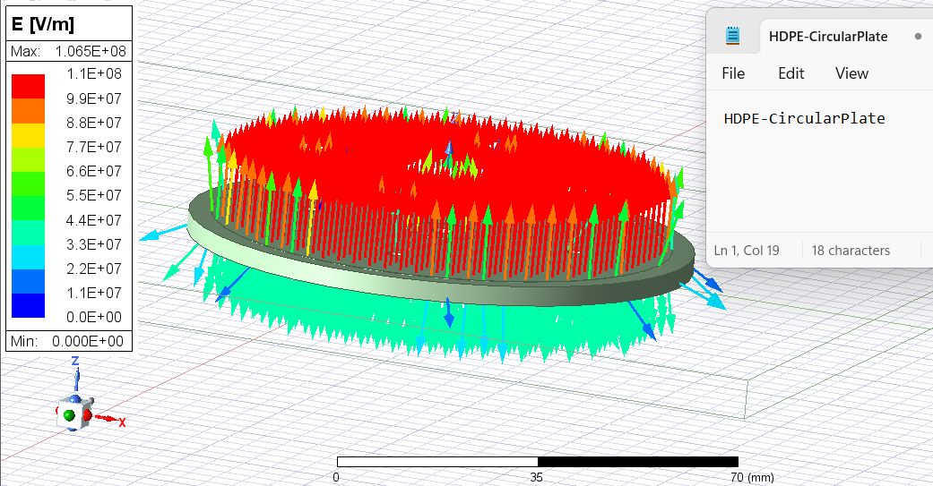
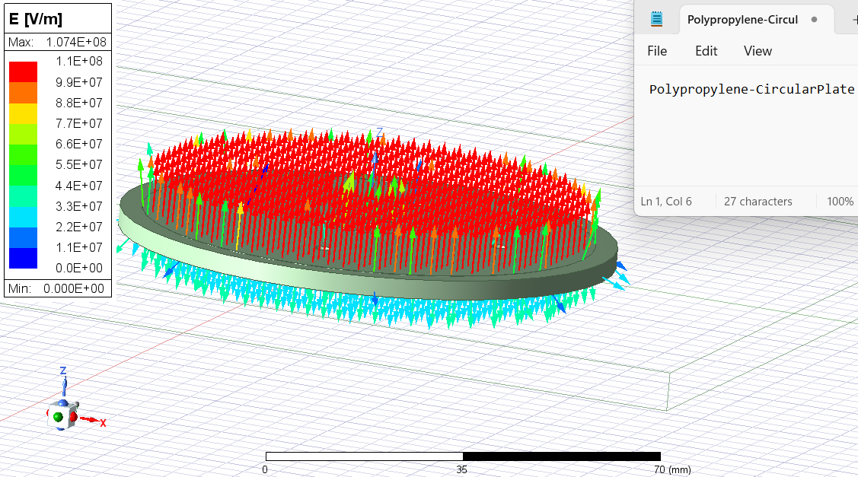
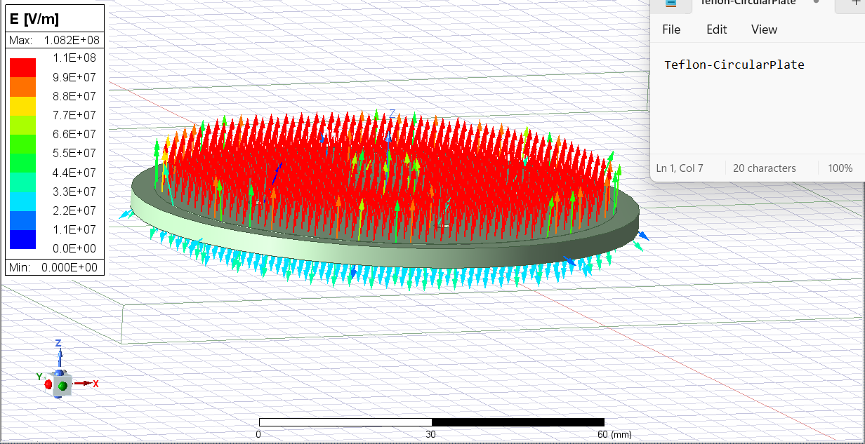

Slide 10
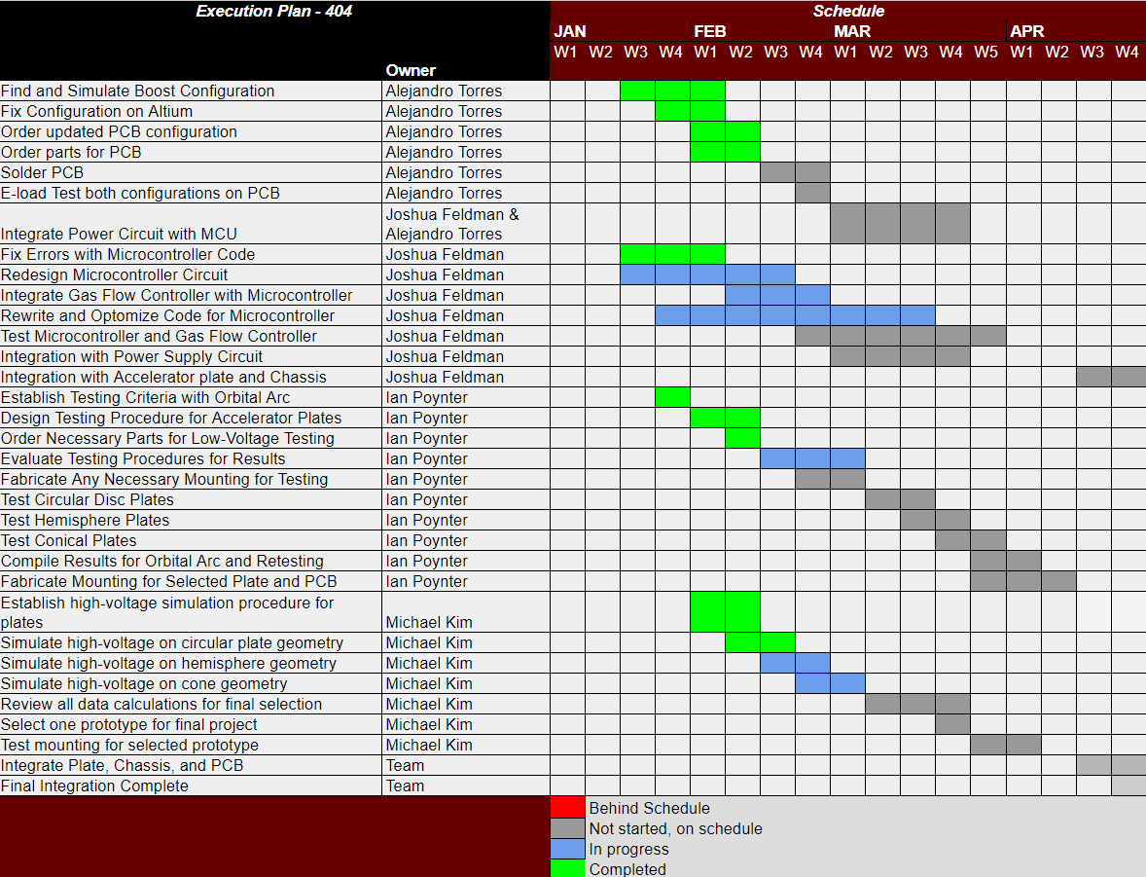
Execution Plan
Notes:
Michelle

Slide 11
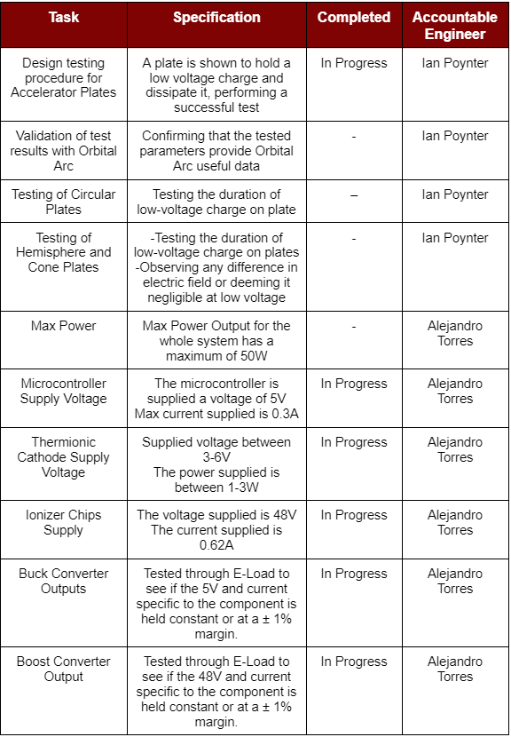
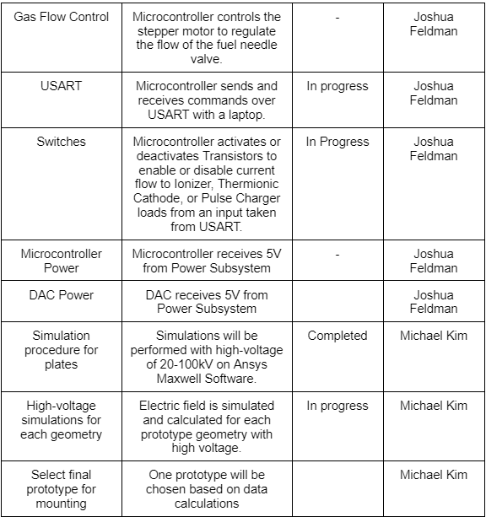
Validation Plan

Slide 12
Thank you!

