Slide 1


ECEN 404
Team #44
Biweekly Update 3
Cubesat EM Material Discharge Eval:
Ian Poynter
Joshua Feldman
Michael Kim
Alejandro Torres
Sponsor: Orbital Arc & SATOP
TA: Souryendu Das

Slide 2
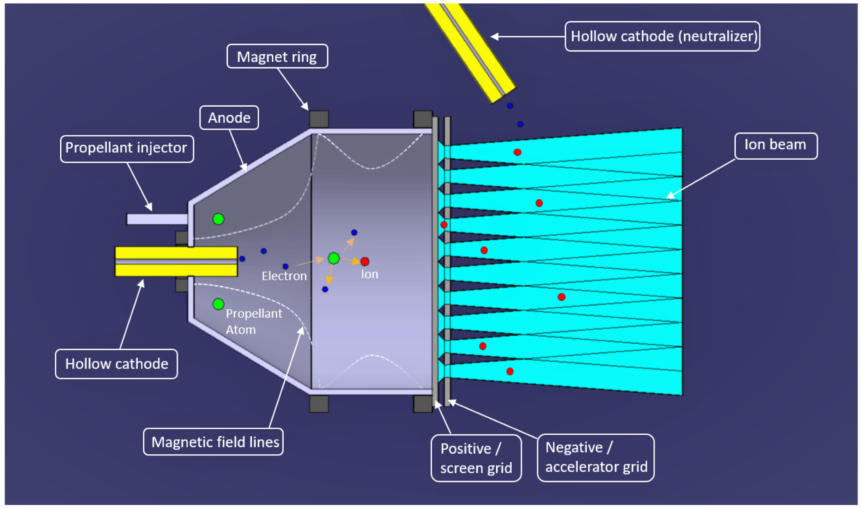
Problem Statement
Current Ion Thrusters have limited use cases due to many factors, including fuel cost and harsh ionization methods

Slide 3
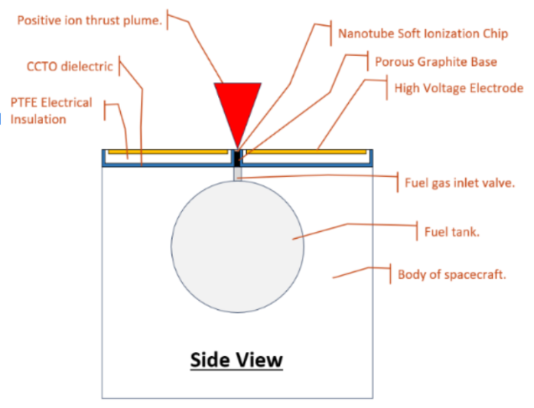
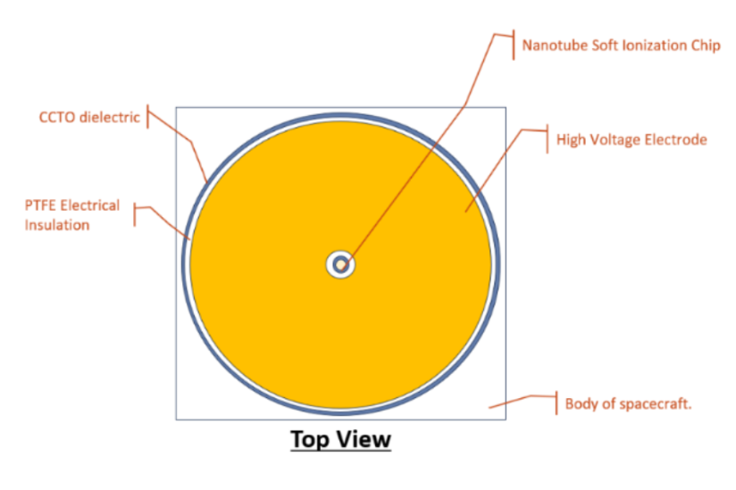
Project Summary
RIOT Drive: New type of Ion Thruster that will reduce these limitations and operate with higher efficiency
Solution
Develop a prototype for the RIOT Drive
Internal Hardware
Power Supply
Microcontroller
Accelerator Plate
Geometry Selection

Slide 4
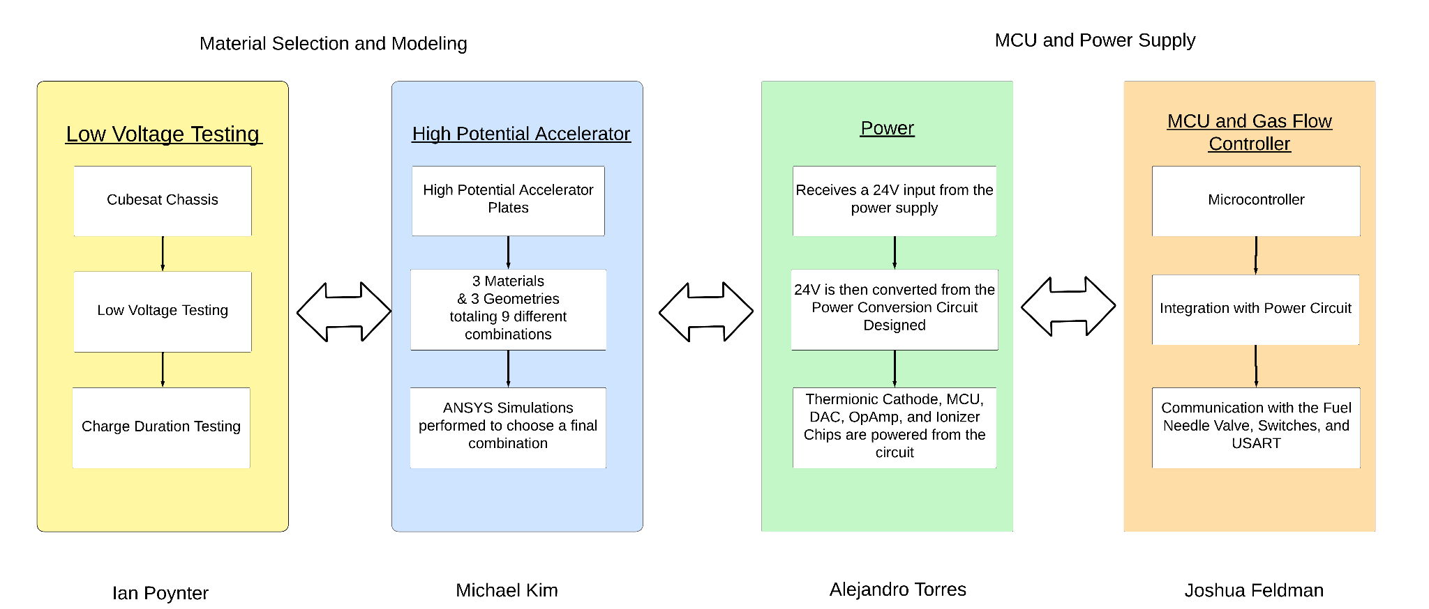
Diagram of Subsystems

Slide 5
Project Timeline
Mechanical Subsystems Design and Testing (completed 12/3) | Hardware Subsystems Redesign and Testing (to complete by 2/22) | Integration of Microcontroller and Power Subsystems (to complete by 3/18) | Validation of Integrated Hardware (to complete by 3/28) | Component Selection for Accelerator Plate (to complete by 3/28) | Final Integration (to complete by 4/12) | Final Demo (to complete by 4/19)

Slide 6
Power Subsystem
Alejandro Torres
Accomplishments since last update 16 hrs of effort | Ongoing progress/problems and plans until the next presentation
Boost Converter soldered and E-load tested. | Fix Boost Converter maximum load current. Solder and test the rest of the PCB. Configure Altium Schematic for Buck converter to power the stepper motor drive.

Slide 7
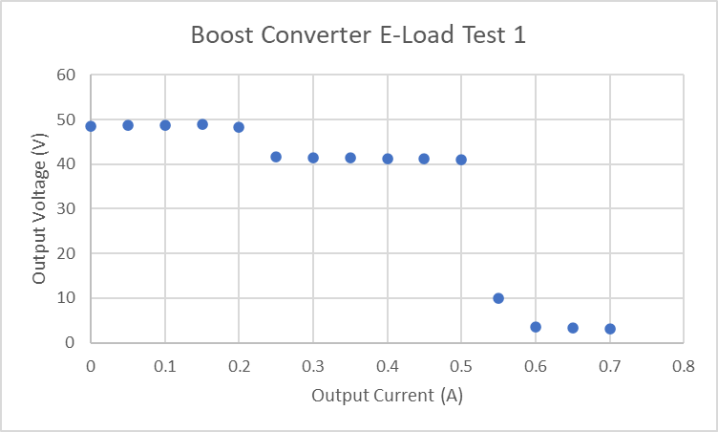
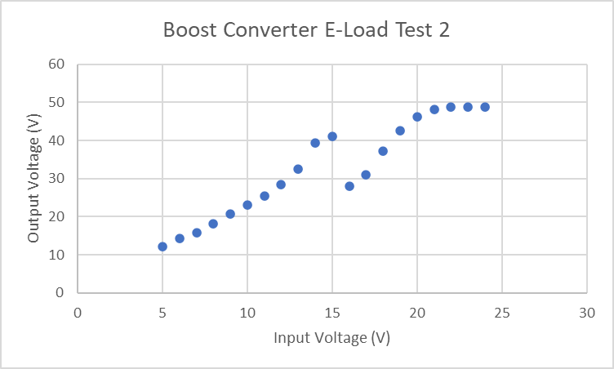
Power Subsystem
Alejandro Torres
Boost Converter Tested through Electronic Load.
48V was not kept constant throughout varying load currents in Test 1 and Test 2.
Need to configure PCB to fix this issue.

Slide 8
Microcontroller
Joshua Feldman
Accomplishments since last update 12 hours of effort | Ongoing progress/problems and plans until the next presentation
Re-coded microcontroller for sponsor’s change to gas flow valve and stepper motor. Changed PCB to send inputs to stepper motor driver and removed now obsolete parts. Ordered board and parts for new revision. | Solder PCB after presentation. Test board with Stepper motor driver, and add stepper motor driver to PCB. Test powering microcontroller with Alejandro’s power PCB after testing board in lab and during Blitz.

Slide 9
Low Voltage Physical Testing
Ian Poynter
Accomplishments since last update 10 hrs of effort | Ongoing progress/problems and plans until the next presentation
Performed initial low-voltage discharge testing Reviewed data with sponsor | Work with Michael to make accelerator plate selection Begin mounting design

Slide 10
High Potential Accelerator Plate
Michael Kim
Accomplishments since last update 20 hrs of effort | Ongoing progress/problems and plans until the next presentation
Completed simulations for hemisphere and cone geometries. | Compare simulations using Gauss’s Law Work with Ian to select final prototype based on reviewed data.

Slide 11
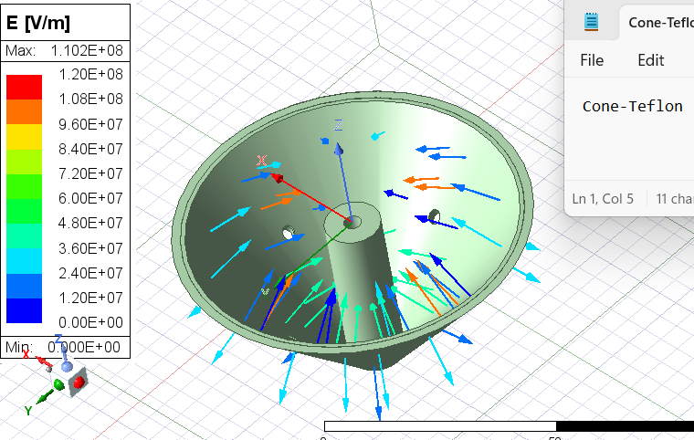
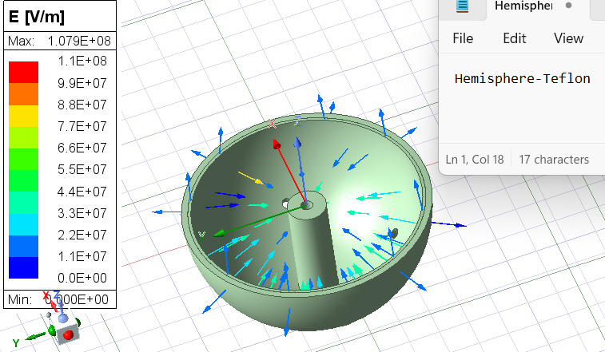
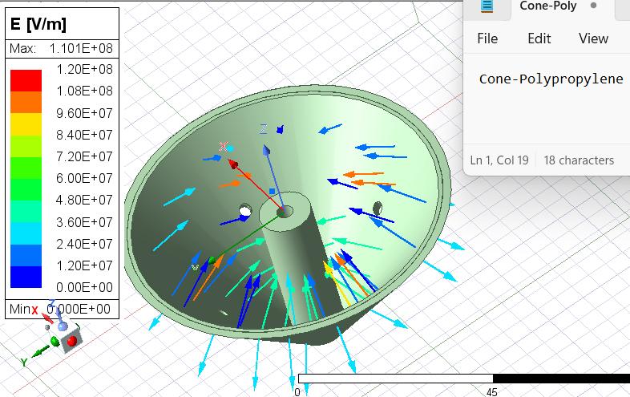
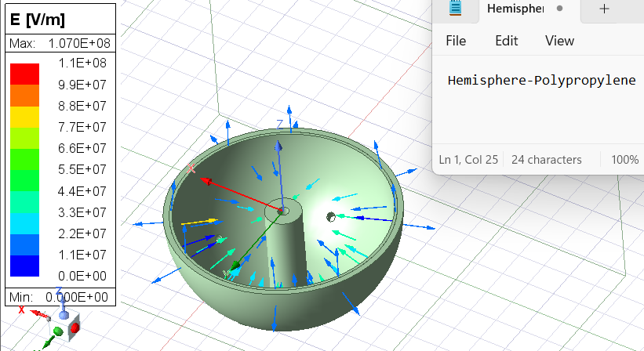
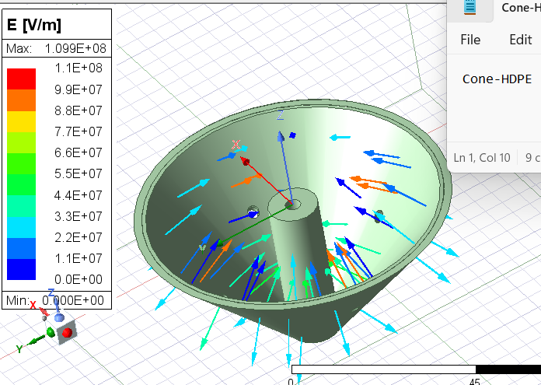
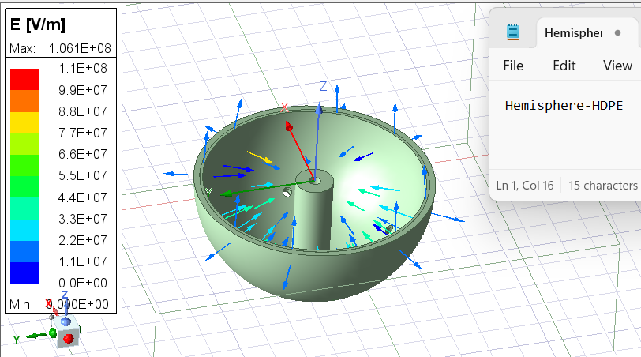

Slide 12
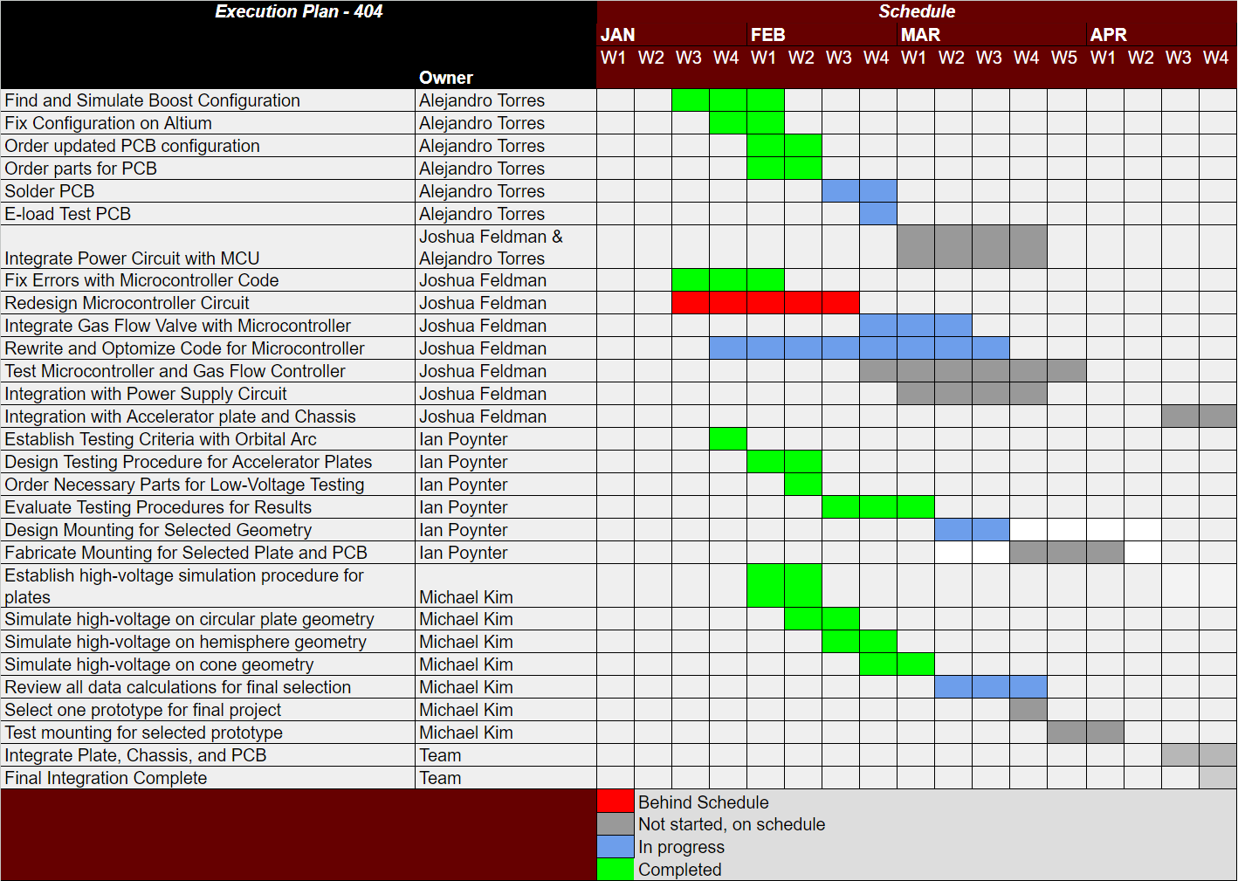
Execution Plan
Notes:
Michelle

Slide 13
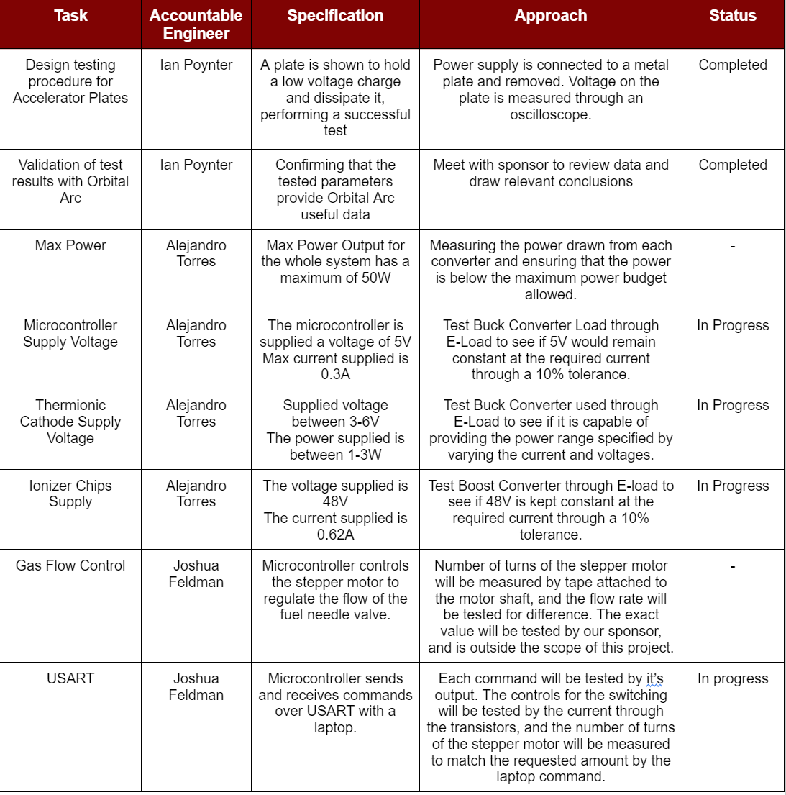
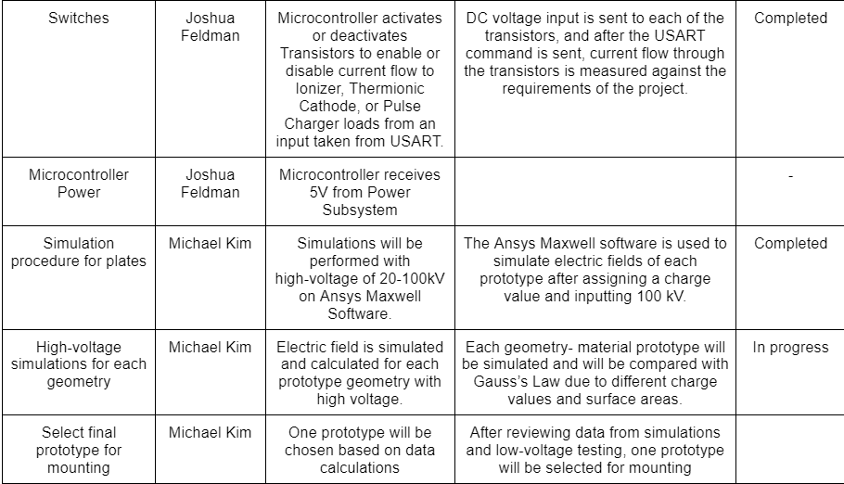
Validation Plan

Slide 14
Thank you!

