Slide 1


Agents

Slide 2
Agents

Slide 3
Agents

Slide 4
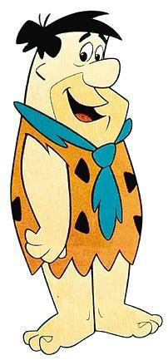
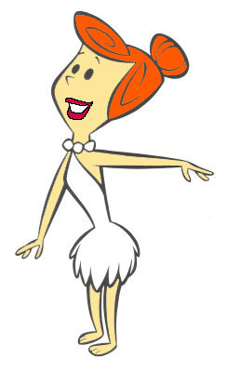
Agents
1 COUPLE
The Basic Decission Unit

Slide 5
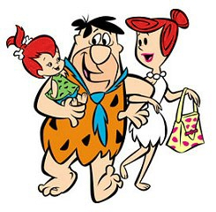
Agents
The model considers also the children
a family(the agent) has.

Slide 6
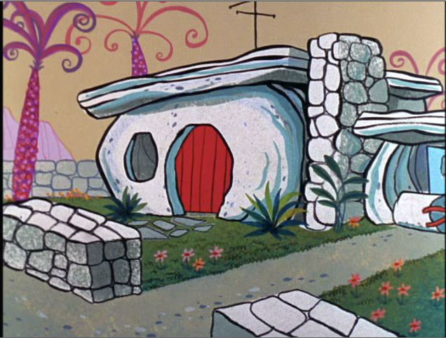
Agents
Home settled in a cell
of type DUNE

Slide 7
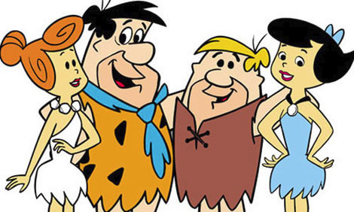
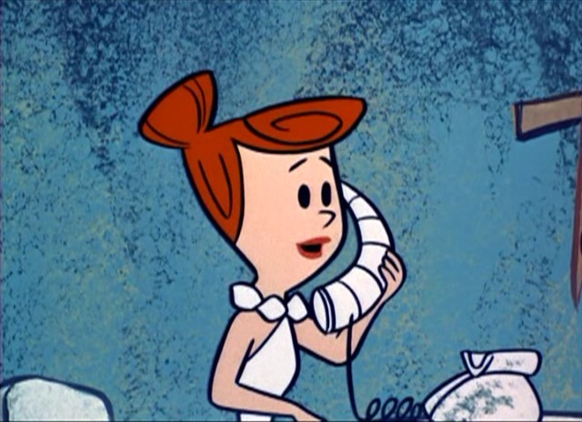
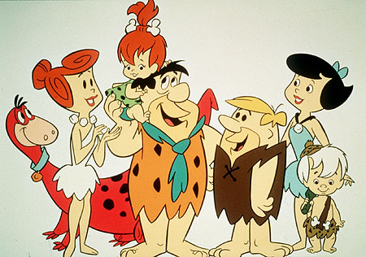
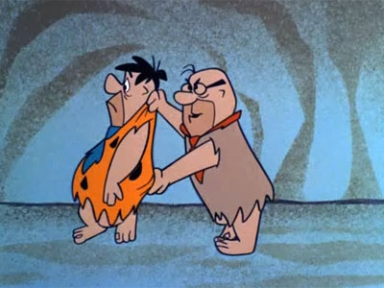
Agents
Acquaintainces

Slide 8
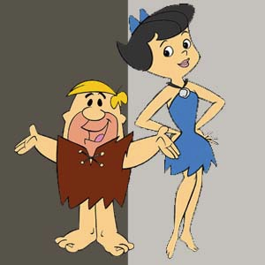


Slide 9
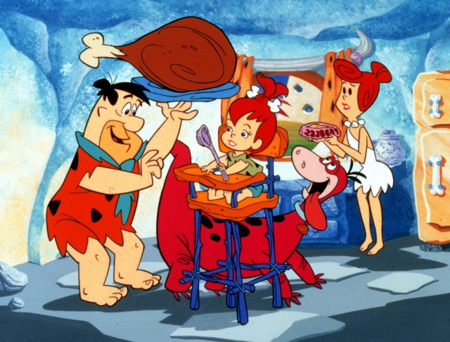
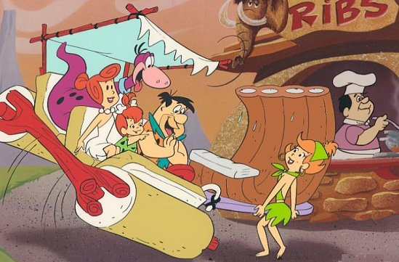
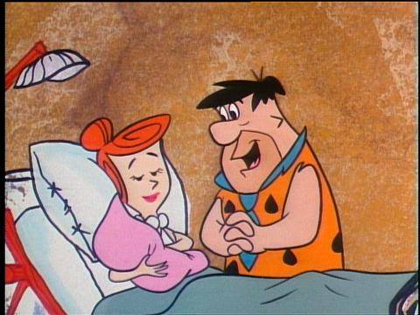
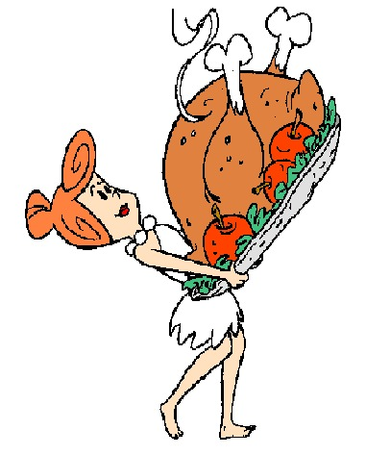
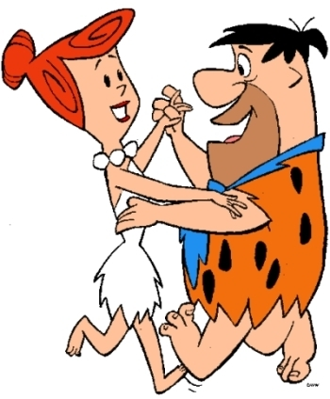
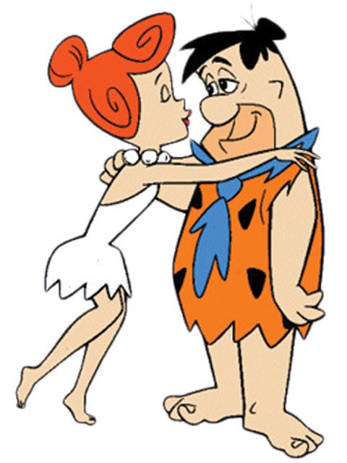
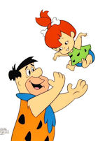
Agents
Resources

Slide 10


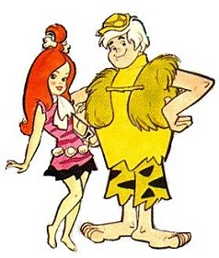

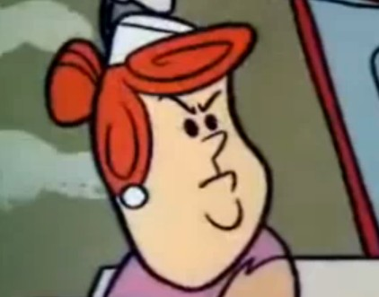
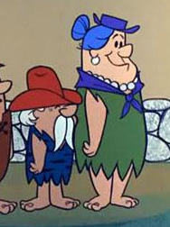

Agents
Age

Slide 11
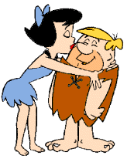
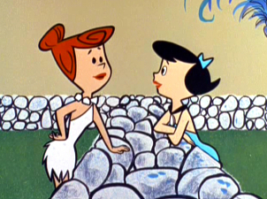


Agents

Slide 12


Agents
Life Cycle
Emigration
age=0
Life
Disease
Aging
Plants home
near parents home
Low resources
condition
Inherited with less
intensity
An agent will move its
home eventually.

Slide 13
Agents

Slide 14
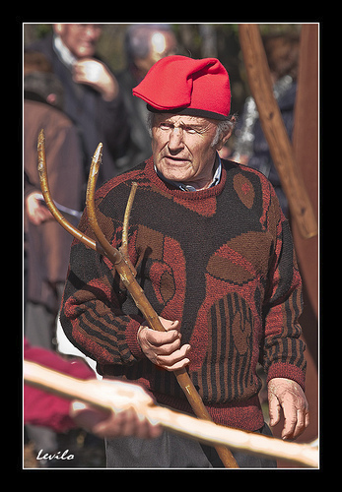
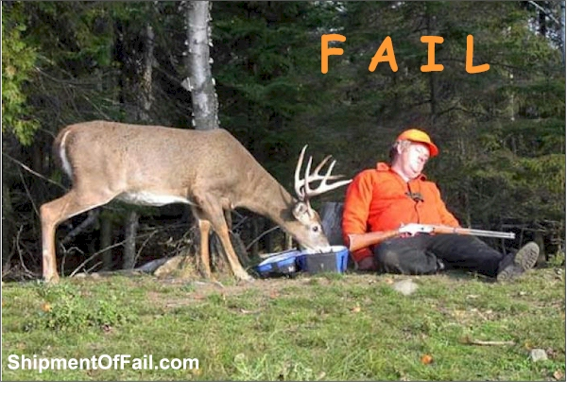
Agents
HUNTER GATHERER
AGRO PASTORALIST

Slide 15
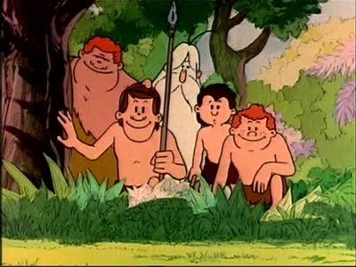



Hunter Gatherer
homerange

Slide 16
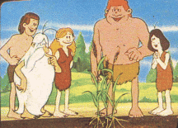

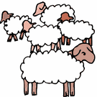
AgroPastoralist
Plot
range
Grazing
range

Slide 17







Decission Process
Actions
GOALS
PERCEPTION
ACTIONS
FEEDBACK
Other agent's information

Slide 18
Decission Process
Actions
Seasonal decisions
Intraseasonal decisions
Yearly decissions

Slide 19
Decission Process
Actions
Perception
Crop State
Neighbours' changes
Weather
Landscape changes
Seasonal decissions
Move Home - AP
Abandon Plot - AP
Establish Plot - AP
Move Home
The agents puts its home in another cell.
Any crop cell out of the new home range Is abandoned.
All buildings from old home are abandoned.
Abandon Plot
The agent stops taking care of the cell.
That action is mandatory after 3 consecutive years of
explotation of the cell.
Establish Plot
An INTERDUNA cell without crop is chosen.
If the agent has not any cell put to crop, automatically
Will launch that action.

Slide 20
Decision Process
Actions
Perception
Cells State
Neighbours' changes
Weather
Landscape changes
Move Home – HG
Sow – AP
Harvest - AP
Yearly decissions
Move Home - HG
The agent puts its home in another cell.
Being that action seasonal such thing reflects the
higher mobility of HG vs AP
Sow - AP
If the agent has a plot to cultivate, this field will be
ready for sowing at the beginning of ONDJ
(after the rain season).
Harvest - AP
At the end of the ONDJ season resources produced by the
crop cell are retrieved.
Excess resources will be stored for future consumption, til
Next cool season

Slide 21
AgroPastoralists
Policy
WILD
CROP
Prepare + Plot
After 3 years
abandoned
Harvest
Plot
FALLOW
(abandoned)
FALLOW
(seasonal)
After 3 years explotation

Slide 22
Decission Process
Actions
IntraSeasonal decisions
HG
HUNT
GATHER
HELP
GIFTS
AP
Maintain PLOT
Maintain HERD
HELP
GIFTS

Slide 23
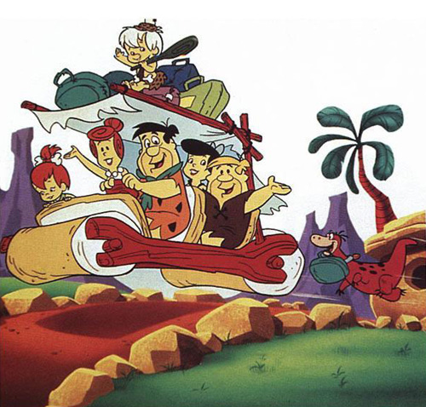
Thank you

