Slide 1
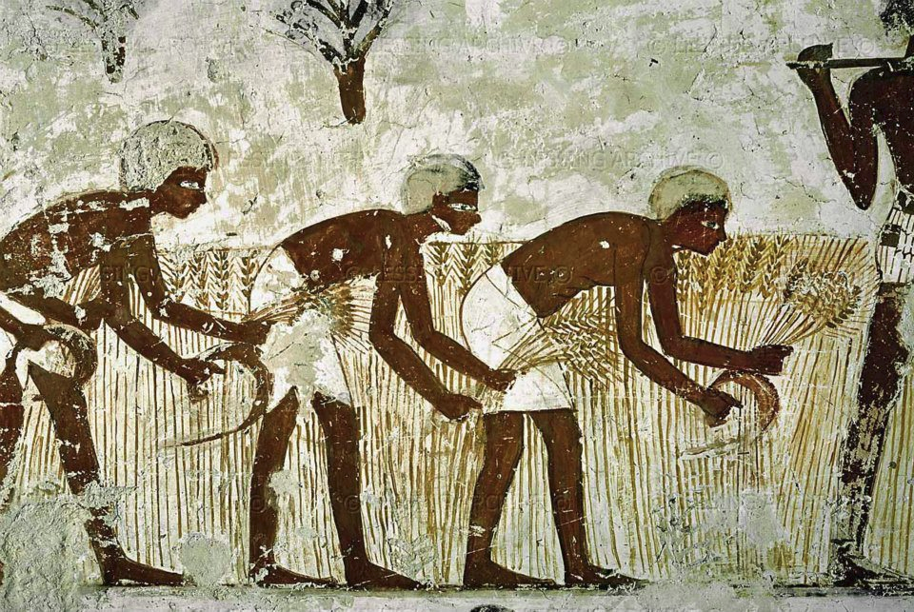
Early Societies Simulation

Slide 2







Agent Architecture
PERCEPTION
ACTIONS
FEEDBACK / REWARD
Other agent's information

Slide 3
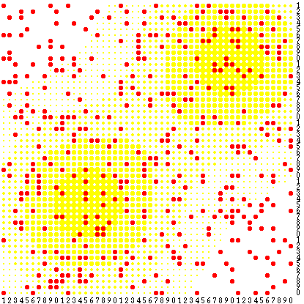
Classical Rule Based Agent
Rules are used to select an action to be launched given a perceived state in the system
Rules have the structure of condition – action.
Where condition evaluates the state of the system,
which if it is true returns the action to be launched in
the world.
ϖiaj
If (season(rainy) ∧ resources < K)
then goHunt();
Sugarscape

Slide 4
Classical Rule Based Agent
(Limitations)
Rules are a hard wired behaviour pattern which tries to be adapted to a set of conditions and states of the System.
If conditions change, the rules serve no more.
The rules encode a static knowledge : It encumbers the agent's adaptability.
LOW FLEXIBILITY,
LOW ADAPTABILITY
The conditions-space could be huge, situations, exceptions to normal situations, complex dynamics and states not predicted by the designers:
if (rainy(season) && resources < 30kg && children>3) then hunt
if (rainy(season) && resources < 30kg && children>3 || number of neighbours > 2) then emigrate

Slide 5





Decision Process - Actions
GOALS.
GOAL Satisfaction → PLAN of Action
Way of living
(Survival Strategy)
Actions
Action will be the mechanism used by the agent to change the current state of the system to
approach it to a desired state were the agent is nearer to its satisfaction of objectives.
Move
Home
Crop
Problem Solving
&
Planning
Gather
Hunt
Harvest
Conditions change, the agent explores and synthesizes a sequence of actions to achieve its goals based on the conditions.
FLEXIBILITY

Slide 6
Smart Agent
Hypothetical Deductive
“What if...?” search tree
The agent constructs a search state space tree from transitions of states triggered by the choice of actions. It tries to predict the sequence of actions that yield greater profit N steps in advance. The first action of the sequence is launched in the world.
0
hunt(South)
hunt(North)
horizon
hunt(East)
Selected Action for current timestep :
hunt(East)
move(North)
move(East)
hunt(South)
The exploration is run at each timestep due to stocasticity of environment and unstability of predictions about it.
Collected
30kg food
move(South)
Collected
20kg food
This is the costly part of the simulations.
SuperComputing allows us to pay that cost for using sophisticated agents.
Collected
5 kg
Collected
0 kg
N timesteps
away
#1
✗
✗
✗
✓

Slide 7
Hypothetical Deductive
“What if...?” search tree
The action that has associated a higher scoring sum of trace sampling is selected : hunt(East).
0
hunt(South)
hunt(North)
horizon
hunt(East)
move(North)
move(East)
hunt(South)
Collected
30kg food
move(South)
Collected
20kg food
Collected
5 kg
Collected
0 kg
N timesteps
away
✗
✓
✗
✗

Slide 8
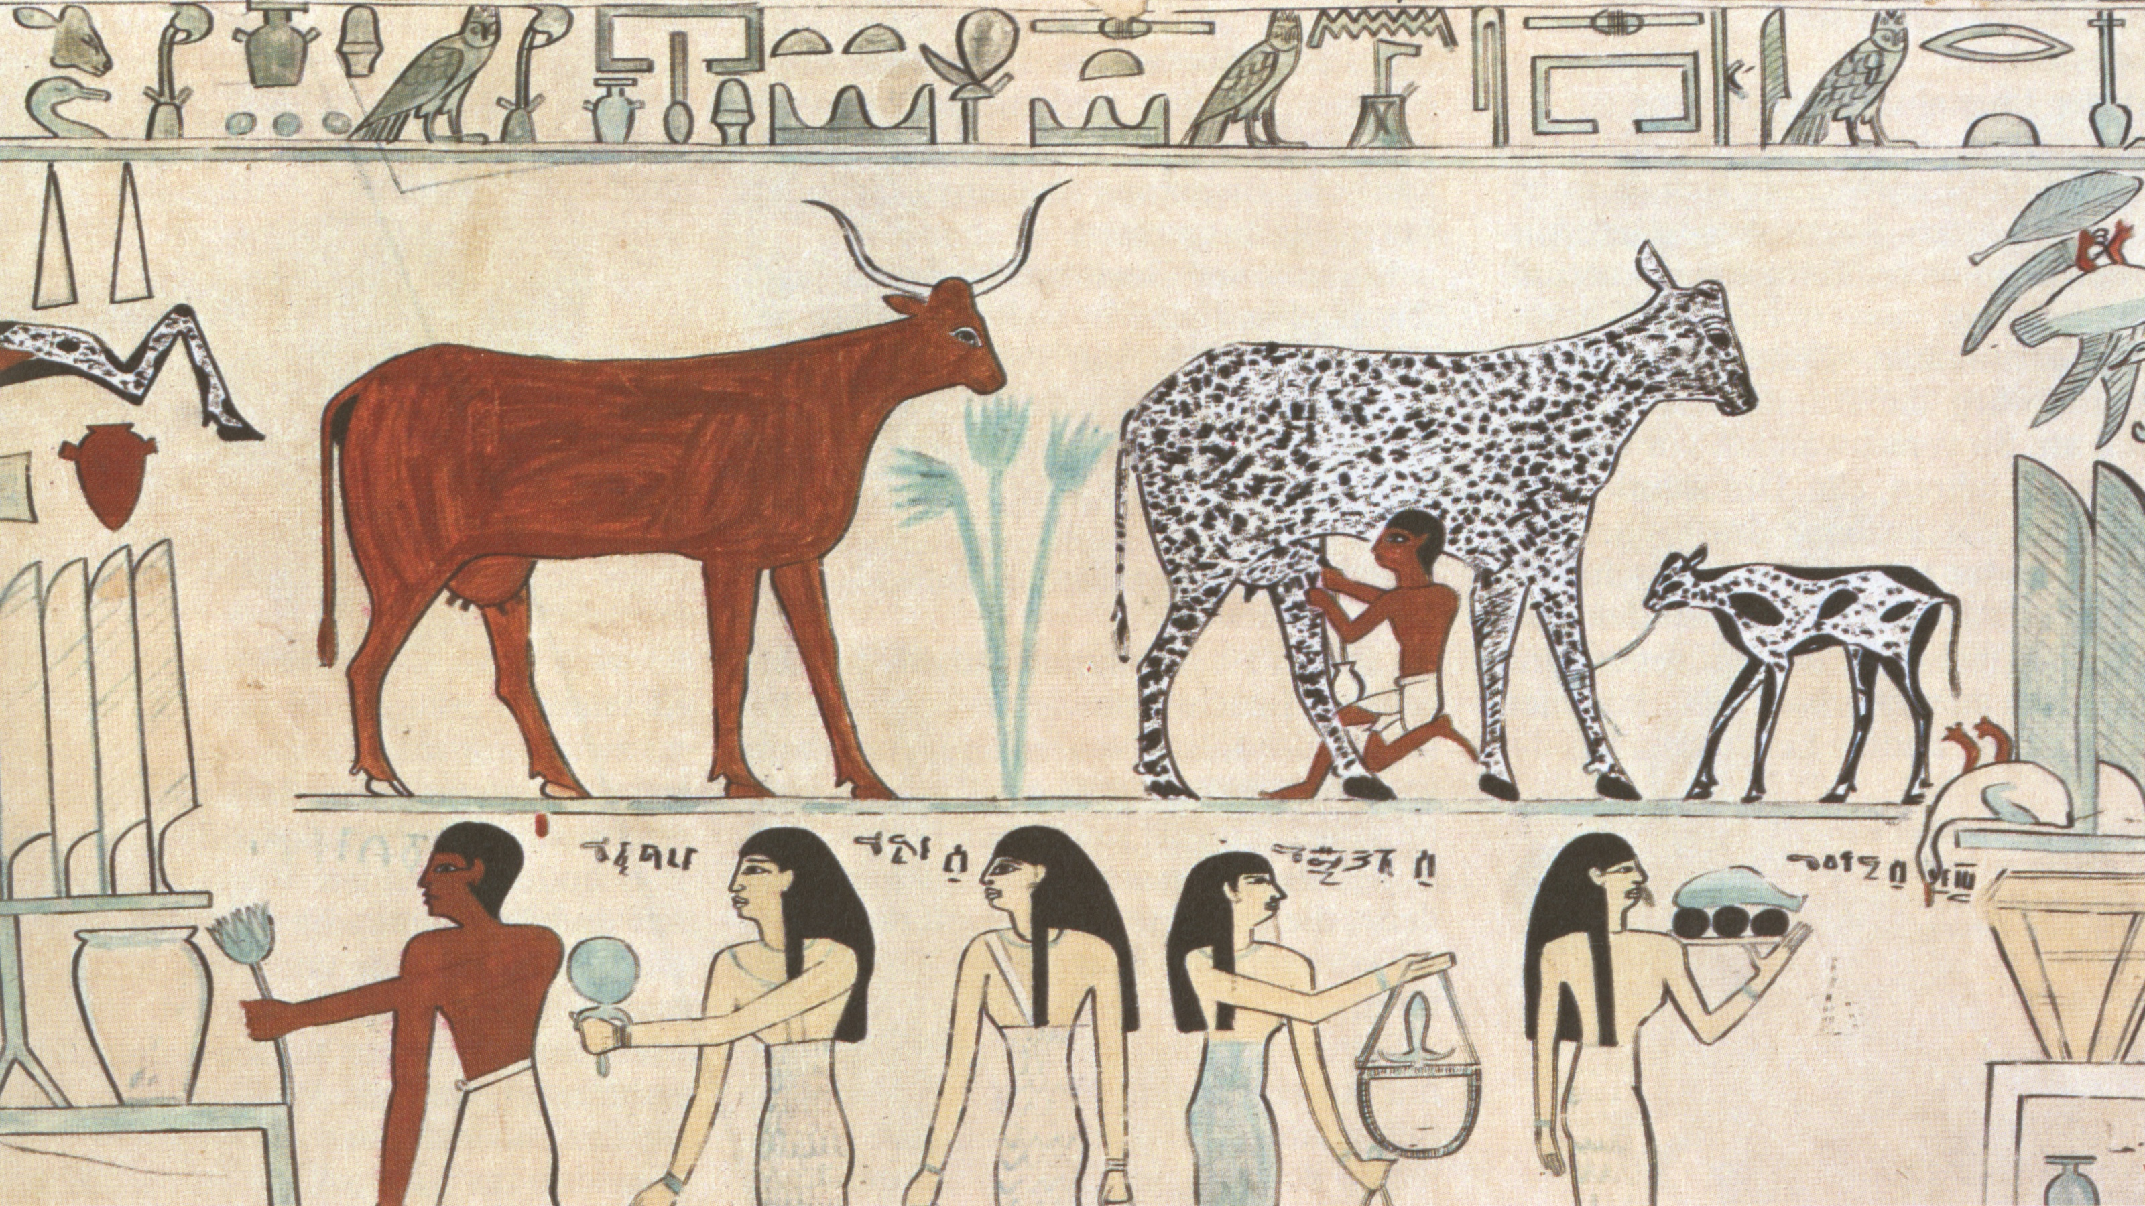
Thank you

