Slide 1
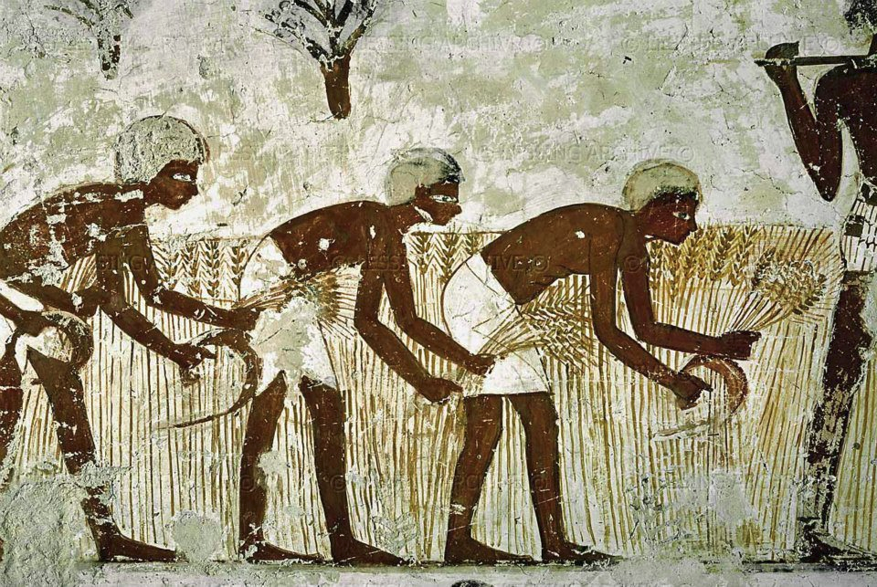
Early Societies Simulation

Slide 2
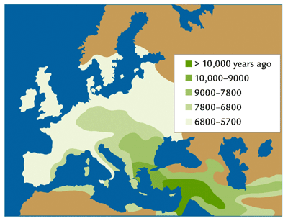




HUNTER GATHERER
SOCIETIES
AGRO PASTORALIST
SOCIETIES
Transition -
Blending

Slide 3
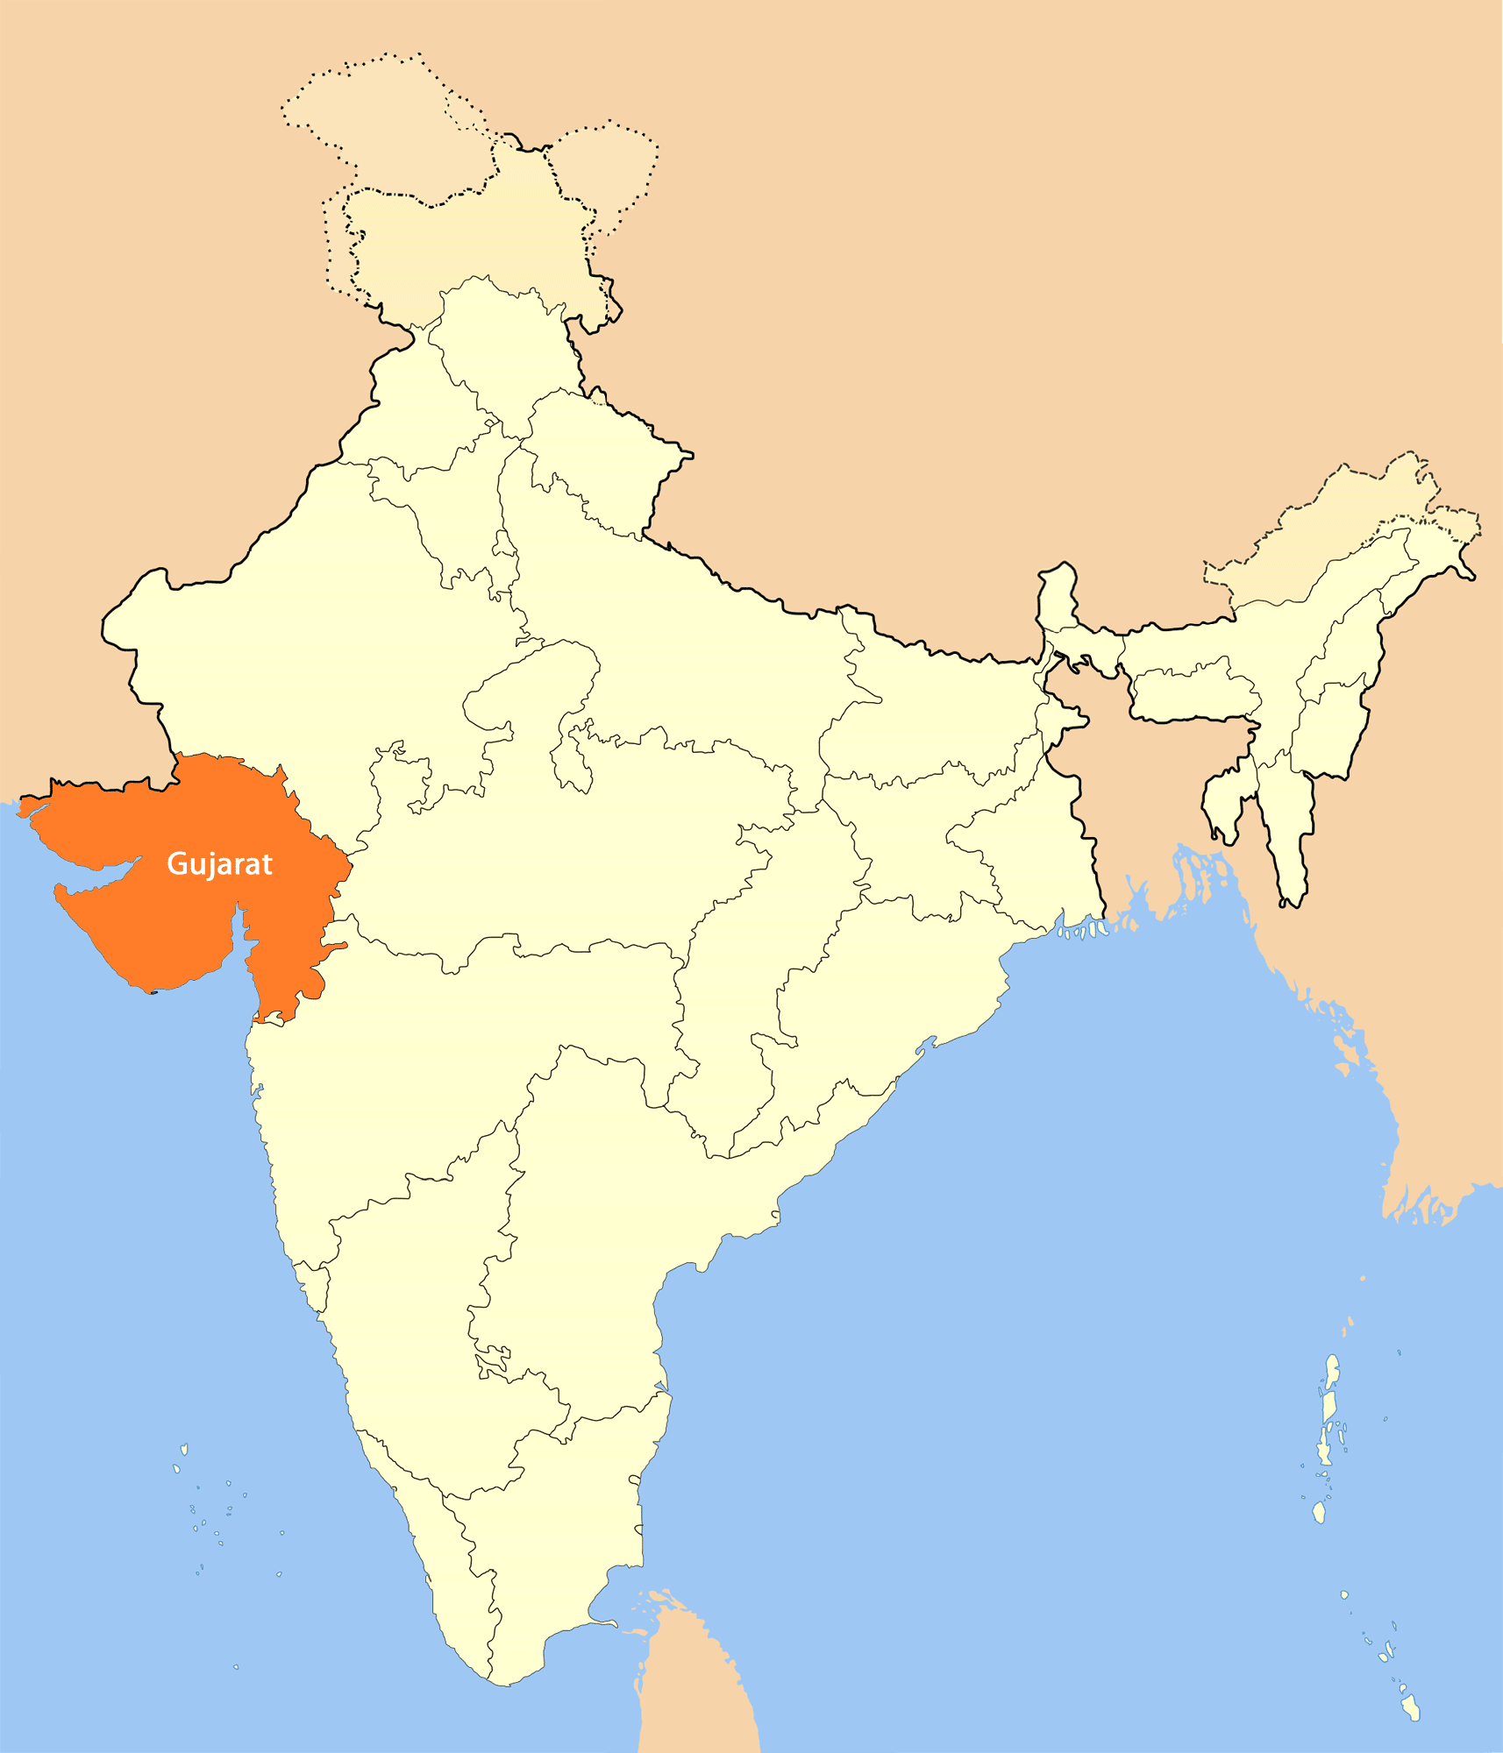
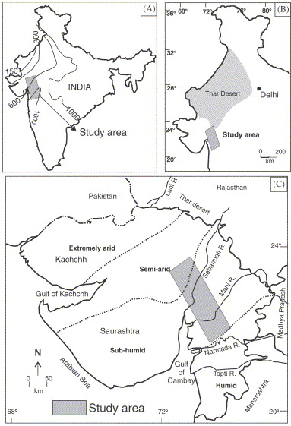
CS1
Delayed extinction of HG strategies at GUJARAT

Slide 4
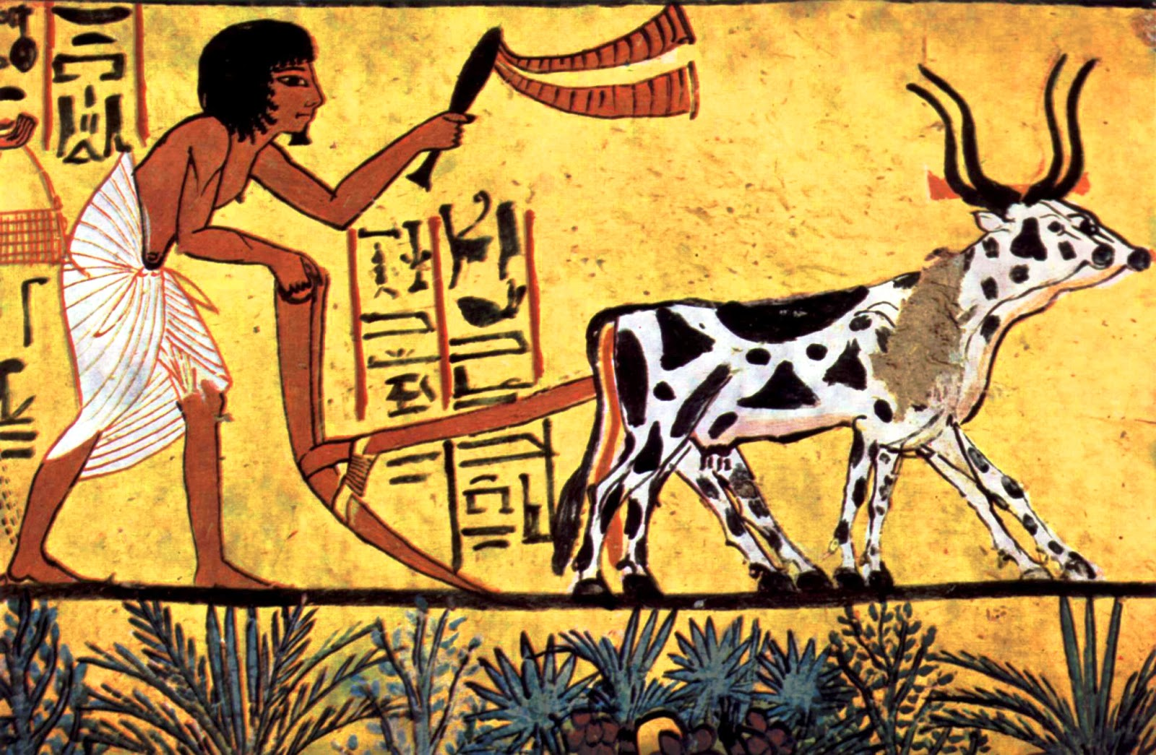
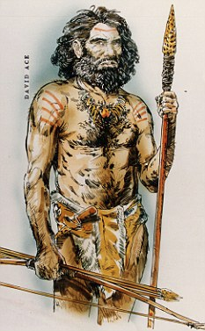
PURPOSE / QUESTION
Strategies Equilibrium
Cultural Evolution
Socio economic simulation

Slide 5


Agent Based Simulation

Slide 6
Agents
1 COUPLE
The Basic Decission Unit

Slide 7
Agents
The model considers also the children
a family(the agent) has.

Slide 8
Agents

Slide 9


Agents
Life Cycle
Emigration
age=0
Life
Disease
Aging
Plants home
near parents home
Low resources
condition
Inherited with less
intensity
An agent will move its
home eventually.

Slide 10
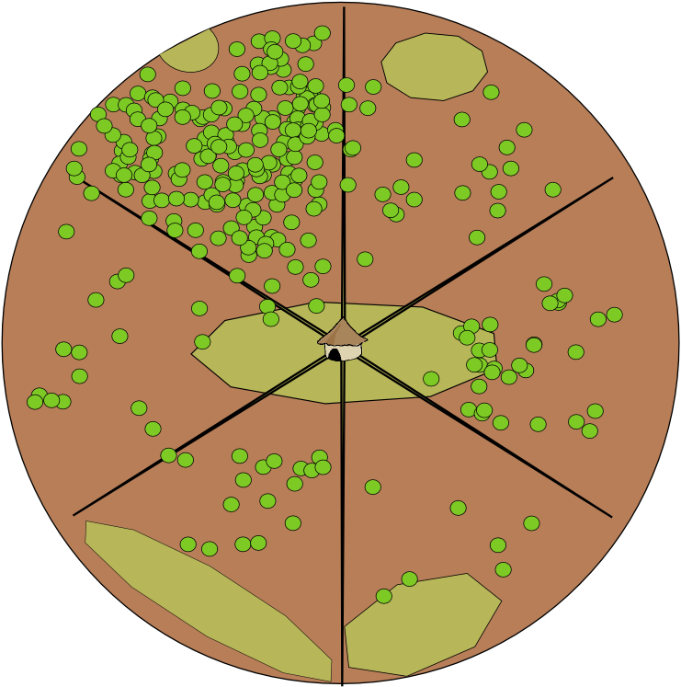
Environment Interaction Model

Slide 11
Environment Interaction Model
Home settled in a cell
of type DUNE
Raster representation of space

Slide 12
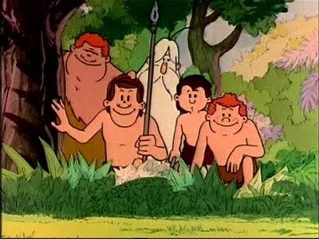

Hunter Gatherer
homerange

Slide 13
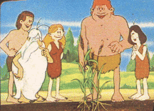
AgroPastoralist
Plot
range
Grazing
range

Slide 14







Agent Architecture
GOALS
PERCEPTION
ACTIONS
FEEDBACK / REWARD
Other agent's information

Slide 15
Decision Process - Actions
Way of living
(Survival Strategy)
Activities
Abstraction Process
(Modelization)
Action is the mechanism used by the agent to change the current state of the system to
approach it to a desired state were the agent is nearer to its satisfaction of objectives.
Actions
ϖi
ϖj
Move
Home
ar
Crop
aq
Gather
ap
ϖu
ϖv
Hunt
Harvest

Slide 16
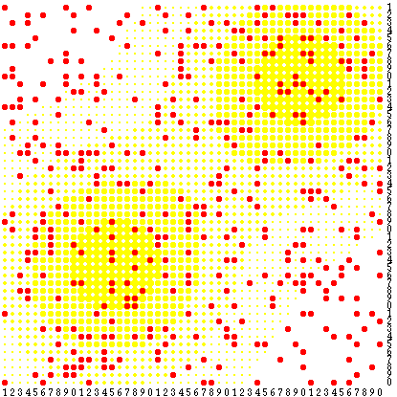
Classical Rule Based Agent
A POLICY table dictates an action to launch given a
perceived state in the system
ϖiaj
A Policy can be represented as a table of correspondences between states and actions or as rules that evaluate with the state of the system and produce the action to launch.
If (season(rainy) ∧ resources < K)
then moveHome();
Sugarscape
f(ϖi,aj){true, false}

Slide 17
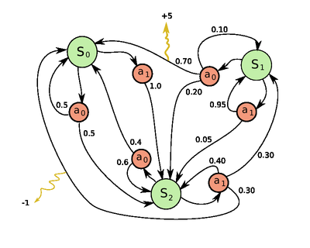
Deliberative Agent
A Deliberative Agent knows the effects that its actions produce.
Hence it will plan the trace of actions to perform better to get nearer of its desired state for the system.
Adaptability, Resilience, Realistic
ϖi + aj  ϖk
What if...?
S0::a1::S2::a1::S1

Slide 18
MDP
Markovian Decision Processes
MDP = < S, A(S), P(si | sj,ak) >
R : state, action → reward ~ distrib(...)
Solver
Maximizing H steps trace reward.
Calculated Policy Table
State | Action
... | ...
sj | ak
... | ...
... | ...

Slide 19
UCT
Hypothetical Deductive
“What if...?” search tree
UCT constructs a search state space tree from transitions of states labeled by the actions that induce them.
S0
horizon
a1
a0
a0
Discount γ<1 on
rewards in future
S2
S2
S0
a0
At time t, reward at level
t+l = γ^{(t+l)} · rewardt+l
S0
horizon=∞
✗
✓
trace τ
a1
N steps
prediction
horizon=∞ → ∀τ a trace:reward(trace)=∞
cannot discriminate between actions to
choose at the first step.
S1
UCT
algorithm

Slide 20
UCT
a1
Δt
At each timestep the agent must decide an action to launch. UCT is run to calculate a prediction H steps forward and find the best action to launch. It is best described through matching it to our hypothetical – deduction reasoning. We have in our heads some premises and think the hypothetical changes of applying some change which we predict through deduction. UCT for each choice applies a tiny simulation to deduce the resulting state of launching certain action.
Si
a1
H steps
This is the costly part of the simulations.
SuperComputation allows us to pay that price for making our agents more sophisticated.
UCT
algorithm

Slide 21
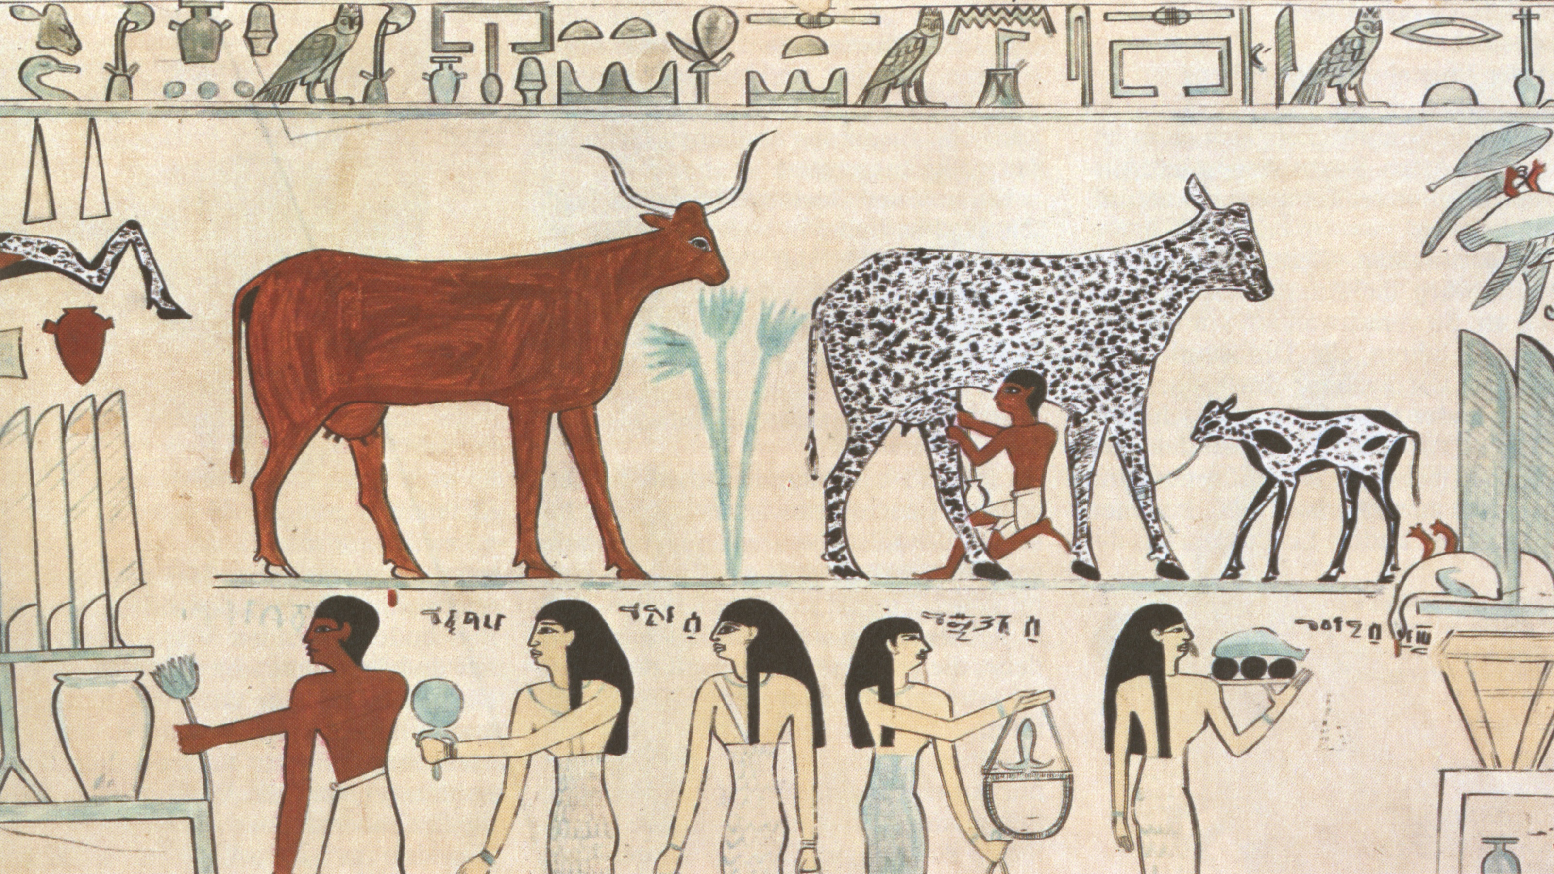
Thank you

