Slide 1

Future Issues

Slide 2
Future Issues
Energy Model
  Conversion, data sources, FAO, …
Agent Improvement
  Decision Engine
    Now : classic ABM, rules
    Future : planning of actions → dynamic programing,...
  Perception and Internal World Model
  Flexible Survival Strategy : HG ↔ AP
Social Network
  Resource safe Network : Help & Gifts
  Knowledge Transmission

Slide 3
Future Issues
Energy Model
Resources – Agent Actions
Relationship

Slide 4
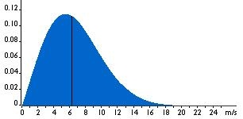
Rainfall x year
-
-
-
-
Weibull(2.63,5300)
Precipitation
(mm)
R
C
WILD
BIOMASS
(Kg)
Precipitation
(mm)
C
HERD
(Kg)
C
Moisture
(mm)
FALLOW
(Kg)
C
ENERGY
(quantum)
C
Soil type
CROP
(Kg)
ECT
C
Resource or derived measure
ACTIONS
Software or pre/postprocessing
Conversion
Measured data
For human
agents

Slide 5
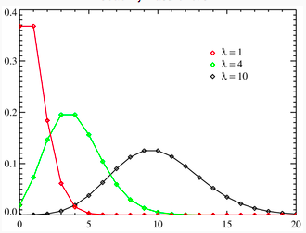
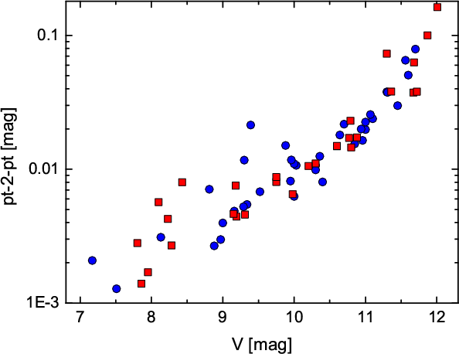
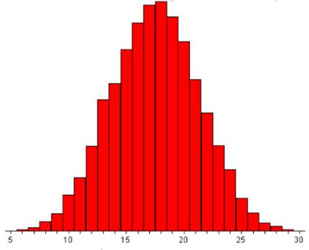
Conversion and other real data
From... |  | To...
Moisture mm |  | Wild plant kg
Moisture mm |  | Domestic plant kg
Wild plant kg |  | Wild animal kg
Wild plant kg |  | Cattle kg
Wild plant kg |  | Energy quantums
Domestic plant kg |  | Energy quantums
Wild animal kg |  | Energy quantums
Cattle kg |  | Energy quantums
CALORIES...

Slide 6
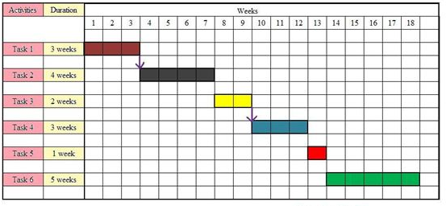
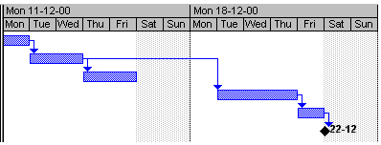
Action Cost
Energy Consumption Table - ECT
ACTION | CONSUMED ENERGY ( quantums per...)
Move | # q per cell moved ,#humans,load
Change settlement | # q per cell moved, # humans, # load,# cattle
Reproduce (v. Surplus) | # q per # children born (constant)
Hunt | # q per cell scanned, # Kg prey retrieved
Foraging | # q per cell scanned, # Kg wild plant foraged
Crop | # q per # cell
Harvest | # q per cell, # Kg plant harvested
Graze | # q per cell, # animal grazed
Basic (v. Food Needs) | # q per body mass (# children in charge...)
Establish Agro Plot ( clean cell? ) | # q per cell
Time Planification

Slide 7
Action Cost
Hard to ponderate the price an agent must pay for performing an action.
Found different approaches
  Consider only time cost ( current )
  Consider only energy cost
  Consider both time and energy
The agent will must include the cost in its planning.

Slide 8
Future Issues
Advanced Agent
Decission process
Knowledge
&
Adaptation

Slide 9



Simple Agent
Decission Engine
PERCEPTION
P
A
ACTION
FEEDBACK
“Rainy season has arrived, I plot my crop cell.”

Slide 10

Advanced Agent
Decision Engine
PERCEPTION
P
P
A
P
A
A
ACTIONS
F
F
FEEDBACK
It will take into account the sequence of past
and future actions, producing a planning
“Last year was bad for rain, I will put more effort for grazing my herd which I will sell soon”

Slide 11
Agent Perception
Raster
Known Area
Raster
Known Area
Terrain knowledge depends on
Explored cells
Shared information from others
v1.0 : omniscence at
homerange scale

Slide 12
Adaptation
Were HG and AP closed group? There was a clear separation into these 2 categories?
Now are closed, what if...?
0.- HG / AP along all your life. Parent inherited.
1.- Only change your children
2.- The agent adapts : new capabilities learning

Slide 13




Adaptation
Once you are born HG, you are HG ¿forever?

Slide 14
Adaptation
Tipical
HG
Skill Proficiency
Tipical
AP

Slide 15
Adaptation
Survival Strategy
change

Slide 16
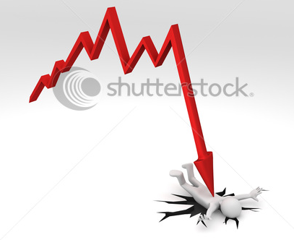

Adaptation
2 FACTORS
Resources Dynamics
+
Cultural Transmission
We want to make emerge the
behavioural change.

Slide 17

Social Network

Slide 18
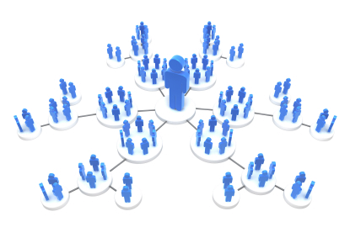
Social Network

Slide 19
Social Network

Slide 20
Social Network

Slide 21
Thank you

