Slide 1
Future Issues

Slide 2
Future Issues
Energy Model
  (Matt, data sources, FAO, … show some numbers, so they can see we have them)
Agent Improvement
  Decision Engine
    Multiple crop field planning
  Perception and Internal World Model
Social Network
  Resource safe Network : Help & Gifts
  ( Matt, more fenomena on HG/AP nets?)
  Competence

Slide 3
Future Issues
Energy Model
Resources – Agent Actions
Relationship

Slide 4
Energy costs of agents actions
Data from FAO's Human Energy Requirements (2001):
1) Estimation of Basic metabolic Rate of agents (BMR), linked with variable Age of agents.
2) Estimation of energy costs of modelled activities (scanning a cell, hunting, move settlement, cropping...)
Ex:
- Non-mechanized agricultural work: PAR = 4,1/hour (FAO)
- Basic Metabolic Rate (Man, 20-25 y.o., 70 kg): 72,7 kcal/hour (FAO)
- Energetical cost of action: 72,7 X 4,1= 298,1 kcal/hour
3) Estimation of:
- energy cost of basic needs (during “inactive” time)
- threshold of maximum energy expenditure per agent

Slide 5
FAO data
Cost of activities
Per agent
Available
energy
for actions
AGENT
Variable: AGE
(+ pregnancy)
Mean BMR
Per agent
Cost of
basic needs
(sleep, etc.)
Basic needs
Maximum
Energy
Expenditure
Per agent
(threshold)

Slide 6
Open questions
1) How to introduce the cost of pregnancy?
Possibility 1:
Assessing total energy extra cost of pregnancy, and taking it as a threshold for reproduction.
> Average extra cost of pregnancy is 77 000 kcal (FAO)
Possibility 2:
Choosing a lower threshold but introduce pregnancy cost in “everyday life”:
1st third of pregnancy: 85 kcal/day
2nd third of pregnancy: 285 kcal/day
3rd third of pregnancy: 475 kcal/day

Slide 7
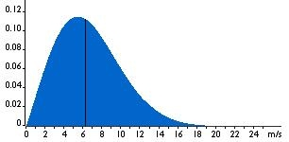
Rainfall x year
-
-
-
-
Weibull(2.63,5300)
Moisture
(mm)
R
C
Moisture
(mm)
WILD
BIOMASS
(Kg)
C
HERD
(Kg)
C
Soil type
FALLOW
(Kg)
C
ENERGY
(quantum)
C
CROP
(Kg)
C
ECT
Temperature
(ºC)
Resource or derived measure
ACTIONS
Software or pre/postprocessing
Conversion
Measured data
For human
agents

Slide 8
Conversion
From... |  | To...
1 Moisture mm |  | 0.5 Wild plant kg
1 Moisture mm |  | 2 Domestic plant kg
10 Wild plant kg |  | 1 Wild animal kg
10 Wild plant kg |  | 1.5 Cattle kg
1 Wild plant kg |  | 1 Energy quantums
1 Domestic plant kg |  | 2 Energy quantums
1 Wild animal kg |  | 4 Energy quantums
1 Cattle kg |  | 4 Energy quantums

Slide 9
Energy Consumption Table - ECT
This is for each season,
and for each
try successful or not.
It should add
time dimension parameter
if time grain becomes
week, month,day...
ACTION | CONSUMED ENERGY ( quantums per...)
Move | # q per cell moved ,#humans,load
Change settlement | # q per cell moved, # humans, # load,# cattle
Reproduce (v. Surplus) | # q per # children born (constant)
Hunt | # q per cell scanned, # Kg prey retrieved
Foraging | # q per cell scanned, # Kg wild plant foraged
Crop | # q per # cell
Harvest | # q per cell, # Kg plant harvested
Graze | # q per cell, # animal grazed
Basic (v. Food Needs) | # q per body mass (# children in charge...)
Establish Agro Plot ( clean cell? ) | # q per cell

Slide 10
Sucess rate formulae
Future option:
Each agent will
have a list of
{capabilities,skills}:
<c_i,success rate>+
ACTION | SUCCESS RATE | OUTCOME
Move | ???
Change settlement | ???
Reproduce | ???
Hunt | weibull | x Kg of Wild Animal
Foraging | weibull | x Kg of Wild Plant
Crop | α : Ratio of production over carrying capacity of the cell | Max waited harvest / Upper bound
Harvest | α : Ratio of production over Max defined at Crop | x Kg of Dom Plant per 1 cell
Graze
Which distribution?
Uniform?
Normal?
Weibull?(weibull value denotes
the mean of success ,older agents
fail more often)
Different ideas
to represent
succes rate

Slide 11
Distributions I
Variable | Units | Model
Annual rainfall | mm | weibull()
#Children | individual | normal()
Infant Mortality | individual | weibull()
Age | season | {Mean Max age, normal()}
Home-Range(HG's) | cell/day | normal()
Herd | #cattle/agent | normal()
Max plot range | cell
Max graze range | cell
Relationship Intensity |  | [0..Max]
Inmigration Probability | probability | poisson
Emigration Probability | probability | poisson
Fertility Age | season | normal()
Wild Anim Occupancy | Kg/cell | ~ poisson
Wild Plant Occupancy | Kg/cell | Normal ( cell also has a max capacity due to moisture+area)
Dom Plant | Kg/cell | Normal (caring increases it)
Ask Help |  | Depends on social networks
Make Gift |  | Depends on social networks
Depends on
cell type!

Slide 12
Distributions II
Variable | Units | Model
disease_i infection | probability
Move settlement

Slide 13
Future Issues

Slide 14
Agent Improvement

Slide 15
Agent Perception
Memory = List of Rects
(<x1,y1><x2,y2>)+
+/-MySQL views?
*must perform a partial remove
each season?
*Each memory rect-cell adds a deviation error
When querying the raster.
Raster
Known Area
Example structure
for querying
about what a cell is :
duna/interduna/water
v1.0 : omniscience (?)

Slide 16

Social Network

Slide 17
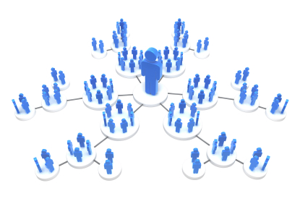
Social Network

Slide 18
Social Network

Slide 19
Social Network

Slide 20
Thank you

Slide 21
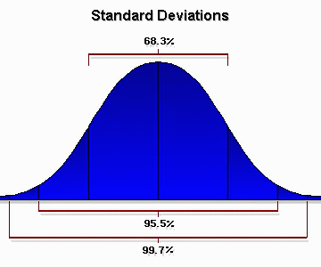
Rainfall x year
-
-
-
-
Weibull(2.63,5300)
Moisture
(mm)
R
Temp x season
-
-
-
-
distrib(params...)
Temperature
(ºC)
R
Wild animals
(Kg)
C
Wild plants
(Kg)
C
Cattle
(Kg)
C
Moisture
(mm)
C
+
C
ENERGY
(quantum)
Soil type
Domestic plants
(Kg)
C
ECT
Temperature
(ºC)
Resource or derived measure
ACTIONS
Software or pre/postprocessing
Conversion
Measured data
For human
agents

