Slide 1
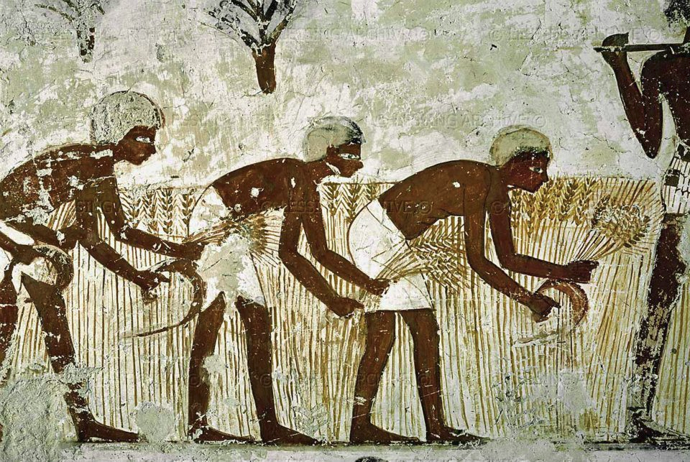
Early Societies Simulation

Slide 2
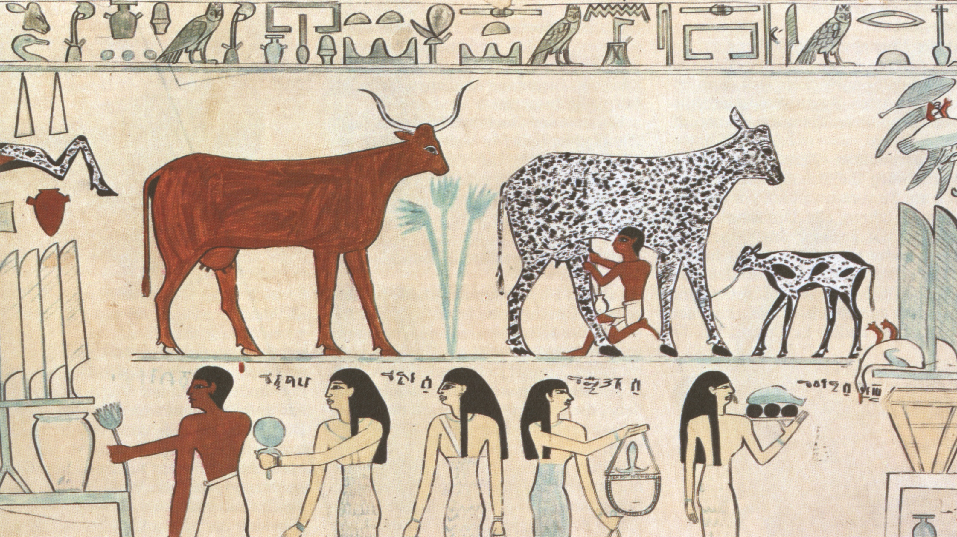

Slide 3
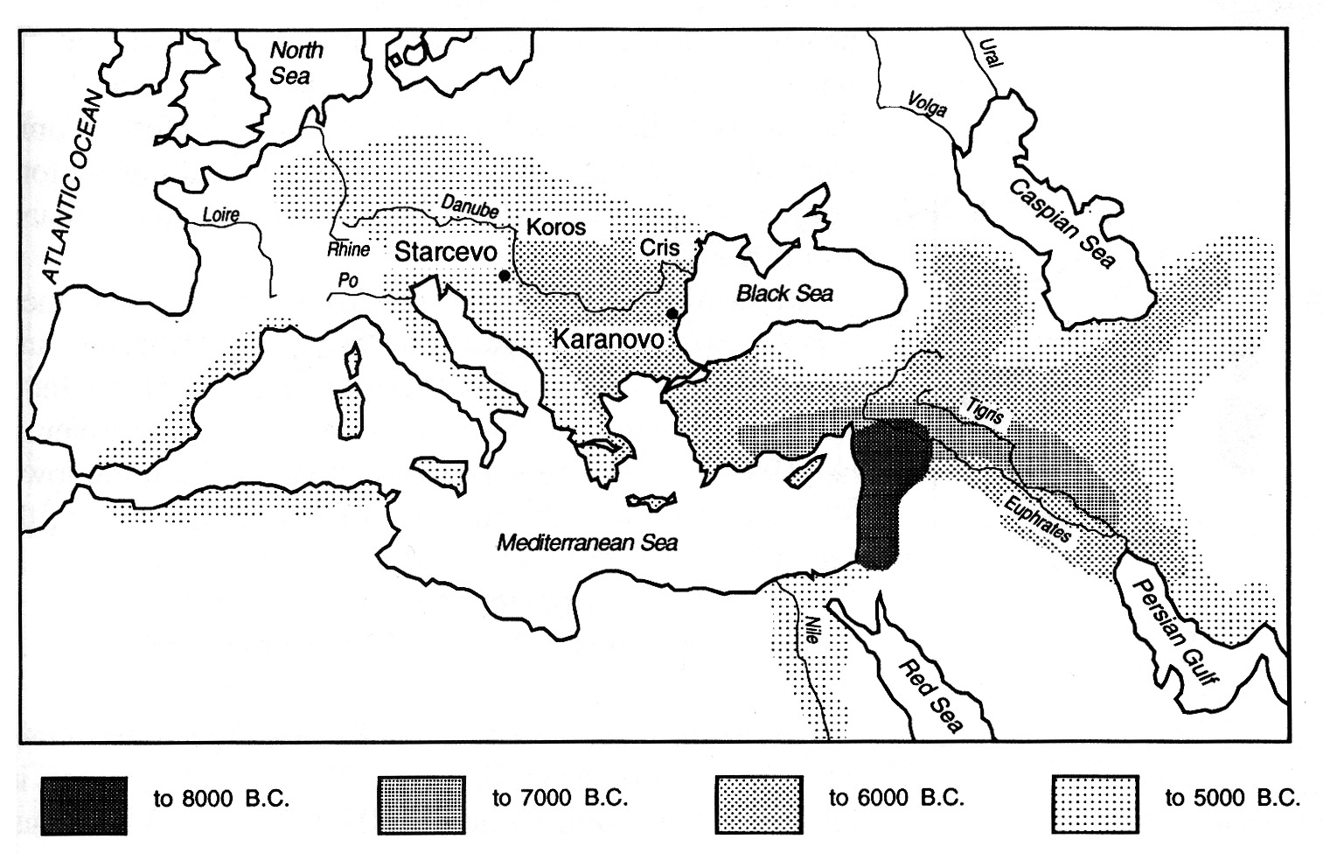
Setting / Question / Purpose
HG → AP

Slide 4
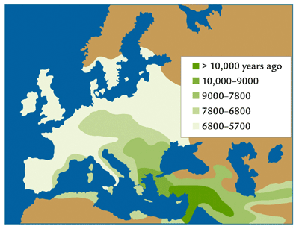

Slide 5
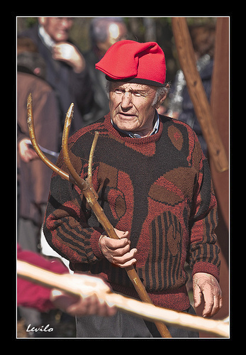
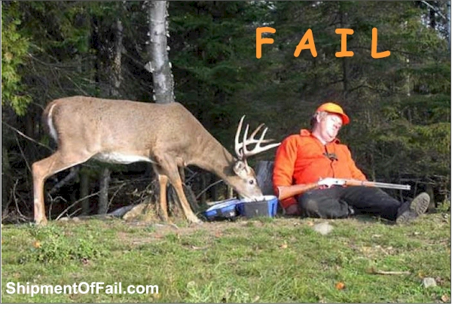
HUNTER GATHERER
AGRO PASTORALIST

Slide 6
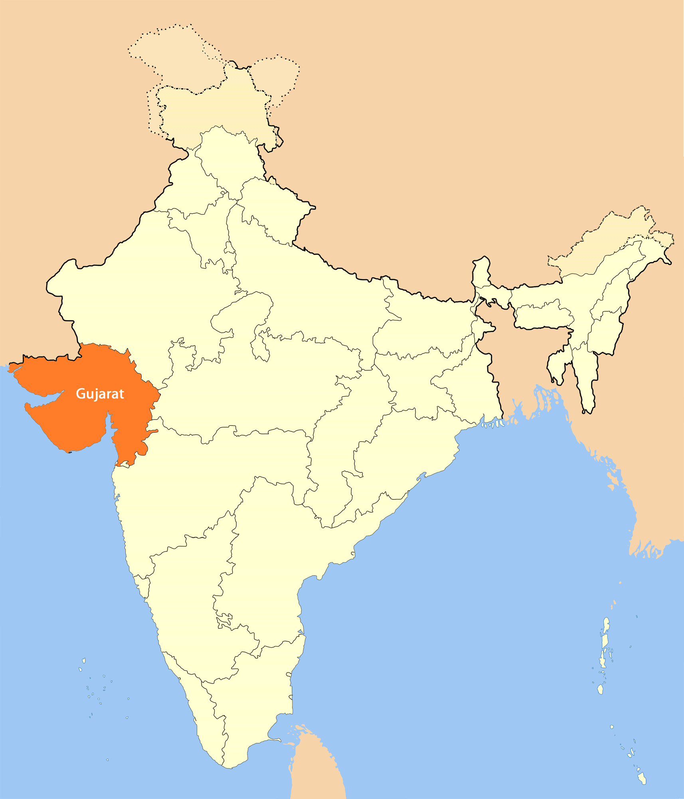
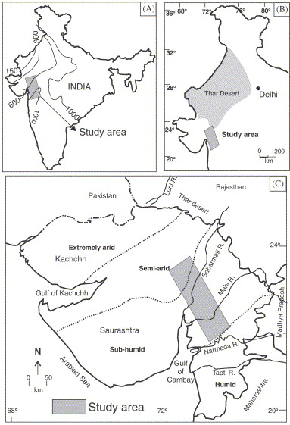
Delayed extinction of HG strategies

Slide 7
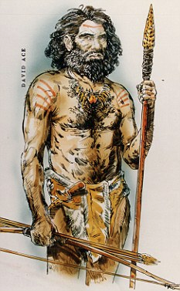
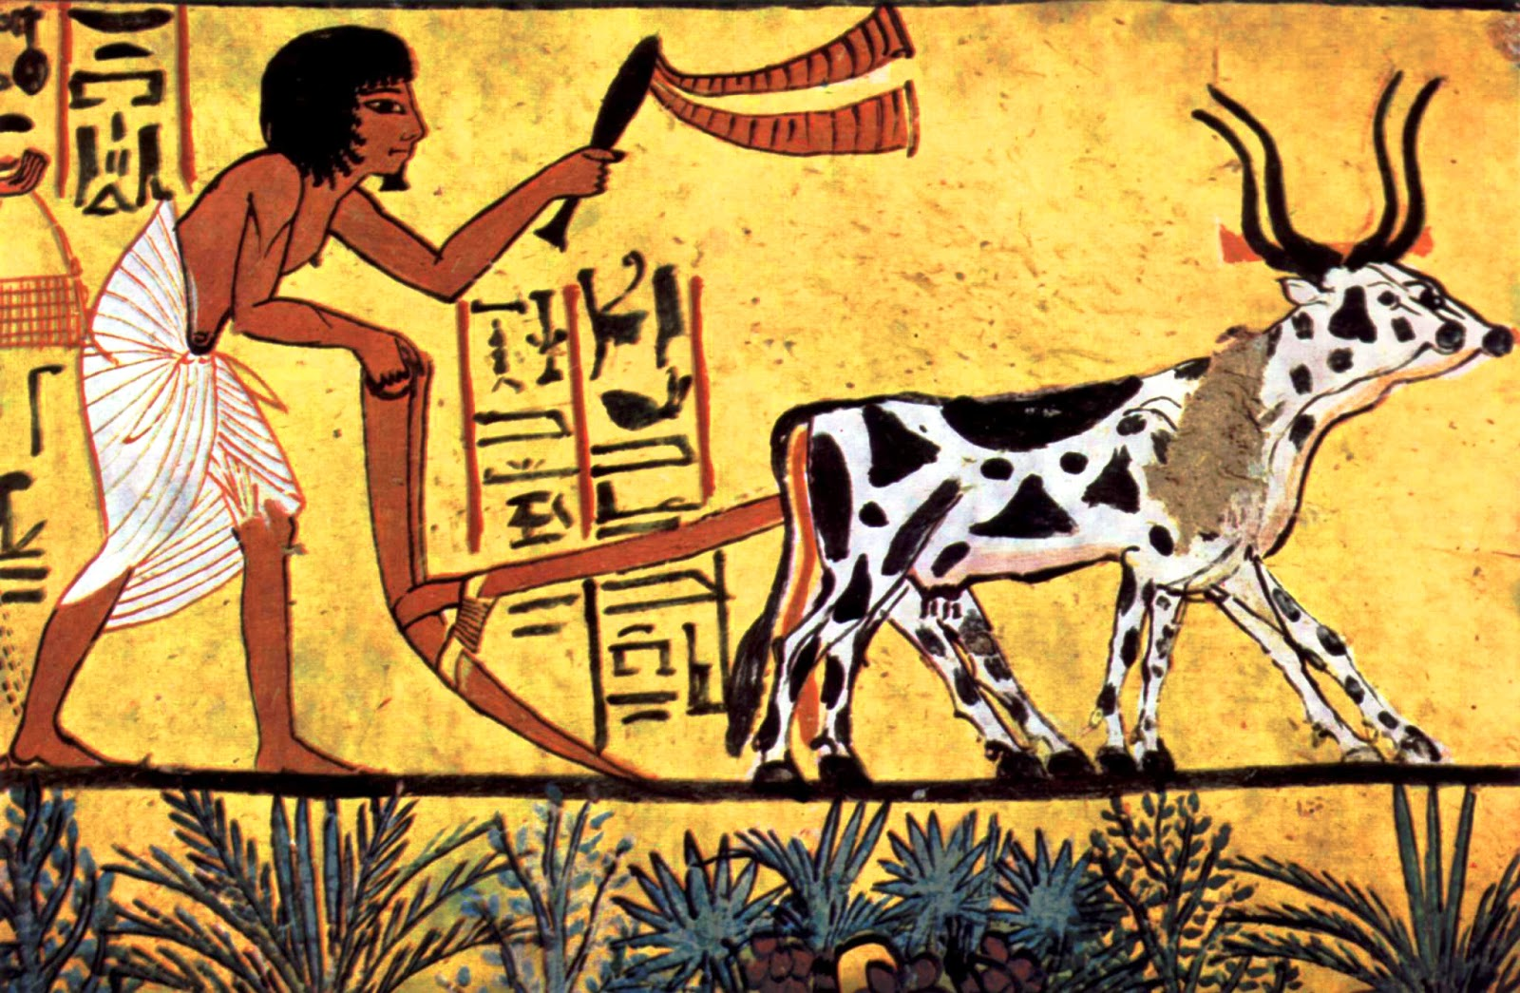
PURPOSE / QUESTION
Strategies Equilibrium
Socio economic simulation

Slide 8


Agent Based Simulation

Slide 9
Agents
1 COUPLE
The Basic Decission Unit

Slide 10
Agents
The model considers also the children
a family(the agent) has.

Slide 11
Agents

Slide 12


Agents
Life Cycle
Emigration
age=0
Life
Disease
Aging
Plants home
near parents home
Low resources
condition
Inherited with less
intensity
An agent will move its
home eventually.

Slide 13
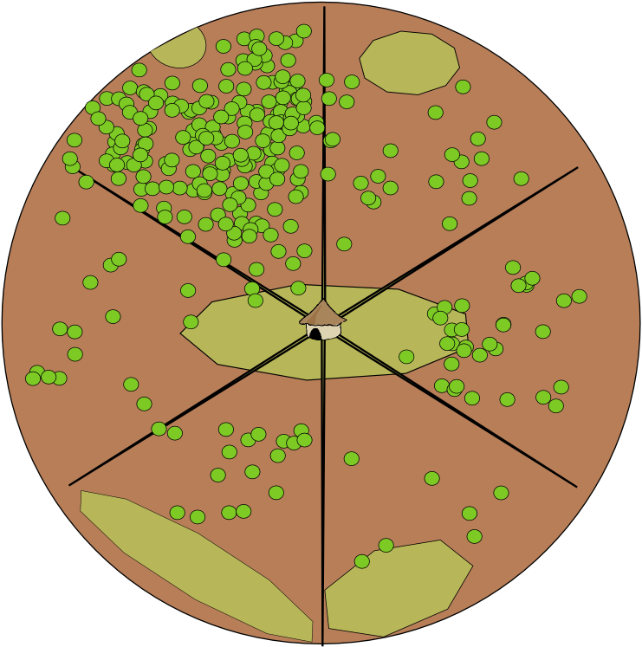
Environment Interaction Model

Slide 14
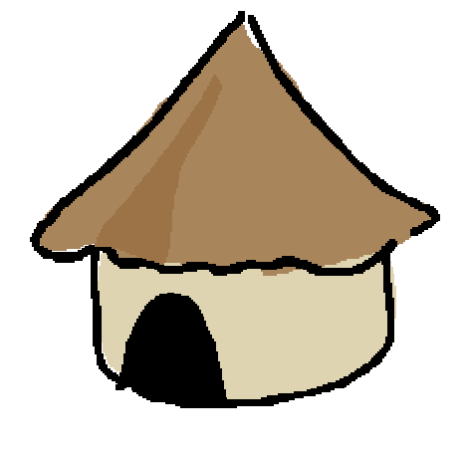
Environment Interaction Model
Home settled in a cell
of type DUNE
Raster representation of space

Slide 15
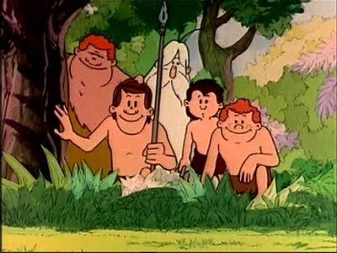

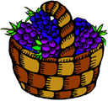

Hunter Gatherer
homerange

Slide 16
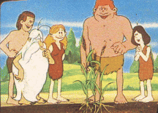

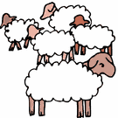
AgroPastoralist
Plot
range
Grazing
range

Slide 17







Decission Process
Actions
GOALS
PERCEPTION
ACTIONS
FEEDBACK / REWARD
Other agent's information

Slide 18
Way of living
(Survival Strategy)
Activities
Abstraction Process
Actions
Move Home
Crop
Gather
Hunt
Harvest

Slide 19
Random Agent
Policy: Random
\forall S :state : E[S]={<action_i,p_i>}
SUM p_i = 1

Slide 20
Rule Based Agent
Policy
Filled by hand table:
bool expression → action
example :
if (rain season && resources < K) → move home

Slide 21
Deliberative Agent
MDP
Search tree
horizon
2 grafiques de recursos gathered
en 1 any, comparar

Slide 22
MDP
G=<S,E>
E : S,action →S+
Reward:S,action → reward ~ distrib
Solve the MDP problem
Find a Policy
Policy
Π:S → action

Slide 23
Mostrar accions : hunt, gather, un abre d'exemple, etc...
LR : 2500 anys en 1 cap de setmana

Slide 24
Thank you

