Slide 1
STRUCTURES OF
REPRESENTATION
/ KNOWLEDGE OF THE WORLD
EFFICIENCY & PERFORMANCE
INFORMATION SHARING

Slide 2
Spatial summary... sectors, rasters, HR, LR,
(seen in Efficiency with A.Albore)

Slide 3


Slide 4

PHYSICAL
MIND

Slide 5
PERFORMANCE

Slide 6
PERFORMANCE
Low Resolution Decision Making
Referenced Point Coordinates
Reuse Structures between states of the decision making
Do not update raster at each time step, INTERPOLATE (next improvement)
2.69 s / step
2.69 seconds / step leads to
1000 years simulated in 11 days aprox.
500 smart agents
simulation

Slide 7
INFORMATION SHARING

Slide 8
Issues - Questions
Problem of space – scale : ask about it
  World size vs Homerange

Slide 9
Sector scoring for “partial mind”
Sector Utility initialization
Utility function
Guessing function
  Which guessing function?
    Pure mean : (max+min)/2
    Displaced mean : (max+2min)/3
  How it affects my resilience?
  Guessed utilities vs Real or newer utility
  Timestamps

Slide 10
Token:
  Random LR cell
  Random Sector
  The best LR cell
  The best Sector
  ...

Slide 11
Actors
  Any neighbour inside social range
  kinship

Slide 12
Proposal
Guess sector utility from the forage walk.

Slide 13
PROTOTYPE
Assumptions
  Token :
    all the cells in the LR raster.
    Update if the other timestamp is newer
  Actors :
    Any agent that its home cell is inside my home range
Results
  figures

Slide 14
3 scenarios comparisation
Scenario 1
  Omniscient Agent :
    free access to the data in the HR raster
    The LR raster used for decission making is updated each timestep with real information.
Scenario 2
  Partial mind
  No information sharing between agents.
Scenario 3
  Partial mind
  Information Sharing

Slide 15
Partial Mind
Information Sharing
  Each time step an agent exchanges information with every agent that has its home inside the home range of the first agent.
  The token exchanged is the complete LR raster in posession of each agent.

Slide 16
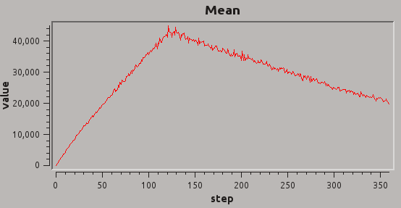
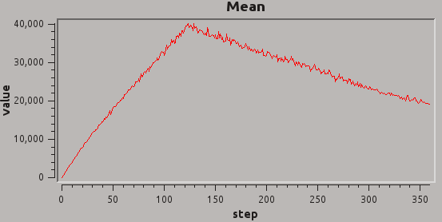
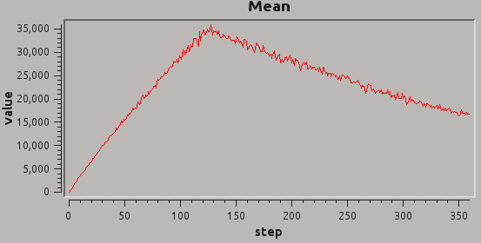
OMNISCIENT
PARTIAL KNOWLEDGE
+
INFORMATION SHARING
PARTIAL KNOWLEDGE

Slide 17
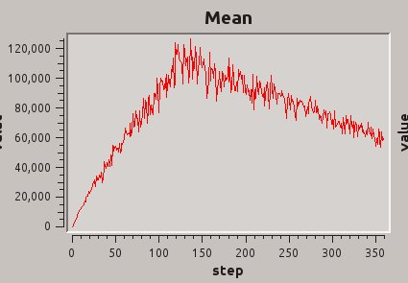
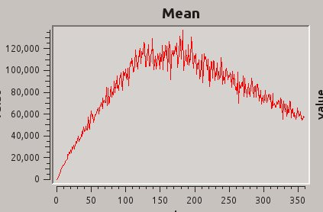
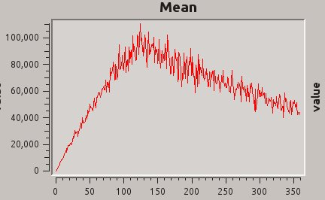
OMNISCIENT
PARTIAL KNOWLEDGE
+
INFORMATION SHARING
PARTIAL KNOWLEDGE

