Slide 1




Slide 2
Index
Introduction
Setting (Gujarat)
Purpose
Environment
Agents
Information Sharing
Efficiency
  LR
  UCT States Reference
  Extrapolate
Conclusions
Future

Slide 3
Index
Introduction
Setting (Gujarat)
Purpose
Environment
Agents
Information Sharing
Efficiency
  LR
  UCT States Reference
  Extrapolate
Conclusions
Future

Slide 4
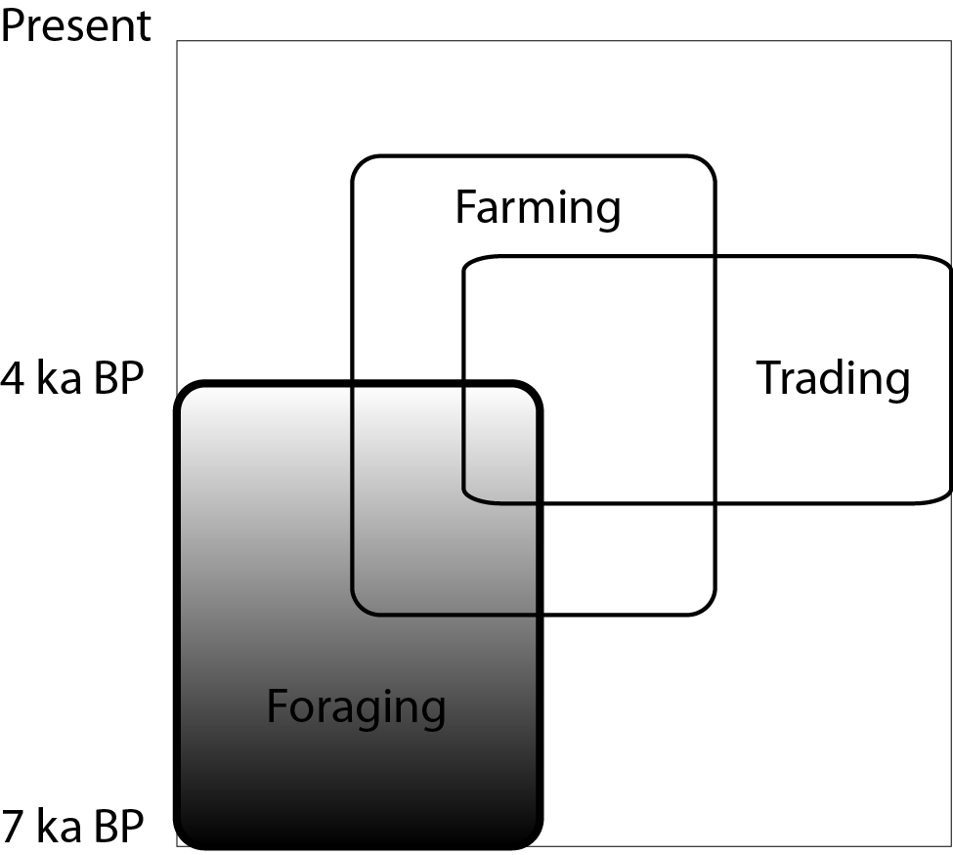
Aim of the model
Explore H-G resilience in semi-arid environments
Model is inspired on archaeological issues (long time presence of HG in Gujarat) and fed with anthropological, climatic, archaeological knowledge
Model focuses on socio-ecological behavior

Slide 5
Model entities
Climate
  Precipitation
  Three seasons modeled from historical data
Environment
  Ground model modeled from satellite imagery
  Biomass modeled from present-day biomass production for semi-arid regions
Agents
  Nuclear family composition modeled from anthropological literature
  Requirements modeled from FAO global reports

Slide 6
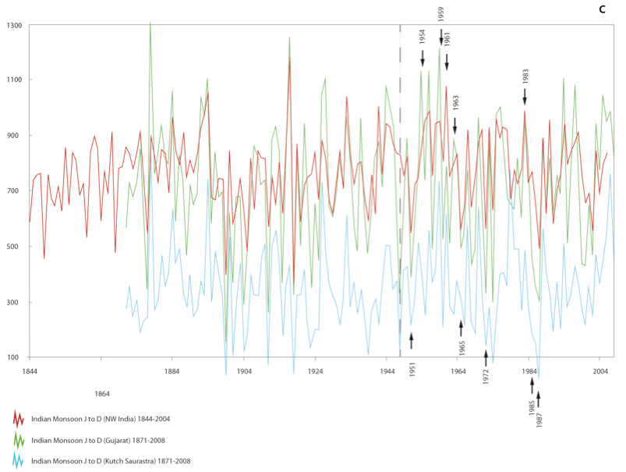
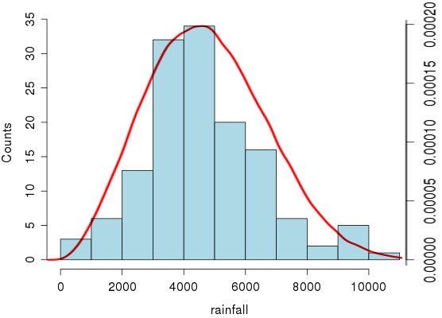
Climate 1/2
Precipitation
Historical record
Weibull distribution

Slide 7
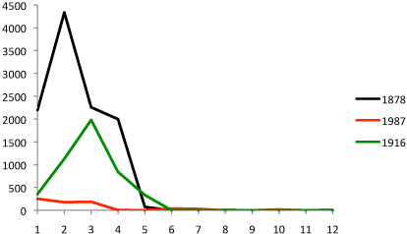
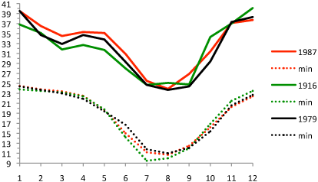
Climate 2/2
Precipitation
JJAS
ONDJ
FMAM

Slide 8
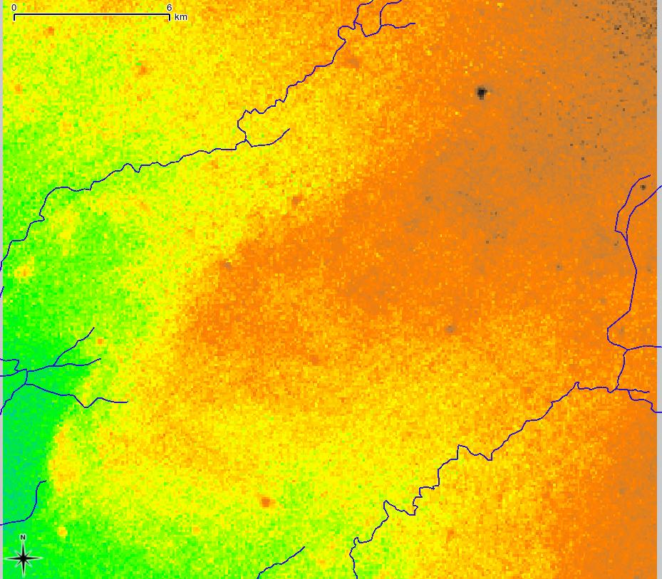
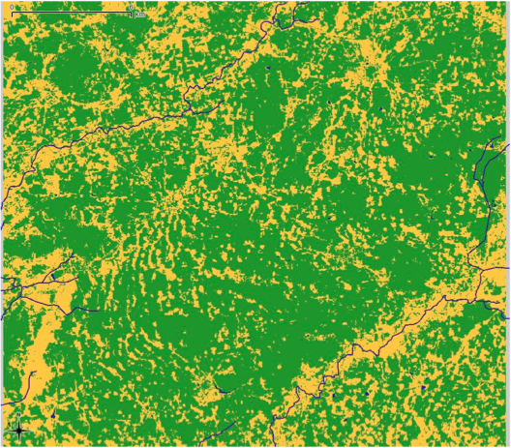
Environment 1/2
Ground model (cells are 31.5x31.5 m = 800x800 cells = 625 km2):
  Dunes (settlement allowed)
  Interdunes (biomass concentration)
  Water (no settlement, no biomass)
DEM
Soil units

Slide 9
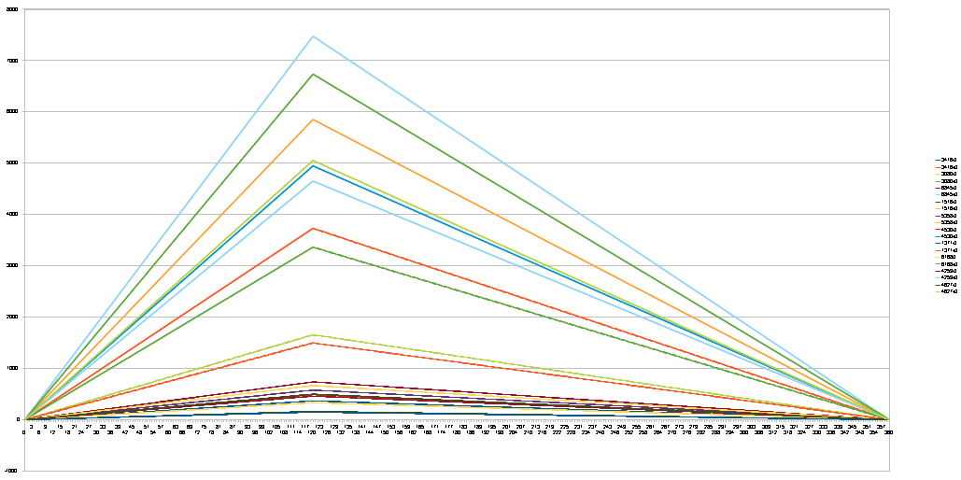
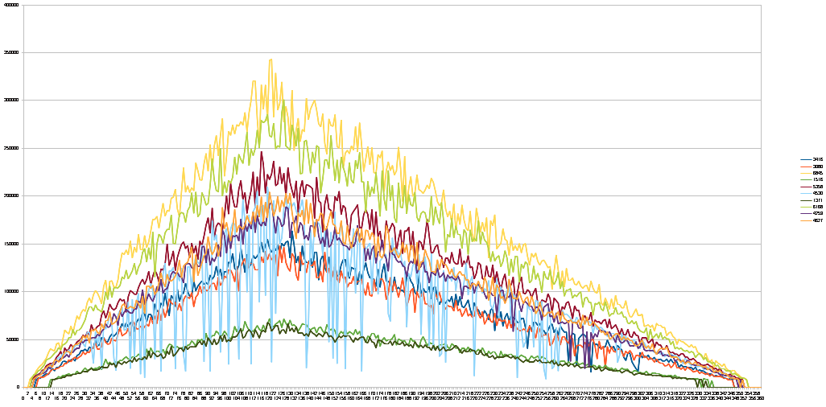
Environment 2/2
Precipitation to biomass conversion:
  Precipitation derived from climate engine
  Total biomass derived from precipitation
  Biomass distribution homogeneous in interdunal areas
Biomass distribution
Gathering behavior
Primary biomass is derived from present-day semi-arid environments

Slide 10
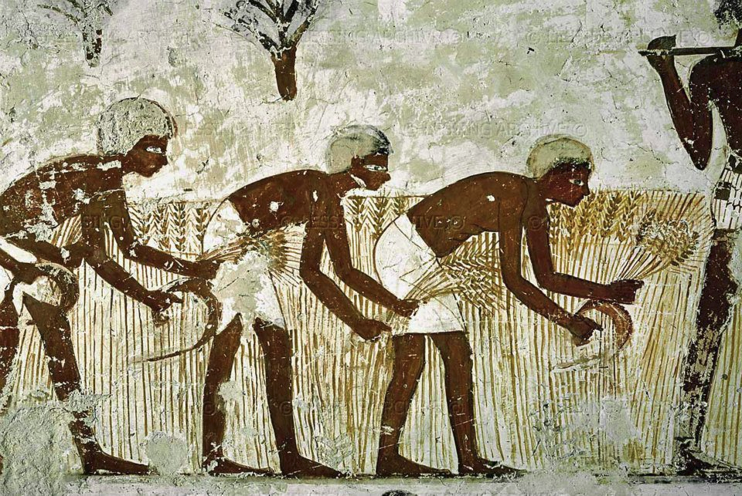
Early Societies Simulation

Slide 11
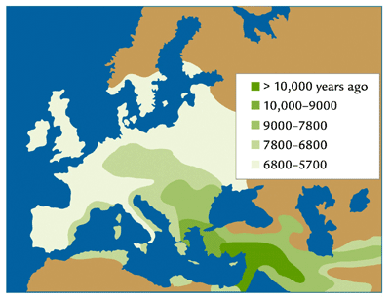



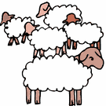
HUNTER GATHERER
SOCIETIES
AGRO PASTORALIST
SOCIETIES
Transition -
Blending

Slide 12
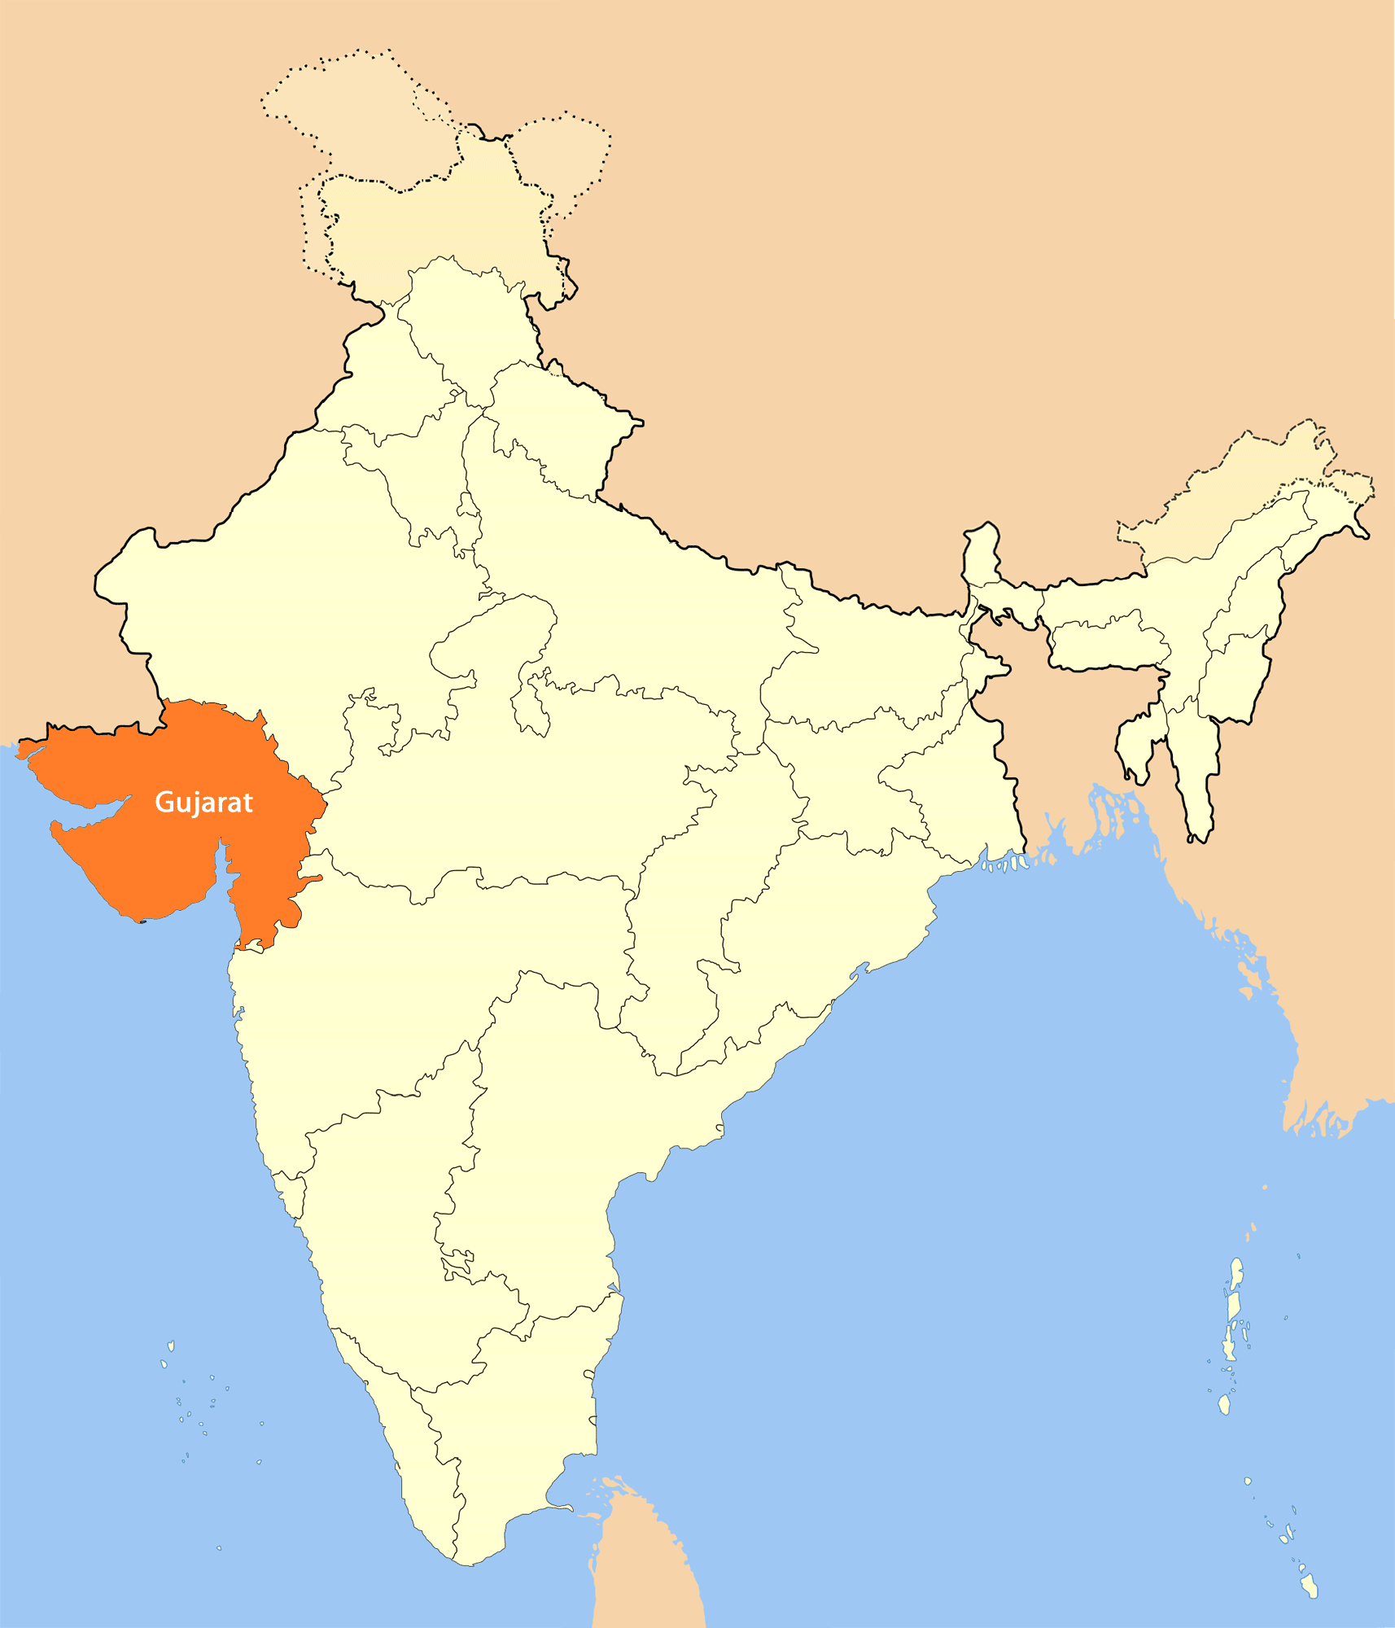
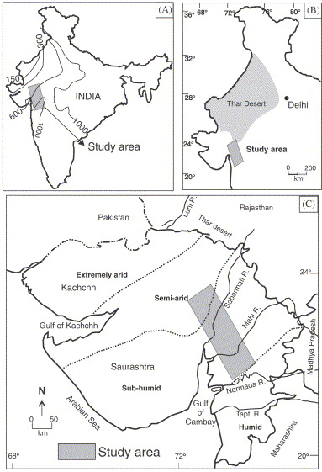
CS1
Delayed extinction of HG strategies at GUJARAT

Slide 13
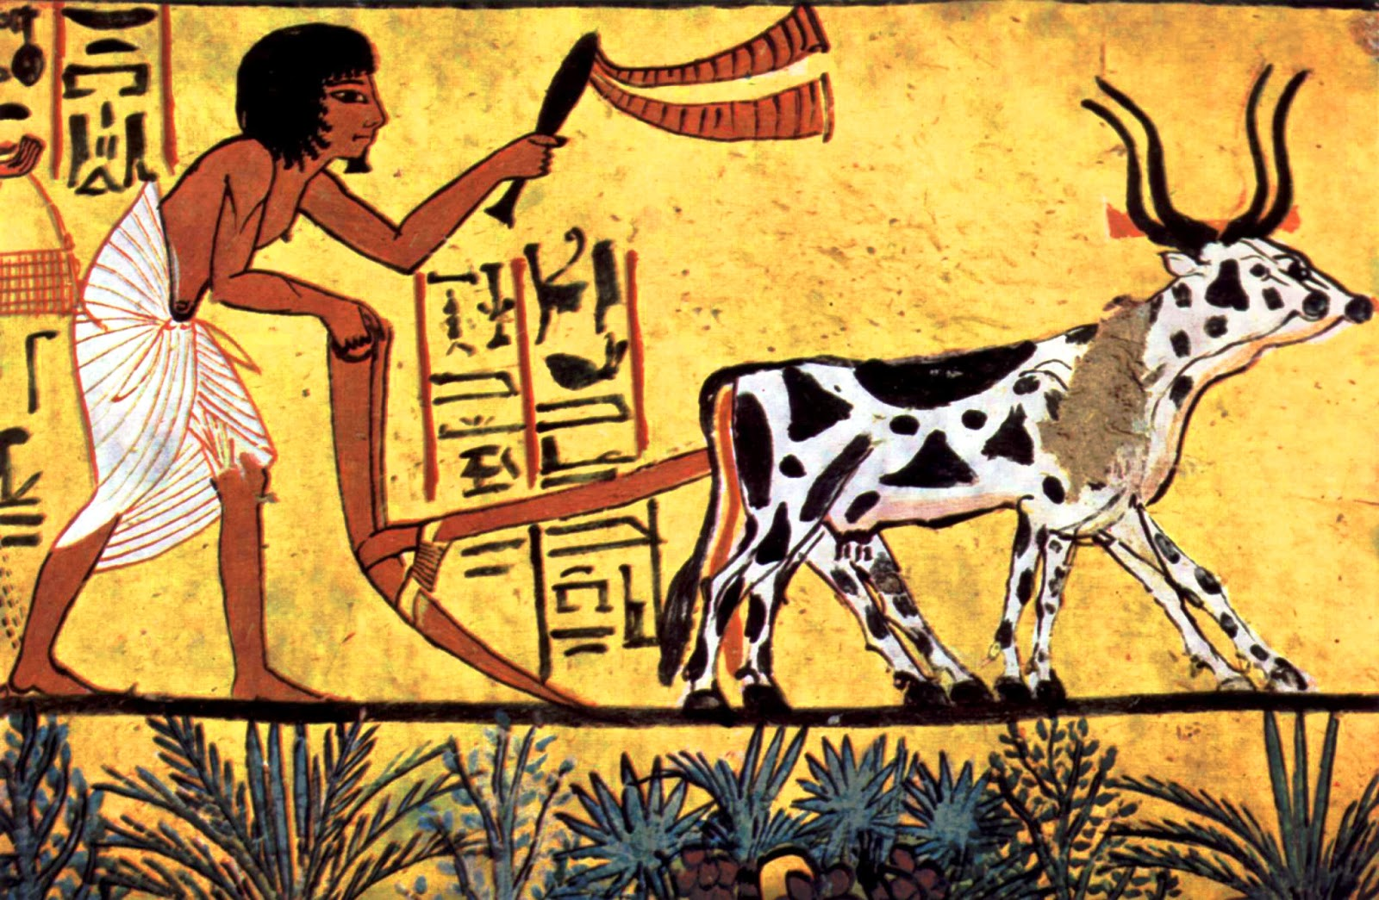
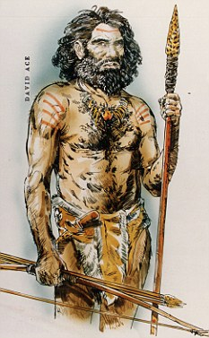
PURPOSE / QUESTION
Strategies Equilibrium
Cultural Evolution
Socio economic simulation

Slide 14


Agent Based Simulation

Slide 15
Agents
1 COUPLE
The Basic Decission Unit

Slide 16
Agents
The model considers also the children
a family(the agent) has.

Slide 17
Agents

Slide 18
Agents 1/5
The demographic model has been implemented at an individual/year level:
  Reproduction – If the couple is active and able to, will reproduce with 50% probability.
  Agent creation – If an agent has children with age > adulthood age it will look for another agent in similar condition. If it is met, a new agent will be created with these two individuals.
The metabolism of the agents is also modelled after individuals:
  Each individual consumes 2.000 calories x day
  Adults will contribute 4.5 hours of workforce x day
  Offsprings that have not arrived to adulthood age will not contribute any workforce.

Slide 19
Agents 2/5
Life expectancy - A mortality check is made every year for every individual:
    10% mortality from 0 to 2 years
    2% mortality from 3 to ? years
Survival – Added to the basic mortality there is another check that is related to the success of the agent on getting the required resources:
    % death = 100 x days without resources / days x year

Slide 20
Agents 3/5

Slide 21

Agents
Life Cycle
Emigration
age=0
Life
Disease
Aging
Low resources
condition
Plants home
near parents home
An agent will move its
home eventually.

Slide 22
Agents 4/5
Each day an agent will execute an action:
  Forage – An action that uses the available workforce to gather resources
    Hunting & Gathering are not differentiated because it is a semiclosed system (no animal migration)
  Move home – The agent's camp is moved to another zone
    A forage action is executed using half workforce
Forage Range
Sector 8
Sector 1
Sector 7
Sector 2
Sector 6
Sector 3
Sector 5
Sector 4

Slide 23
Agents 5/5
Strategies – We have defined three different strategies for the decision-making processes of the agents:
  Random behaviour – Useful for testing null hypothesis
  Wired algorithm – Classic Agent-Based Modelling approach
  Model-Based Agent – Agents plan their actions in relation to goals and costs

Slide 24
Agents 5/5/a
Random agent
  An agent will choose Forage Action 80% of the time steps
  The sector to forage is also randomly chosen
  Move Action will randomly choose a suitable area for the new camp from all available options

Slide 25
Agents 5/5/b
Wired agent algorithm
If the richest sector contains twice the value of required needs:
Forage richest sector
Else
Forage richest sector and move to a place with more resources

Slide 26
Agents 5/5/c/1
Model-Based Agent
For every time step an agent will:
  Update knowledge
  Build a model of their environment
  Construct a plan of actions to achieve a goal (improve starvation rating)
  Simulate the effects of the different actions and choose the best action

Slide 27
Planning
UCT

Slide 28
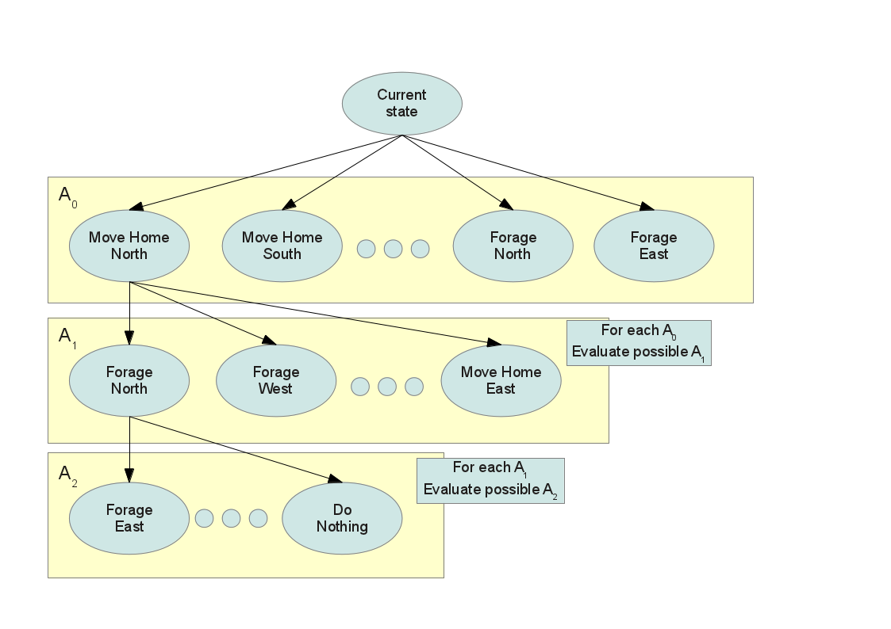
Agents 5/5/c/2

Slide 29
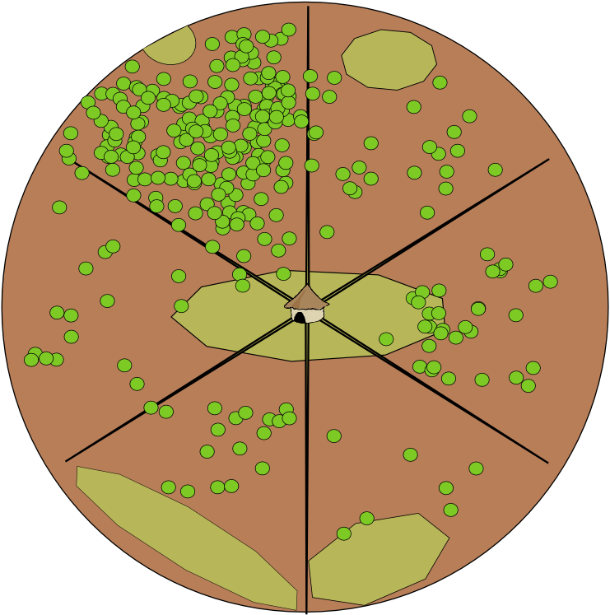
Environment Interaction Model

Slide 30
Environment Interaction Model
Home settled in a cell
of type DUNE
DUNE
INTERDUNE
WATER BODY
Raster representation of space

Slide 31
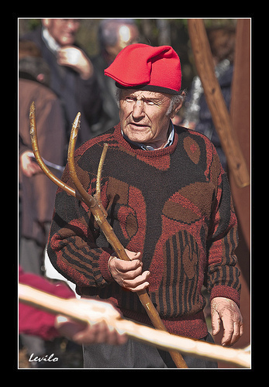
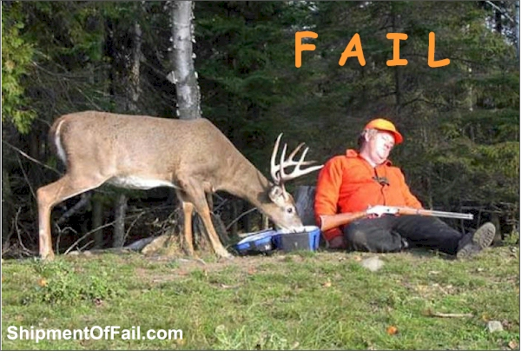
Agents
HUNTER GATHERER
AGRO PASTORALIST

Slide 32
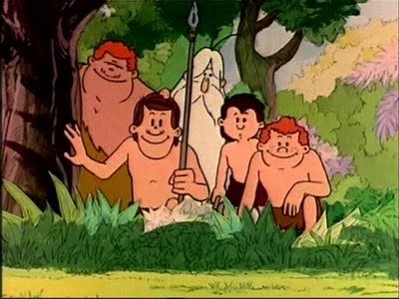

Hunter Gatherer
homerange

Slide 33
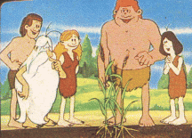
AgroPastoralist
Plot
range
Grazing
range

Slide 34







Agent Architecture
GOALS
PERCEPTION
ACTIONS
FEEDBACK / REWARD
Other agent's information

Slide 35
Decision Process - Actions
Way of living
(Survival Strategy)
Activities
Abstraction Process
(Modelization)
Action is the mechanism used by the agent to change the current state of the system to
approach it to a desired state were the agent is nearer to its satisfaction of objectives.
Actions
ϖi
ϖj
Move
Home
ar
Crop
aq
Gather
ap
ϖu
ϖv
Hunt
Harvest

Slide 36
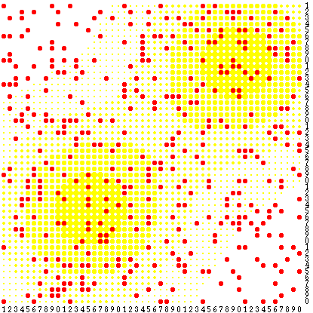
Classical Rule Based Agent
A POLICY table dictates an action to launch given a
perceived state in the system
ϖiaj
A Policy can be represented as a table of correspondences between states and actions or as rules that evaluate with the state of the system and produce the action to launch.
If (season(rainy) ∧ resources < K)
then moveHome();
Sugarscape
f(ϖi,aj){true, false}

Slide 37
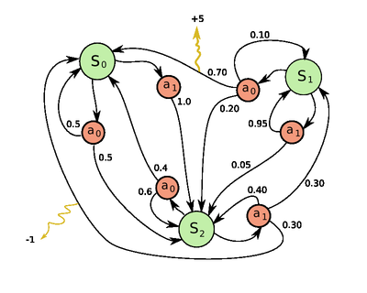
Deliberative Agent
A Deliberative Agent knows the effects that its actions produce.
Hence it will plan the trace of actions to perform better to get nearer of its desired state for the system.
Adaptability, Resilience, Realistic
ϖi + aj  ϖk
What if...?
S0::a1::S2::a1::S1

Slide 38
MDP
Markovian Decision Processes
MDP = < S, A(S), P(si | sj,ak) >
R : state, action → reward ~ distrib(...)
Solver
Maximizing H steps trace reward.
Calculated Policy Table
State | Action
... | ...
sj | ak
... | ...
... | ...

Slide 39
UCT
Hypothetical Deductive
“What if...?” search tree
UCT constructs a search state space tree from transitions of states labeled by the actions that induce them.
S0
horizon
a1
a0
a0
Discount γ<1 on
rewards in future
S2
S2
S0
a0
At time t, reward at level
t+l = γ^{(t+l)} · rewardt+l
S0
horizon=∞
✗
✓
trace τ
a1
N steps
prediction
horizon=∞ → ∀τ a trace:reward(trace)=∞
cannot discriminate between actions to
choose at the first step.
S1
UCT
algorithm

Slide 40
UCT
a1
Δt
At each timestep the agent must decide an action to launch. UCT is run to calculate a prediction H steps forward and find the best action to launch. It is best described through matching it to our hypothetical – deduction reasoning. We have in our heads some premises and think the hypothetical changes of applying some change which we predict through deduction. UCT for each choice applies a tiny simulation to deduce the resulting state of launching certain action.
Si
a1
H steps
This is the costly part of the simulations.
SuperComputation allows us to pay that price for making our agents more sophisticated.
UCT
algorithm

Slide 41
Results 1/7
Survival - Preliminary results show that the system “lives” constantly on the edge of collapse:
  Starvation rates are extremely high due to a month of scarce resources
  Mid-term extinction (30-40 years) is almost impossible to avoid

Slide 42
Results 2/7
The system can not survive with more than 2% yearly starvation

Slide 43
Results 3/7

Slide 44
Results 4/7
The impact of “bad” years and the high variability of the rain are responsible for these results

Slide 45
Results 5/7

Slide 46
Results 6/7

Slide 47
Results 7/7
Mobility
  Wired agents will not move for most part of the year if scale is correct
  Mobility was used on the first sets of runs, which used 1/5 of the real foraging range
  It is not a problem of the agent's behavior, because the Model-Based Agents never chooses Move Home Action
Do they need to move?
  A sector contains around 50.000 cells of homogeneously distributed resources
  Each individual can forage 9 cells in a day (spending 0.5 hours x cell)
  An agent will spend 123 years foraging before repeating a cell

Slide 48
Issues and possible solutions 1/8
Offsprings:
    From 0 to 15 years the offsprings are increasing their metabolic needs following a linear progression (from 600 to 2200 kcal)
    From 5 to 15 years the offsprings are increasing they foraging capacity to adulthood standards also following a linear progression (‘learning’ module)

Slide 49
Issues and possible solutions 2/8
Life expectancy without starvation is too short at 25 years.
We have adjusted the adult mortality check from 2% to 1.5% to shift life expectancy to a more real 35 years.

Slide 50
Issues and possible solutions 3/8
Mobility
  Possible modifications:
    Climate (discarded)
    Environment (presently homogeneous distribution of resources in interdune areas)
    Agents (Model-Based agent is optimal)
  Ground model needs to be refined to allow for redistribution of biomass (e.g. using water as an attractor)
    First simplified model based on linear distribution of biomass with higher concentrations near water bodies
    Work in progress: DEM derived from CORONA satellite imagery

Slide 51
Issues and possible solutions 4/8
Linear or logarithmic decrease of resources directly related with cell distance to water
The total resources are the same as in previous distribution pattern

Slide 52
Issues and possible solutions 5/8

Slide 53
Issues and possible solutions 6/8

Slide 54
Issues and possible solutions 7/8

Slide 55
Issues and possible solutions 8/8

Slide 56
Discussion 1/1
Survival
  Offsprings
    0-15 y.o. linear increase of metabolic needs, from 600 to 2200 kcal
    5-15 y.o. linear increase of foraging capacity to adulthood standards
    (‘learning’).
  Mid-term extinction: discuss new observed trends
  Life expectancy: discuss change from 25 to 35 years (from 2% to 1.5%
    mortality check)
Mobility: discuss possible modifications:
    Climate (discarded)
    Agents (discarded)
    Environment (OK): ground model needs to be refined to allow for more accurate of biomass (e.g. using water as an attractor)
    Preliminary model based on linear distribution of biomass with higher concentrations near water bodies
    Work in progress: DEM derived from CORONA satellite imagery

Slide 57
Future implementations 1/1
Stress
Social networks
  Kinship/acquaintance
  Ask/give
Cultural transmission
  Information
  Learning
Agro-Pastoralists
  Resilience
  Interaction

Slide 58
Efficiency : UCT states world info re-use
VALGRIND profiler detected high use of Point2D stl templates used to reference cells in rasters.
The bottleneck was focused in the UCT part.
Things were changed to use Point2D pointers in the knowledge structures.
Coordinates Point2D were stored in reusable pools of Point2D objects.
This led to the idea of make lighter computations at each node of the search tree of UCT by reusing agent knowledge between states.

Slide 59
Efficiency : UCT states world info re-use
Each state of UCT represents the transformation of the system after an action was applied and changes happened in the world and agents.
Each state produces children states through assuming the agent chooses one action to be applied with some parameters.
The choice is based on some knowledge about the world the agent has --> For each state the agent updates its knowledge of the world to take the decision.

Slide 60
Extrapolate
Applying VALGRIND profiler we seeked the weak points and bottlenecks.
There was high

Slide 61
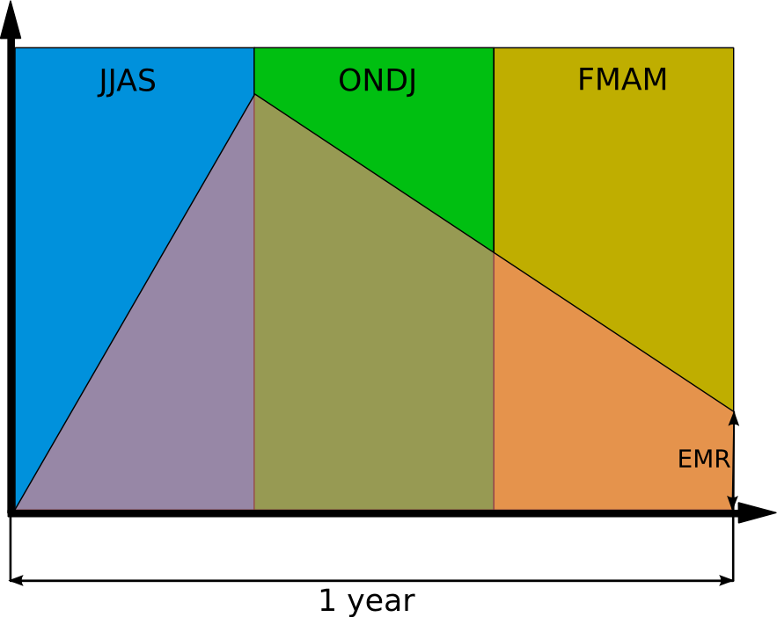
Extrapolate
R_i : resources at
timestep t_i in cell (x,y)
R_i = R_{i-1}+g
Linear Relationship:
R_i=m(t_i)+n
R_{i+d} = m(t_i+d)+n
d
t_i
t_i + d

Slide 62
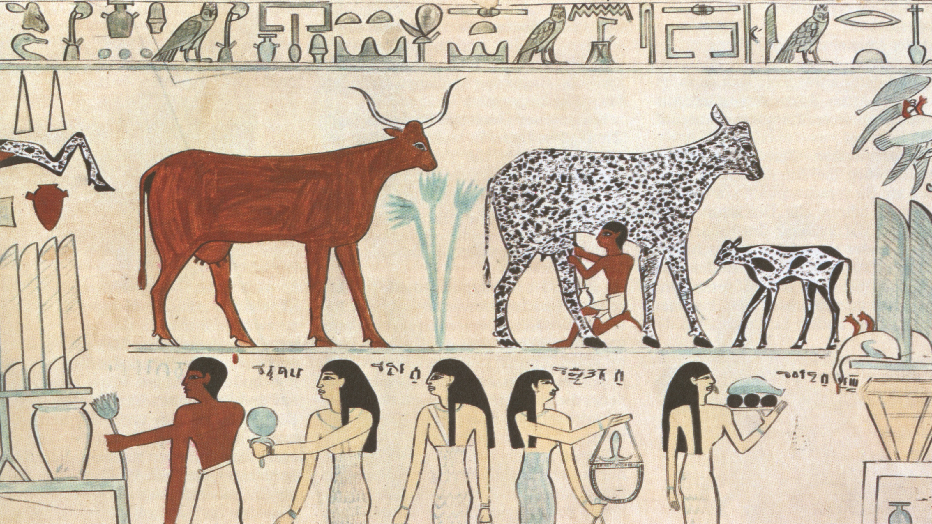
Thank you

