Slide 1
Multiple Sequence Alignment of TNF-receptor gene
Notes:
https://www.ncbi.nlm.nih.gov/gene/135544487
*Gene symbol: LOC135544487
*Gene description: TNF receptor-associated factor 2-like
*Gene type: protein coding
*Organism: Oncorthynchus masou masou (cherry salmon)

Slide 2
Introduction
To further understand the purpose of the gene present in an individual.
Comparing evolutionary relationships based on common patterns → identifying structure and function of genes/proteins
Main organism used was the Oncorthynchus masou masou (cherry salmon) → tumor necrosis factor gene
Gene type: protein coding
Notes:
The sequence was done on the organism Oncorthynchus masou masou (aka cherry salmon)
Performing a multiple sequence alignment allows for the comparison between genes.
Identifying the evolutionary relationship between species on the same genes based on common patterns of these genes.
Comparing these evolutionary relationships can further help identify the structure and function of these genes and proteins.

Slide 3
Methods
Programs Used:
NCBI
BLAST → blastn & blastp
T-COFFEE
MEGA
Boxshade
Notes:
An NCBI search was done on the Oncorthynchus masou masou TNF gene which is a protein coding gene → to retrieve the genome sequence
Blastn was then used to find differing species with the same TNF gene present using the main species DNA sequence
The 3 different species based on the genome sequence were…
Salmo trutta (river trout)
Coregonus sp. balchen (blue whitefish)
Salvelinus namaycush (lake trout)
Another NCBI search was done for the cherry salmon TNF gene but instead using the protein rather than genome database to find the protein sequence
Using the protein sequence into BLAST again and running a blastp with the protein sequence to find different species with the TNF gene
Homo sapiens (humans)
Mus musculus (mouse)
Rattus norvegicus (brown rat)
6. Using the protein sequences of all four species a T-COFFEE MSA was run for a sequence alignment of the protein sequences together
7. Downloading the FASTA file and CLUSTALW file for the phylogenetic trees and Boxshade
8. Boxshade was used for the FASTA file of the alignment to color code the similar and different consensus of the alignment
9. Mega was run with the CLUSTAL file to evolutionary compare the species based on their sequences

Slide 4
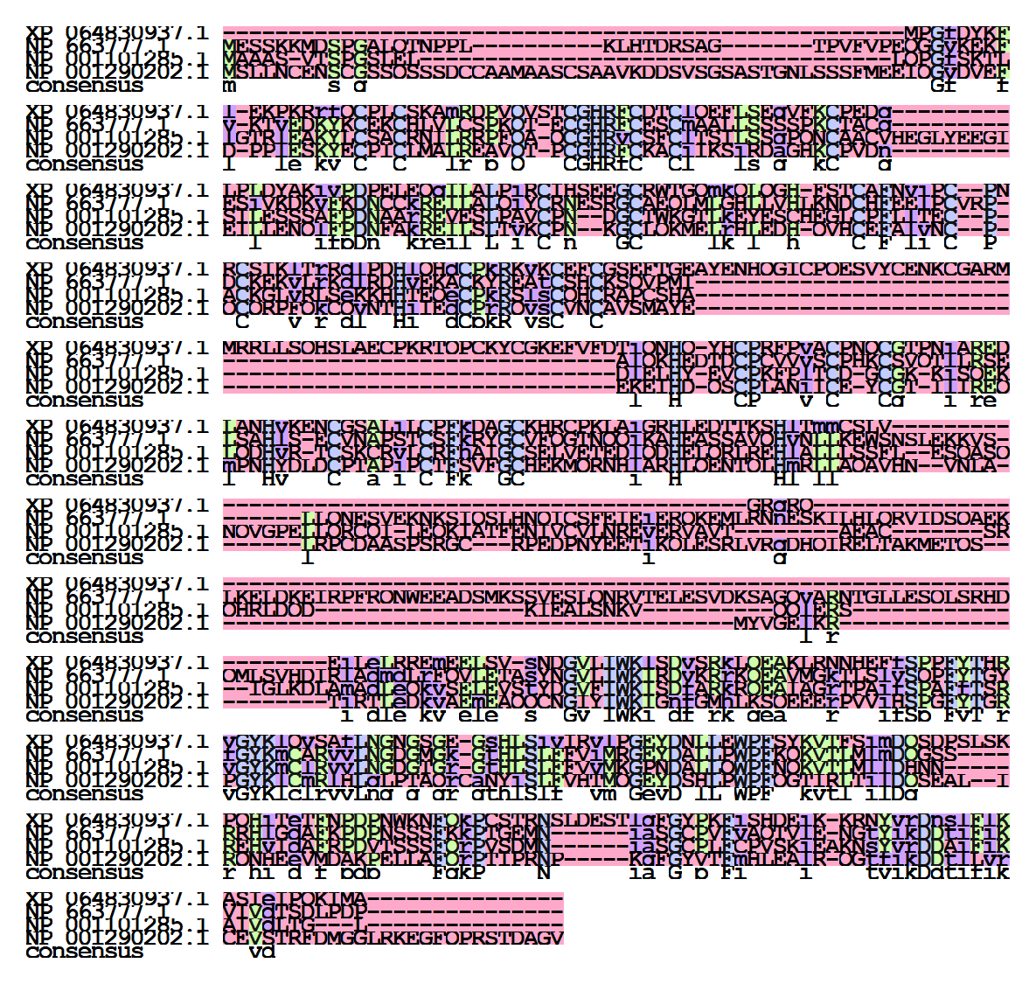
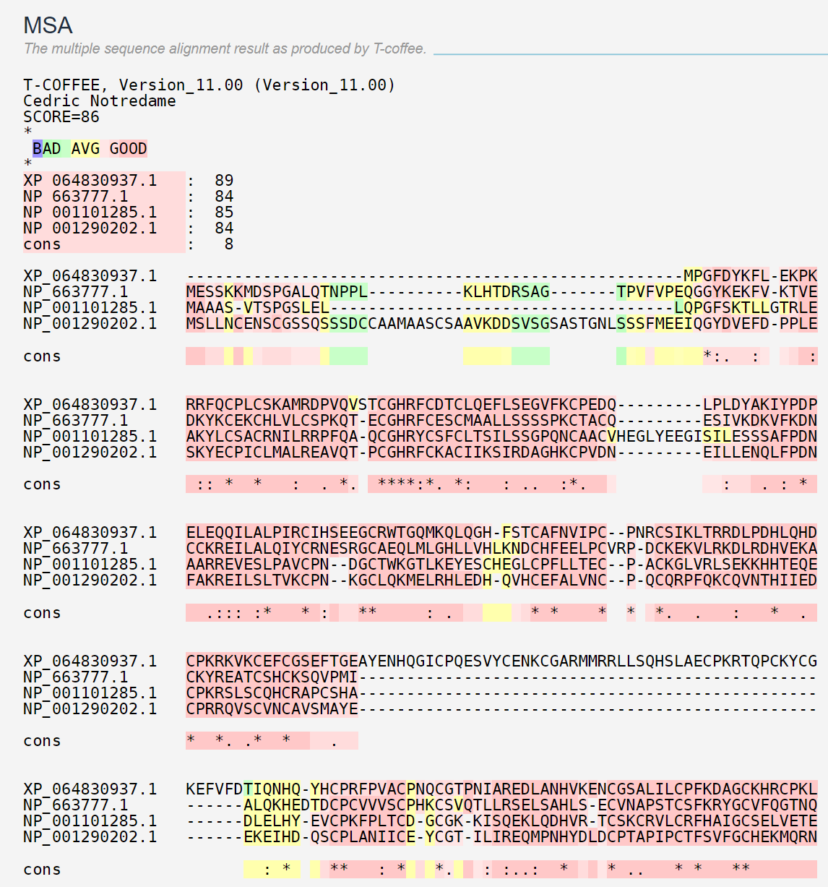
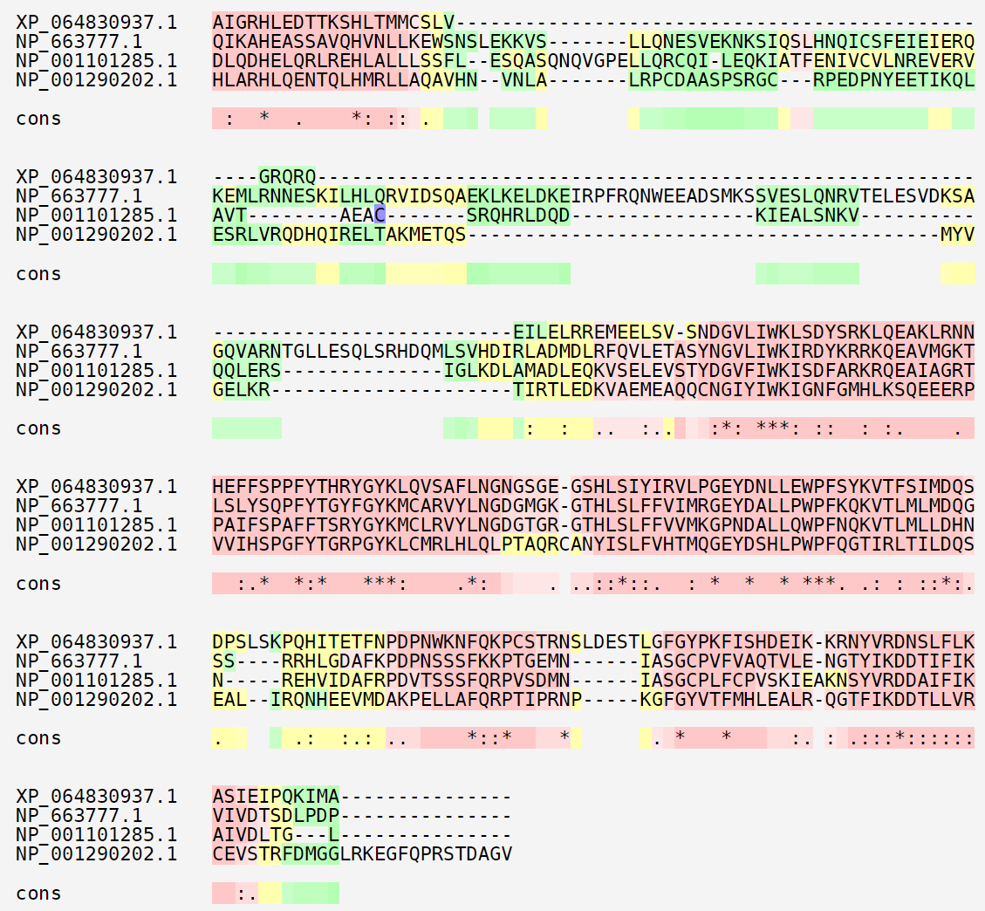
Results
T-COFFEE MSA
Boxshade of FASTA protein alignment
Notes:
The following are the resulting T-coffee MSA with a 86 score
Boxshade alignment of the FASTA file from the protein sequences
The pink shading representing the similar consensus and the blue/purple representing the differing consensus

Slide 5
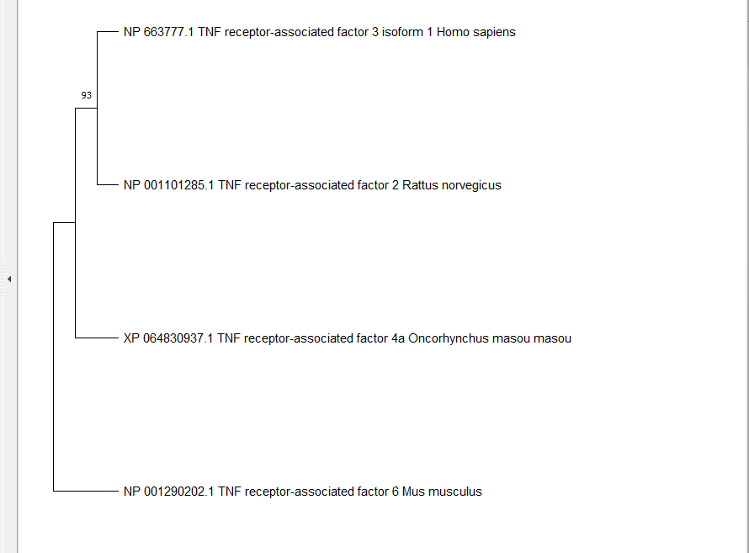
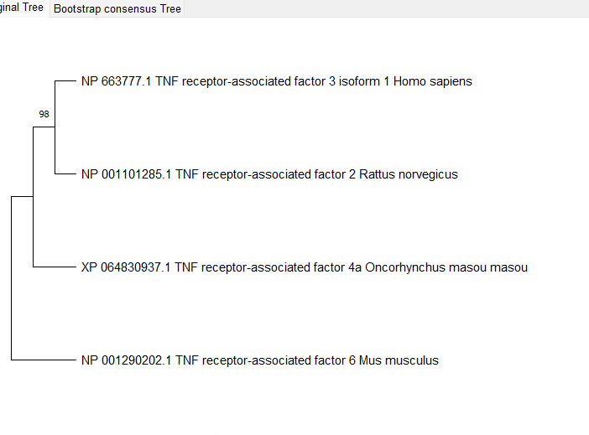
Conclusion
Neighbor-Joining Tree (93)
1000, 5000, and 10000 bootstrapping
Maximum Likelihood Tree (98)
1000 bootstrapping
Notes:
Based on the aligned sequences produced from the T-Coffee four phylogeny trees were created → 3 neighboring-joining trees and 1 maximum likelihood tree
The 3 neighbor joining trees were done with a 1,000, 5,000, and 10,000 bootstrapping
The maximum likelihood tree was done with a 1,000 bootstrapping
The Max. likelihood had a higher accuracy than the Neighbor-Joining trees regardless of the amount of bootstrapping done.

