Slide 1
Tplyr | Hands-on-Training
PharmaSUG 2022 – 90 minutes

Slide 2
Workshop Environment
https://tinyurl.com/Tplyr-HoT

Slide 3
Agenda
Section 1:
Where does Tplyr start? Where does it end?
Basics of a Tplyr table
Tplyr layer types
Section 2:
Working with population data
Format strings
Order variables
Section 3:
Multiple target variables
Auto-precision

Slide 4
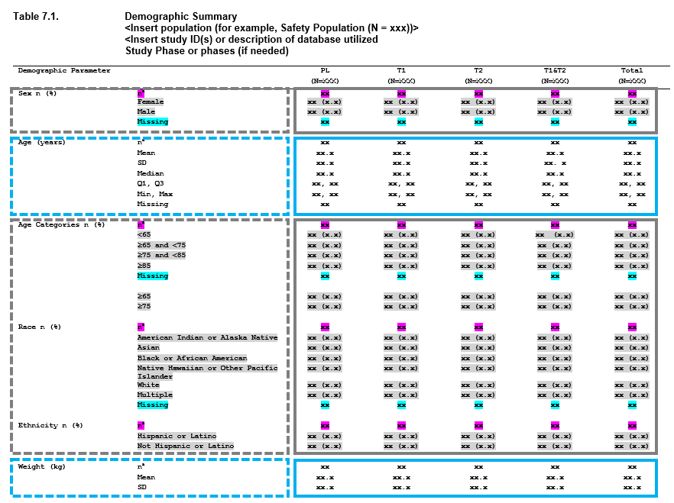
What is a Tplyr Table?
A grammar of tables
Breaks the concept of a table into 'layers'
Count layers
Descriptive statistics layers
Shift layers
Design with a mock in mind

Slide 5
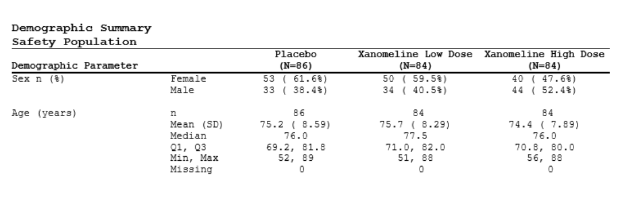

Tplyr Table Components
t <- tplyr_table(adsl, TRT01P) %>%
add_layer(
group_count(SEX, by = "Sex n (%)")
) %>%
add_layer(
group_desc(AGE, by = "Age (years)")
)
dat <- t %>% build()

Slide 6
Tplyr Table Components
t <- tplyr_table(adsl, TRT01P) %>%
add_layer(
group_count(SEX, by = "Sex n (%)")
) %>%
add_layer(
group_desc(AGE, by = "Age (years)")
)
dat <- t %>% build()

Slide 7
Tplyr Table Components
t <- tplyr_table(adsl, TRT01P) %>%
add_layer(
group_count(SEX, by = "Sex n (%)")
) %>%
add_layer(
group_desc(AGE, by = "Age (years)")
)
dat <- t %>% build()

Slide 8
Tplyr Table Components
t <- tplyr_table(adsl, TRT01P) %>%
add_layer(
group_count(SEX, by = "Sex n (%)")
) %>%
add_layer(
group_desc(AGE, by = "Age (years)")
)
dat <- t %>% build()

Slide 9
Tplyr Table Components
t <- tplyr_table(adsl, TRT01P) %>%
add_layer(
group_count(SEX, by = "Sex n (%)")
) %>%
add_layer(
group_desc(AGE, by = "Age (years)")
)
dat <- t %>% build()

Slide 10
What does Tplyr produce?
t <- tplyr_table(adsl, TRT01P) %>%
add_layer(
group_count(SEX, by = "Sex n (%)")
) %>%
add_layer(
group_desc(AGE, by = "Age (years)")
)
dat <- t %>% build()
A tibble!
# A tibble: 8 × 5
row_label1 row_label2 var1_Placebo `var1_Xanomeline High Dose` `var1_Xanomeline Low Dose`
<chr> <chr> <chr> <chr> <chr>
1 Sex n (%) Female "53 ( 61.6%)" "40 ( 47.6%)" "50 ( 59.5%)"
2 Sex n (%) Male "33 ( 38.4%)" "44 ( 52.4%)" "34 ( 40.5%)"
3 Age (years) n " 86" " 84" " 84"
4 Age (years) Mean (SD) "75.2 ( 8.59)" "74.4 ( 7.89)" "75.7 ( 8.29)"
5 Age (years) Median "76.0" "76.0" "77.5"
6 Age (years) Q1, Q3 "69.2, 81.8" "70.8, 80.0" "71.0, 82.0"
7 Age (years) Min, Max "52, 89" "56, 88" "51, 88"
8 Age (years) Missing " 0" " 0" " 0"

Slide 11
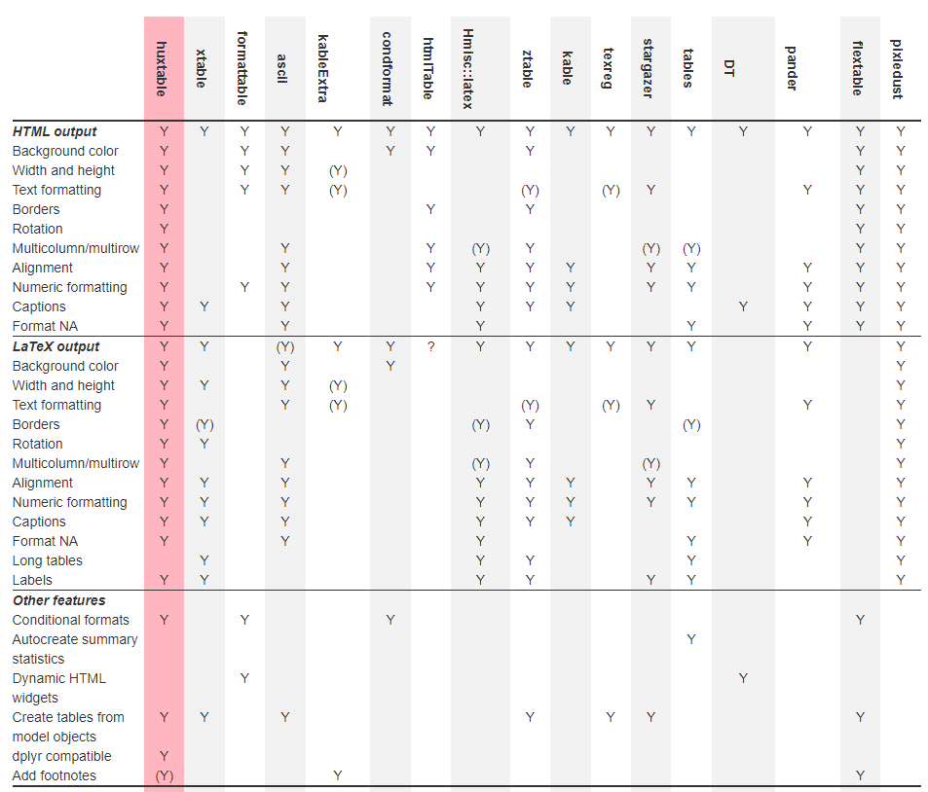
Why output a data frame / tibble?

Slide 12
Exercise 1
Demographics

Slide 13
Working with Population Data
t <- tplyr_table(adae, TRTA, SAFFL == "Y" & AESEV == "SEVERE") %>%
set_pop_data(adsl) %>% Population dataset
set_pop_treat_var(TRT01A) %>%
set_pop_where(SAFFL == "Y") %>%
add_layer(
group_count(AEDECOD)
)
dat <- t %>% build()

Slide 14
Working with Population Data
t <- tplyr_table(adae, TRTA, SAFFL == "Y" & AESEV == "SEVERE") %>%
set_pop_data(adsl) %>%
set_pop_treat_var(TRT01A) %>% Population treatment variable
set_pop_where(SAFFL == "Y") %>%
add_layer(
group_count(AEDECOD)
)
dat <- t %>% build()

Slide 15
Working with Population Data
t <- tplyr_table(adae, TRTA, SAFFL == "Y" & AESEV == "SEVERE") %>%
set_pop_data(adsl) %>%
set_pop_treat_var(TRT01A) %>%
set_pop_where(SAFFL == "Y") %>% Population filter (if different)
add_layer(
group_count(AEDECOD)
)
dat <- t %>% build()

Slide 16
Working with Population Data
t <- tplyr_table(adae, TRTA, SAFFL == "Y" & AESEV == "SEVERE") %>%
set_pop_data(adsl) %>%
set_pop_treat_var(TRT01A) %>%
set_pop_where(SAFFL == "Y") %>%
add_layer(
group_count(AEDECOD)
)
dat <- t %>% build()
header_n(t)
TRT01A n
<fct> <int>
1 Placebo 86
2 Xanomeline High Dose 84
3 Xanomeline Low Dose 84

Slide 17
Tplyr format strings
t <- tplyr_table(adae, TRTA, SAFFL == "Y" & AESEV == "SEVERE") %>%
set_pop_data(adsl) %>%
set_pop_treat_var(TRT01A) %>%
set_pop_where(SAFFL == "Y") %>%
add_layer(
group_count(AEDECOD) %>%
set_distinct_by(USUBJID)
)
t %>% build()
# A tibble: 30 × 4
row_label1 var1_Placebo `var1_Xanomeline High Dose` `var1_Xanomeline Low Dose`
<chr> <chr> <chr> <chr>
1 AGITATION 0 ( 0.0%) 0 ( 0.0%) 1 ( 1.2%)
2 APPLICATION SITE DERMATITIS 0 ( 0.0%) 0 ( 0.0%) 1 ( 1.2%)
3 APPLICATION SITE ERYTHEMA 0 ( 0.0%) 0 ( 0.0%) 2 ( 2.4%)
4 APPLICATION SITE IRRITATION 0 ( 0.0%) 0 ( 0.0%) 3 ( 3.6%)
5 APPLICATION SITE PRURITUS 0 ( 0.0%) 0 ( 0.0%) 1 ( 1.2%)
6 APPLICATION SITE WARMTH 0 ( 0.0%) 0 ( 0.0%) 1 ( 1.2%)
7 ARTHRITIS 1 ( 1.2%) 0 ( 0.0%) 0 ( 0.0%)
8 ATRIAL FIBRILLATION 0 ( 0.0%) 1 ( 1.2%) 0 ( 0.0%)
9 ATRIOVENTRICULAR BLOCK SECOND DEGREE 1 ( 1.2%) 0 ( 0.0%) 0 ( 0.0%)
10 BENIGN PROSTATIC HYPERPLASIA 1 ( 1.2%) 0 ( 0.0%) 0 ( 0.0%)

Slide 18
Tplyr format strings
t <- tplyr_table(adae, TRTA, SAFFL == "Y" & AESEV == "SEVERE") %>%
set_pop_data(adsl) %>%
set_pop_treat_var(TRT01A) %>%
set_pop_where(SAFFL == "Y") %>%
add_layer(
group_count(AEDECOD) %>%
set_distinct_by(USUBJID) %>%
set_format_strings(f_str('xx (xx.x%) [x]', distinct_n, distinct_pct, n))
)
t %>% build()
# A tibble: 30 × 4
row_label1 var1_Placebo `var1_Xanomeline High Dose` `var1_Xanomeline Low Dose`
<chr> <chr> <chr> <chr>
1 AGITATION " 0 ( 0.0%) [0]" " 0 ( 0.0%) [0]" " 1 ( 1.2%) [1]"
2 APPLICATION SITE DERMATITIS " 0 ( 0.0%) [0]" " 0 ( 0.0%) [0]" " 1 ( 1.2%) [1]"
3 APPLICATION SITE ERYTHEMA " 0 ( 0.0%) [0]" " 0 ( 0.0%) [0]" " 2 ( 2.4%) [3]"
4 APPLICATION SITE IRRITATION " 0 ( 0.0%) [0]" " 0 ( 0.0%) [0]" " 3 ( 3.6%) [3]"
5 APPLICATION SITE PRURITUS " 0 ( 0.0%) [0]" " 0 ( 0.0%) [0]" " 1 ( 1.2%) [1]"
6 APPLICATION SITE WARMTH " 0 ( 0.0%) [0]" " 0 ( 0.0%) [0]" " 1 ( 1.2%) [1]"
7 ARTHRITIS " 1 ( 1.2%) [1]" " 0 ( 0.0%) [0]" " 0 ( 0.0%) [0]"
8 ATRIAL FIBRILLATION " 0 ( 0.0%) [0]" " 1 ( 1.2%) [1]" " 0 ( 0.0%) [0]"
9 ATRIOVENTRICULAR BLOCK SECOND DEGREE " 1 ( 1.2%) [1]" " 0 ( 0.0%) [0]" " 0 ( 0.0%) [0]"
10 BENIGN PROSTATIC HYPERPLASIA " 1 ( 1.2%) [1]" " 0 ( 0.0%) [0]" " 0 ( 0.0%) [0]"

Slide 19
Order Variables
Order variables support sorting of the output data
Generate for:
Each layer
Each by variables
Necessary row labels to support results
Can originate from:
<VAR>N variable present in source data (i.e. AVISIT/AVISITN)
Factor levels of an input variable
Alphabetical sorting
For results, a specific result value

Slide 20
Tplyr format strings
t <- tplyr_table(adae, TRTA, where= SAFFL == "Y") %>%
set_pop_data(adsl) %>%
set_pop_treat_var(TRT01A) %>%
add_layer(
group_count(vars(AEBODSYS, AEDECOD)) %>%
# Distinct counts by subject
set_distinct_by(USUBJID) %>%
# Specify the results format
set_format_strings(f_str('xx (xx.x%) [x]', distinct_n, distinct_pct, n)) %>%
# These three functions set you up to be able to sort by descending
# occurrence within the Xanomeline High Dose group
set_order_count_method("bycount", break_ties='desc') %>% Use a count result to sort
set_ordering_cols("Xanomeline High Dose") %>%
set_result_order_var(distinct_n)
)

Slide 21
Tplyr format strings
t <- tplyr_table(adae, TRTA, where= SAFFL == "Y") %>%
set_pop_data(adsl) %>%
set_pop_treat_var(TRT01A) %>%
add_layer(
group_count(vars(AEBODSYS, AEDECOD)) %>%
# Distinct counts by subject
set_distinct_by(USUBJID) %>%
# Specify the results format
set_format_strings(f_str('xx (xx.x%) [x]', distinct_n, distinct_pct, n)) %>%
# These three functions set you up to be able to sort by descending
# occurrence within the Xanomeline High Dose group
set_order_count_method("bycount", break_ties='desc') %>%
set_ordering_cols("Xanomeline High Dose") %>% Use result from High Dose column
set_result_order_var(distinct_n)
)

Slide 22
Tplyr format strings
t <- tplyr_table(adae, TRTA, where= SAFFL == "Y") %>%
set_pop_data(adsl) %>%
set_pop_treat_var(TRT01A) %>%
add_layer(
group_count(vars(AEBODSYS, AEDECOD)) %>%
# Distinct counts by subject
set_distinct_by(USUBJID) %>%
# Specify the results format
set_format_strings(f_str('xx (xx.x%) [x]', distinct_n, distinct_pct, n)) %>%
# These three functions set you up to be able to sort by descending
# occurrence within the Xanomeline High Dose group
set_order_count_method("bycount", break_ties='desc') %>%
set_ordering_cols("Xanomeline High Dose") %>%
set_result_order_var(distinct_n) Use the distinct N value
)

Slide 23
Exercise 2
Adverse Events

Slide 24
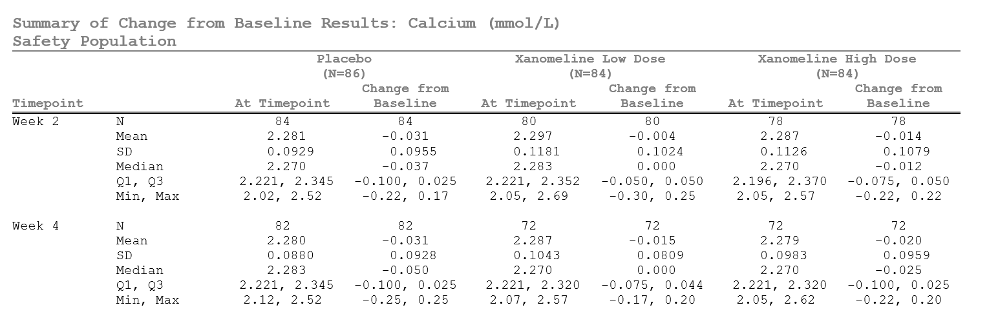
Multiple Target Variables

Slide 25

Multiple Target Variables
t <- tplyr_table(adlb, TRTA, where = PARAMCD == "ALB" & !is.na(AVISITN)) %>%
add_layer(
group_desc(vars(AVAL, CHG), by = vars(PARAMCD, AVISIT))
)
# Build and order the columns
t %>%
build() %>%
select(starts_with('row_label'),
var1_Placebo, var2_Placebo,
`var1_Xanomeline Low Dose`, `var2_Xanomeline Low Dose`)
# A tibble: 60 × 7
row_label1 row_label2 row_label3 var1_Placebo var2_Placebo `var1_Xanomeline Low Dose` `var2_Xanomeline Low`
<chr> <chr> <chr> <chr> <chr> <chr> <chr>
1 ALB Week 2 n " 83" " 83" " 80" " 80"
2 ALB Week 2 Mean (SD) "38.9 ( 3.11)" "-1.0 ( 2.49)" "38.7 ( 3.17)" "-1.1 ( 2.71)"
3 ALB Week 2 Median "39.0" "-1.0" "39.0" "-1.0"
4 ALB Week 2 Q1, Q3 "37.0, 41.0" "-3.0, 1.0" "37.0, 41.0" "-2.0, 1.0"
5 ALB Week 2 Min, Max "31, 46" "-6, 6" "31, 46" "-8, 6"
6 ALB Week 2 Missing " 0" " 0" " 0" " 2"
7 ALB Week 4 n " 79" " 79" " 72" " 72"
8 ALB Week 4 Mean (SD) "38.8 ( 3.29)" "-1.0 ( 2.69)" "38.6 ( 2.80)" "-1.2 ( 2.66)"
9 ALB Week 4 Median "39.0" "-1.0" "38.5" "-1.0"
10 ALB Week 4 Q1, Q3 "37.0, 41.0" "-3.0, 1.0" "37.0, 40.0" "-3.0, 0.0"

Slide 26
Multiple Target Variables
t <- tplyr_table(adlb, TRTA, where = PARAMCD == "ALB" & !is.na(AVISITN)) %>%
add_layer(
group_desc(vars(AVAL, CHG), by = vars(PARAMCD, AVISIT))
)
# Build and order the columns
t %>%
build() %>%
select(starts_with('row_label'),
var1_Placebo, var2_Placebo,
`var1_Xanomeline Low Dose`, `var2_Xanomeline Low Dose`)
# A tibble: 60 × 7
row_label1 row_label2 row_label3 var1_Placebo var2_Placebo `var1_Xanomeline Low Dose` `var2_Xanomeline Low`
<chr> <chr> <chr> <chr> <chr> <chr> <chr>
1 ALB Week 2 n " 83" " 83" " 80" " 80"
2 ALB Week 2 Mean (SD) "38.9 ( 3.11)" "-1.0 ( 2.49)" "38.7 ( 3.17)" "-1.1 ( 2.71)"
3 ALB Week 2 Median "39.0" "-1.0" "39.0" "-1.0"
4 ALB Week 2 Q1, Q3 "37.0, 41.0" "-3.0, 1.0" "37.0, 41.0" "-2.0, 1.0"
5 ALB Week 2 Min, Max "31, 46" "-6, 6" "31, 46" "-8, 6"
6 ALB Week 2 Missing " 0" " 0" " 0" " 2"
7 ALB Week 4 n " 79" " 79" " 72" " 72"
8 ALB Week 4 Mean (SD) "38.8 ( 3.29)" "-1.0 ( 2.69)" "38.6 ( 2.80)" "-1.2 ( 2.66)"
9 ALB Week 4 Median "39.0" "-1.0" "38.5" "-1.0"
10 ALB Week 4 Q1, Q3 "37.0, 41.0" "-3.0, 1.0" "37.0, 40.0" "-3.0, 0.0"

Slide 27
Multiple Target Variables
t <- tplyr_table(adlb, TRTA, where = PARAMCD == "ALB" & !is.na(AVISITN)) %>%
add_layer(
group_desc(vars(AVAL, CHG), by = vars(PARAMCD, AVISIT))
)
# Build and order the columns
t %>%
build() %>%
select(starts_with('row_label'),
var1_Placebo, var2_Placebo,
`var1_Xanomeline Low Dose`, `var2_Xanomeline Low Dose`)
# A tibble: 60 × 7
row_label1 row_label2 row_label3 var1_Placebo var2_Placebo `var1_Xanomeline Low Dose` `var2_Xanomeline Low`
<chr> <chr> <chr> <chr> <chr> <chr> <chr>
1 ALB Week 2 n " 83" " 83" " 80" " 80"
2 ALB Week 2 Mean (SD) "38.9 ( 3.11)" "-1.0 ( 2.49)" "38.7 ( 3.17)" "-1.1 ( 2.71)"
3 ALB Week 2 Median "39.0" "-1.0" "39.0" "-1.0"
4 ALB Week 2 Q1, Q3 "37.0, 41.0" "-3.0, 1.0" "37.0, 41.0" "-2.0, 1.0"
5 ALB Week 2 Min, Max "31, 46" "-6, 6" "31, 46" "-8, 6"
6 ALB Week 2 Missing " 0" " 0" " 0" " 2"
7 ALB Week 4 n " 79" " 79" " 72" " 72"
8 ALB Week 4 Mean (SD) "38.8 ( 3.29)" "-1.0 ( 2.69)" "38.6 ( 2.80)" "-1.2 ( 2.66)"
9 ALB Week 4 Median "39.0" "-1.0" "38.5" "-1.0"
10 ALB Week 4 Q1, Q3 "37.0, 41.0" "-3.0, 1.0" "37.0, 40.0" "-3.0, 0.0"

Slide 28
Descriptive Summaries and Precision
t <- tplyr_table(adlb, TRTA, where = PARAMCD == "ALB" & !is.na(AVISITN)) %>%
add_layer(
group_desc(vars(AVAL, CHG), by = vars(PARAMCD, AVISIT)) %>%
set_format_strings(
"N" = f_str("xx", n),
"Mean" = f_str('xx.a+1', mean),
"SD" = f_str('xxx.a+2', sd),
"Median" = f_str('xx.a+1', median),
"Q1, Q3" = f_str('xx.a+1, x.a+1', q1, q3),
"Min, Max" = f_str("x.a, x.a", min, max),
# Cap the decimal length
cap = c(dec=2)
) %>%
set_precision_on(AVAL)
)
# A tibble: 60 × 7
row_label1 row_label2 row_label3 var1_Placebo var2_Placebo `var1_Xanomeline Low Dose` `var2_Xanomeline Low Dose`
<chr> <chr> <chr> <chr> <chr> <chr> <chr>
1 ALB Week 2 N "83" "83" "80" "80"
2 ALB Week 2 Mean "38.9" "-1.0" "38.7" "-1.1"
3 ALB Week 2 SD " 3.11" " 2.49" " 3.17" " 2.71"
4 ALB Week 2 Median "39.0" "-1.0" "39.0" "-1.0"
5 ALB Week 2 Q1, Q3 "37.0, 41.0" "-3.0, 1.0" "37.0, 41.0" "-2.0, 1.0"
6 ALB Week 2 Min, Max "31, 46" "-6, 6" "31, 46" "-8, 6"
7 ALB Week 4 N "79" "79" "72" "72"
8 ALB Week 4 Mean "38.8" "-1.0" "38.6" "-1.2"
9 ALB Week 4 SD " 3.29" " 2.69" " 2.80" " 2.66"
10 ALB Week 4 Median "39.0" "-1.0" "38.5" "-1.0"

Slide 29
Multiple Target Variables
t <- tplyr_table(adlb, TRTA, where = PARAMCD == "ALB" & !is.na(AVISITN)) %>%
add_layer(
group_desc(vars(AVAL, CHG), by = vars(PARAMCD, AVISIT)) %>%
set_format_strings(
"N" = f_str("xx", n),
"Mean" = f_str('xx.a+1', mean),
"SD" = f_str('xxx.a+2', sd),
"Median" = f_str('xx.a+1', median),
"Q1, Q3" = f_str('xx.a+1, x.a+1', q1, q3),
"Min, Max" = f_str("x.a, x.a", min, max),
# Cap the decimal length
cap = c(dec=2)
) %>%
set_precision_on(AVAL)
)
# A tibble: 60 × 7
row_label1 row_label2 row_label3 var1_Placebo var2_Placebo `var1_Xanomeline Low Dose` `var2_Xanomeline Low Dose`
<chr> <chr> <chr> <chr> <chr> <chr> <chr>
1 ALB Week 2 N "83" "83" "80" "80"
2 ALB Week 2 Mean "38.9" "-1.0" "38.7" "-1.1"
3 ALB Week 2 SD " 3.11" " 2.49" " 3.17" " 2.71"
4 ALB Week 2 Median "39.0" "-1.0" "39.0" "-1.0"
5 ALB Week 2 Q1, Q3 "37.0, 41.0" "-3.0, 1.0" "37.0, 41.0" "-2.0, 1.0"
6 ALB Week 2 Min, Max "31, 46" "-6, 6" "31, 46" "-8, 6"
7 ALB Week 4 N "79" "79" "72" "72"
8 ALB Week 4 Mean "38.8" "-1.0" "38.6" "-1.2"
9 ALB Week 4 SD " 3.29" " 2.69" " 2.80" " 2.66"
10 ALB Week 4 Median "39.0" "-1.0" "38.5" "-1.0"

Slide 30
Multiple Target Variables
t <- tplyr_table(adlb, TRTA, where = PARAMCD == "ALB" & !is.na(AVISITN)) %>%
add_layer(
group_desc(vars(AVAL, CHG), by = vars(PARAMCD, AVISIT)) %>%
set_format_strings(
"N" = f_str("xx", n),
"Mean" = f_str('xx.a+1', mean),
"SD" = f_str('xxx.a+2', sd),
"Median" = f_str('xx.a+1', median),
"Q1, Q3" = f_str('xx.a+1, x.a+1', q1, q3),
"Min, Max" = f_str("x.a, x.a", min, max),
# Cap the decimal length
cap = c(dec=2)
) %>%
set_precision_on(AVAL)
)
# A tibble: 60 × 7
row_label1 row_label2 row_label3 var1_Placebo var2_Placebo `var1_Xanomeline Low Dose` `var2_Xanomeline Low Dose`
<chr> <chr> <chr> <chr> <chr> <chr> <chr>
1 ALB Week 2 N "83" "83" "80" "80"
2 ALB Week 2 Mean "38.9" "-1.0" "38.7" "-1.1"
3 ALB Week 2 SD " 3.11" " 2.49" " 3.17" " 2.71"
4 ALB Week 2 Median "39.0" "-1.0" "39.0" "-1.0"
5 ALB Week 2 Q1, Q3 "37.0, 41.0" "-3.0, 1.0" "37.0, 41.0" "-2.0, 1.0"
6 ALB Week 2 Min, Max "31, 46" "-6, 6" "31, 46" "-8, 6"
7 ALB Week 4 N "79" "79" "72" "72"
8 ALB Week 4 Mean "38.8" "-1.0" "38.6" "-1.2"
9 ALB Week 4 SD " 3.29" " 2.69" " 2.80" " 2.66"
10 ALB Week 4 Median "39.0" "-1.0" "38.5" "-1.0"

Slide 31
Multiple Target Variables
t <- tplyr_table(adlb, TRTA, where = PARAMCD == "ALB" & !is.na(AVISITN)) %>%
add_layer(
group_desc(vars(AVAL, CHG), by = vars(PARAMCD, AVISIT)) %>%
set_format_strings(
"N" = f_str("xx", n),
"Mean" = f_str('xx.a+1', mean), Collected precision + 1
"SD" = f_str('xxx.a+2', sd), Collected precision + 2
"Median" = f_str('xx.a+1', median), Collected precision + 1
"Q1, Q3" = f_str('xx.a+1, x.a+1', q1, q3), Collected precision + 1
"Min, Max" = f_str("x.a, x.a", min, max), Collected precision
# Cap the decimal length
cap = c(dec=2)
) %>% Do not exceed more than 2 decimal places of collected precision
set_precision_on(AVAL)
)
# A tibble: 60 × 7
row_label1 row_label2 row_label3 var1_Placebo var2_Placebo `var1_Xanomeline Low Dose` `var2_Xanomeline Low Dose`
<chr> <chr> <chr> <chr> <chr> <chr> <chr>
1 ALB Week 2 N "83" "83" "80" "80"
2 ALB Week 2 Mean "38.9" "-1.0" "38.7" "-1.1"
3 ALB Week 2 SD " 3.11" " 2.49" " 3.17" " 2.71"
4 ALB Week 2 Median "39.0" "-1.0" "39.0" "-1.0"
5 ALB Week 2 Q1, Q3 "37.0, 41.0" "-3.0, 1.0" "37.0, 41.0" "-2.0, 1.0"
6 ALB Week 2 Min, Max "31, 46" "-6, 6" "31, 46" "-8, 6"
7 ALB Week 4 N "79" "79" "72" "72"
8 ALB Week 4 Mean "38.8" "-1.0" "38.6" "-1.2"
9 ALB Week 4 SD " 3.29" " 2.69" " 2.80" " 2.66"
10 ALB Week 4 Median "39.0" "-1.0" "38.5" "-1.0"

Slide 32
Exercise 3
Laboratory Results

