Slide 1
JavaScript
Workshop
Marco Franssen, Jan Saris, Sander van de velde

Slide 2
Workshop JavaScript mbv jQuery
Basic jQuery
Ajax mbv jQuery
jQuery UI
Advanced JavaScript
MVVM met KnockoutJS

Slide 3
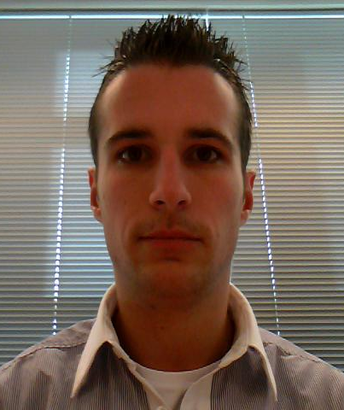
Who are we?
Marco Franssen
Twitter
@marcofranssen
Interests
Architecture
Design Patterns
Domain Driven Design
Distributed Systems
CQRS
Dependency Injection
Jan Saris
Twitter
@jpgsaris
Interests
Sander van de Velde
Twitter
@svelde
Interests

Slide 4
Knockout JS → MVVM pattern
UI
Alleen opmaak (geen logica)
Mappings op verschillende UI elementen
Visibility
ViewModel
Position
Data en gedrag specifiek voor de UI
Transformations
Data
Mappings, manipulaties en toevoegingen van data
Domein model
Data

Slide 5
Github
Open source workshop
Eigen bijdrage leveren
Forken
Handleiding op http://github.com/atosorigin/javascriptWorkShop

Slide 6
Thanks
For more information please contact: T+ 33 1 98765432 F+ 33 1 88888888 M+ 33 6 44445678 namefirstname@atos.net Atos (Country and legal form) Address post/zip code, location

