Slide 1
JavaScript
Workshop
Marco Franssen, Jan Saris, Sander van de velde

Slide 2
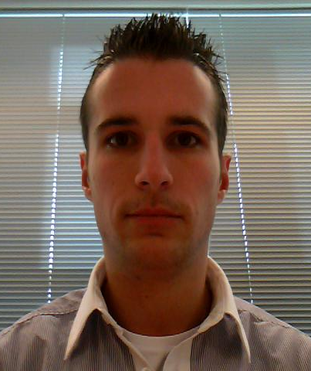
Who are we?
Marco Franssen
Twitter
@marcofranssen
Interests
Architecture
Design Patterns
Domain Driven Design
Distributed Systems
CQRS
Dependency Injection
Jan Saris
Twitter
@jpgsaris
Interests
Sander van de Velde
Twitter
@svelde
Interests

Slide 3
Knockout JS → MVVM pattern
UI
Alleen opmaak (geen logica)
Mappings op verschillende UI elementen
ViewModel
Data en gedrag specifiek voor de UI
Mappings, manipulaties en toevoegingen van data
Domein model
Data

Slide 4
Github
Open source workshop
Eigen bijdrage leveren
Forken
Handleiding op http://github.com/atosorigin/javascriptWorkShop

Slide 5
Thanks
For more information please contact: T+ 33 1 98765432 F+ 33 1 88888888 M+ 33 6 44445678 namefirstname@atos.net Atos (Country and legal form) Address post/zip code, location

