Slide 1




Predictive Modeling for Strongly Correlated f-electron Systems: A first-principles and database driven machine learning approach
Towfiq Ahmed, Abdullah Mueen, Heike Harper, Olle Eriksson, John Wills, Alexander Balatsky
Goal:
Explore the rich and complex electronic and structural properties of f-electron systems aided by theory, large simulated data and machine learning (ML) methods in order to achieve deeper physical understanding and better predictability to engineer next generation correlated materials.
http://softwarestore.ispfulfillment.com/Store/Product.aspx?skupart=I23SD3

Slide 2
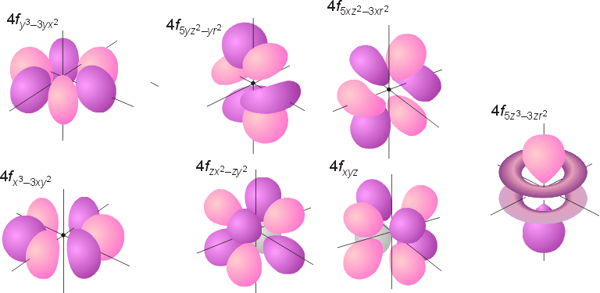
Why f-electron Systems for Materials Science ?
Complex f-electronic properties can ENRICH the conventional materials through doping etc
Complexity → Enrichment and Novelty (when external conditions can be controlled)
High atomic (Z) number → Strong SO coupling
Localized f-orbitals → Strong local Coulomb interaction
Hybridization between local f-orbitals with itinerant conduction bands → Many-body effect

Slide 3
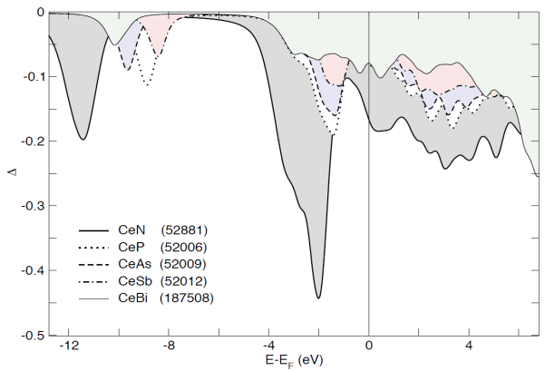
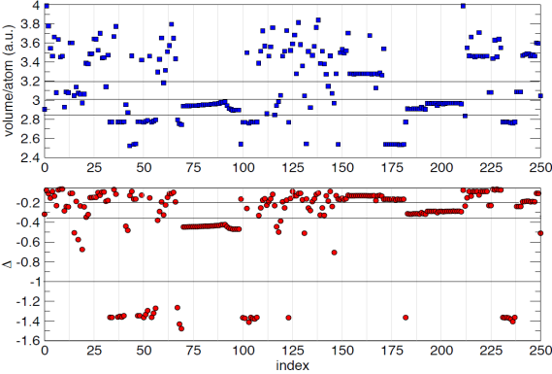
Example: simple DFT theory gives insight Analysis based on 257 Ce based compounds
Volume (red)
VS
Hybridization (blue)
Hybridization Function

Slide 4
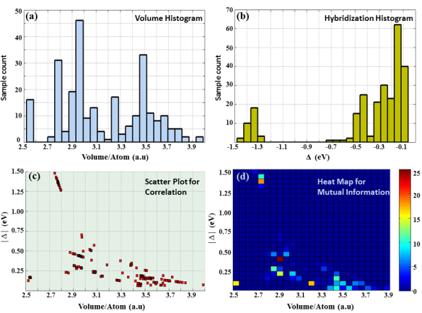
f-electron Ce compounds: Simple Theory
Volume (red)
VS
Hybridization (blue)
Hybridization Function
Theoretical Analysis
Statistical analysis reveals
Relation between
Hybridization and Volume
Data Analysis

Slide 5
