Slide 1
Semiclassical Analysis of Quantum Mechanical Calculations of Rotationally Inelastic Collisions of He and Ar with NaK
Ashley Towne

Slide 2
Background
Experiment – Prof. Huennekens' group
  Rotationally inelastic collisions at thermal energies
Theory – Prof. Hickman's group
Notes:
System that has vibrational and rotational states
Study angular momentum transitions
NaK is rotationally inelastic
Thermal energies – 600K, same order of magnitude as room temp

Slide 3
NaK potential curves
Notes:
Potential curves due to the electronic state
States of interest have the same symmetry

Slide 4
Experimental Measurements
Cross sections for jm→j'm' transitions
Fraction of orientation preserved in collisions
  Typically orientation is random, <m>=0
  Laser polarization can create nonrandom <m>

Slide 5
Vector Model
Notes:
Expression for orientation comes straight from the vector model
Need a system with a nonzero orientation

Slide 6
Creating nonzero orientation
Use polarized lasers
Pump creates an orientation in the A state
Probe is used to measure polarization after collisions
Notes:
Potential curves – three states
Pump laser
- excites the system with a specific energy
- knowledge of population
Probe laser
- linear = superposition of left and right circular
- measure laser passed through polarizer perpendicular to original polarization, so nothing should get through

Slide 7
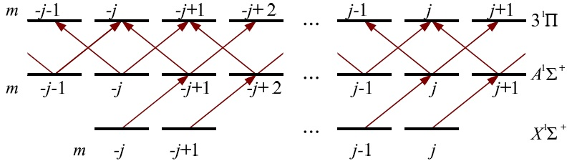
Creating nonzero orientation
Selection rule Δm = +1 leads to preferential population of large m
Notes:
Preferential population of large m
- first circular polarization dictates initial orientation
- probe laser's left and right polarizations interact differently
- one will be absorbed more, and the total polarization become elliptical
- small signal will pass through the polarizer, giving a metric of orientation

Slide 8
Comparison for σ(j→j')
Propensity for Δj to be even
  Strict selection rule for homonuclear molecules
Malenda, et al.
Notes:
Past results
It's not a selection rule for NaK

Slide 9
Theory – quantum mechanical
λ is related to transfer of angular momentum from projectile (He or Ar) to target NaK
Notes:
We can calculate the cross section of the collision exactly
Lambda must be an integer value
k is just a constant
* add alpha to diagram

Slide 10
Theory – semiclassical
λ is related to the tipping angle α between j and j'
Approximate cross sections
B(j,j',cosα) gives the distribution of tipping angles
Notes:
Law of cosines, angular momentum squaring rules
SC: if any alpha were allowed
What is B's angular distribution
Talk about how QM => transfer of a discrete amount of angular momentum
And SC => tips by an angle which is a continuous variable

Slide 11
He Δj=2
Distribution of tipping angles α
Notes:
Both models plotted, helium, j=19, j'=21, (jbar=20), Δj=2
Note that B_{SC} is B_{α}sinα and B_{QM} is B_{λ}(2λ+1)
- to obtain useful trends (scaling purposes) and because that's what you sum/integrate to get the cross-section

Slide 12
Helium
Argon
Comparison Δj=2
Distribution of tipping angles α
Notes:
Closer look at He and Ar

Slide 13
Trends in B(j,j,cosα)
Helium
  Larger average tipping angle for odd Δj than even Δj
  α tends to be small for the more probable transitions
Argon
  Larger <α> as Δj increases
  No even/odd Δj propensities
Comparison
  Argon B values are larger
  As j increases, <α> decreases
Notes:
He
- propensity rule
- expected tipping angle is closer to 0 for even Δj
Ar
- no propensity
Both
- decrease in magnitude as Δj increases (He wrt propensity rule)
- Ar is bigger
- higher j states have smaller tipping angle

Slide 14
Cross sections (σ)
σ(jm→j'm')
One can to relate Δθ to B(j,j',cosα)
Notes:
Cross section: sum over all λ/α possibilities for j/j' pair
Go back to the vector model
- the model is 3D
- j vector precesses around z-axis
- α != θ'-θ
Think of spheres

Slide 15
Methods for Δθ analysis
Quantum mechanical model
  Compute Δθ from j, j', m, m'
  Create histogram angle bins
  Convolve with Gaussian
Compute semiclassical model
  Numerically
  Analytically
Notes:
QM – cross sections are delta functions
Want a distribution of dthetas; QM are discrete, so dtheta is not a continuous variable
To compare with the continuous semiclassical model, used a histogram with bins
averaging

Slide 16
Helium
Argon
Δj=1
Distribution of cross sections vs Δθ

Slide 17
Helium
Argon
Δj=2
Distribution of cross sections vs Δθ

Slide 18
Helium
Argon
Δj=3
Distribution of cross sections vs Δθ

Slide 19
Helium
Argon
Δj=4
Distribution of cross sections vs Δθ

Slide 20
Trends
Δθ tends to be conserved
  m tends to change
As Δj increases
  Δθ is less conserved for both
  Argon's σ distribution becomes more spread out than Helium
As j increases, QM and SC agreement improves, and σ's are less spread out
Notes:
Δθ is not usually exactly 0 (QM)

Slide 21
Acknowledgements
  NSF (Physics grant, REU program)
  XSEDE for computer time at TACC (Texas Advanced Computation Center)
  Teri Price, Kara Richter, Prof. Huennekens
Citation
  Malenda, R. F., T. J. Price, J. Stevens, S. L. Uppalapati, A. Fragale, P. M. Weiser, A. Kuczala, D. Talbi, and A. P. Hickman. "Theoretical Calculations of Rotationally Inelastic Collisions of He with NaK(A¹Σ⁺): Transfer of Population, Orientation, and Alignment." J. Chem. Phys. J. Chemical Physics 142, 224301 (2015). Print.

Slide 22
Citations

