Slide 1
CLC | Mathematics
Solving Problems with Desmos
A Complete Student Guide – CLC Educational Institute
clc.gr | desmos.com/calculator

Slide 2
What We Will Cover Today
01
Getting Started
05
Calculus
Interface, navigation, saving & sharing
Derivatives, integrals, limits
02
Algebra
06
Statistics
Points, lines, equations, inequalities, tables
Data, regression, distributions
03
Functions & Graphing
07
Tips & Tricks
Quadratics, sliders, piecewise, parametric, polar
Shortcuts, mobile, pro features
04
Geometry
Shapes, conics, constructions, Geometry tool
CLC Educational Institute | clc.gr

Slide 3
Getting Started
Understanding the Desmos interface
CLC Educational Institute | clc.gr

Slide 4
What is Desmos?
Desmos is a free, browser-based graphing calculator — no download or installation needed.
Access it at desmos.com/calculator on any computer, tablet, or smartphone.
It plots points, graphs equations, evaluates functions, tables, and more — all in real time.
Used by millions of students worldwide and accepted in many standardized exams.
Also includes a Geometry tool, Scientific Calculator, and classroom activities.
All your work can be saved and shared with a simple URL — no account required to start.
TIP: Desmos works in any modern browser. Bookmark desmos.com/calculator so you always have it ready.
CLC Educational Institute | clc.gr

Slide 5
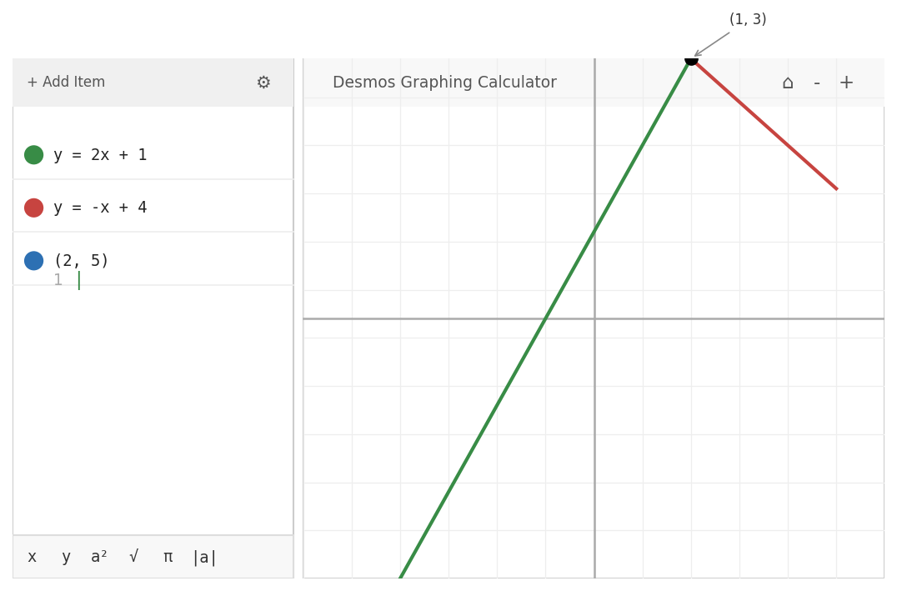
A Tour of the Desmos Interface
Expression List (left panel): where you type equations, points, and notes.
Graph (right): updates instantly as you type.
Colored circle: click to change color or hide a graph.
Keyboard (bottom): access math symbols, Greek letters, functions.
Wrench icon (top-right of graph): change axes, grid, angle units.
Home button: resets the view to fit all graphs on screen.
Share button: save and share your graph as a URL or image.
TIP: Click directly on any curve on the graph to see its key points.
CLC Educational Institute | clc.gr

Slide 6
Why Use Desmos?
Completely FREE — no subscription, no login required to start.
Instant visual feedback: you see the graph the moment you type.
Interactive sliders let you explore how changing a number changes the graph.
Handles everything from basic arithmetic to calculus and statistics.
Works on computers, iPads, and Android tablets — great for home study.
Accepted on many international assessments and curricula.
If you can write a math formula, Desmos can graph it.
DESMOS TOOLS
Graphing Calculator
Scientific Calculator
Four-Function Calc
Matrix Calculator
Geometry Tool
Classroom Activities
3D Calculator (beta)
CLC Educational Institute | clc.gr

Slide 7
Navigating the Graph
Pan: click and drag anywhere on the graph to move the view.
Zoom: use the + and – buttons, or scroll your mouse wheel.
Home button: press to auto-fit the view so all graphs are visible.
Set exact range: click the Wrench icon and enter x-min, x-max, y-min, y-max.
Points of interest appear automatically — hover to see exact coordinates.
Click a point to pin its label so it stays visible on screen.
Audio trace: press Alt+T to hear a graph as sound.
ZOOM SHORTCUTS
Scroll wheel = zoom
Ctrl + = zoom in
Ctrl - = zoom out
Home btn = auto-fit
Drag = pan
Wrench = set range
CLC Educational Institute | clc.gr

Slide 8
Saving and Sharing Your Work
Save button (top-left): saves your graph — prompts login if not signed in.
Share button: generates a unique URL — paste it anywhere to share.
Export image: save as PNG, SVG, or even Braille embosser format.
Snapshot: a static image of your current graph view.
Re-open saved graphs by clicking the folder icon (top-left) after sign-in.
No account? The URL in your browser bar reflects your latest graph — bookmark it.
TIP: Always copy your graph's URL before closing the tab if you don't have an account.
CLC Educational Institute | clc.gr

Slide 9
Essential Keyboard Shortcuts
New Line
Undo
Redo
Duplicate
Enter
Ctrl + Z
Ctrl + Y
Ctrl+Shift+C
Deg / Rad toggle
Superscript (^)
Fraction
Show Shortcuts
Alt + D
^ key
/ key
Ctrl + /
CLC Educational Institute | clc.gr

Slide 10
Basic Algebra
Equations, lines, inequalities & tables
CLC Educational Institute | clc.gr

Slide 11
Plotting Points
Type a coordinate pair directly into the expression list.
(3, 4) <- plots a point at x=3, y=4
(-2, 0) <- plots a point on the x-axis
// Multiple points — list them on one line:
(-1,1), (0,0), (1,1), (2,4)
// Or use a Table: click + -> Table
// and enter x and y columns
TIP: Click any plotted point to see its exact coordinates. You can drag points to move them.
CLC Educational Institute | clc.gr

Slide 12
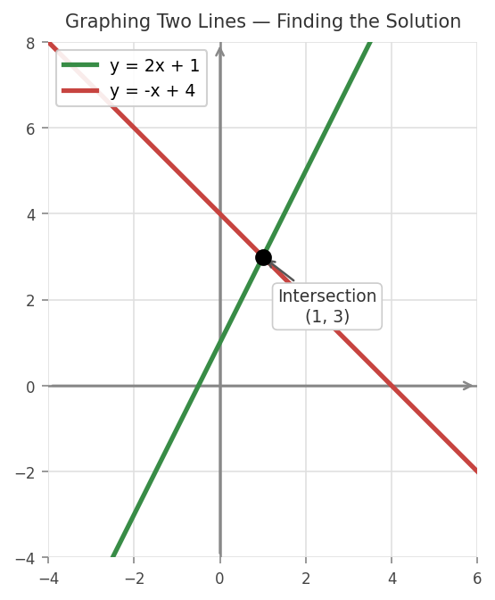
Graphing Lines and Finding Intersections
Type any equation involving x and y — Desmos draws it instantly.
y = 2x + 1 draws a line with slope 2, y-intercept 1.
y = -x + 4 draws a line with slope -1.
Type TWO equations and Desmos automatically shows their intersection point.
Click the intersection dot to read the exact (x, y) solution.
Vertical line: type x = 3. Horizontal: type y = -2.
TIP: Hover over the intersection point to read the exact coordinates.
CLC Educational Institute | clc.gr

Slide 13
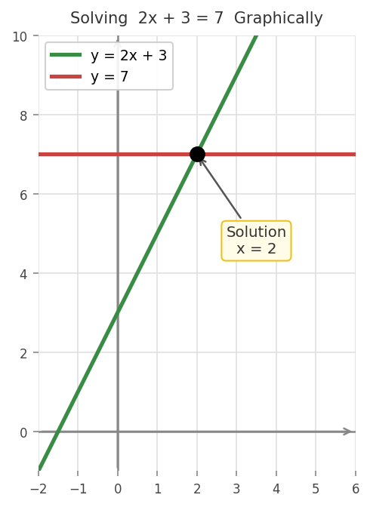
Solving Linear Equations Graphically
Method: type both sides of the equation as y = ...
Example: solve 2x + 3 = 7
Line 1: y = 2x + 3
Line 2: y = 7
The x-coordinate of the intersection = the solution.
Click the point to confirm: x = 2.
You can check any hand-calculated answer this way instantly.
TIP: All three methods — graphical, table, direct equation — give the same answer.
CLC Educational Institute | clc.gr

Slide 14
Systems of Equations
Type each equation on a separate line — Desmos plots both and marks the intersection.
The intersection point (x, y) is the solution to the system.
Click the intersection dot to read the exact coordinates — no calculation needed.
Works for 2 or more equations simultaneously.
Parallel lines = no intersection = no solution.
Overlapping lines = infinitely many solutions.
Try adding a slider to see how changing a coefficient moves the solution.
TIP: Add x = ... or y = ... as a check line to verify each equation in the system.
CLC Educational Institute | clc.gr

Slide 15
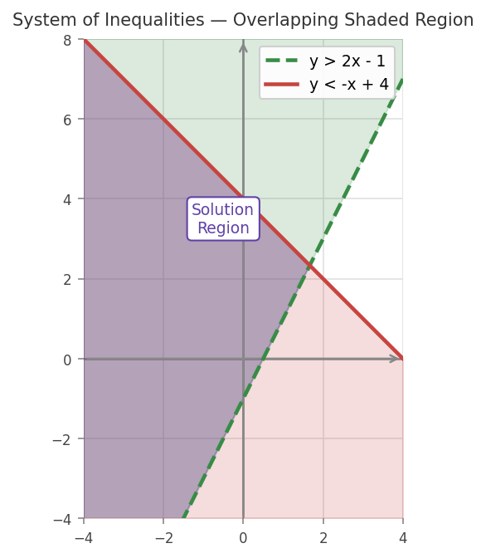
Graphing Inequalities
Replace = with > < >= <= — Desmos shades the solution region.
y > 2x - 1 shades ABOVE the dashed line.
y <= x + 3 shades BELOW with a solid boundary.
Type two inequalities together — Desmos shows the overlapping region.
Dashed boundary = strict inequality (< or >).
Solid boundary = includes the line (<= or >=).
The shaded overlap is the solution to the system.
TIP: Type >= for >= and <= for <= — Desmos converts them automatically.
CLC Educational Institute | clc.gr

Slide 16
Using Tables in Desmos
Click + then Table to add a data table to the expression list.
Enter x values in the left column — y values fill automatically if you set a function.
Or enter both x and y manually to create a scatter of data points.
Press Enter inside the table to add more rows.
Type y1 = f(x1) to link a table column to any function you defined.
Tables are the starting point for regression — enter your data here, then fit a curve.
You can paste data copied from Excel or Google Sheets directly into a table.
TIP: Use tables to spot patterns: look for constant differences (linear) or constant ratios (exponential).
CLC Educational Institute | clc.gr

Slide 17
Functions & Graphing
Defining, evaluating, and transforming functions
CLC Educational Institute | clc.gr

Slide 18
Defining and Evaluating Functions
Name your own function — then call it anywhere in the expression list.
f(x) = x^2 - 4x + 3 <- define the function
f(2) <- evaluates to -1
f(0) <- evaluates to 3
// Plot f and a specific point together:
f(x) = x^2 - 4x + 3
(2, f(2)) <- plots the point (2, -1) on the curve
TIP: Use any letter: f(x), g(x), h(x). Desmos assigns a different color to each.
CLC Educational Institute | clc.gr

Slide 19
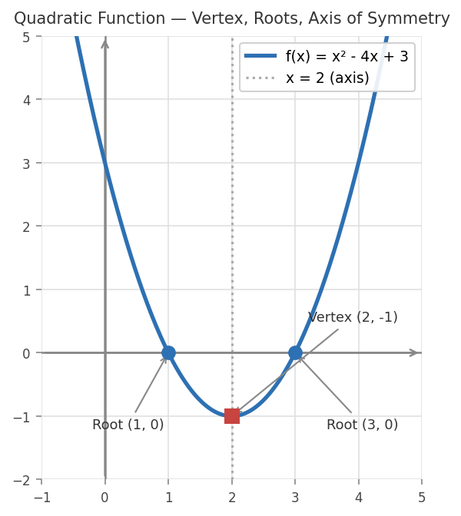
Quadratic Functions
Standard form: f(x) = ax^2 + bx + c
Vertex form: f(x) = a(x-h)^2 + k
Vertex is the highest or lowest point — click it to read (h, k).
Roots (x-intercepts): click where the curve crosses the x-axis.
Axis of symmetry: the vertical line x = h.
Add sliders for a, b, c (or a, h, k) — drag and watch the parabola move.
If the graph never crosses the x-axis, the roots are complex (no real solutions).
TIP: Type x = (-b)/(2a) to plot the axis of symmetry as a dotted line.
CLC Educational Institute | clc.gr

Slide 20
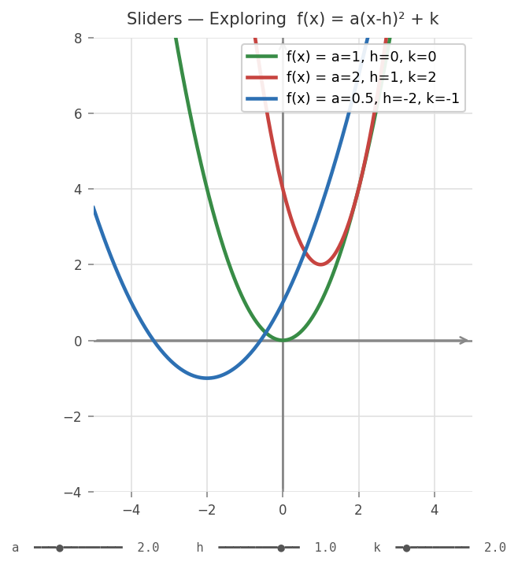
Sliders and Transformations
Type a letter not yet defined — Desmos offers to add a slider.
Example: type f(x) = a*x^2 + b then press 'add sliders'.
Drag the slider handle to change the value — the graph updates live.
Press the Play button on any slider to animate it continuously.
Set slider range and step in the slider's settings icon.
Try f(x) = a*sin(bx+c)+d to explore amplitude, period, phase, midline.
Sliders build the deepest intuition about how formulas control graphs.
TIP: Use sliders in exams preparation: explore 'what happens if a doubles?' style questions.
CLC Educational Institute | clc.gr

Slide 21
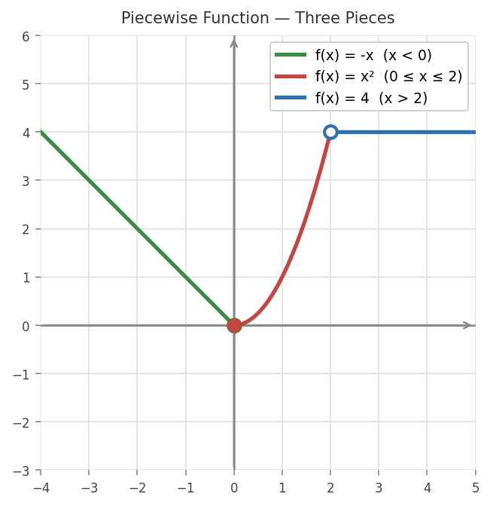
Piecewise Functions
Define functions that behave differently on different intervals.
Use curly braces { } with comma-separated pieces.
Syntax: f(x) = {condition: expression, condition: expression}
Example: f(x) = {x<0: -x, 0<=x<=2: x^2, x>2: 4}
Desmos draws each piece only in its correct interval.
Open circles = strict inequality (not included).
Filled circles = the endpoint is included.
TIP: Press the { } keys on your keyboard directly — no special menu needed.
CLC Educational Institute | clc.gr

Slide 22
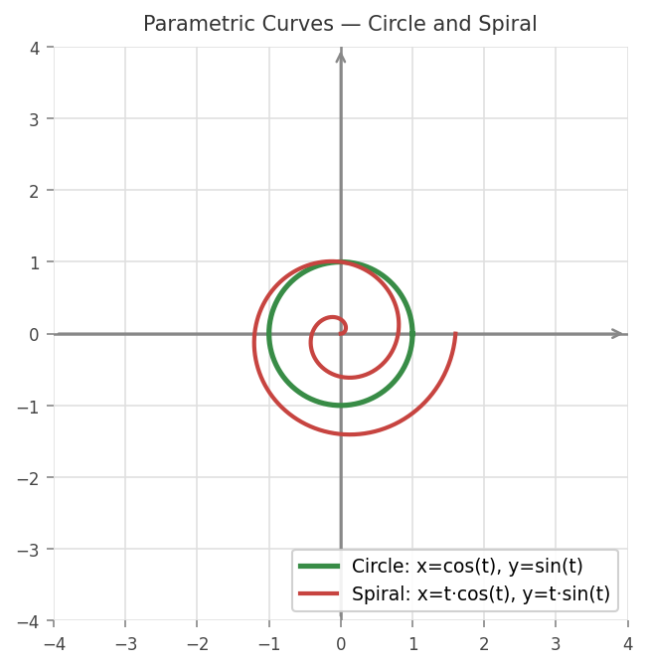
Parametric Curves
Graph curves defined by separate x(t) and y(t) expressions.
Type x = cos(t) and y = sin(t) on consecutive lines — Desmos links them.
A bracket appears on the left — click to set the t domain.
Circle: x=cos(t), y=sin(t) | Spiral: x=t*cos(t), y=t*sin(t)
Restrict: add 0 <= t <= 2*pi to control how much is drawn.
Parametric curves let you draw shapes impossible in y = f(x) form.
TIP: Any curve that loops or doubles back on itself must be parametric or polar.
CLC Educational Institute | clc.gr

Slide 23
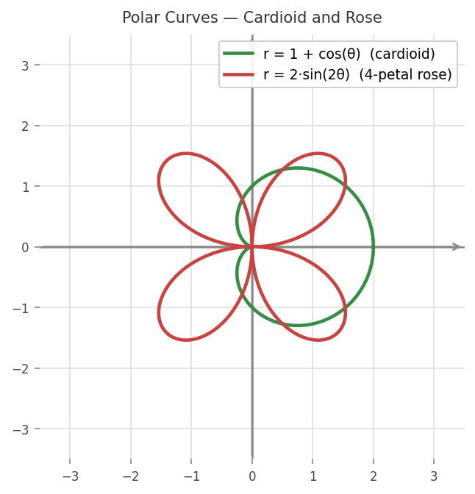
Polar Curves
Graph equations of the form r = f(theta).
Enable the polar grid: Wrench icon -> Grid -> Polar.
Type 'theta' — Desmos converts it to the Greek letter automatically.
r = 3 → circle of radius 3
r = 1 + cos(theta) → cardioid
r = sin(2*theta) → 4-petal rose
r = theta → Archimedean spiral
TIP: Use 0 <= theta <= 4*pi to draw extra loops on spirals and multi-petal roses.
CLC Educational Institute | clc.gr

Slide 24
Geometry
Shapes, conics, constructions, and the Geometry tool
CLC Educational Institute | clc.gr

Slide 25
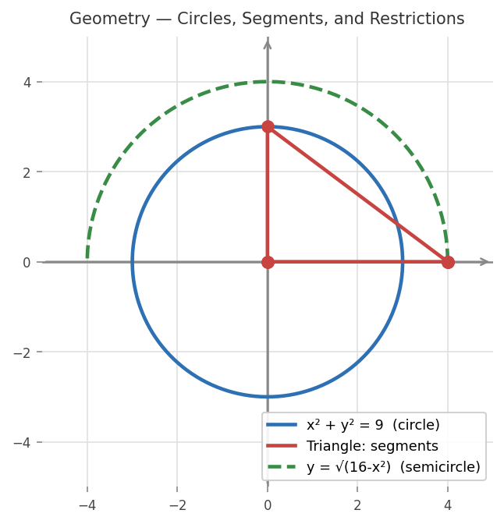
Geometry in the Graphing Calculator
Desmos plots geometric shapes from their algebraic equations.
Circles, triangles, polygons, and conics — all from standard equations.
Restrict domains to draw only segments of lines or curves.
Plot vertex points alongside segments to label shapes.
Combine algebra and geometry on the same grid.
Everything is interactive — drag slider points in real time.
TIP: For compass-and-ruler constructions, use the separate desmos.com/geometry tool.
CLC Educational Institute | clc.gr

Slide 26
Lines, Rays, and Segments
Restrict the domain of any equation using curly braces to draw just a portion.
y = 2x + 1 <- full infinite line
y = 2x + 1 {0 <= x <= 4} <- segment from x=0 to x=4
y = 2x + 1 {x >= 0} <- ray starting at x=0
// Vertical segment:
x = 3 {1 <= y <= 5} <- from (3,1) to (3,5)
// Right triangle (3 segments):
y = 0 {0<=x<=4} x = 0 {0<=y<=3} y = (-3/4)*x + 3 {0<=x<=4}
TIP: Combine multiple segments to draw any polygon — label the vertices as points.
CLC Educational Institute | clc.gr

Slide 27
Circles and Polygons
Type standard geometric equations — Desmos draws the shape instantly.
// Circle: (x-h)^2 + (y-k)^2 = r^2
x^2 + y^2 = 25 <- centre (0,0), radius 5
(x-2)^2 + (y-3)^2 = 9 <- centre (2,3), radius 3
// Triangle (three restricted lines):
y=x {0<=x<=4} y=4 {0<=x<=4} x=0 {0<=y<=4}
// Upper semicircle:
y = sqrt(16 - x^2) <- top half of circle r=4
TIP: Plot vertex points like (0,0), (4,0), (0,4) alongside your segments.
CLC Educational Institute | clc.gr

Slide 28
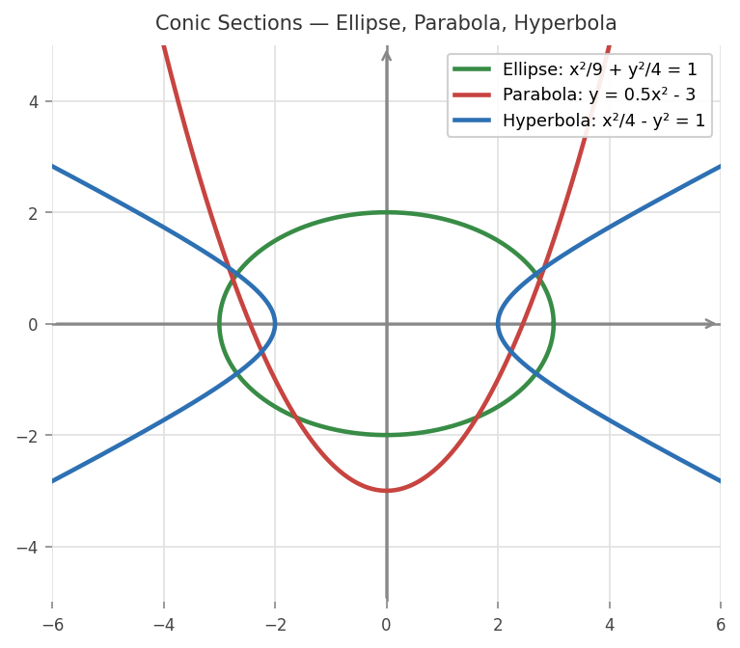
Conic Sections
Circle: (x-h)^2 + (y-k)^2 = r^2
Ellipse: (x-h)^2/a^2 + (y-k)^2/b^2 = 1
Hyperbola: (x-h)^2/a^2 - (y-k)^2/b^2 = 1
Parabola: y = a(x-h)^2 + k or x = a(y-k)^2 + h
Add sliders for h, k, a, b — drag them to see how parameters change shape.
Desmos draws the full conic from one equation — no need to split into halves.
For a vertical hyperbola, swap x and y in the hyperbola formula.
TIP: Conics are cross-sections of a cone — Desmos lets you explore all four in seconds.
CLC Educational Institute | clc.gr

Slide 29
Distance, Midpoint, and Slope
Define draggable points with sliders — formulas update live as you move them.
// Define two moveable points:
A = (a1, a2) <- add sliders for a1 and a2
B = (b1, b2) <- add sliders for b1 and b2
// Distance |AB|:
d = sqrt((b1-a1)^2 + (b2-a2)^2)
// Midpoint M:
M = ((a1+b1)/2, (a2+b2)/2)
// Slope of AB:
m = (b2-a2) / (b1-a1)
TIP: Drag slider points A and B — watch d, M, and m update instantly. Perfect for verifying formulas.
CLC Educational Institute | clc.gr

Slide 30
The Desmos Geometry Tool (desmos.com/geometry)
A separate compass-and-ruler environment — free, no account needed.
Draw points, lines, circles, and polygons using geometric tools (not equations).
Construct midpoints, perpendicular bisectors, angle bisectors, parallel lines.
Measure lengths, angles, areas, and perimeters with the Measure tool.
Reflect, rotate, translate, and dilate shapes with transformation tools.
Add labels and annotations to create clear geometry diagrams for proofs.
Everything is draggable — pull any point to explore how the construction changes.
TIP: Use the Geometry tool for proof-style constructions; use the Graphing Calculator when you need equations.
CLC Educational Institute | clc.gr

Slide 31
Calculus
Derivatives, integrals, and limits
CLC Educational Institute | clc.gr

Slide 32
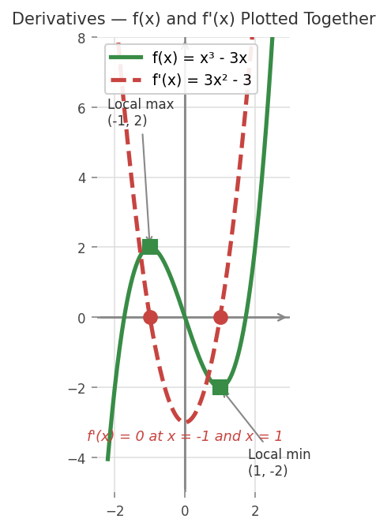
Derivatives
Type f'(x) to plot the derivative of f — Desmos computes it automatically.
Example: if f(x) = x^3 - 3x, then f'(x) draws 3x^2 - 3.
Add f'(x) = 0 as a line to find critical points (where f'(x) crosses x-axis).
Local max: f'(x) changes from + to - (click to read coordinates).
Local min: f'(x) changes from - to + (click to read coordinates).
Type f''(x) for the second derivative — find inflection points where f''=0.
TIP: Press the apostrophe key ( ' ) for prime. Higher orders: f''(x), f'''(x).
CLC Educational Institute | clc.gr

Slide 33
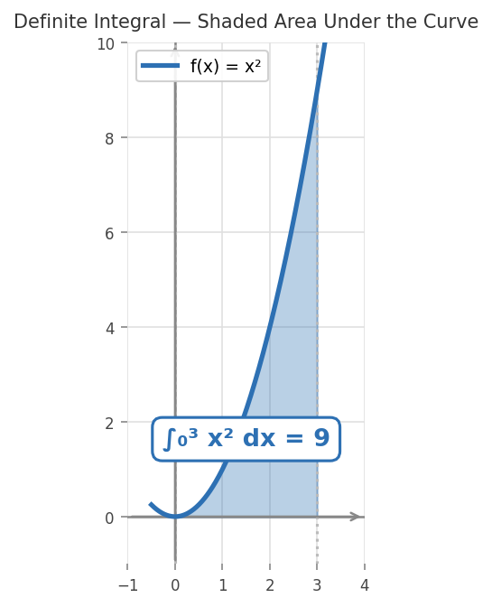
Definite Integrals and Area
Access the integral symbol via the Desmos keyboard: tap f(x) -> Calculus.
The integral shades the region AND shows the numeric value.
Example: integral from 0 to 3 of x^2 dx = 9.
Area between two curves: integrate (f(x) - g(x)) over the interval.
Negative areas = the curve is below the x-axis (Desmos shows this correctly).
Click the vertical boundary lines to drag the integration limits interactively.
TIP: Desmos shows the shaded region AND the numeric answer — use this to verify your hand calculations.
CLC Educational Institute | clc.gr

Slide 34
Exploring Limits Visually
Desmos does not compute limits symbolically — but you can explore them visually.
Method 1 — Graph: look for an open circle (hole) at a removable discontinuity.
Method 2 — Table: set x values approaching the limit (e.g. 1.9, 1.99, 1.999, 2).
Read the y column — the values converging tell you the limit.
Example: f(x) = (x^2 - 4)/(x - 2) has a hole at x=2, but the limit equals 4.
Zoom in very close to the point to read the limit numerically from both sides.
For one-sided limits, restrict domain: f(x) {x < 2} and f(x) {x > 2} separately.
TIP: If the graph has a hole at x=a, the limit still exists — Desmos shows it as an open circle.
CLC Educational Institute | clc.gr

Slide 35
Statistics
Data, regression, and distributions
CLC Educational Institute | clc.gr

Slide 36
Entering Data in Desmos
Click + -> Table to create a data table in the expression list.
Type your x values in the left column (x_1, x_2 ...) and y values on the right.
Press Enter to add more rows. The scatter plot appears automatically.
You can paste data copied from Excel or Google Sheets directly into the table.
Edit cell values directly — the scatter plot updates instantly.
Click any data point on the graph to see its exact coordinates.
A table can have more than 2 columns — add a third for a second y-variable or formula.
TIP: Start by pasting your class data into a table — you will have a scatter plot in seconds.
CLC Educational Institute | clc.gr

Slide 37
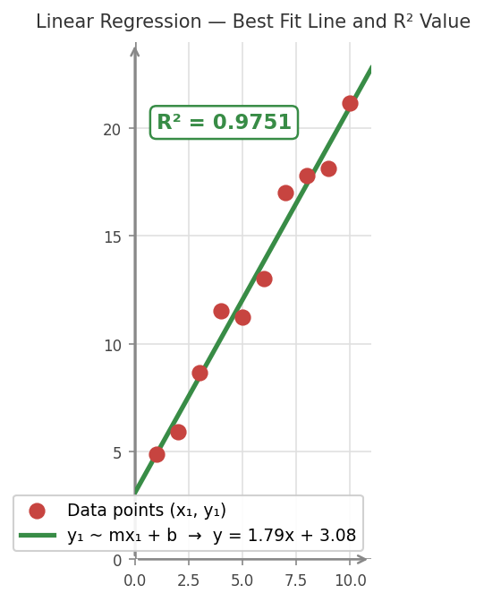
Regression and Best Fit
Use the ~ (tilde) operator to fit any model to your data.
After entering data in a table (columns x_1, y_1):
y_1 ~ m*x_1 + b linear regression
y_1 ~ a*x_1^2 + b*x_1 + c quadratic
y_1 ~ a*e^(b*x_1) exponential
Desmos shows the best-fit parameters AND the R² value.
R² closer to 1 = better fit. The fitted curve is drawn over your data.
TIP: Try multiple models (linear, quadratic, exponential) and compare their R² values.
CLC Educational Institute | clc.gr

Slide 38
Statistical Functions with Lists
Define a dataset as a list: data = [12, 15, 18, 22, 25, 30]
mean(data) — arithmetic mean | median(data) — middle value
stdev(data) — standard deviation | mad(data) — mean absolute deviation
min(data) and max(data) | total(data) — sum | length(data) — count
sort(data) — ascending order | shuffle(data) — random order
These functions work on any list — no need to create a table first.
You can combine them: mean(sort(data)) or stdev(data)/mean(data) (CV).
EXAMPLE
scores = [72,85,90,
66,88,91]
mean(scores) = 82
stdev(scores) = 10.2
median(scores) = 86.5
min = 66
max = 91
CLC Educational Institute | clc.gr

Slide 39
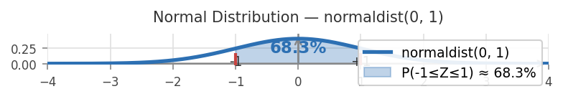
Probability Distributions
f(x) = normaldist(0, 1) → standard normal curve
normaldist(0,1).cdf(-1, 1) → P(-1 ≤ Z ≤ 1) = 0.683
normaldist(0,1).inversecdf(0.95) → finds the 95th percentile
f(x) = binomialdist(10, 0.5) → binomial n=10, p=0.5
Desmos also supports: poissondist, uniformdist, and more.
Click any point on the distribution curve to read its exact probability.
TIP: Use .cdf(a, b) for P(a ≤ X ≤ b) and .inversecdf(p) to find the value at probability p.
CLC Educational Institute | clc.gr

Slide 40
Tips, Tricks & Pro Features
Get the most out of Desmos
CLC Educational Institute | clc.gr

Slide 41
Organizing Your Expression List
Add a text note: start any expression line with " (quotation mark) to write a comment.
Create folders: click + -> Folder to group related expressions.
Click the folder arrow to collapse or expand it.
Hide a graph without deleting it: click its colored circle to toggle visibility.
Duplicate an expression: open Edit List mode (gear icon) and click the duplicate icon.
Rearrange lines: in Edit List mode, drag the handle on the left to reorder.
Delete: press the X button, or use Edit List mode for batch deletes.
TIP: Keep your list tidy — folders and text notes make complex graphs much easier to understand.
CLC Educational Institute | clc.gr

Slide 42
Using Desmos on iPad and Mobile
Open desmos.com/calculator in Safari or Chrome — the full calculator works in the browser.
The free Desmos app is available on the App Store (iOS) and Google Play (Android).
On touchscreen: pinch to zoom, two-finger drag to pan the graph.
Tap the keyboard icon (bottom of expression list) to open the math keyboard.
iPad copy/paste Method 1: three-finger pinch closed = copy, pinch open = paste.
iPad copy/paste Method 2: tap-and-hold an expression, select Copy from the menu.
iPad copy/paste Method 3: with a physical keyboard, use Ctrl+C / Ctrl+V as usual.
Duplicate an expression: tap Edit (gear icon) then tap the overlapping-squares icon.
TIP: The iPad app and browser version are nearly identical — all features work on both.
CLC Educational Institute | clc.gr

Slide 43
Pro Tips for Students
Use Desmos as a checker — solve by hand, then verify with Desmos.
Label important points: click any graph point and add a custom label.
Animate sliders with the Play button — great for spotting patterns visually.
Type pi for pi, e for Euler's number, infinity for infinity.
Use f(x) = {condition: value} to restrict any function to a domain.
For scientific notation: type 1e6 for 1,000,000.
The Desmos keyboard has Greek letters, absolute value, summation — explore it all.
Explore Desmos Art online — students have created stunning images with only equations!
TIP: Your teacher can also set up a Desmos Classroom activity for interactive lessons at teacher.desmos.com.
CLC Educational Institute | clc.gr

Slide 44
Arithmetic Operations in Desmos
Basic operators: + - * / ^
Square root: type sqrt(9) = 3 or use the keyboard symbol
nth root: nthroot(8,3) = 2 (cube root of 8)
Pi: type pi → Desmos shows π = 3.14159...
Euler’s number: type e → Desmos uses e = 2.71828...
Absolute value: abs(-7) = 7 or use | | from the keyboard
Logarithms: log(100) = 2 | ln(e) = 1
Trig: sin(pi/6) = 0.5 (use Wrench to set Radians or Degrees)
EXAMPLES
sqrt(2) * pi = 4.4429...
e^2 + sqrt(5) = 9.6207...
nthroot(27, 3) = 3
log(1000) = 3
sin(pi/2) = 1
2^10 = 1024
abs(-5) + sqrt(16) = 9
TIP: Desmos evaluates expressions instantly. Use it as a scientific calculator — no graphing needed!
CLC Educational Institute | clc.gr

Slide 45
Regression: Fitting a Curve to Data
Enter data in a Table with columns x₁ and y₁
Use ~ (tilde) to define your model
Desmos shows best-fit parameters and R² value (closer to 1 = better fit)
QUADRATIC REGRESSION (3 points)
Table: x₁ = [0, 2, 4]
y₁ = [1, 5, 17]
y₁ ~ a*x₁^2 + b*x₁ + c
Result: a=1, b=1, c=1
y = x² + x + 1
R² = 1.0 (perfect fit)
OTHER MODELS:
y₁ ~ a*e^(b*x₁) exponential
y₁ ~ a*ln(x₁) + b logarithmic
LINEAR REGRESSION (2 points)
Table: x₁ = [1, 4] y₁ = [3, 9]
y₁ ~ m*x₁ + b
Result: m = 2, b = 1 (y = 2x + 1)
R² = 1.0 (perfect fit)
TIP: Try multiple models and compare R² values — the model closest to 1 fits your data best.
CLC Educational Institute | clc.gr

Slide 46
Mean and Standard Deviation
Define your data as a list: data = [v1, v2, ...]
Mean: mean(data) = arithmetic average
Standard deviation: stdev(data)
Median: median(data) = middle value
Min / Max: min(data) / max(data)
Total / Count: total(data) / length(data)
No table needed — lists work directly in the expression list
EXAMPLE
scores = [72, 85, 90, 66, 88, 91]
mean(scores) = 82
stdev(scores) = 10.2
median(scores) = 86.5
min(scores) = 66
max(scores) = 91
total(scores) = 492
length(scores) = 6
COEFFICIENT OF VARIATION:
stdev(scores)/mean(scores) = 0.124
TIP: On the SAT, mean and standard deviation are frequently tested. Verify your hand calculation instantly with Desmos.
CLC Educational Institute | clc.gr

Slide 47
SAT Quick-Reference: Desmos Commands
ARITHMETIC
sqrt(x) square root
nthroot(x,n) nth root
abs(x) |x|
pi π = 3.14159...
e e = 2.71828...
log(x) log base 10
ln(x) natural log
REGRESSION
Enter data in a Table
columns x₁, y₁
then type your model:
y₁ ~ mx₁ + b linear
y₁ ~ ax₁^2+bx₁+c quadratic
y₁ ~ ae^(bx₁) exponential
y₁ ~ aln(x₁)+b logarithmic
Desmos shows R² and
best-fit curve automatically
STATISTICS
data = [v1, v2, ...]
then call:
mean(data) average
stdev(data) std dev
median(data) middle
min(data) minimum
max(data) maximum
total(data) sum
length(data) count
TIP: Keep this slide as your Desmos cheat sheet for SAT exam day — all three toolsets in one view!
CLC Educational Institute | clc.gr

Slide 48
CLC | Mathematics
You are now ready to
solve problems with Desmos!
Start exploring today:
desmos.com/calculator
CLC Educational Institute | clc.gr
All rights reserved. For educational use only.

