Slide 1


ASSESSING THE VALUE OF THERMAL ENERGY STORAGE COUPLED WITH HEAT PUMPS FOR RESIDENTIAL SPACE HEATING IN U.S. CITIES
An Pham
External Advisory Board Meeting November 2022

Slide 2
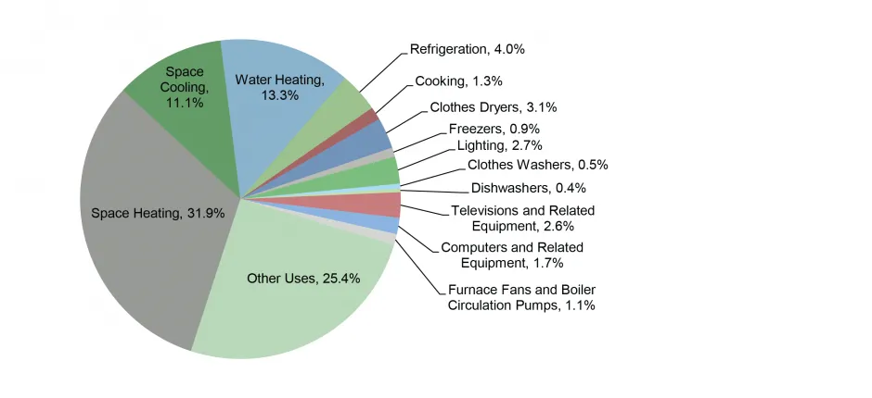
INTRODUCTION
Decarbonization of the residential sector is imperative to global decarbonization efforts
17% of global energy sector’s CO2 emission
Residential sector is 22% of U.S. primary energy consumption

Slide 3
INTRODUCTION
In the near- and long-run, space heating will continue to be electrified
One of the most common ways is via air-source heat pump (ASHP)
ASHP has COP greater than 1.0, indicating higher efficiency rates than traditional heating devices
However, ASHP can be inefficient in colder climate areas during cold periods
Thermal energy storage (TES) can enhance ASHP’s efficiency during these periods

Slide 4
INTRODUCTION
Literature exploring different heat pump-TES designs in experimental and actual systems is abundant
Do not offer insights into the effectiveness of different TES materials and designs
Ignore actual building characteristics that might effect heating loads.
Studies that explore the performances and economic analysis of different TES materials and designs are rare
All focus on grid-scale TES storage materials and characteristics that are not suitable to be applied to building applications

Slide 5
RESEARCH QUESTIONS
What are the relationships between various TES system design parameters and their impacts on total system cost and energy consumption for space heating in U.S. residential buildings?
How much peak load reduction can be achieved via TES without increasing total system operational cost?

Slide 6
METHODOLOGIES
Function of outdoor temps (Waite and Modi, 2020)
Inputs:
COPs
Heating load (NREL’s Resstock)
TES roundtrip efficiency
TES energy capacity (storage size)
Heat pump capacity
TES power rating as function of SOC
Optimizes:
Hourly heat pump output to load
Hourly heat pump’s output to TES
Hourly TES discharging
Hourly TES charging
Hourly TES SOC
Hourly TES power rating
TES Model:
Optimization Model for space heating in residential buildings
Economic values of TES

Slide 7
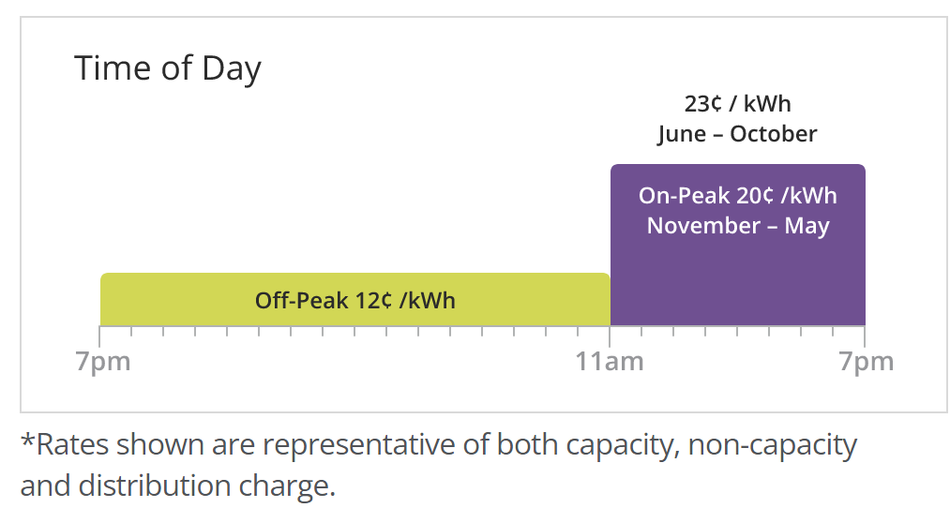
METHODOLOGIES
Other cities (WIP)
Multiple U.S. Cities:
Different climate areas
400 representative buildings in each city (Deetjen et al, 2021)
TES Model
Detroit
Fixed Rate:
$0.183/kWh

Slide 8
TES MATERIALS CONSIDERED

Slide 9
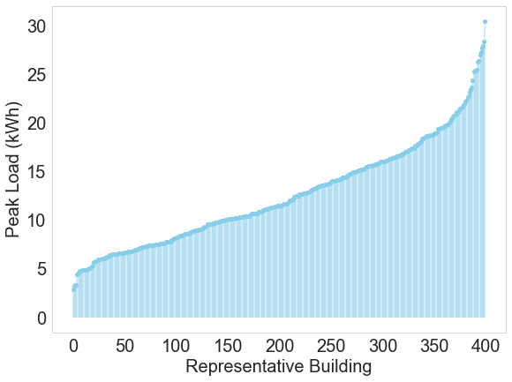
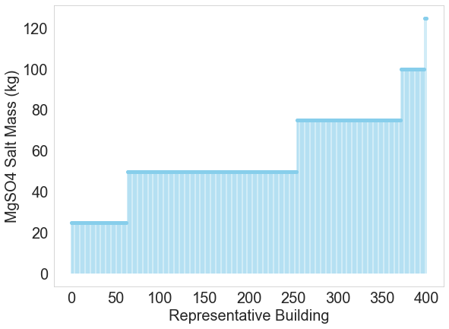
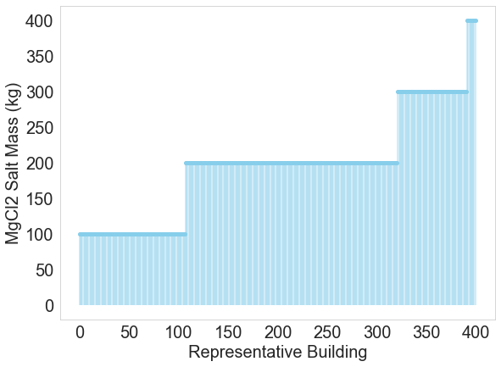
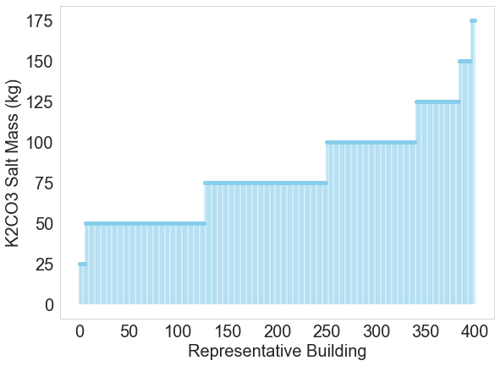
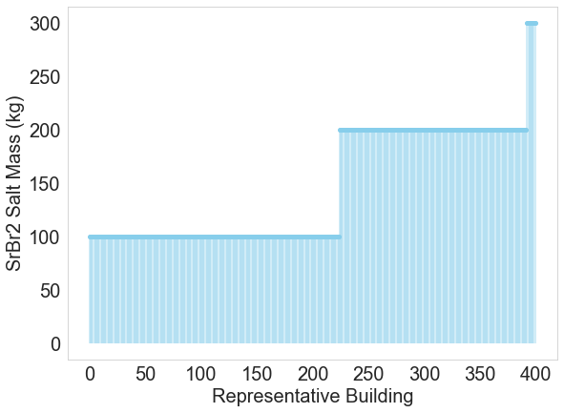
TES SIZING
TES is sized based on peak load
25 kg or 100 kg increment

Slide 10
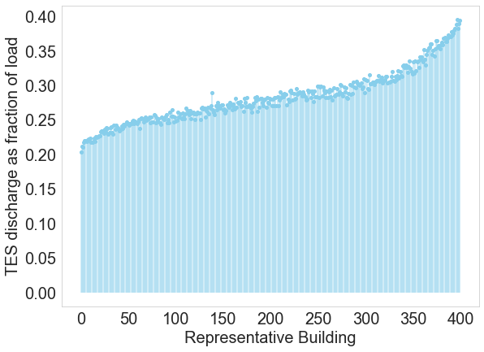
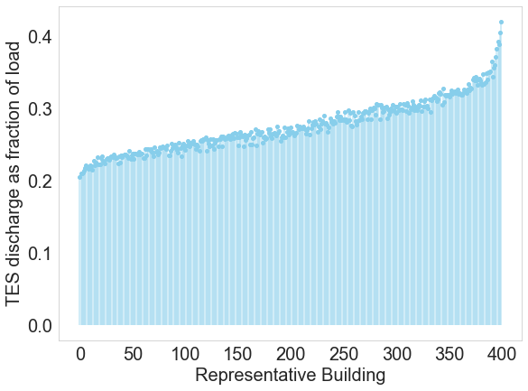
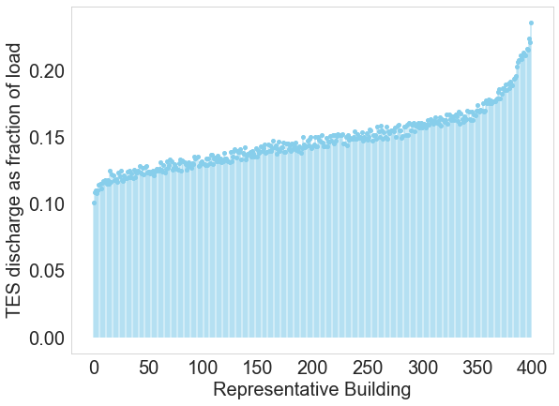
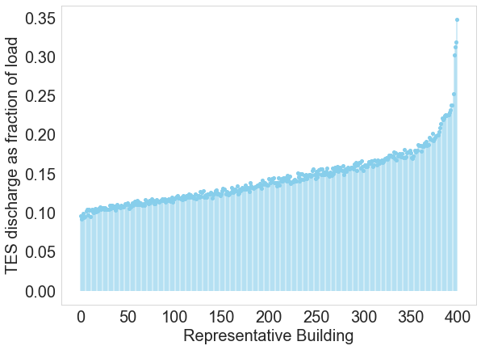
TES CAN SERVE UP TO BETWEEN 24% and 39% OF SPACE HEATING LOAD IN INDIVIDUAL BUILDINGS
MgSO4
20% to 39% of load annually.
MgCl2
20.5% to 42% of load annually.
K2CO3
10.1% to 24% of load annually.
SrBr2
9.6% to 34.8% of load annually.

Slide 11
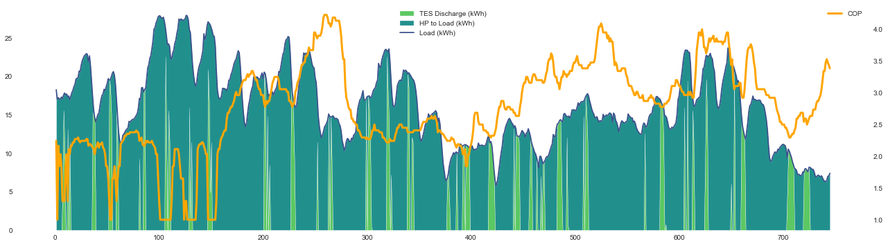
TES DISCHARGES WHEN COP DECLINES (OUTDOOR TEMP FALLS)
Building 5 (High Load Building) in January – TES Material: MgSO4

Slide 12
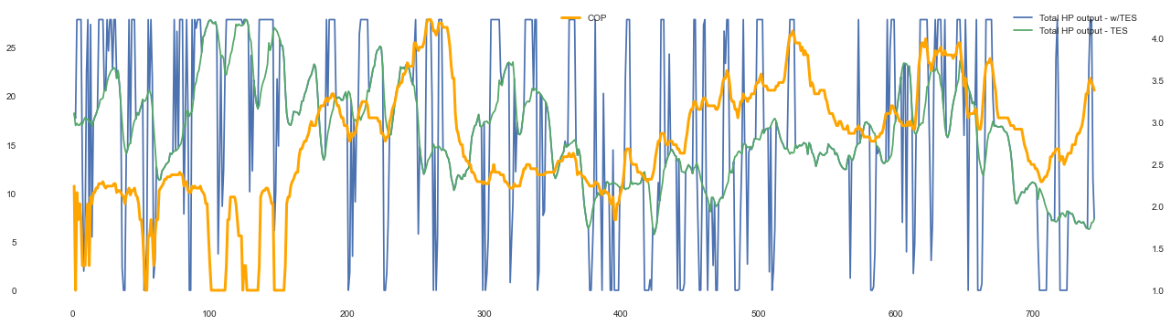
TES CHARGES (HEAT PUMP INCREASES OUTPUT) WHEN COP IS HIGH OR IS INCREASING
Building 5 (High Load Building) in January – TES Material: MgSO4

Slide 13

TES CHARGING AND DISCHARGING BEHAVIORS VARY WITH DIFFERENT SALTS
Salts with lower specific energy (K2CO3) relative to specific power require more salt mass to draw out the same kWh of energy.
Less TES discharge
MgSO4
K2CO3
Notes:
MgSO4 results in a lot more TES discharge
Even though K2CO3 salt mass is higher
K2CO3 has lower specific energy so it takes more salt to draw out the same kWh
MgSO4 has much higher specific energy (0.75 kWh/kg vs K2CO3’s 0.18 kWh/kg)
K2CO3 has higher specific power
MgSO4 salt mass is decided by power requirements
K2CO3 salt mass is decided by energy requirements

Slide 14
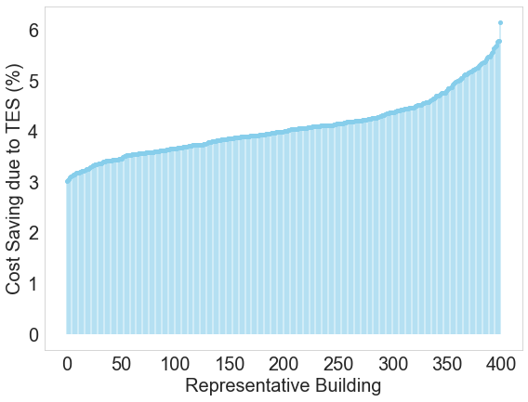
COST SAVINGS DUE TO TES USING FIXED RATE
Using MgSO4 as TES salt
Cost saving ranges from 3% annually to 6.1% in individual homes
Total annual cost saving for Detroit is $230 million (or 4%)

Slide 15
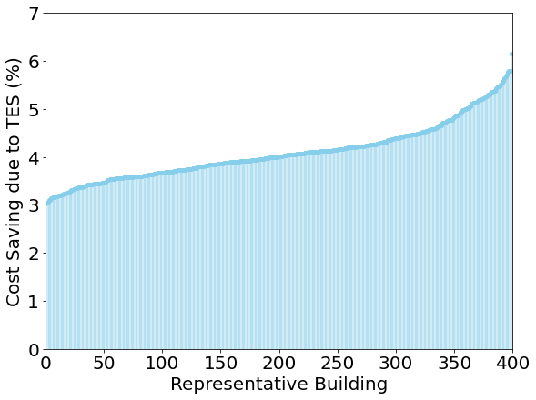
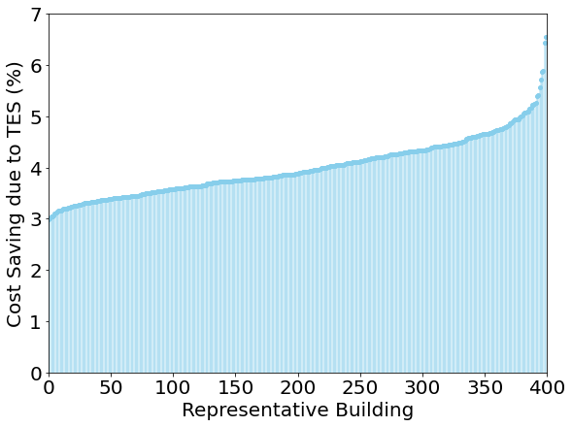
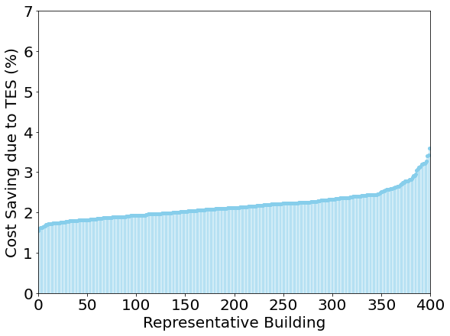
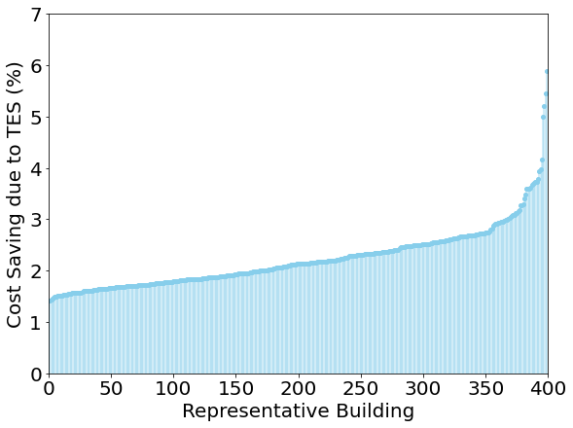
ANNUAL COST SAVINGS DUE TO TES BETWEEN $122M to $230M ACROSS SALTS
MgCl2
3% to 6.5% annually
$226 million (or 4%)
Max size: 400 kg
MgSO4
3% to 6.1% annually
$230 million (or 4%)
Max size: 120 kg
K2CO3
1.5% to 3.6% annually
$122 million (or 2.1%)
Max size: 175 kg
SrBr2
1.4% to 5.9% annually
$121 million (or 2.1%)
Max size: 300 kg

Slide 16
COST SAVINGS DUE TO TES INCREASES SIGNIFICANTLY WHEN USING TIME OF USE RATE
Using MgSO4 as TES salt
Cost saving ranges from 3% annually to 6.1% in individual homes
Total annual cost saving for Detroit is $230 million (or 4%)

Slide 17
APPLYING TIME OF USE RATE CHANGES TES OPERATIONAL BEHAVIORS

Slide 18
TES CAN REDUCE UP TO 26% OF PEAK LOAD IN INDIVIDUAL BUILDING

Slide 19
CONCLUSION
TES can reduce annual space heating cost
between 3.5% to 7% with fixed rate
Between 13.4% to 19.7% with time of use rate
TES can reduce peak load between 13-26% at the same cost as just using heat pumps
TES operations depend on types of TES materials, designs, and sizes.

Slide 20
NEXT STEPS
Quantify TES values in other US. Cities.
Quantify TES values with more TES designs besides TES materials
Emission impacts

Slide 21
THANK YOU!
Questions?
Contact: anph@umich.edu

