Slide 1


ASSESSING THE VALUE OF THERMAL ENERGY STORAGE COUPLED WITH HEAT PUMPS FOR RESIDENTIAL SPACE HEATING IN U.S. CITIES
Notes:
Introduce
Slide numbers
Subscript CO2 and other chemical

Slide 2
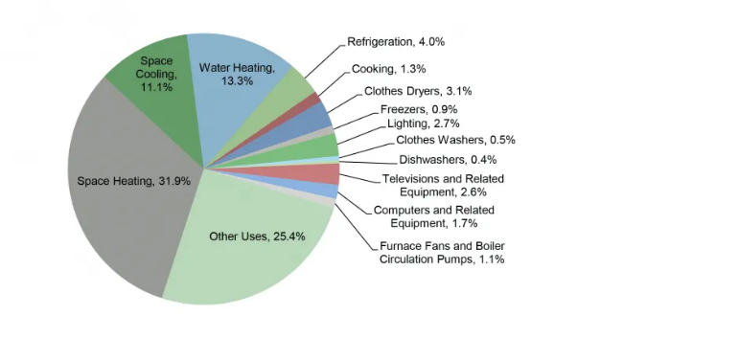
INTRODUCTION
Decarbonization of the residential sector is imperative to global decarbonization efforts
17% of global energy sector’s CO₂ emission
Residential sector is 22% of U.S. primary energy consumption

Slide 3
INTRODUCTION
In the near- and long-run, space heating will continue to be electrified
One of the most common ways is via air-source heat pump (ASHP)
Thermal energy storage (TES) can enhance ASHP’s efficiency during cold climates/periods
Notes:
Simplify this slide. Write out or skip COP
ASHP has COP greater than 1.0, indicating higher efficiency rates than traditional heating devices
However, ASHP can be inefficient in colder climate areas during cold periods

Slide 4
INTRODUCTION
Literature exploring different heat pump-TES designs in experimental and actual systems is abundant
Do not offer insights into the effectiveness of different TES materials and designs
Ignore actual building characteristics that might effect heating loads.
Studies that explore the performance and economic analysis of different TES materials and designs are rare
All focus on grid-scale TES storage materials and characteristics that are not suitable to be applied to building applications
Notes:
Why don’t they offer insights into efficacy of different TES materials & designs? Will need to flesh this out a bit more.
In these papers with heat pump-TES system applied to simulated buildings or one single actual building all consider water tank for TES.
Engineering papers considering different characteristics of TES salt but do not study how they perform in buildings.
One thing missing here I think is the reason for choice of salt hydrates as TES and the specific 4 salts we use
Simplify these

Slide 5
RESEARCH QUESTION
What are the relationships between various TES system design parameters and their impacts on total system cost and energy consumption for space heating in U.S. residential buildings?

Slide 6
METHODS
Function of outdoor temps (Waite and Modi, 2020)
TES Model:
Optimization Model for space heating in residential buildings:
Minimizes Operational System Cost
Inputs:
COPs
Heating load (NREL’s Resstock)
TES roundtrip efficiency
TES energy capacity (storage size)
Heat pump capacity
TES power rating as function of SOC
Optimizes:
Hourly heat pump’s output to load
Hourly heat pump’s output to TES
Hourly TES discharging
Hourly TES charging
Hourly TES SOC
Hourly TES power rating
Economic values of TES

Slide 7
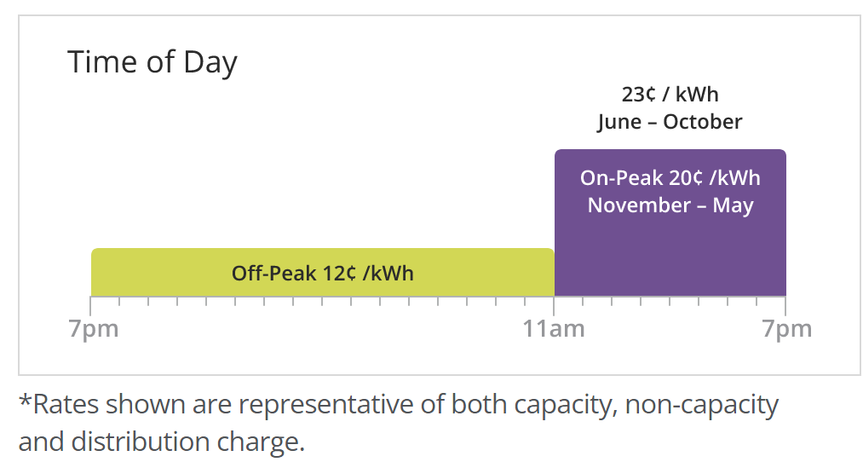
METHODS
Other cities (WIP)
Multiple U.S. Cities:
Different climate areas
400 representative buildings in each city (Deetjen et al, 2021)
TES Model
Detroit
Fixed Rate:
$0.183/kWh

Slide 8
TES MATERIALS CONSIDERED
Notes:
Say it out loud
Why pick these salts

Slide 9
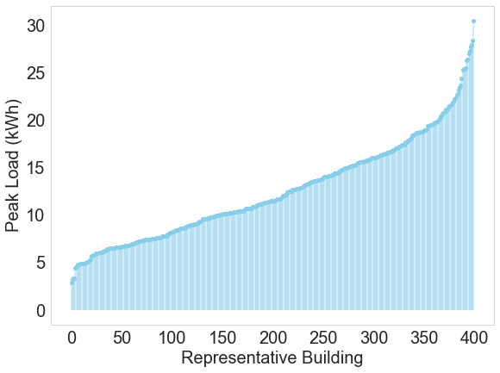
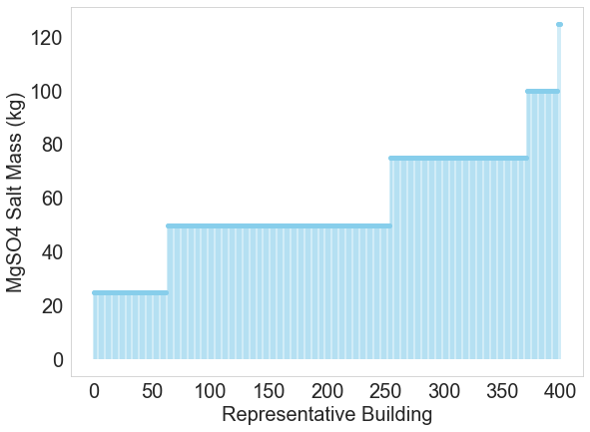
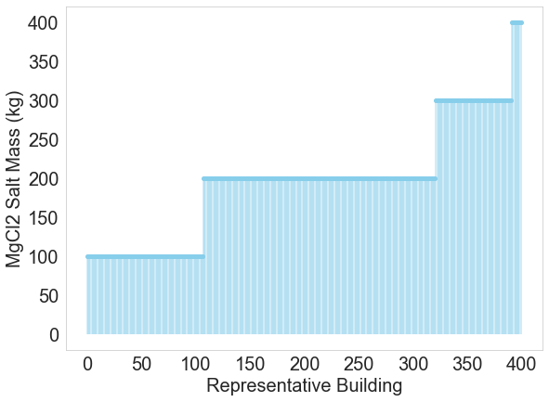
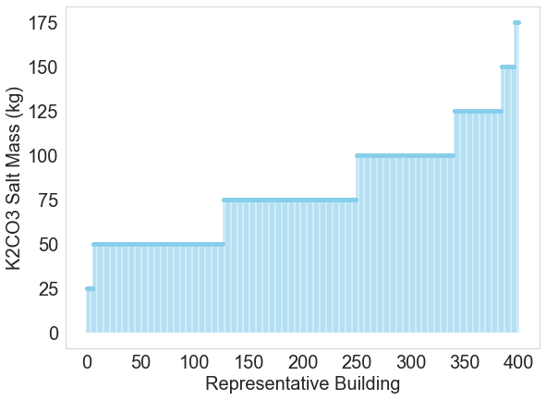
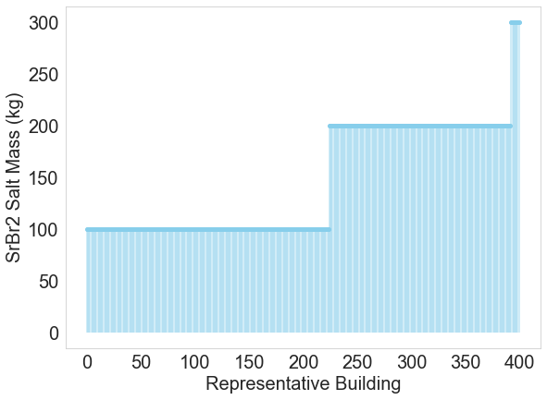
TES SIZING
TES is sized based on peak load
25 kg or 100 kg increment

Slide 10
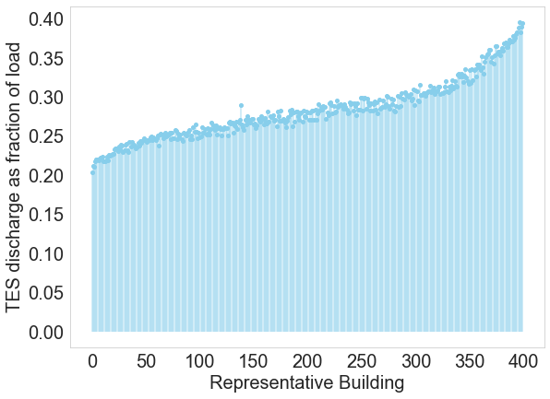
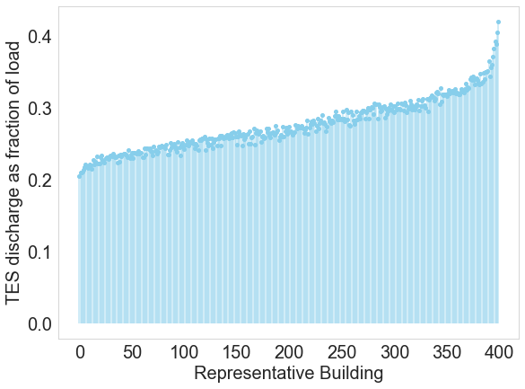
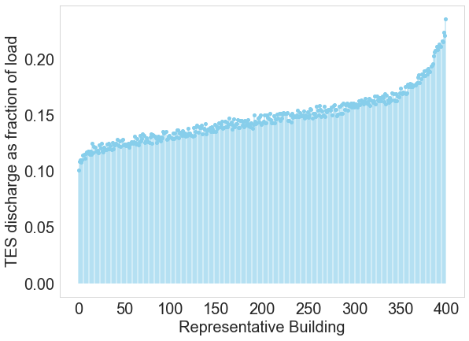
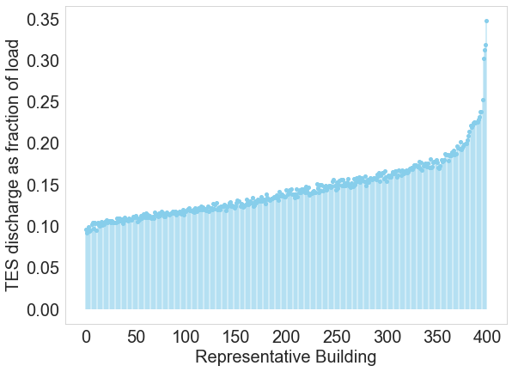
TES CAN SERVE UP TO 24% TO 42% OF ANNUAL SPACE HEATING LOAD IN AN INDIVIDUAL BUILDING
MgSO4
20% to 39% of load annually.
MgCl2
21% to 42% of load annually.
K2CO3
10% to 24% of load annually.
SrBr2
10% to 35% of load annually.
Notes:
Annual HEATING load I think you mean?

Slide 11
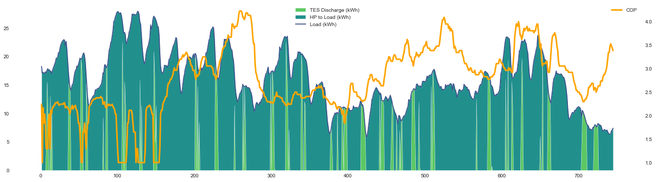
TES DISCHARGES WHEN COP DECLINES (OUTDOOR TEMP FALLS)
kWh
hours
Building 5 (High Load Building) in January – TES Material: MgSO4
Notes:
Show charging
TES only transfers load not serves load
Emphasize on PCM
Resstock is also modeled buildings
Axis label
Explain labels figure first

Slide 12
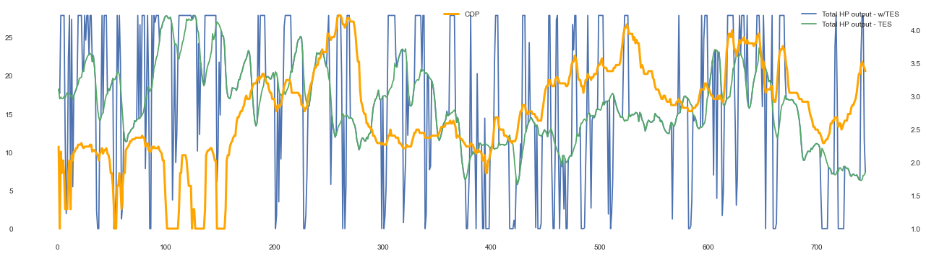
TES CHARGES (HEAT PUMP INCREASES OUTPUT) WHEN COP IS HIGH OR IS INCREASING
kWh
Building 5 (High Load Building) in January – TES Material: MgSO4

Slide 13

TES CHARGING AND DISCHARGING BEHAVIORS VARY WITH DIFFERENT SALTS
Salts with lower specific energy (K2CO3) relative to specific power require more salt mass to draw out the same kWh of energy.
Less TES discharge
MgSO4
kWh
hours
K2CO3
kWh
hours
Notes:
MgSO4 results in a lot more TES discharge
Even though K2CO3 salt mass is higher
K2CO3 has lower specific energy so it takes more salt to draw out the same kWh
MgSO4 has much higher specific energy (0.75 kWh/kg vs K2CO3’s 0.18 kWh/kg)
K2CO3 has higher specific power
MgSO4 salt mass is decided by power requirements
K2CO3 salt mass is decided by energy requirements

Slide 14
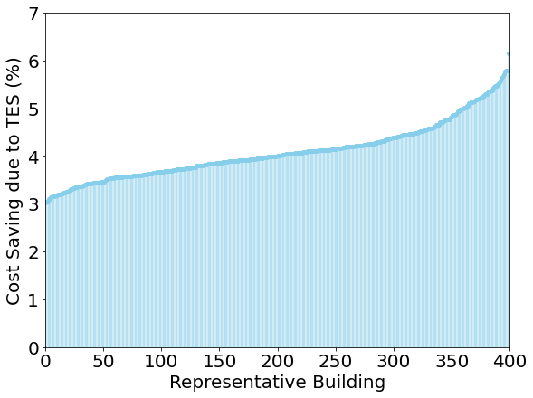
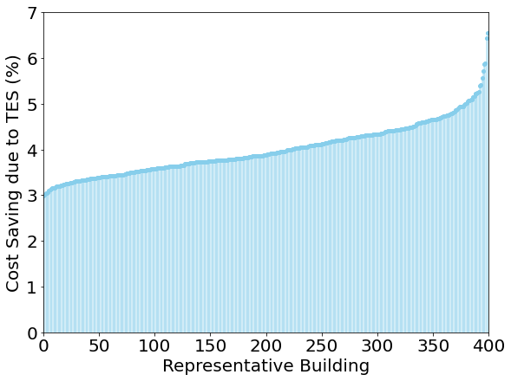
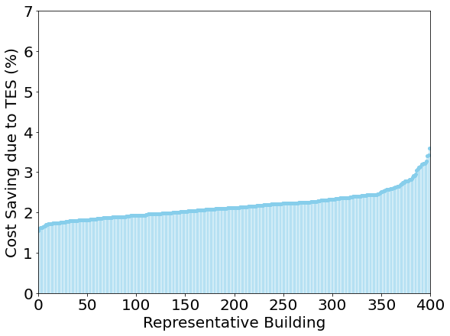
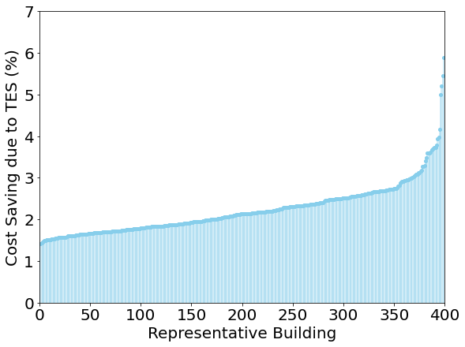
ANNUAL COST SAVINGS DUE TO TES BETWEEN $122M to $230M ACROSS SALTS (UP TO 4% SAVING)
MgCl2
3% to 7% annually
$226 million (or 4%)
Max size: 400 kg
MgSO4
3% to 6% annually
$230 million (or 4%)
Max size: 120 kg
K2CO3
2% to 4% annually
$122 million (or 2%)
Max size: 175 kg
SrBr2
1.4% to 6% annually
$121 million (or 2%)
Max size: 300 kg

Slide 15
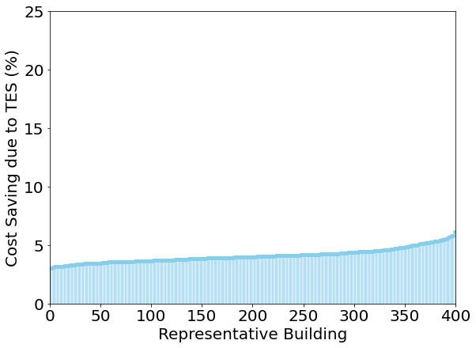
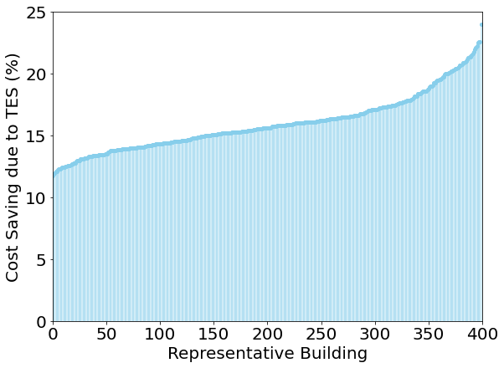
COST SAVINGS DUE TO TES INCREASES SIGNIFICANTLY WHEN USING TIME OF USE (TOU) RATE
Fixed Rate
Time of Use Rate
MgSO4 as TES salt, Detroit
Annual cost saving increases from 4% - 7% with fixed rate to 13% - 24% with TOU rate
Notes:
Give point of comparison from flat rates somewhere on this slide (or show graphs side by side)
Fixed y axis

Slide 16
APPLYING TIME OF USE RATE CHANGES TES OPERATIONAL BEHAVIORS
kWh
hours
kWh
hours
Notes:
How does it change?
I will just say it >> Applying TOU results in TES being discharged when rate is high or when COP is really inefficient. While with fixed rate, TES discharges completely based on COP, which depends on outdoor temperature

Slide 17
TES CAN REDUCE UP TO 26% OF PEAK LOAD IN INDIVIDUAL BUILDING
kWh
hours
kWh
hours

Slide 18
CONCLUSION
TES can reduce annual space heating cost in buildings
Up to 7% with fixed rate
Up to 24% with TOU rate
TES can reduce peak load between 13%-26% at the same cost as just using heat pumps
TES operations depend on types of TES materials, designs, and sizes.

Slide 19
NEXT STEPS
Quantify TES values in other US. Cities.
Quantify TES values with more TES designs besides TES materials
Emission impacts

Slide 20
ACKNOWLEDGEMENT
Collaborators from ME:
Rohini Chandran
Bryan Kinzer
Questions?
Contact: anph@umich.edu
Inputs and Feedback from:
Parth Vaishnav
Claire McKenna
Pamela Wildstein

