Slide 1
Timeless Navigators

Slide 2
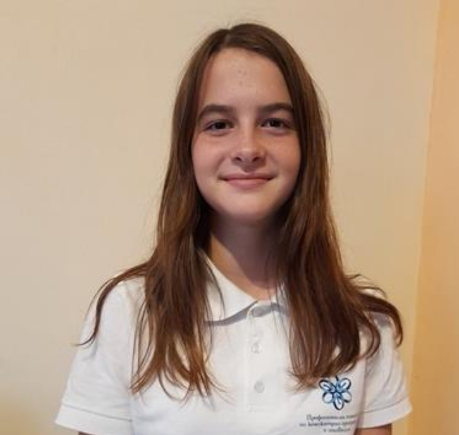
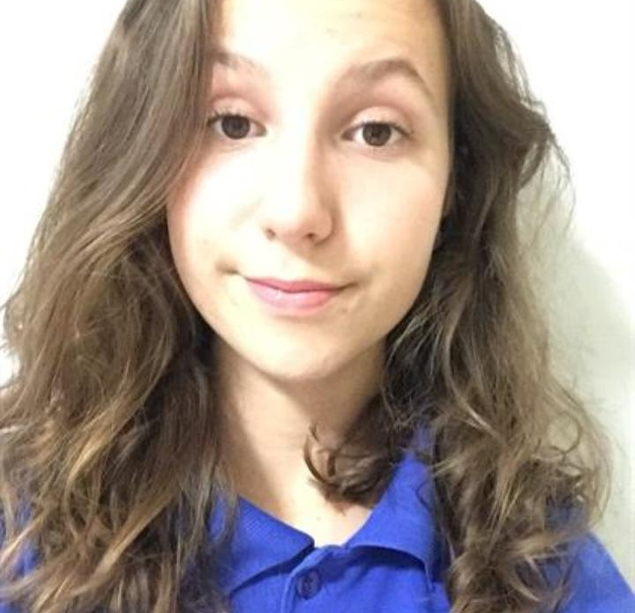
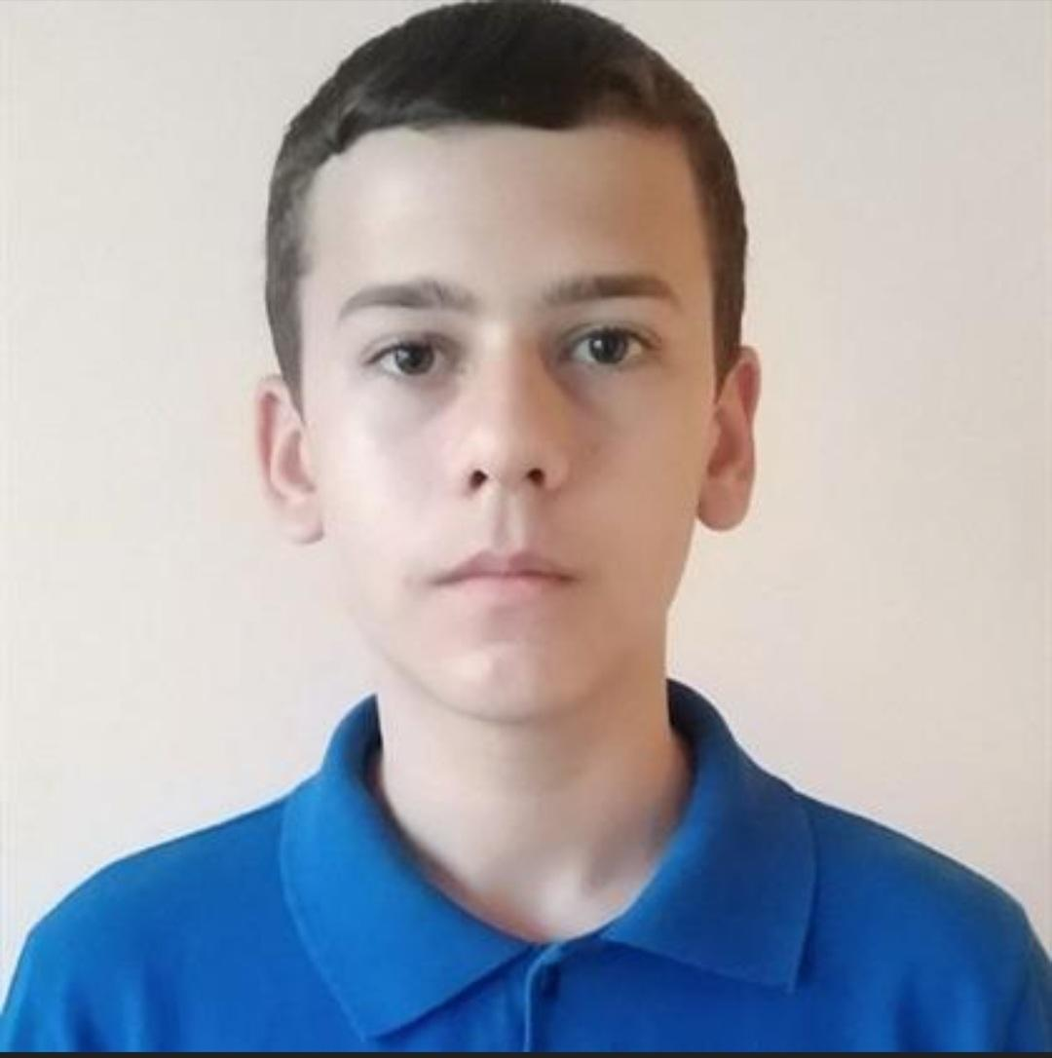
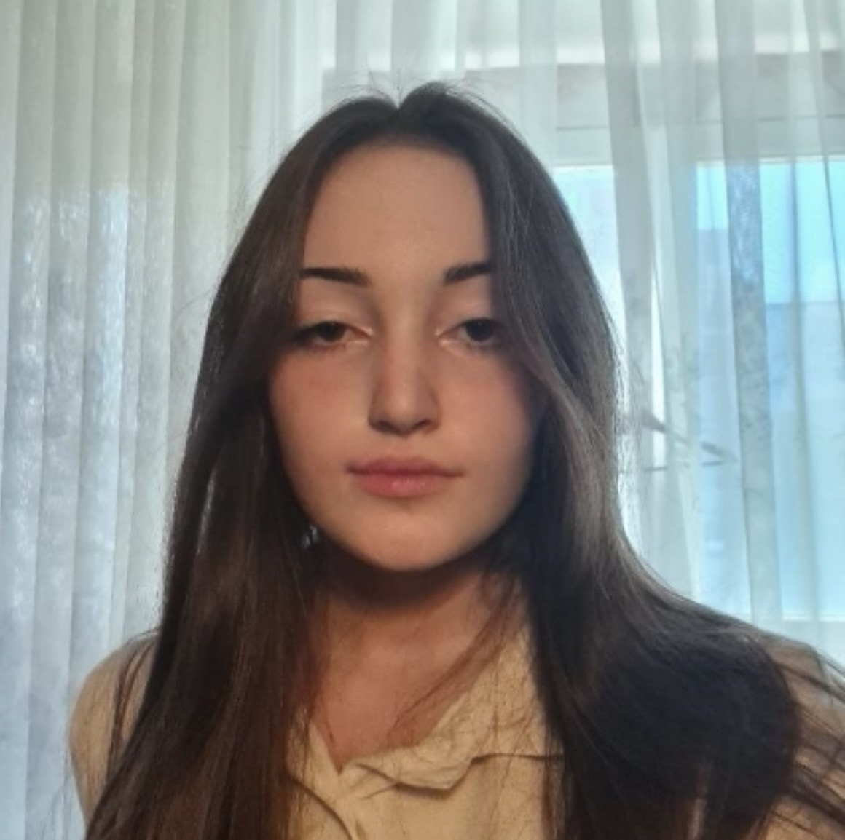
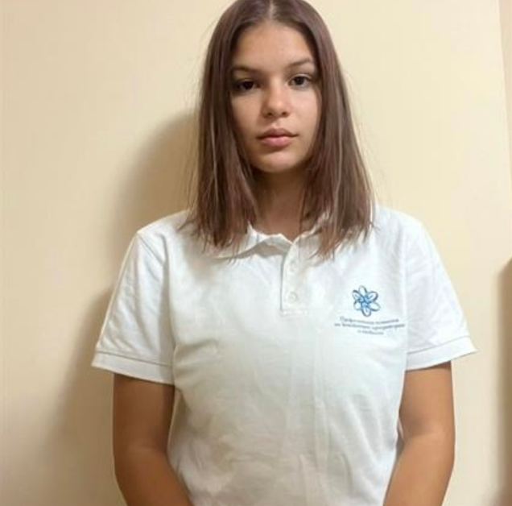
Stela Georgieva
Alexandra Zheleva
Alexander Popov
Nikoleta Ruseva
Scrum trainer
Frontend developer
Backend developer
Polina Dineva
Backend developer
Backend developer

Slide 3
Stages of creation
02
03
01
04
We assigned roles
We came up with a name
We chose the theme of the app
05
06
We made the app
We made a presentation and documentation
We practiced our presentation

Slide 4


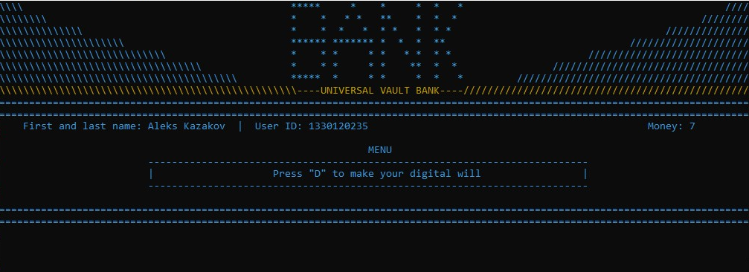
The app

Slide 5









Technologies used

Slide 6
Let's get to the game

