Slide 1
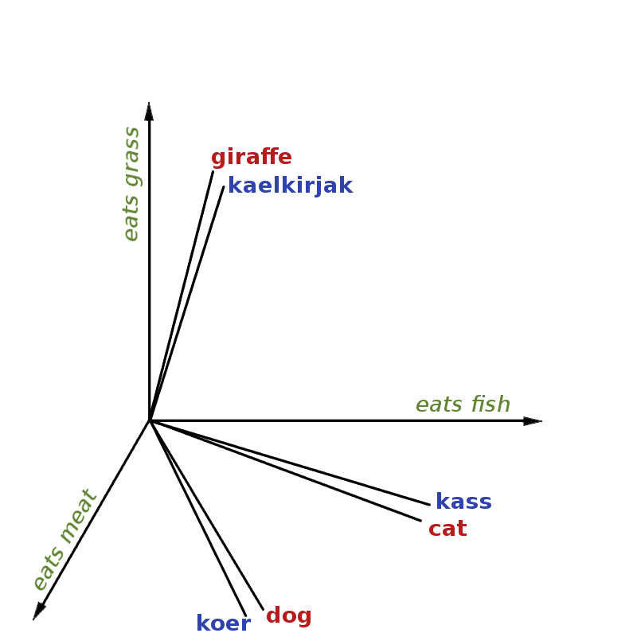
Recursive Deep Models For Semantic Compositionality Over a Sentiment Treebank
Gleb Alexeev

Slide 2
Important Definitions
Semantic Word Space
Aim to capture meaning in a phrase or text by providing representations of natural language. [1]
Semantic Compositionality
The principle that the meaning of a (syntactically complex) whole is a function only of the meanings of its (syntactic) parts together with the manner in which these parts were combined. [2] In other words, describing a function using it’s parts and the operations between them. For example, to describe f(x,y,z), we set it equal to the operations based on its parts: f(x,y,z) = y(x + z)/(x-y) + xyz (simple example)

Slide 3
Introduction
Problems with meaning captured in longer phrase representation through semantic vector spaces used as features.
Semantic Compositionality receiving a lot of attention, but likewise held back by absence of labeled data.
Point of the paper:
Provide a new corpus, The Stanford Sentiment Treebank
Provide a powerful and accurate model using Recursive Neural Tensor Networks
Compare between other models on different aspects to the corpus

Slide 4
Stanford Sentiment Treebank
Corpus based on dataset introduced by Pang and Lee (2005) and consists of 11,855 single sentences extracted from movie reviews. [3]
215,154 unique phrases, each annotated by 3 human judges.
https://nlp.stanford.edu/sentiment/treebank.html
There are other treebanks available, but not enough on short comments like Twitter. (less overall signal per document)

Slide 5
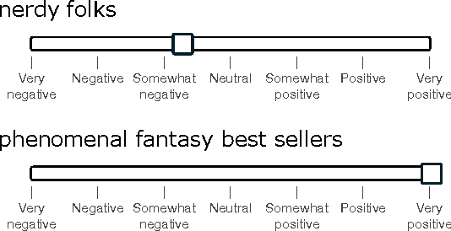
Stanford Sentiment TreeBank cont’d
Bag of Words
Works well with strong sentiments, but still on average has achieved 80% accuracy for binary classification problems
60% with multiclass.
Ignoring word order is not plausible, especially in the case of negation, and Stanford sentiment deals with that, by providing an n-gram model.
Used Amazon Mechanical Turk (interface) to label 215,154 phrases and n-grams taken from rottentomatoes.com corpus, which was basically a slider:

Slide 6
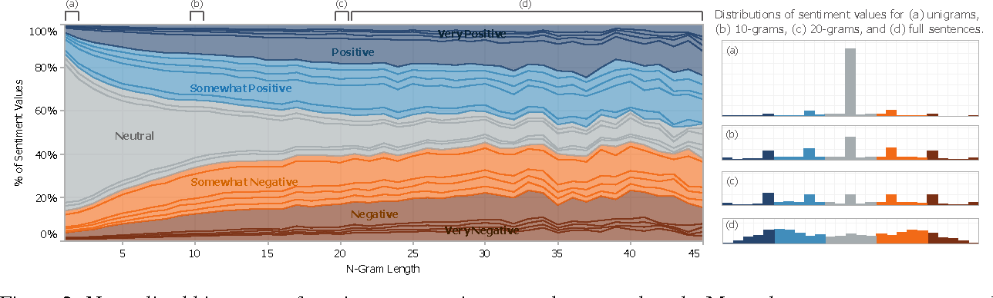
Stanford Sentiment TreeBank cont’d
Observations:
Reader’s perception is that many of the sentences could be neutral
Stronger sentiment builds up in longer phrases, and the majority of shorter phrases are neutral
Most annotators moved the slider to one of 5 options: negative, somewhat negative, neutral, somewhat positive, and positive
This forms a 5 class classification capturing most of the variance within the labels. (named fine-grained sentiment classification).
The main point of the experiment was to recover these 5 labels for phrases of all lengths.

Slide 7
Recursive Neural Models
Parse a given n-gram into a binary tree and represent each word (corresponding to leaves in the tree) using a d-dimensional vector.
Compute parent vectors using a bottom-up approach using different composition functions.
To start with, word vectors are initialized randomly from a uniform distribution.
For classification task, use the compositions word vectors as input for the softmax.
Different models differ in terms of how word vectors are combined together as shown in the figure.

Slide 8
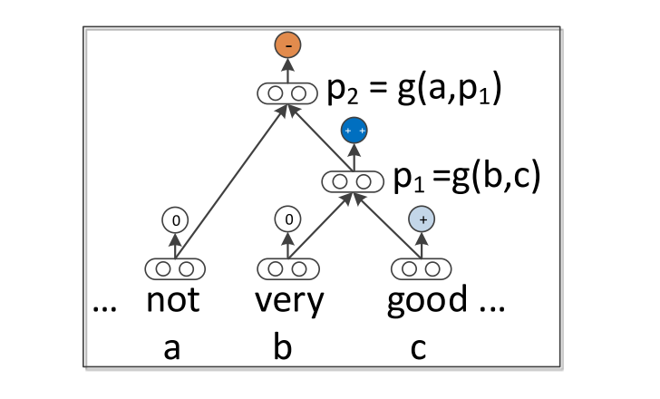

Slide 9
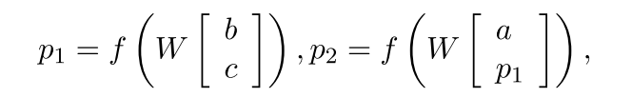
RNN
Neural Network
Words represented as d-dimensional vectors, used to optimize parameters
Compute posterior via softmax
RNN
Model uses parent and child vector inter-relations
f = tanh
W is the weight matrix to be learnt.

Slide 10
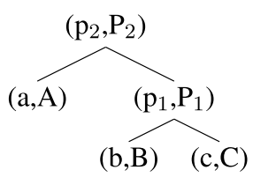
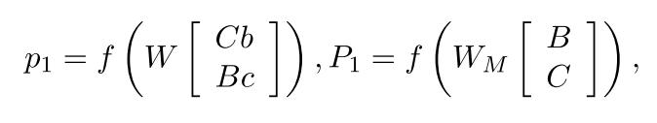
MV-RNN: Matrix-Vector RNN
Main idea
Represent every word and phrase as both a vector and a matrix.
Matrix for each word is initialized as identity matrix plus a small Gaussian noise.
Example parse tree, with example equation used:
Disadvantage:
Number of parameters of MV-RNN becomes extremely large for even slightly larger relations (as each word is represented as a dxd matrix)

Slide 11
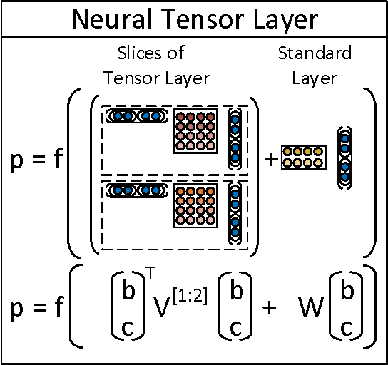
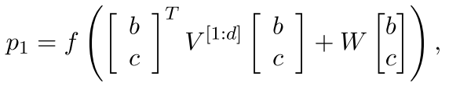
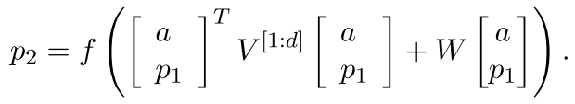
RNTN: Recursive Neural tensor network
Asks the question: can a single composition function form and compose better aggregate meaning from smaller constituents more accurately than many input specific ones?
The answer is yes, thanks RNTN!
Picture shows as single layer of the recursive neural tensor network. Each dashed box represents one of d-many slices and can capture a type of influence a child can have on its parent.
V is the tensor that defines multiple bilinear forms.
Each slice of the tensor V can be interpreted as capturing a specific type of composition

Slide 12
Experiments
Fine-grained Sentiment For All Phrases
Full Sentence Binary Sentiment
Contrastive Conjunction
Sentences of the form X but Y
High Level Negation
Negating Positive Sentences
Negating Negative Sentences

Slide 13
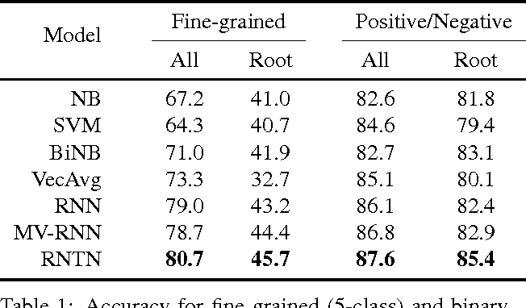
Results
Models compared with
Naive Bayes - NB
SVMs
Naive Bayes with bag of bigram features - biNB
Average neural word vectors (ignoring word order) – vecAvg
RNTN outperforms other models in special cases like where a positive sentence is negated or where a negative sentence is negated to make it less negative (not positive though). This suggests that RNTN could capture the effect of negative words in both positive and negative sentiment sentences.

Slide 14
Bibliography
[1] Baroni, Marco; Lenci, Alessandro. "Distributional Memory: A General Framework for Corpus-Based Semantics". Computational Linguistics. 36 (4): 673–721. doi:10.1162/coli_a_00016.
[2] Pelletier, F.J. Topoi (1994) 13: 11. https://doi.org/10.1007/BF00763644
[3] http://www.cs.cornell.edu/people/pabo/movie-review-data/
[4] The paper itself (see syllabus, but here’s the link anyway) https://nlp.stanford.edu/~socherr/EMNLP2013_RNTN.pdf

