Slide 1


Music Genre and Feature Classification Using ML and NLP Techniques via Visual, Audio, and Linguistic Analysis
Gleb Alexeev

Slide 2
Introduction
Audio is a very big part of NLP, and something that’s a growing industry.
Decided to focus on music as lots of interesting work there, but also can be applied to Speech recognition, beat recognition, emphasis, etc.
Previous Work
https://github.com/jazdev/genreXpose
“proof of concept”
http://cs229.stanford.edu/proj2011/HaggbladeHongKao-MusicGenreClassification.pdf
Neural Networks and other algorithms
https://arxiv.org/pdf/1612.01840.pdf
FMA
A lot of previous work has been done on music classification, but not many NN approaches

Slide 3
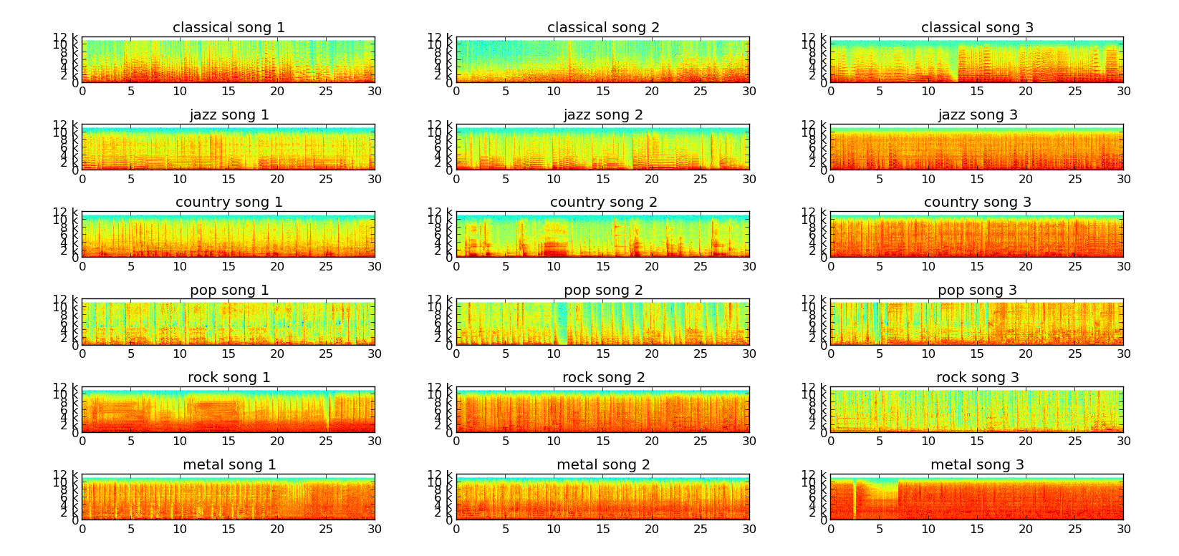
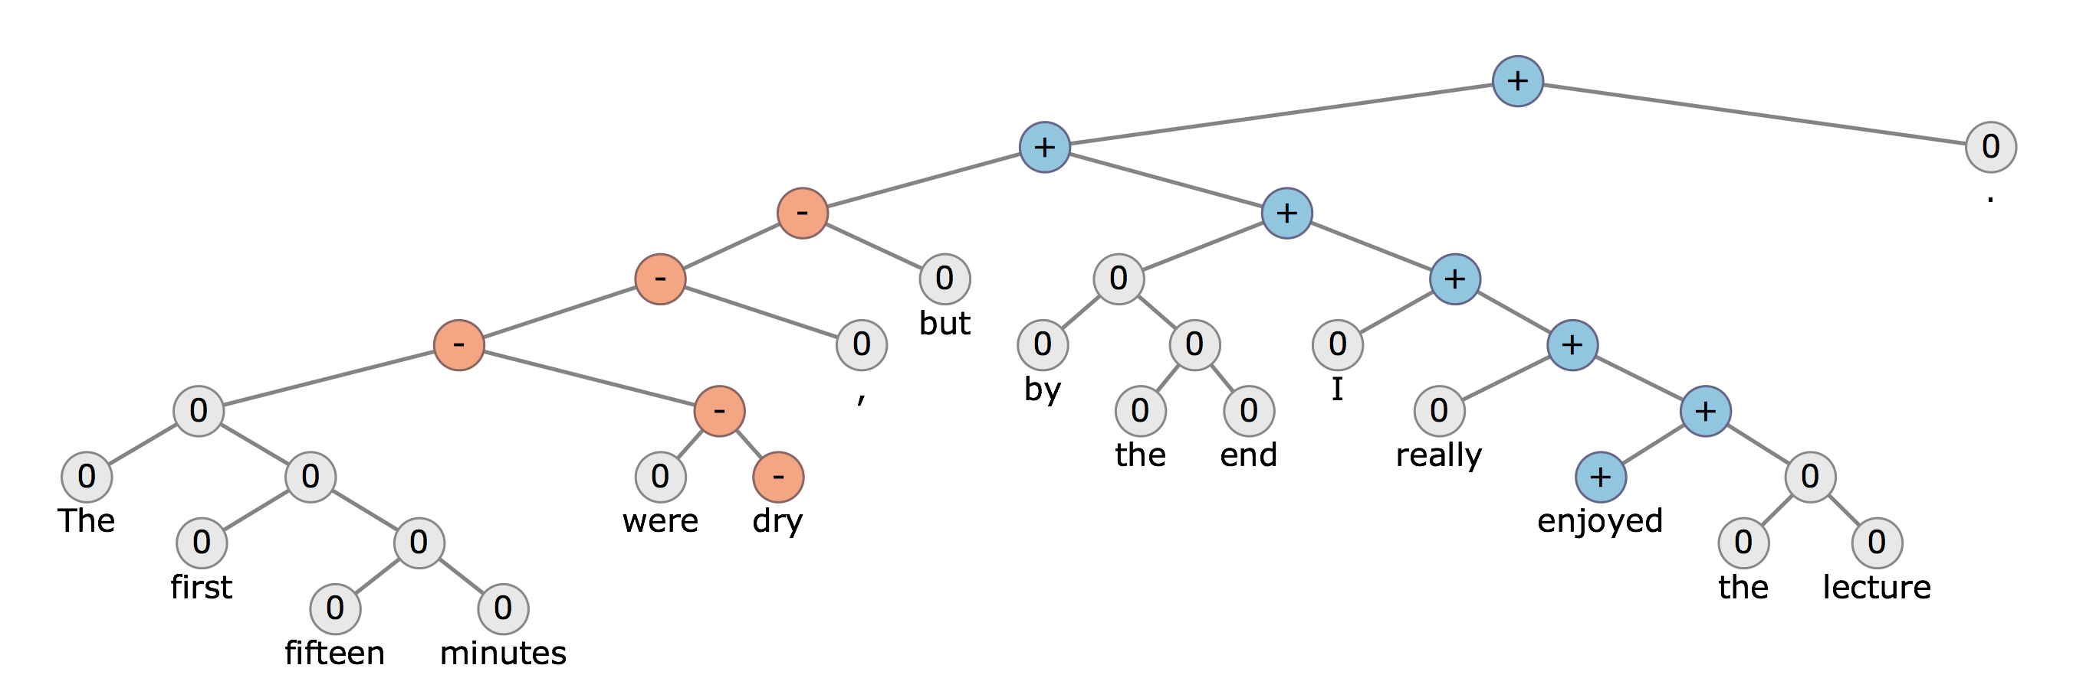
Background
Dataset
Audio
Fourier Transforms
MFCC
Image Classification
Linguistics Approach
Features

Slide 4
Dataset
FMA
8,000 tracks of 30s, 8 balanced genres (GTZAN-like)
per track metadata such as ID, title, artist, genres, tags
common features extracted with librosa.
Script to pull lyrics for each song snippet (classifying the whole song)

Slide 5
Audio
Fourier Transform
Transform from time domain to frequency domain
Spectral analysis
Mel-frequency cepstral coefficients (MFCC)
Encodes the power spectrum of a sound.
Calculated as the Fourier transform of the logarithm of the signal's spectrum.
Lower range focus, great for audio analysis in speech recognition
Features to be extracted via scikit.learn, scipy, librosa, opensmile:)
Use logistic regression for starters to classify between the 8 states, then use RNN
http://www.cs.colorado.edu/~mozer/Research/Selected%20Publications/reprints/Mozer1994.pdf
https://www-cs.stanford.edu/people/anusha/static/deepplaylist.pdf
Beat Classification

Slide 6
Image Classification
Write script to download google image files for each of the 8000 songs (either album or song, using name).
Less interesting
Use Spectogram images and pass into a CRNN.
http://deepsound.io/music_genre_recognition.html
Would be interesting to see difference between FFT and MFCC

Slide 7
Linguistics Approach
Download lyrics of each song (if existent)
word2vec model
Classify via CRNN
Features
Year
Artist
Title
Lyrics
Apply NLP to words

Slide 8
Evaluation
Compare to state of the art music classification via deep ML
Difference in that it is not a single classification of the entirety of the file, but rather a continuous output containing the network’s belief of the genre in every point of time.
Expected higher error
classifications:
Beat classification (continuous, then split as either “fast/slow”)
Genre classification (discrete)
Potentially Year classification (discrete)
Template based Natural Language generation

Slide 9
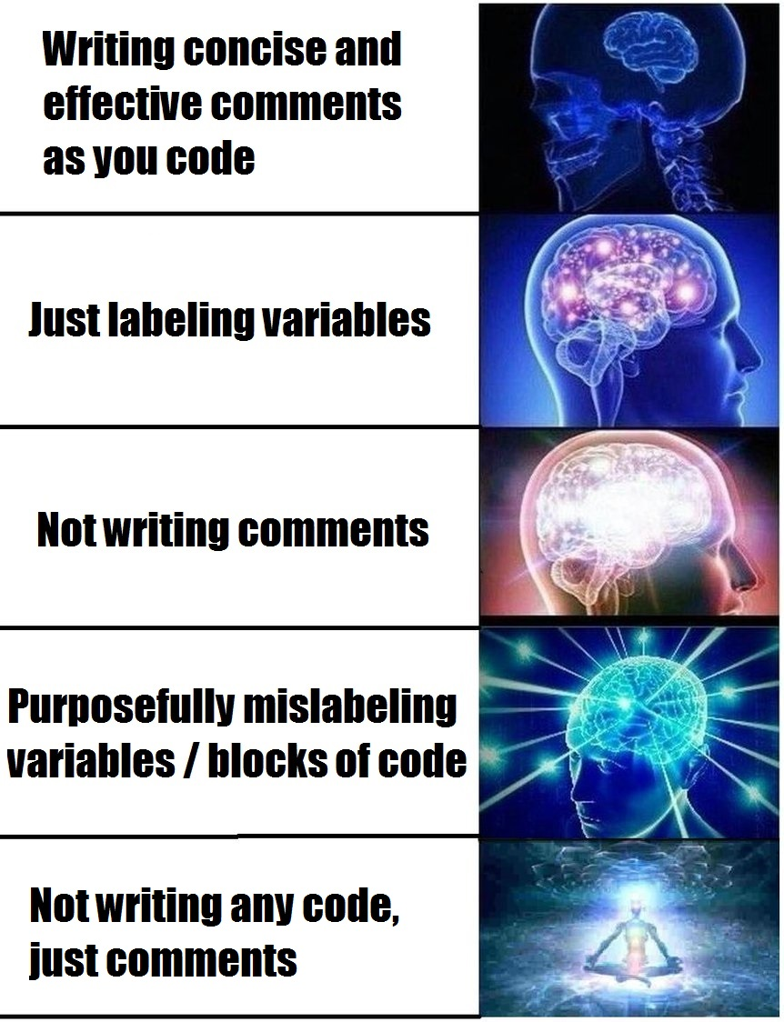
Questions? Recommendations?

