Slide 1

FP-Growth
Notes:
It is using the background from https://dribbble.com/shots/1588545--Freebie-7-Low-Poly-Backgrounds-svg-png
Template modified by fppt.com

Slide 2
Frequent Pattern Growth(FP-Growth)
Algorithm FP-Growth is an association algorithm in data mining algorithm used for extracting frequent patterns from a large dataset. It is considered one of the popular algorithms ,it relies on encoding the data into a data structure called FP-Tree (short for "Frequent Pattern Tree"), the FP-Tree consists of a set of nodes (patterns) linked to each other. The algorithm builds the FP-Tree based on the frequency of patterns occurring in the data, was developed to overcome some limitations faced by other algorithms like Apriori in data analysis.
Notes:
It is using the background from https://dribbble.com/shots/1588545--Freebie-7-Low-Poly-Backgrounds-svg-png
Template modified by fppt.com

Slide 3
Frequent Pattern Growth(FP-Growth)
It is used in various fields such as e-commerce analysis, pattern discovery in databases, time series analysis, machine learning, and other applications that require extracting frequent patterns from data.
Notes:
It is using the background from https://dribbble.com/shots/1588545--Freebie-7-Low-Poly-Backgrounds-svg-png
Template modified by fppt.com

Slide 4
main Phase:
The FP-Growth algorithm relies on four main Phase :
1- Encoding Phase:
- The data is represented in the form of a matrix composed of lists. Each list represents a row in the dataset and contains the items present in that row.
- The frequency of each item in the data is calculated, the number of times it appears in the dataset.
- The items are sorted according to their frequency in descending order. This sorting is used to efficiently identify frequent patterns.
Notes:
It is using the background from https://dribbble.com/shots/1588545--Freebie-7-Low-Poly-Backgrounds-svg-png
Template modified by fppt.com

Slide 5
Main Phase:
2. FP-Tree Construction Phase:
- The FP-Tree data structure is built using the sorted items according
to their frequency.
- This process is repeated for all the data to build the complete FP-
Tree.
- It consists of a root node (the main node) and subsidiary nodes
representing different items in the data.
Notes:
It is using the background from https://dribbble.com/shots/1588545--Freebie-7-Low-Poly-Backgrounds-svg-png
Template modified by fppt.com

Slide 6
Main Phase:
3. Pattern Extraction Phase:
- Frequent patterns are extracted from the FP-Tree.
- This is done by performing a backward traversal (backtracking) from
the last node in the FP-Tree towards the root node.
- It starts with individual patterns and then builds the most frequent
patterns based on their frequency in the FP-Tree.
- This process is repeated to obtain all frequent patterns.
Notes:
It is using the background from https://dribbble.com/shots/1588545--Freebie-7-Low-Poly-Backgrounds-svg-png
Template modified by fppt.com

Slide 7
Main Phase:
4. Pruning Phase:
- The support for each frequent pattern is calculated, which is the
ratio of the number of times the pattern appears in the dataset to the
total dataset size.
- it using one or more techniques such as minimum support or
minimum confidence.
Notes:
It is using the background from https://dribbble.com/shots/1588545--Freebie-7-Low-Poly-Backgrounds-svg-png
Template modified by fppt.com

Slide 8
Advantages of FP-Growth
1. Ability to handle large datasets: Due to its high efficiency, the FP-Growth algorithm can handle large datasets efficiently.
2. Support for multiple-item patterns: The FP-Growth algorithm supports the extraction of frequent patterns that contain a set of items rather than a single item.
Notes:
It is using the background from https://dribbble.com/shots/1588545--Freebie-7-Low-Poly-Backgrounds-svg-png
Template modified by fppt.com

Slide 9
Disadvantages of FP-Growth
1. Memory consumption: The FP-Growth algorithm may consume a significant amount of memory, especially when analyzing large datasets.
2. Programming and implementation complexity: Programming and implementing the FP-Growth algorithm can be more complex compared to some other algorithms for extracting frequent patterns.
3. Inability to handle real-time data updates: it requires re-analyzing the entire data in case of updates or additions to the data.
Notes:
It is using the background from https://dribbble.com/shots/1588545--Freebie-7-Low-Poly-Backgrounds-svg-png
Template modified by fppt.com

Slide 10
Example
Step 1: Scan DB for the first time to generate L:
Min_support=3
Frequency | Item
4 | f
4 | c
3 | a
3 | b
3 | m
3 | p
Items bought | TID
{f,a,c,d,g,i,m,p} | 100
{a,b,c,f,I,m,o} | 200
{b,f,h,j,o} | 300
{b,c,k,s,p} | 400
{a,f,c,e,I,p,m,n} | 500
By-Product of first
scan of Database
Notes:
It is using the background from https://dribbble.com/shots/1588545--Freebie-7-Low-Poly-Backgrounds-svg-png
Template modified by fppt.com

Slide 11
Example
Step 1: Scan DB for the second time , order Frequency items in each transaction:
(ordered) Frequent Items | items bought | TID
{f,c,a,m,p} | {f,a,c,d,g,i,m,p} | 100
{f,c,a,b,m} | {a,b,c,f,I,m,o} | 200
{f,b} | {b,f,h,j,o} | 300
{c,b,p} | {b,c,k,s,p} | 400
{f,c,a,m,p} | {a,f,c,e,I,p,m,n} | 500
Notes:
It is using the background from https://dribbble.com/shots/1588545--Freebie-7-Low-Poly-Backgrounds-svg-png
Template modified by fppt.com

Slide 12
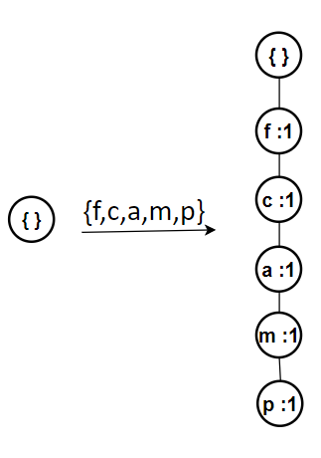
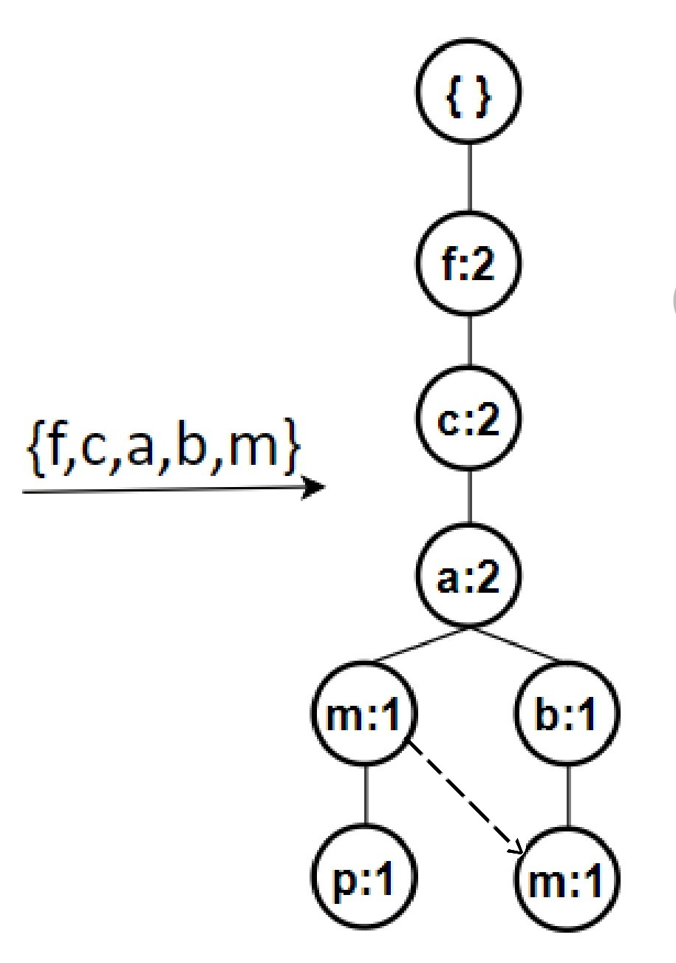
Example
Step 2: construct FP-tree :
Node link
Notes:
It is using the background from https://dribbble.com/shots/1588545--Freebie-7-Low-Poly-Backgrounds-svg-png
Template modified by fppt.com

Slide 13
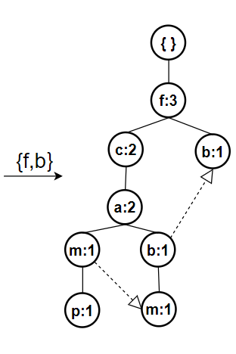
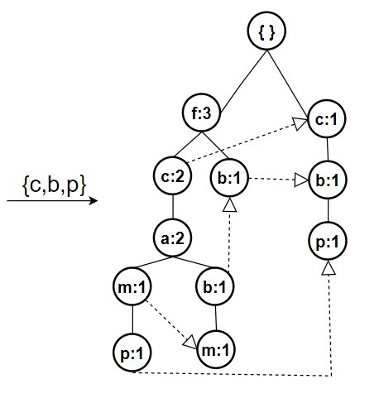
Example
Step 2: construct FP-tree :
Notes:
It is using the background from https://dribbble.com/shots/1588545--Freebie-7-Low-Poly-Backgrounds-svg-png
Template modified by fppt.com

Slide 14
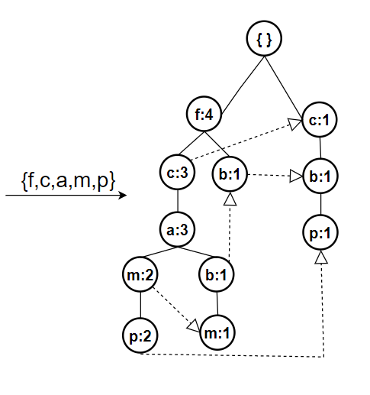
Example
Step 2: construct FP-tree :
Notes:
It is using the background from https://dribbble.com/shots/1588545--Freebie-7-Low-Poly-Backgrounds-svg-png
Template modified by fppt.com

Slide 15
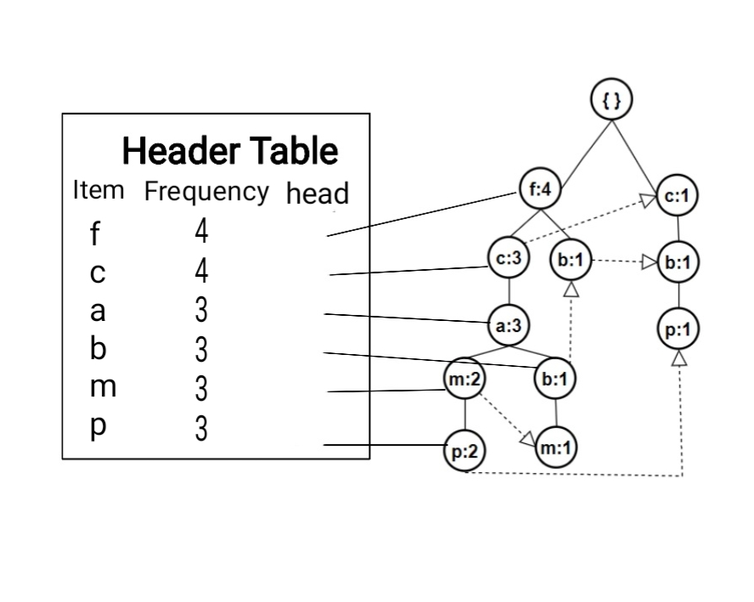
Example
Step 2: final FP-tree :
Notes:
It is using the background from https://dribbble.com/shots/1588545--Freebie-7-Low-Poly-Backgrounds-svg-png
Template modified by fppt.com

Slide 16
Example
Step 3: Frequent pattern generation
Frequent Pattrens generated | Conditional FP-tree | Conditional pattern Base | Item
{c,p}:3 | {(c:3)} | {{f,c,a,m:2},{c,b:1}} | P
{f,m}:3,{c,m}:3,{a,m}:3,{f,c,m}:3, {f,a,m}:3,{c,a,m}:3,{f,c,a,m}:3 | {(f:3,c:3,a:3)} | {{f,c,a:2},{f,c,a,b:1}} | M
 |  | {{f,c,a:1},{f:1},{c:1}} | B
{f,a}:3,{c,a}:3,{f,c,a}:3 | {(f:3,c:3)} | {f,c:3} | A
{f,c}:3 | {(f:3)} | {f:3} | C
 |  |  | F
Notes:
It is using the background from https://dribbble.com/shots/1588545--Freebie-7-Low-Poly-Backgrounds-svg-png
Template modified by fppt.com

Slide 17
FP-tree Example
Step 4: Frequent itemsets
1- Frequent itemset L1 =(f:4, c:4,a:3,b:3,m:3,p:3)
2- Frequent itemset L2 =({c,p}:3{f,m}:3,{c,m}:3,{a,m}:3, {f,a}:3,{c,a}:3,{f,c}:3)
3- Frequent itemset L3 =({f,c,m}:3,{f,a,m}:3,{c,a,m}:3,{f,c,a}:3) 4- Frequent itemset L4 =({f,c,a,m}:3)
Notes:
It is using the background from https://dribbble.com/shots/1588545--Freebie-7-Low-Poly-Backgrounds-svg-png
Template modified by fppt.com

