Slide 1
Deployment
DevOps

Slide 2

Agenda
1. | DevOps Principles
2. | Continuous Delivery
3. | Deployment strategies
4.
5.
Notes:
Agenda, 2 spalter, 10 punkter

Slide 3
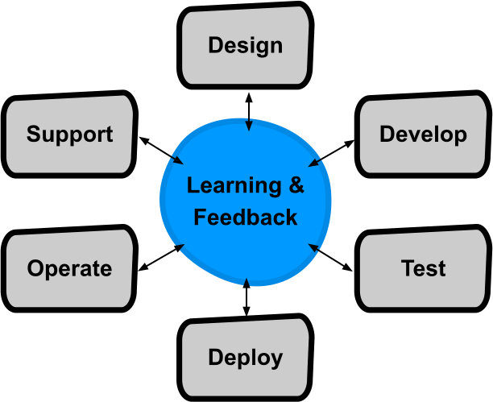
DevOps principles
Kilde: “Full Cycle Developers at Netflix — Operate What You Build”

Slide 4
Continuous delivery
Mål:
Low risk releases
Faster time to market
Higher quality
Lower costs
Tools:
Deployment pipelines
Test automation (functional,acceptance,unit,system,etc)

Slide 5
Deployment strategies

