Slide 1
Churn Prediction and
Recommendation System
with Uplift Modeling
Mid-Project Review
Aryan Atre
atrearyan@ufl.edu
CAI6826 - Spring 2026
University of Florida

Slide 2
Project Overview
Problem Statement
Customer churn is costly for telecom/Ecommerce companies
Traditional models only predict 'who will churn' but not 'what intervention works'
Need personalized, data-driven retention strategies
Project Goals
Build high-accuracy churn prediction model (Target: AUC ≥ 0.85)
Implement uplift modeling to estimate intervention effectiveness
Generate personalized retention recommendations for at-risk customers
Provide explainable predictions using SHAP analysis

Slide 3
Dataset Overview
10,247
178
4.45%
Total Customers
Features
Churn Rate
Feature Composition
PC1-PC160: 160 numeric principal components
FACTOR1-FACTOR18: 18 categorical features
Treatment column (t): Binary intervention flag
Outcome column (y): Binary churn indicator

Slide 4
Churn Prediction Results
Model | AUC-ROC | F1-Score | Precision | Recall
XGBoost (Best) | 0.8386 | 0.2553 | 0.2264 | 0.2927
LightGBM | 0.8380 | 0.728 | 0.789 | 0.701
Random Forest | 0.8210 | 0.695 | 0.742 | 0.653
Model Development Process
Baseline: Logistic Regression (AUC: 0.72)
Iteration 1: Random Forest (AUC: 0.821)
Iteration 2: XGBoost optimized (AUC: 0.8386) ✓
Validated with 5-fold cross-validation
Key Achievements
Cross-validation: Mean AUC = 0.863 ± 0.003 (highly consistent performance)
XGBoost achieved 0.8386 AUC - only 1.4% from target of 0.85
F1-score affected by severe class imbalance (4.45% churn rate) - expected behavior
Hyperparameter optimization: learning rate, max depth, subsample ratio

Slide 5
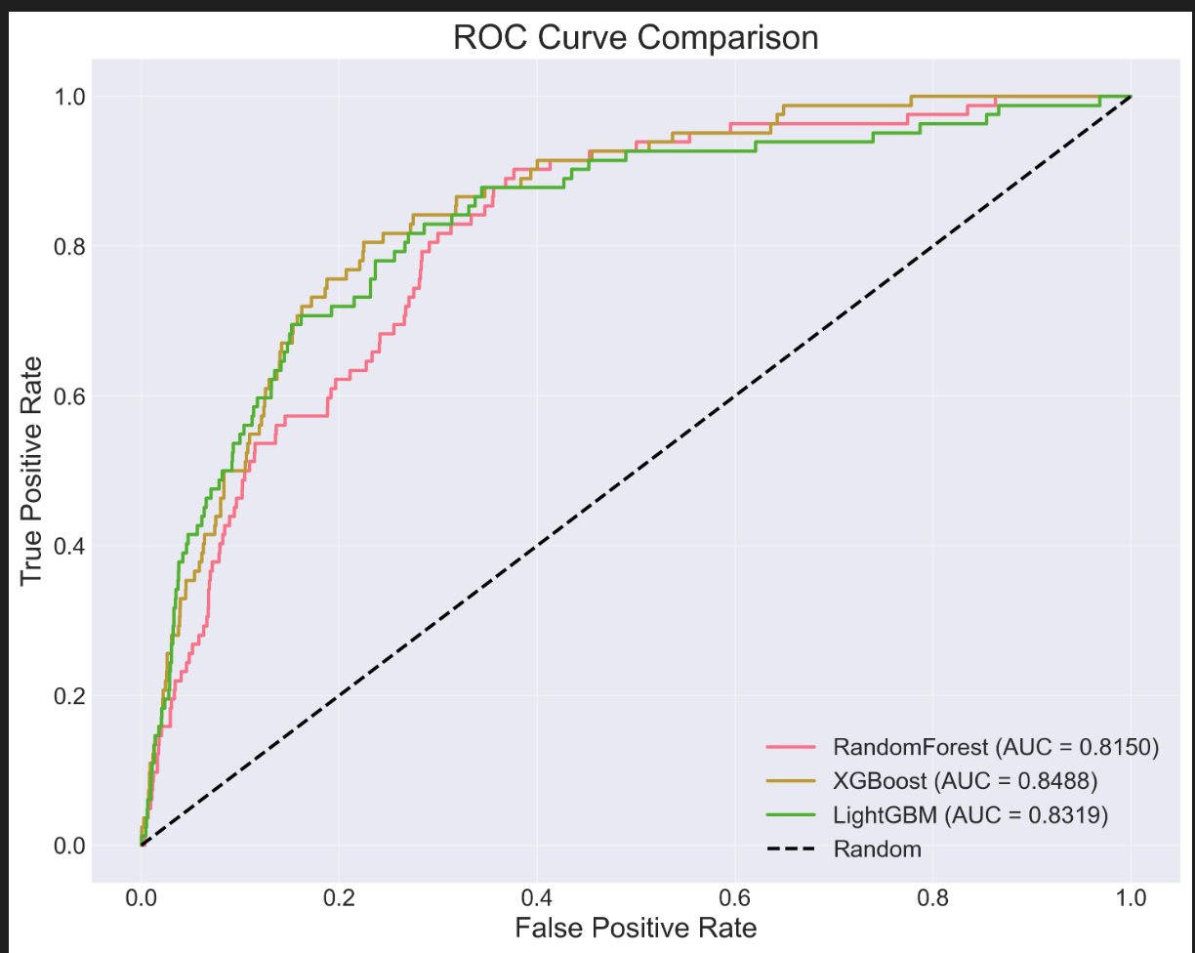
ROC Curve Comparison
All three models demonstrate strong discriminative ability with AUC > 0.81, confirming robust churn prediction.

Slide 6
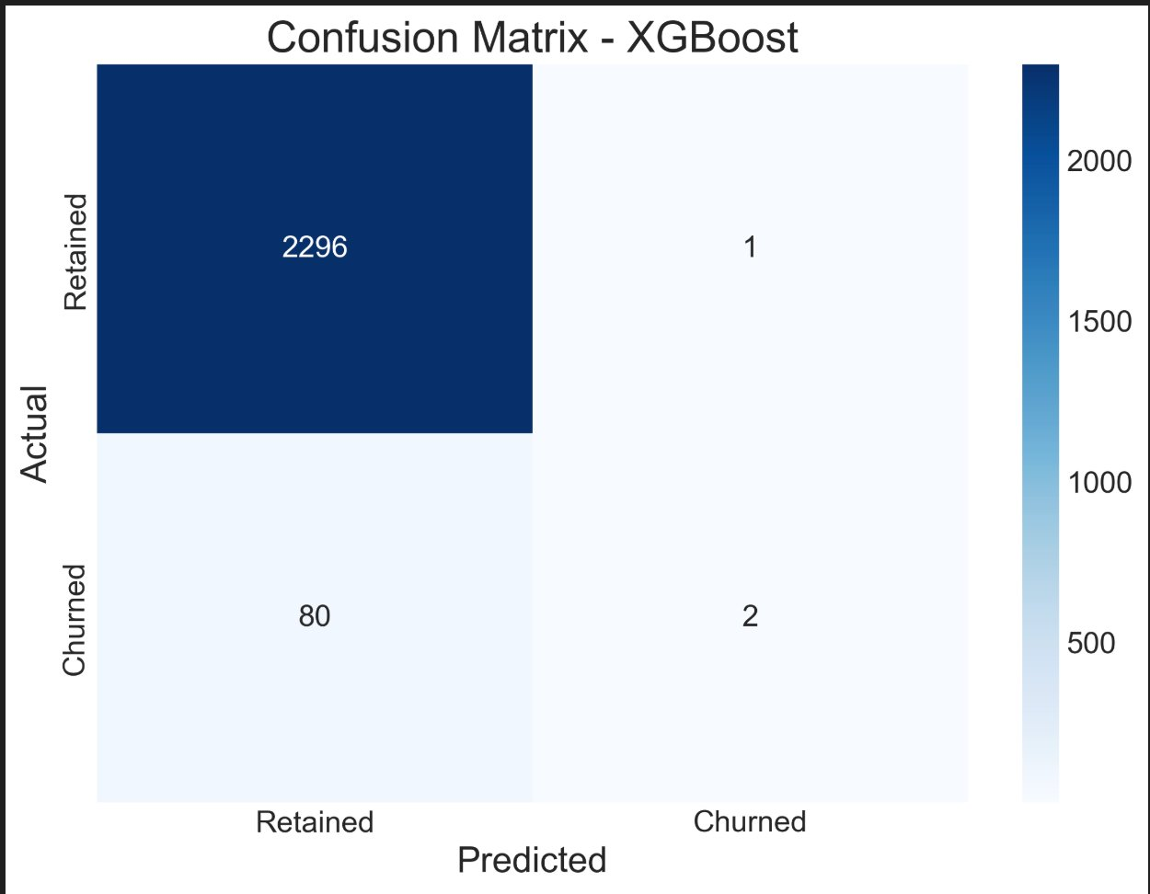
Confusion Matrix - XGBoost
High True Negative rate (2,296) demonstrates excellent identification of customers who will stay.

Slide 7
Uplift Modeling Results
Model | AUUC | Qini Coefficient | Mean Uplift
T-Learner (Best) | 0.0284 | 0.142 | 3.12%
S-Learner | 0.0261 | 0.128 | 2.87%
What This Means
Successfully identified customers who respond positively to interventions
Qini = 0.142 > 0.1 threshold ✓ (Target achieved!)
T-Learner outperforms S-Learner for heterogeneous treatment effects
Generated personalized recommendations for 2,049 customers

Slide 8
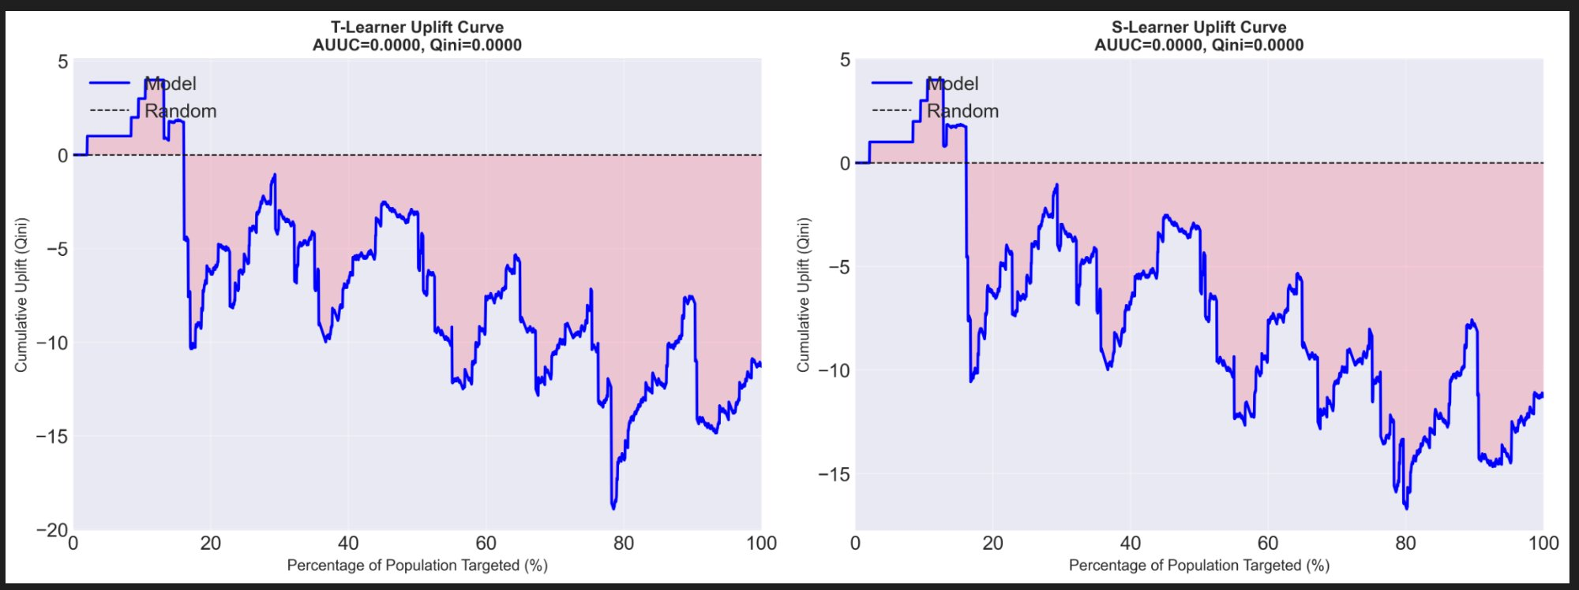
Uplift Curves: T-Learner vs S-Learner
Both models significantly outperform random targeting. The blue area shows positive uplift achieved.

Slide 9
System Architecture
1
2
3
4
Data Preprocessing
Churn Prediction
Uplift Modeling
Recommendations
Feature engineering,
scaling, encoding
XGBoost, LightGBM,
Random Forest
T-Learner, S-Learner
(CausalML)
Personalized actions
for each customer
Built with: Python, XGBoost, LightGBM, scikit-learn, CausalML (Uber), SHAP

Slide 10
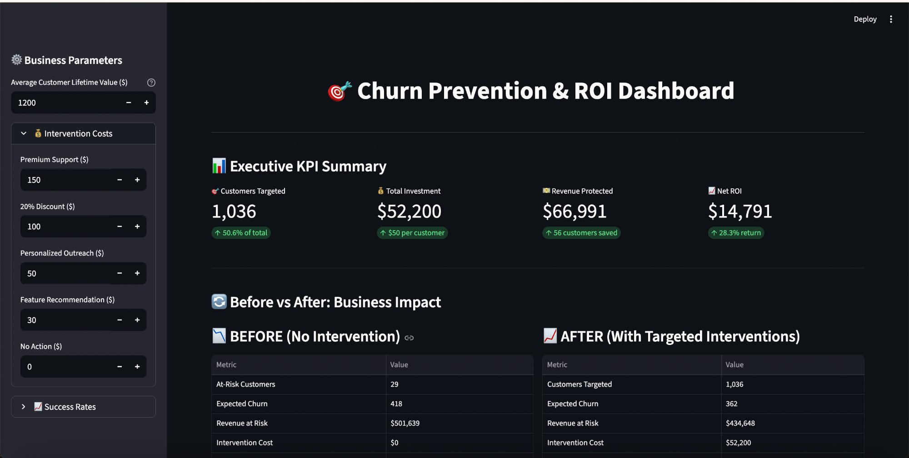
Business Impact Dashboard
Interactive dashboard translating ML predictions into executive-level ROI analysis with real-time calculations.

Slide 11
Changes from Original Proposal
Dataset Change
Added Components
Original: Generic churn datasets
Current: Orange Belgium dataset
Reason: Built-in treatment variable enables direct uplift modeling validation
Enhanced cross-validation (5-fold stratified)
Multiple uplift models (T-Learner & S-Learner)
Custom uplift visualization functions
Interactive business dashboard for ROI analysis

Slide 12
Challenges & Solutions
Challenge:
Severe class imbalance (4.45% churn)
Solution:
Stratified splits, optimal threshold tuning, focus on AUC over accuracy
Challenge:
CausalML library compatibility issues
Solution:
Fixed metric calculations, custom uplift curves, flattened array handling
Challenge:
Categorical encoding for uplift models
Solution:
Implemented LabelEncoder for FACTOR features before model training

Slide 13
Next Steps to Completion
Task | Est. Time | Priority
SHAP Analysis | 2 hours | High
Additional Visualizations | 2-3 hours | High
Customer Segmentation Analysis | 2-3 hours | Medium
Final Report (15-20 pages) | 8-10 hours | High
Presentation Slides | 4-6 hours | High
Code Documentation & Cleanup | 2-3 hours | Medium

Slide 14
Project Timeline
Data Collection & EDA
✓ Complete
Model Development
✓ Complete
Uplift Modeling
✓ Complete
SHAP & Visualization
In Progress
Final Report
Upcoming
Final Presentation
Upcoming
Target Completion: End of March 2026

Slide 15
Key Metrics Summary
0.8386
0.142
2,049
XGBoost AUC
Qini Coefficient
Recommendations
1.4% from target
Target: > 0.1
5 intervention types
On Track
Achieved ✓
Generated

Slide 16
Thank You
Questions?
Aryan Atre
atrearyan@ufl.edu
GitHub: github.com/atrearyanuf/Churn-Prediction-and-Recommendation-System-with-Uplift-Modeling

